Slide 1
The Goodwin oscillator
MATLAB modeling

Slide 2
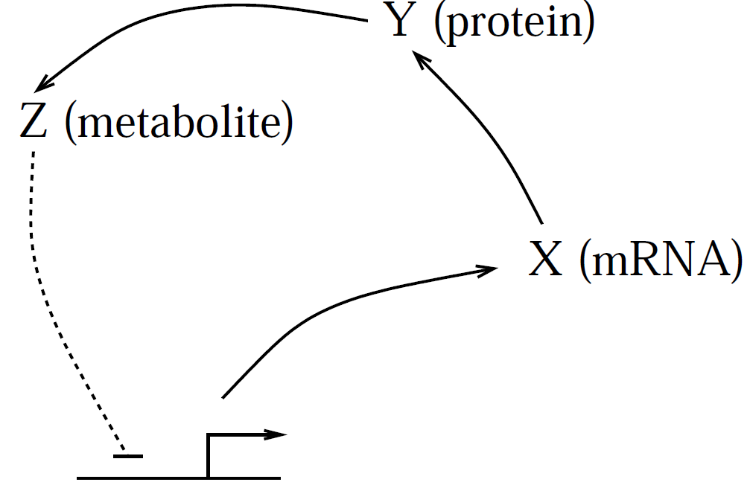
Goodwin,B.C.(1965). Oscillatory behavior in enzymatic control processes. Advances in Enzyme Regulation, 3, 425–428.
dx/dt = a / (k^{n}+ z^{n})- b x
dy/dt = α x - β y
dz/dt = 𝜸 y - δ z
Oscillations can arise from negative feedback if the effect of the feedback is delayed and if there is sufficient nonlinearity in the loop. Two-state model cannot exhibit sustained oscillations,
Even with three step, a high degree of nonlinearity is required to generate limit-cycle oscillations in this model.

Slide 3
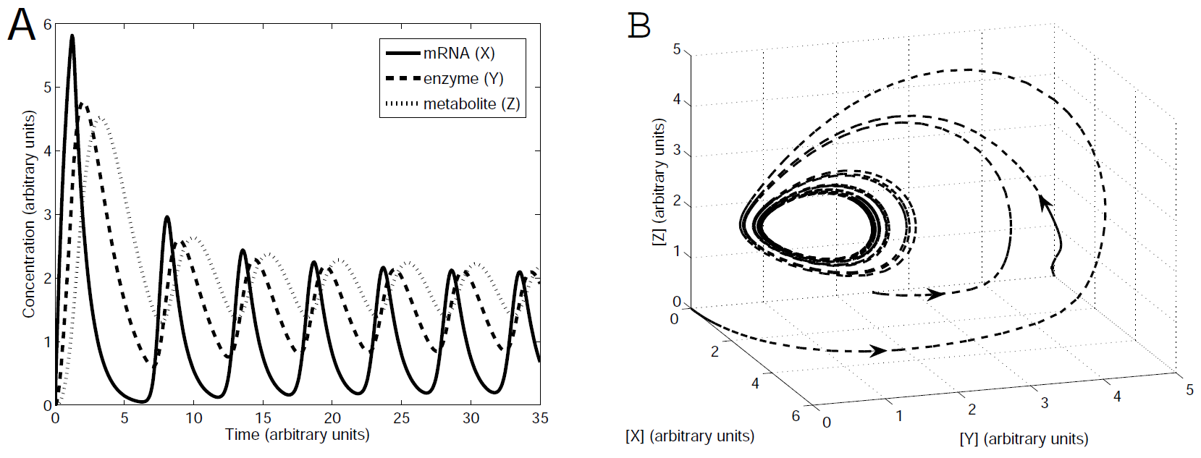
In each cycle, the mRNA concentration rises, followed by rise in enzyme, and then rise in metabolite.
The rise in z causes a crash in x, which causes y and z to drop, allowing x to rise again.

Slide 4
PROBLEM: (Use the script goodwin_oscillator.m )
This system exhibits limit-cycle oscillations provided the Hill coefficient n is sufficiently large.
Unfortunately, for reasonable choices of the other parameter values, n has to be chosen very high to ensure oscillatory behaviour. Modifications that generate oscillations with smaller Hill coefficients are shown below.
a) Taking parameter values as in the Figure, verify that there are no oscillations if we modify n to n = 7. Print.
b) Replace the term for degradation of Z by a Michaelis-Menten term: - δ z / (K_{M} + z)
Verify that this modified system oscillates even with no cooperativity (i.e. with n = 1).
Take a = 150, k = 1, b = α = β = 𝜸 = 0.2, δ = 15, and K_M = 1.

