Slide 1
SHOULD THOMAS HANSEN BUY NOW?
Space, timing, and location — finding where a family of 7 gets the most home for the money.
BUYER PROFILE · FAMILY OF 7 · BUDGET-CONSCIOUS · KING COUNTY HOUSING DATA

Slide 2

KOMPASS
A N A L Y T I C S
Meet the Analyst
DH
Daniel H. Chercos
Senior Real Estate Data Scientist · Kompass Analytics · Hamburg, Germany
Daniel advises buyers and sellers on U.S. housing markets from his data practice in Hamburg, pairing hypothesis-driven analysis with plain-English recommendations, trained in Urban Data Science (Neuefische); 8 years turning public housing records into buyer- and seller-side strategy.
Hypothesis-driven EDA
Housing data
Buyer strategy
Cross-border consulting
Prepared by Kompass Analytics, Hamburg — For buyer client

Slide 3
Meet the Buyer
Every hypothesis on this deck is built to answer questions specific to Thomas's situation.
H
Household
5 kids — needs efficient bedroom count without paying for excess space
B
Budget
Limited — every dollar of price premium has to be justified
P
Priority
A nice, socially active neighborhood matters as much as the house itself
O
Open questions
Best timing to buy, and which location fits the budget
Daniel H. Chercos · Kompass Analytics · Hamburg, Germany
3

Slide 4
How We Tested These Hypotheses
A quick note on the data and approach behind every chart in this deck.
D
Data & Scope
M
Missing Data Handling
King County home sales — ~21,600 records with price, size, condition, and location fields for homes sold 2014–2015.
Waterfront, view, basement size, and renovation year each have gaps (roughly 0.3%–18% missing). Missing basement size/waterfront/view is treated as "not present" rather than dropped; missing renovation year is treated as "never renovated." Rows missing core fields (price, location) are excluded.
N
Neighborhood Proxies
V
Validation Approach
The source data has no neighborhood name, school rating, or crime data. Zipcode and lat/long stand in as location proxies throughout — good enough to spot patterns, not to confirm "social" or "safe.“
Each hypothesis pairs one simple chart with a plain-English takeaway. Prices are aggregated to the zip code, total Sq.feet of the Hause or month level before plotting, to keep individual outlier sales from skewing the picture.
Daniel H. Chercos · Kompass Analytics · Hamburg, Germany
4

Slide 5
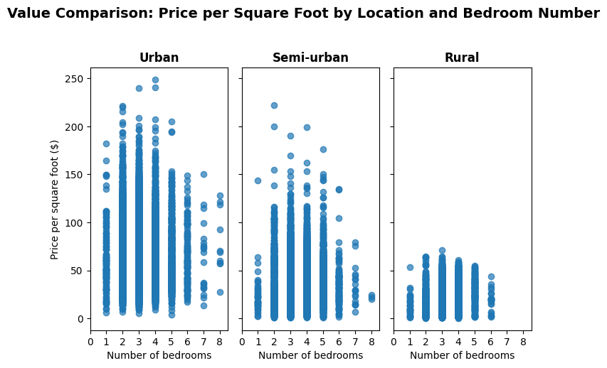
Where does a family get more bedrooms for the dollar?
HYPOTHESIS 1
Reading it
Data showed that there is significant price differences per unit square foot across Neighborhood Setting .
Recommandation
Mr. Tomas should consider buying home in Rural part of king county.
Suggested Zip codes
98014 Carnation
98022 Enumclaw
98045 North Bend
98070 Vashon Island
Daniel H. Chercos · Kompass Analytics · Hamburg, Germany
5

Slide 6
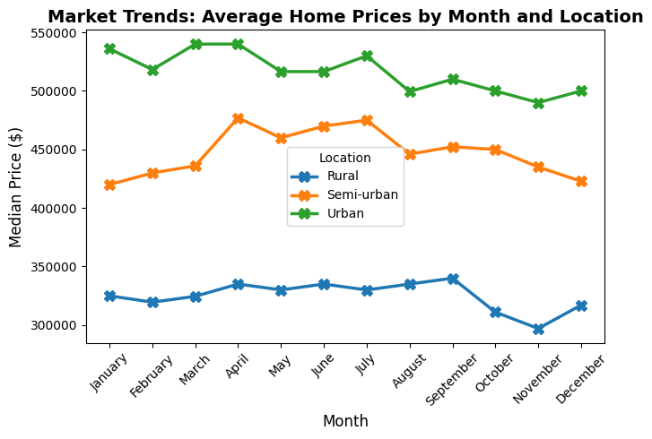
Is there a cheaper month to buy?
HYPOTHESIS 2
Reading it
The data showed fluctuation of housing price throughout the year.
Recommendation
Assuming Mr. Tomas considering to buy in rural part of King County, the best time to buy is in November.
Daniel H. Chercos · Kompass Analytics · Hamburg, Germany
6

Slide 7
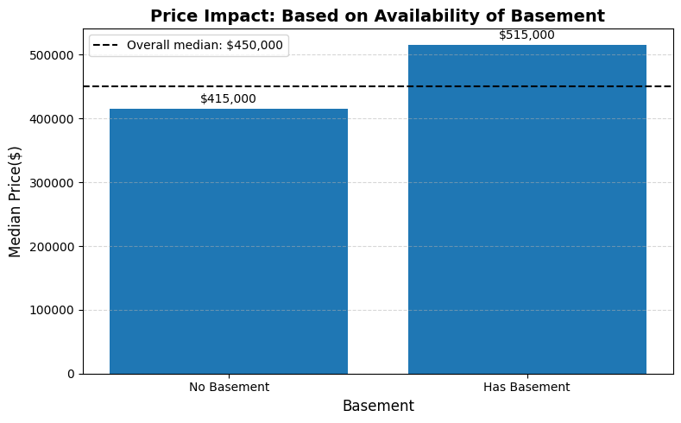
Does a finished basement add space without adding much cost?
HYPOTHESIS 3
Reading it
The data showed that availability of basement increase the price of houses significantly.
Recommendation
Given limited budget, we advise Mr. Tomas should consider houses without basement.
Daniel H. Chercos · Kompass Analytics · Hamburg, Germany
7

Slide 8
Recommendation
We advise Mr. Thomas Hanson to focus his search on homes without basements across Carnation (98014), Enumclaw (98022), North Bend (98045), and Vashon Island (98070). These specifications offer the best value for a large family, especially if the purchase is finalized during the high-savings month of November..
Daniel H. Chercos · Kompass Analytics · Hamburg, Germany
8

Slide 9
THANK YOU FOR TOURING OUR HYPOTHESES
No open-house cookies here, but the data's fresh and the price is negotiable.
Any Questions?
Ask away — unlike this housing market, our door is always open (and we won't ask for 10% over asking).
Daniel H. Chercos · Kompass Analytics · Hamburg, Germany
9

