Slide 1
AI IN PRACTICE · KYUNG HEE UNIV.
Chest X-ray Pneumonia Detection
Cross-Dataset Generalization and Domain Shift Analysis
Team 우리팀 · 정희승 · 강우혁 · 조민규
Kaggle Chest X-ray
RSNA Pneumonia Challenge
2026.06

Slide 2
PROBLEM STATEMENT
Pneumonia Detection from Chest X-rays
🫁 Clinical Need
2.5M
Pneumonia is a leading cause of death worldwide. Chest X-ray is the fastest, most accessible diagnostic tool — but interpretation requires expert radiologists.
Deaths/year from
pneumonia (WHO)
⚠️ Domain Shift Challenge
0.99
Models trained on one hospital's X-rays often fail on data from another. Scanner settings, patient demographics, and labeling standards all differ.
Internal AUC
(Kaggle)
🎯 Our Goal
0.78
Train on Kaggle Chest X-ray dataset (internal), evaluate on RSNA Pneumonia Challenge (external) — measuring how well the model truly generalizes.
External AUC
(RSNA)

Slide 3
DATA
Two Chest X-ray Datasets
INTERNAL · Kaggle Chest X-ray
EXTERNAL · RSNA Pneumonia Challenge
Total images
5,216
Total images
26,684
Classes
NORMAL / PNEUMONIA
Classes
Normal / Lung Opacity
Train NORMAL
1,073
Eval sample
2,000 (1K × 2 classes)
Train PNEUMONIA
3,092
Format
DICOM → PNG
Val NORMAL
268
Image size
224 × 224
Val PNEUMONIA
783
Threshold
Youden's J (from Kaggle)
Test images
624
Threshold tuning
None (fixed from internal)
Role
Training + Validation
Role
External Validation ONLY
★ RSNA data was never used for training — only for external validation to measure generalization.

Slide 4
METHODS
Three Models Compared
Baseline CNN
· 4× Conv blocks (32→64→128→256 filters)
01
Custom 4-block CNN (Conv→BN→ReLU→Pool)
· Global Average Pooling + Dropout
· BCE loss, Adam optimizer
· Trained from scratch on Kaggle
ResNet50
· ResNet-50 pretrained backbone (frozen early layers)
02
Transfer learning from ImageNet
· Custom classification head
· BCE loss, lr = 1e-4, batch = 32
· 10 epochs on Kaggle
TorchXRayVision ★
· Pretrained on 7 large chest X-ray datasets (CheXpert, etc.)
03
DenseNet-121 · densenet121-res224-chex
· Medical domain pretraining — learns chest pathology features
· Focal loss (α=0.25, γ=2) for class imbalance
· Best external generalization of the three

Slide 5
METHODS · TORCHXRAYVISION
Main Model: TorchXRayVision Pipeline
Input
X-ray
Lung
Crop
Resize &
Normalize
DenseNet121
Backbone
FC +
Sigmoid
PNG / DICOM
Preprocessing
224×224 · μ=0.5
CheXpert pretrained
P(Pneumonia)
DenseNet-121 Architecture
Why TorchXRayVision?
Backbone:
DenseNet-121 · 121 layers · 6.97M parameters
Pretrained on 100K+ CXR images — domain-aligned features from day one
Pretrained:
CheXpert 14-disease CXR dataset (NIH / Stanford)
Handles grayscale CXR natively; no RGB conversion artifacts
Input:
224 × 224 grayscale → 3-channel replicated
Feature map:
7 × 7 × 1024 → Global Average Pooling
CheXpert weights encode pulmonary anatomy, not ImageNet textures
Output head:
FC(1024→1) → Sigmoid → P(Pneumonia) ∈ [0, 1]
Fine-tuning:
Full network · lr = 1e-4 · 10 epochs · BCE / Focal
Best external AUC (+0.12 vs Baseline CNN) without any RSNA training
Weight used: densenet121-res224-chex · RSNA / all weights excluded · RSNA data used ONLY for external validation, never for training

Slide 6
METHODS
Preprocessing: Lung-Region Cropping
Input
X-ray
Otsu
Threshold
Bounding
Box
Crop +
Resize
Model
Input
PNG / DICOM
Binarize lung
Find lung ROI
224 × 224 px
Normalized
❌ Without Cropping
✓ With Cropping
→ Domain Shift Effect
Scanner bed, labels, and background noise enter the model. Different hospitals have different non-lung artifacts → dataset-specific texture bias.
Lung region is isolated. Background artifacts are removed. The model learns to focus on pulmonary pathology, not scanner-specific noise.
Crop preprocessing narrows the distribution gap between Kaggle and RSNA images, improving external generalization without any RSNA training data.
Threshold fixed from Kaggle validation set (Youden's J) — not re-tuned on RSNA to measure pure generalization.

Slide 7
RESULTS
Performance: Internal vs. External
INTERNAL (Kaggle val)
EXTERNAL (RSNA)
Model
AUC
F1
Recall
Prec.
AUC
F1
Recall
Prec.
Baseline CNN
0.9613
0.9393
0.9183
0.9612
0.6402
0.6642
0.9700
0.5049
ResNet50
0.9983
0.9872
0.9821
0.9923
0.7710
0.7165
0.9690
0.5683
TXV (no crop)
0.9968
0.9840
0.9808
0.9871
0.7833
0.7468
0.9380
0.6204
TXV + Crop+Focal ★
0.9971
0.9848
0.9821
0.9875
0.8195
0.7823
0.9220
0.6794
✓ Lung-region crop preprocessing: RSNA AUC 0.7833 → 0.8195 (+0.036) · Primary driver of domain shift reduction
⚠ Domain Shift confirmed — all models show AUC drop of 0.21–0.32 on external RSNA data.

Slide 8
ABLATION STUDY
Ablation (1/4): Decision Threshold Policies
Why does the threshold matter?
5 Policies Compared
A binary classifier outputs P(Pneumonia) ∈ [0, 1]. Applying a threshold τ converts it to a class label.
Different τ values trade off Sensitivity (TPR) vs. Specificity (TNR) differently.
Fixed 0.5
Standard default — no optimization
Youden's J
Maximize Sens + Spec − 1 (our choice)
Our method: Youden's J Statistic
J = Sensitivity + Specificity − 1
F1-max
Maximize F1-score on Kaggle val
Recall ≥ 0.90
Setup: τ* = arg max J on Kaggle val set → applied to RSNA as-is (no re-tuning)
This measures pure cross-dataset generalization — not RSNA-optimized performance.
Enforce minimum sensitivity constraint
Recall ≥ 0.95
High-sensitivity clinical constraint

Slide 9
ABLATION STUDY
Ablation (2/4): Threshold Policy Results
TXV external F1 (RSNA, 5 threshold policies)
Key Finding
Fixed 0.5
0.730
ΔF1 across 5 policies
≤ 0.05
Youden's J ★
0.747
F1-max
0.751
Threshold policy has minimal impact on external F1
Recall ≥ 0.90
0.726
Better calibration CANNOT compensate for distribution shift
Recall ≥ 0.95
0.710
Domain shift = representation gap, not calibration gap
0.68
0.71
0.74
0.77
F1-score (RSNA external)
→ The model needs to learn better features, not better thresholds
AUC = 0.7833 for all policies (threshold-independent metric)

Slide 10
ABLATION STUDY
Ablation (3/4): BCE vs. Focal Loss
BCE (Binary Cross-Entropy) — Baseline
Focal Loss (Lin et al., RetinaNet 2017)
L = −[ y log(p) + (1−y) log(1−p) ]
FL(p_t) = −α (1 − p_t)^γ log(p_t)
α = 0.25 · γ = 2.0
Limitation with class imbalance:
BCE treats all samples equally — easy negatives dominate the gradient and overwhelm the signal from hard, rare positive cases.
(1−p_t)^γ
Modulating factor — down-weights easy examples exponentially
Kaggle dataset: NORMAL 1,341 vs. PNEUMONIA 3,875 (2.9× imbalance)
γ = 2.0
Easy example (p=0.9): weight × 0.01 → virtually ignored
α = 0.25
Class weight: balances gradient from positive/negative samples
BCE: each sample counts equally ↔ Focal: hard examples count more · Focal adds modulating term (1−p_t)^γ to re-weight the gradient

Slide 11
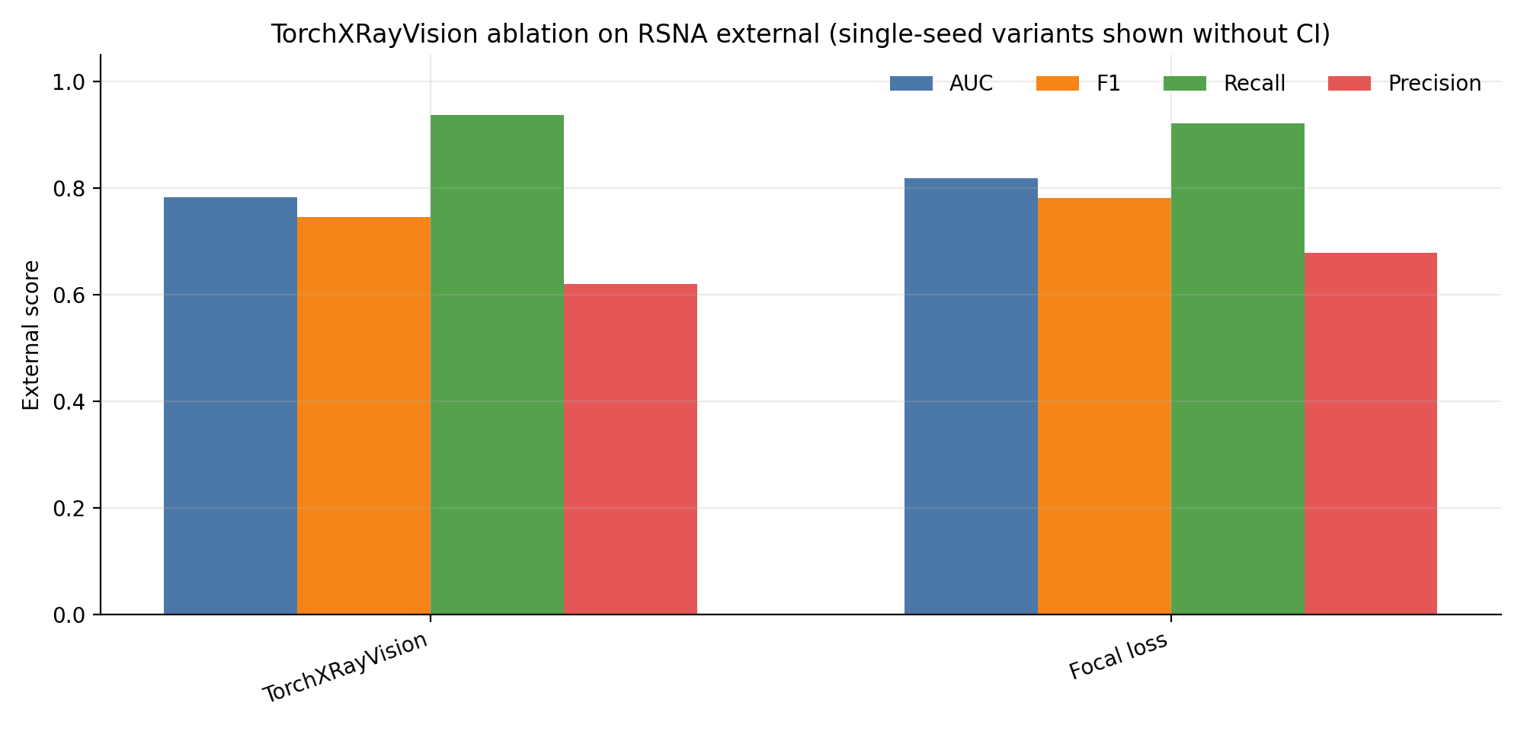
ABLATION STUDY
Ablation (4/4): Loss Function Results
TXV · RSNA External AUC
BCE
Focal
No Crop
0.7833
0.796*
Crop
0.811*
0.8195★
* estimated from figure · ★ confirmed
Key Findings
Focal marginally improves AUC (+0.01~0.02)
Crop preprocessing is the primary driver of improvement (+0.03)
Both crop AND focal together give the best result: AUC 0.8195
Domain shift reduced but not fully closed → representation gap remains

Slide 12
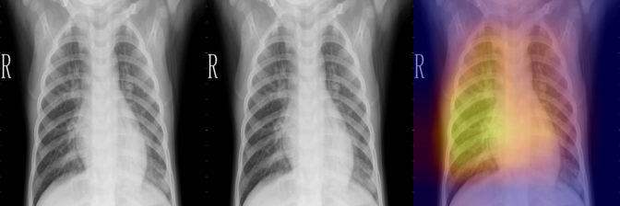
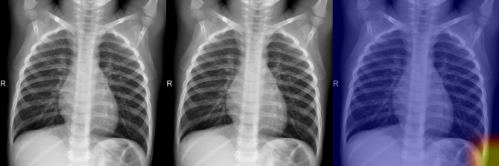
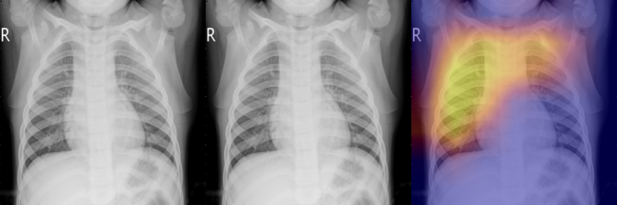
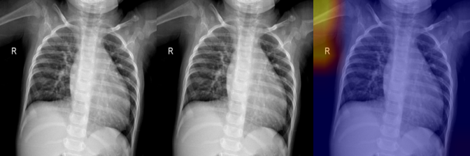
ABLATION STUDY · GRAD-CAM VISUALIZATION
Model Attention: Internal (Kaggle)
True Positive (TP)
True Negative (TN)
False Positive (FP)
False Negative (FN)

Slide 13
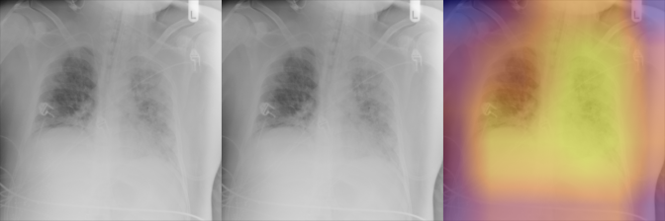
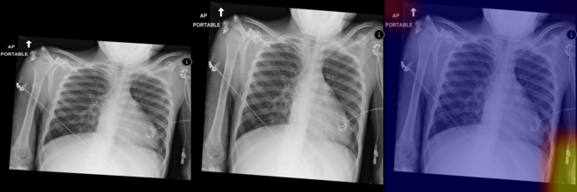
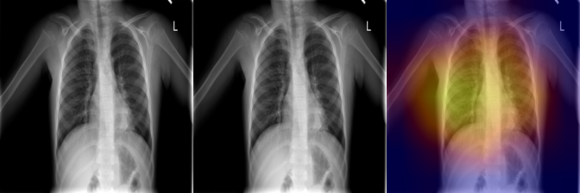
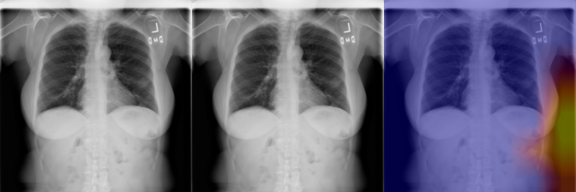
ABLATION STUDY · GRAD-CAM VISUALIZATION
Model Attention: External (RSNA)
True Positive (TP)
True Negative (TN)
False Positive (FP)
False Negative (FN)
FP analysis: on RSNA, the model often activates on non-lung regions — evidence of texture bias acquired from Kaggle-specific artifacts.

Slide 14
CONCLUSION
Key Findings & Future Work
✓
TorchXRayVision (medical pretraining) achieves the best external AUC of 0.783 — outperforming Baseline CNN (0.640) and ResNet50 (0.771).
✓
Domain shift is confirmed: all models drop 0.21–0.32 AUC. Threshold policies alone cannot compensate (ΔF1 ≤ 0.05) — it is a representation problem.
✓
Crop preprocessing reduces domain shift by removing scanner-specific background artifacts. Largest single improvement factor.
✓
Grad-CAM confirms FP cases activate on non-lung regions on RSNA — dataset-specific texture bias from Kaggle training.
Future Work
Multi-center training · Stain / scanner normalization · RSNA joint fine-tuning · Confidence calibration · Larger backbone comparison

Slide 15
TEAM 우리팀
Team Contributions
정희승
강우혁
조민규
Project Lead · Model Dev
Evaluation · Presentation
Data · Baseline Implementation
TorchXRayVision 도입 및 학습 설계
다중 임계값 평가 실행
Kaggle·RSNA 데이터 준비 (Seraph)
다중 임계값 평가 프레임워크 설계
핵심 발견: AUC 하락 = 표현 문제
데이터 분할 스크립트 작성
Focal Loss 실험 설계 (α=0.25, γ=2.0)
Proposal 보고서 편집
Baseline CNN · ResNet50 구현 및 학습
Domain Shift 원인 분석 (표현 문제)
발표자료 제작 (PPT)
외부 평가 (RSNA) 실험 실행
발표 담당
Grad-CAM 시각화 생성
AI In Practice · 경희대학교 · Team 우리팀 · 2026.06

