Slide 1
Assignment1-Part-B
Name:J.P.DANIEL CHRISTOPHER
SRN:PES2UG20CS433
5 G

Slide 2
Abstract

Slide 3
Abstract:
We classify whether the data in the dataset is churn or not
1 if churn else 0 if not churn
Build Decision tree classified From sklearn library and classify the dataset ,xt is given in the question ,target variable is ‘Churn’ Column
Build Confusion matrices for Decision Tree Classifier:
Accuracy is:85.26%
Build Ruc curve calculate auc and also graphviz to generate a pdf of the obtained Decision Tree Graphically
From sklearn split into test/train in the ratio 80:20.
Use SVM classifier and calculate Accuracy.
Accuracy is:90.424%
Use MLP classifier(For ANN) and calculate Accuracy.
Build a comparative table

Slide 4
Flowchart

Slide 5
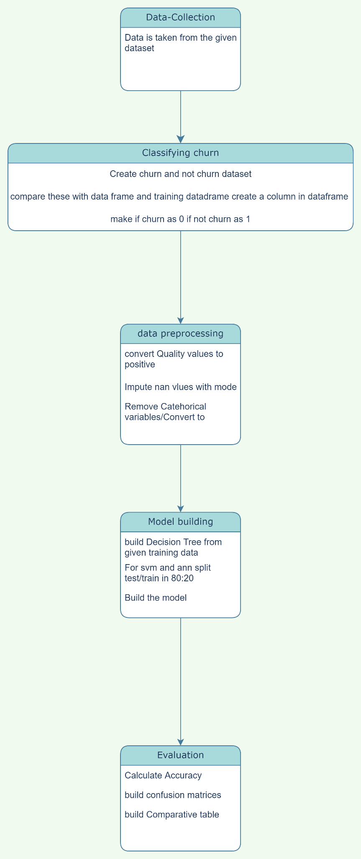
Flowchart

Slide 6
Libraries Used

Slide 7
Libraries Used
Sklearn:For train-test split for all the classifiers,SVM,DecisionTreeClassifier,MLP,confusion matrices
Pandas:For dataframe ,For mode imputation
Graphviz:To generate a pdf of decision tree
Matplotlib,seaborn:To plot graphs

Slide 8
Output Screenshots

Slide 9
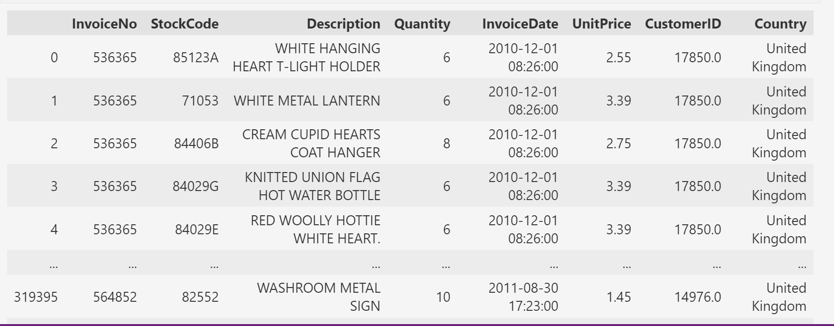
Output Screenshots
Dataframe:

Slide 10
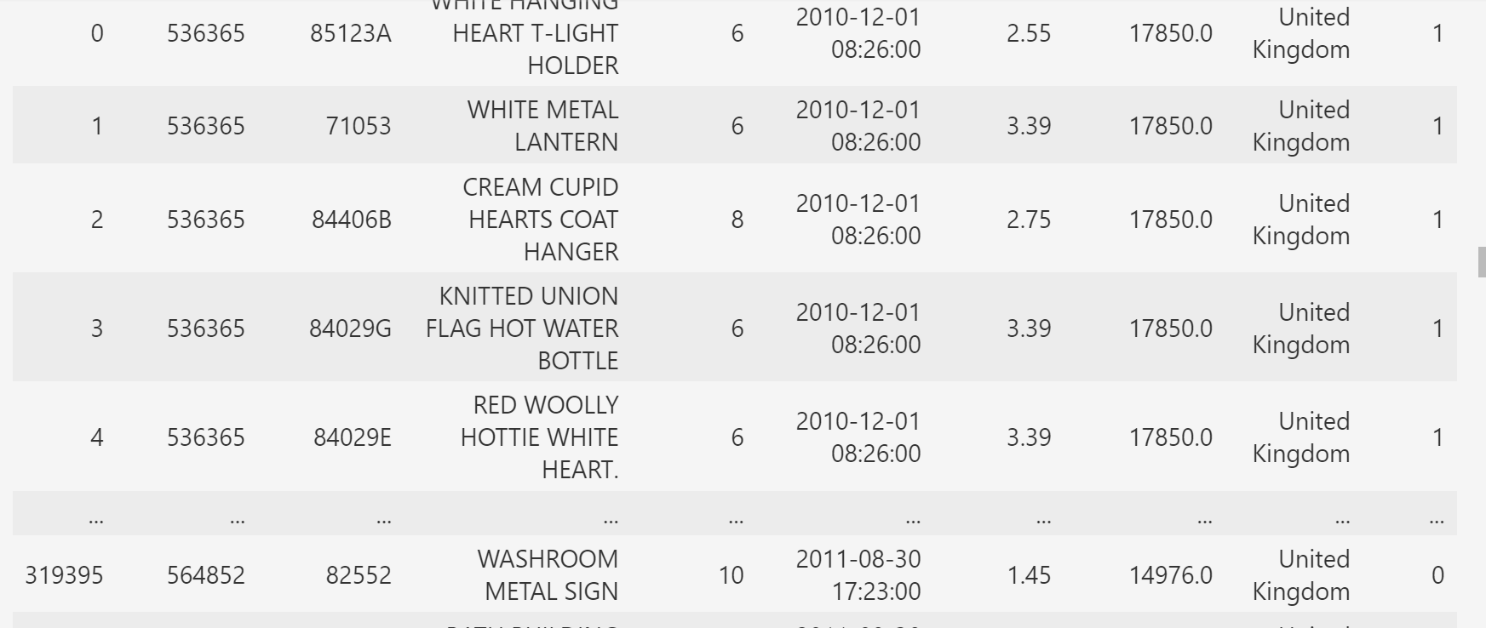
Output Screenshots
Updated Dataframe with churn or not:

Slide 11
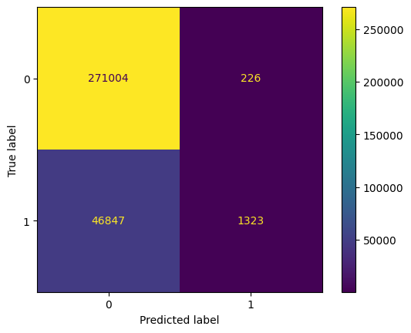
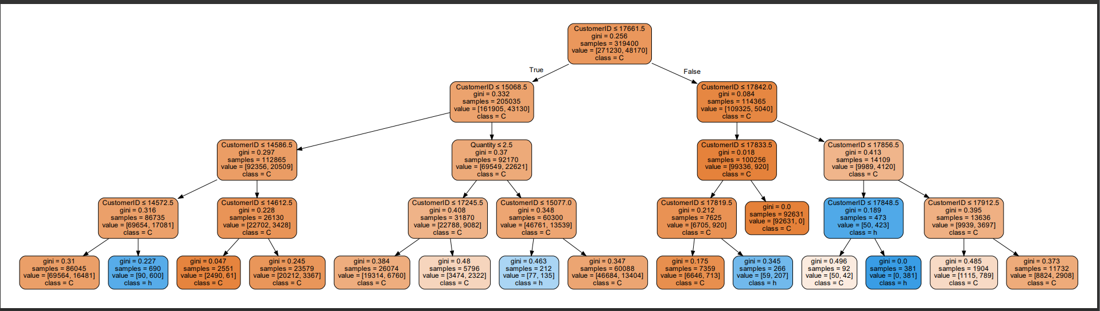
Output Screenshots
Decision Tree:

Slide 12
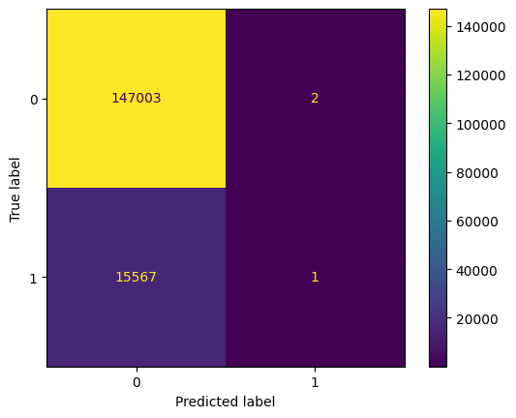
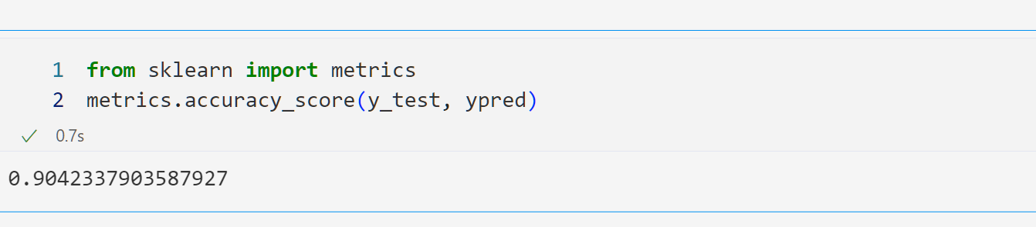
Output Screenshots
SVM:

Slide 13

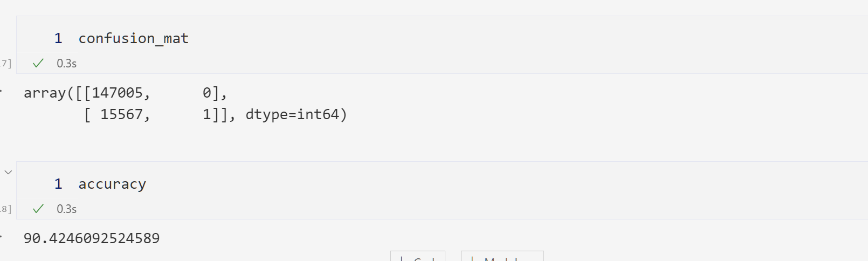
Output Screenshots
ANN:

Slide 14
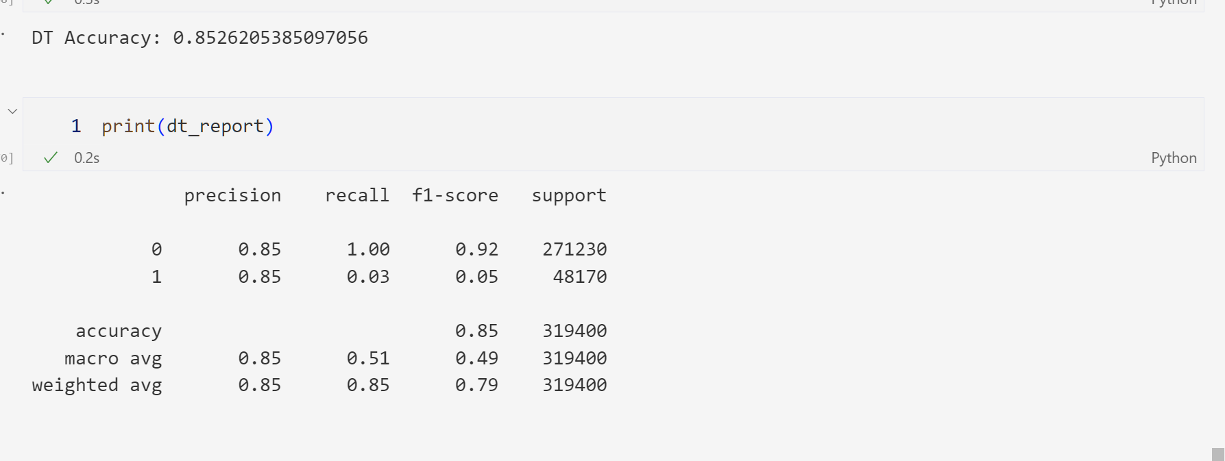
Output Screenshots
Summary:
Decision Tree:

Slide 15
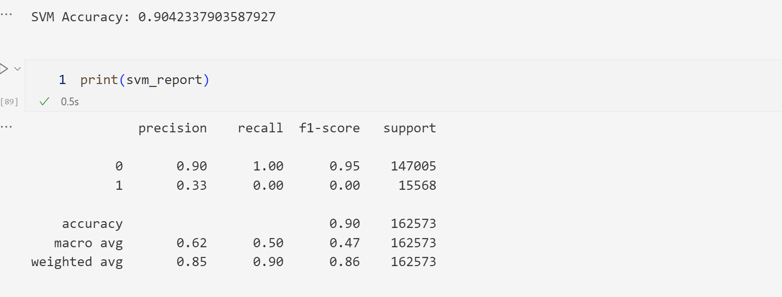
Output Screenshots
Summary:
SVM:

Slide 16
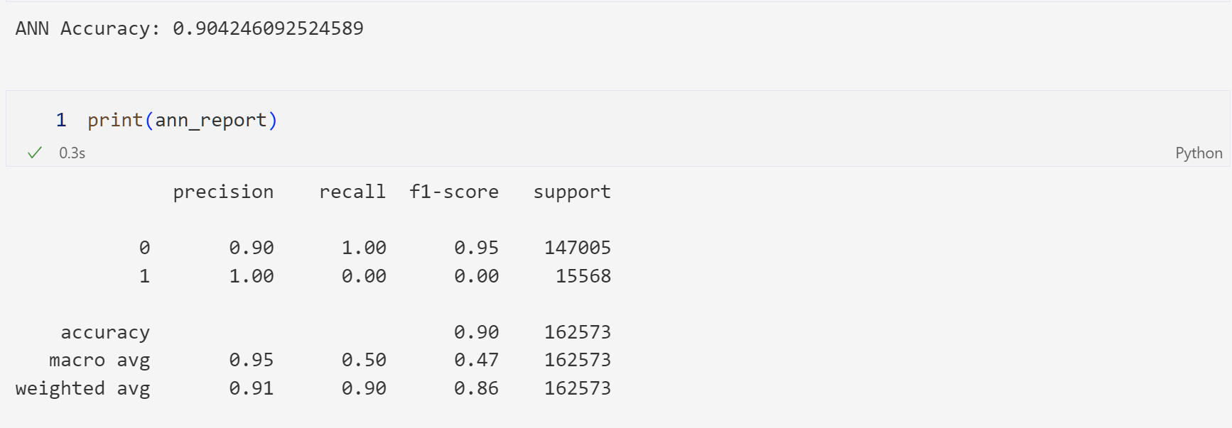
Output Screenshots
Summary:
ANN:

Slide 17
Thank You

