Slide 1

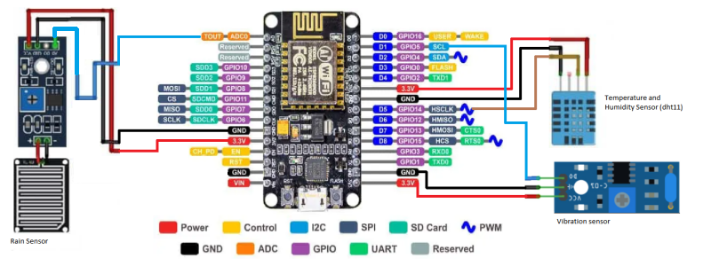
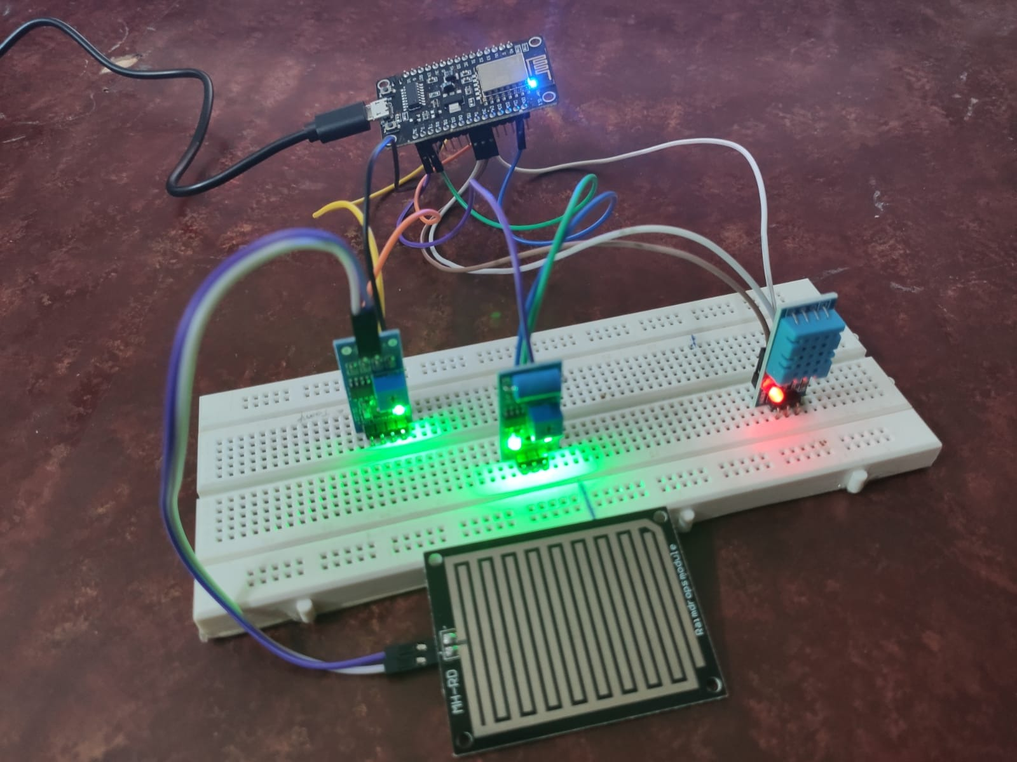
Mini Weather Station with NodeMCU ESP8266
IOT Weather Station with NodeMCU ESP8266
In this IoT project, we HAVE MADE an IoT Based Simple Online Weather Station using ESP8266 NodeMCU (wemos D1) Wi-Fi development board .
The NodeMCU pulls weather data like temperature, humidity, rain,vibration and displays on the localhost SERVER HOSTED BY NodeMCU.

