Slide 1

Big brother
GovTech Challenge
A proprietary app to prevent violent extremism

Slide 2
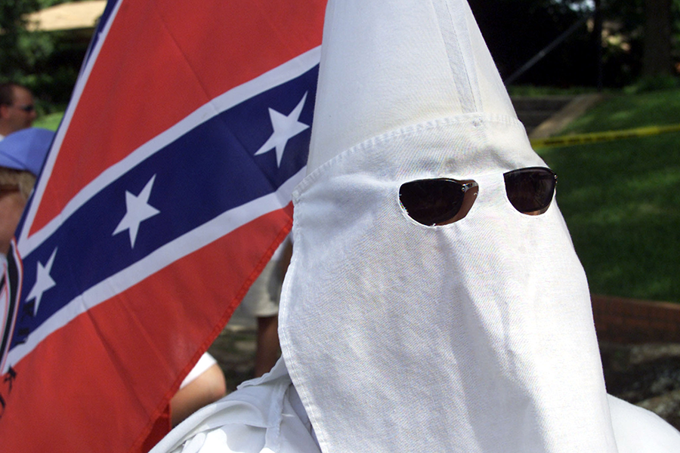
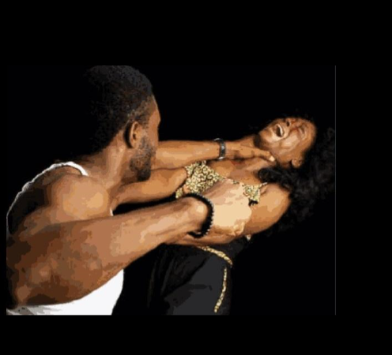
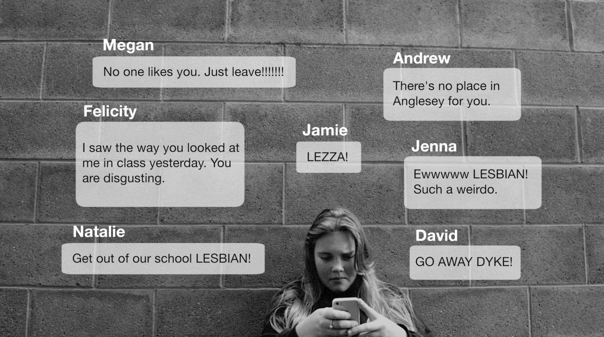
What is Violent Extremism
Beliefs and actions of people who support or use ideologically motivated violence to achieve radical ideological, religious or political views.

Slide 3
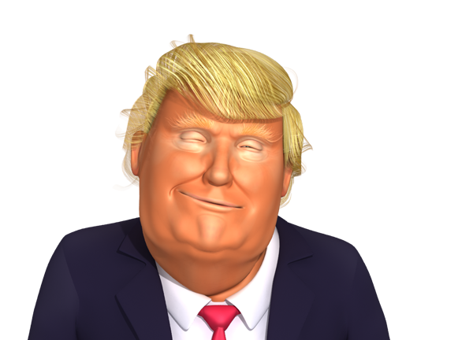
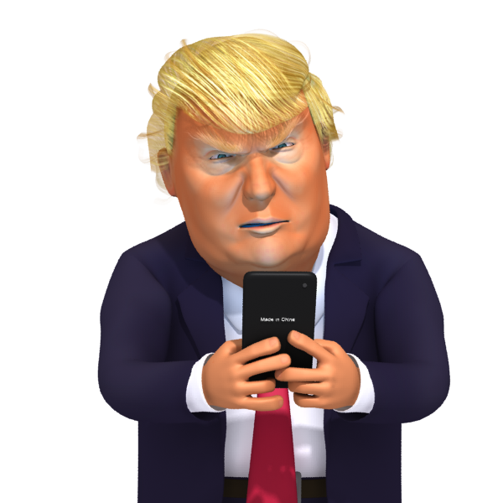
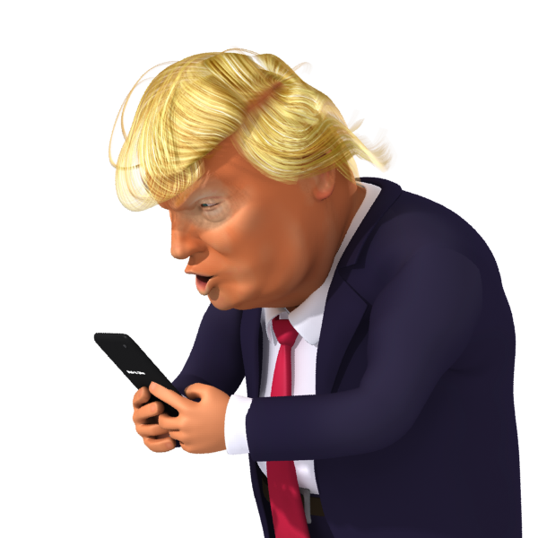

BigBrother
Vision: Prevent violent extremism
Mission: Create an intelligence system
Understand and identify targets of violent extremist content online
Engineer and push content through touch-points to subliminally avert conversion.
Ask us how
Example
Mr. Dwumph
8 AM 10 AM 12 PM 3 PM 5PM 10 PM 12 AM
Push subliminal messages that interacts with System 2 thinking and help create aversion over time

Slide 4
Thank you!
Questions?
Team Details:
Bhavesh Suhagia
Hoa Mattaliano
Yao Kou
Daniel Chia
Janak A Jain

Slide 5
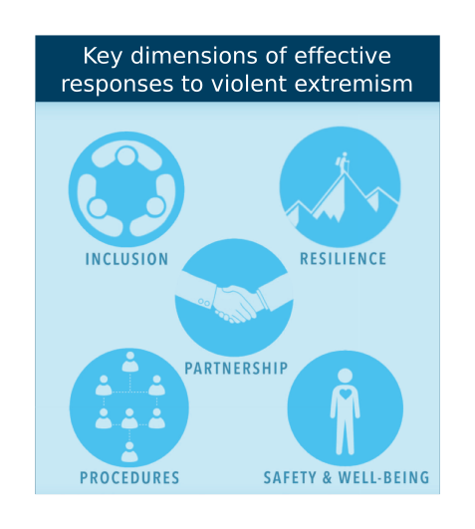

Slide 6
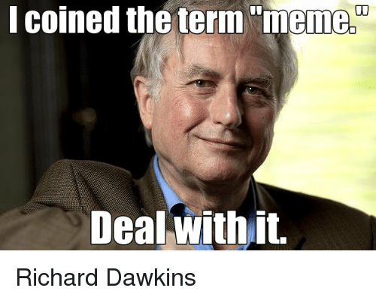
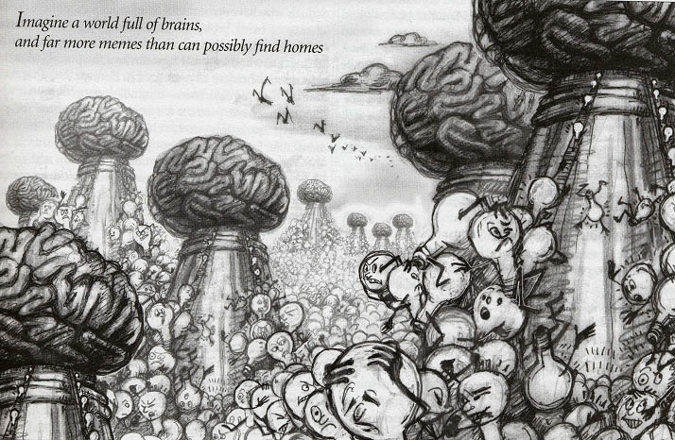
Memetic Engineering
Information is selfish and wants to infect as many minds as possible.
But, not all kinds of information can survive this race to occupy space in brains – Survival of the fittest

