Slide 1
Spotify Group Recommendation
By Krystof Belak

Slide 2
Agenda
Quick update on team situation
Functionality
General Structure
Spotify-API
User Interface
ML-performance
Lessons learned

Slide 3
Functionality
2-5 Spotify users
Sequential Login from Browser
Only works on whitelisted accounts
Group playlist generation (50 songs)
Addition of group playlist to users‘ Spotify library

Slide 4
General Structure
1
Spotify Accounts Service
redirect, access_token
redirect
Website: kbelak.github.io/
Spotify Accounts Service
add playlist to library
retrieve library
pass access_token
2
Python-Server (Flask API)
3
generate group playlist

Slide 5
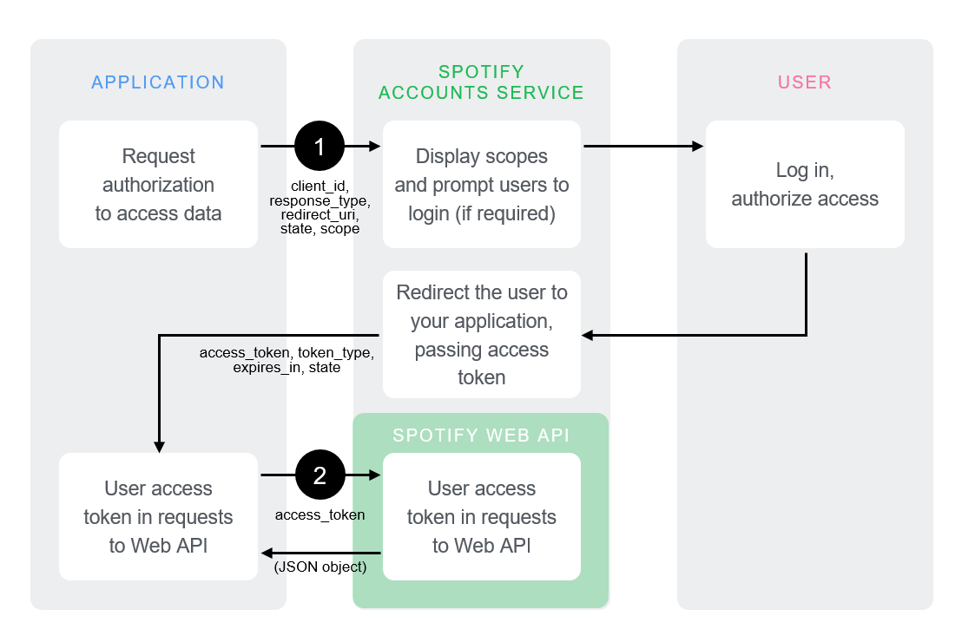
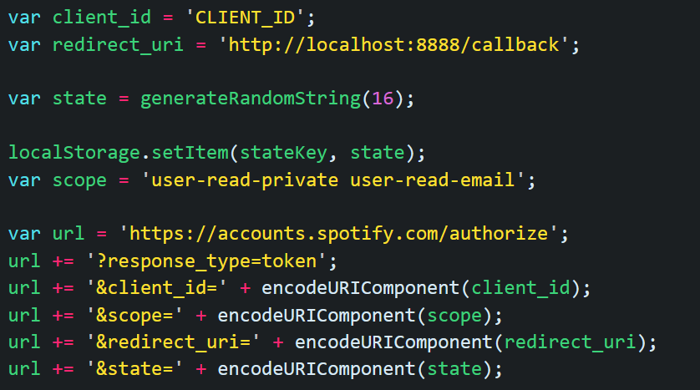
Spotify-API: Authorization
Implicit Grant Flow https://developer.spotify.com/assets/AuthG_ImplicitGrant.pngc
https://developer.spotify.com/documentation/general/guides/authorization/implicit-grant/

Slide 6
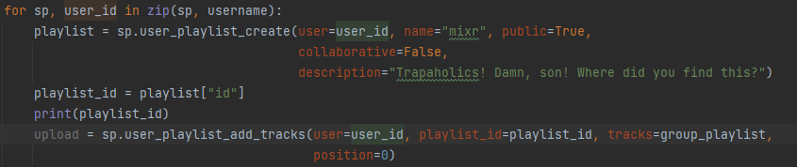
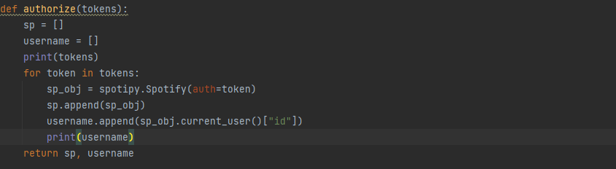
Spotify-API: spotipy
Python library
Method-based Spotify-API calls

Slide 7


User-Interface
Ugly HTML website :(
Handles Authentication
Web-based
Accessible on Mobile and Desktop

Slide 8

ML-Performance: See for yourself!

Slide 9
Lessons Learned: Programming
CORS-Headers exist (or rather they don‘t espacially when you need them)
Web-based API client implementation sometimes impossible
Cookies can be defined and updated individually by name in JS
→ But they can‘t be read as easily
It is very difficult to create and update global variables in Flask
→ Make as few API calls as possible, try to pack everything in one big request, rather than multiple different ones
git reset –hard <commit_id> exists
→ If you made bad decisions, you can always go back, don‘t spend hours debugging code, that just worked fine a few seconds ago

Slide 10
Lessons Learned: Project Management
If they don‘t show up to the scrum meeting, they‘re probably not gonna make the sprint either
→ Don‘t assume they‘re quietly doing their part, unless given reasonable reasons to do so
Project Teams can be an echo chamber
→ Talk to people outside the Team to get a different perspective
on the problem you‘re trying to solve

