Slide 1
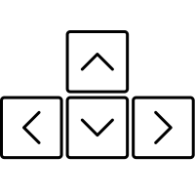
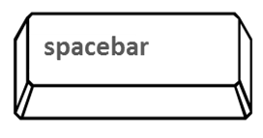

Move the crosshair with the arrow keys
Shoot balls with the space bar
Test your skills getting as many balls as you can inside the boxes

Slide 2

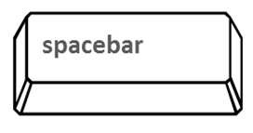
Move the crosshair with the arrow keys
Shoot balls with the space bar
Test your skills getting as many balls as you can inside the boxes

