Slide 1

Backend Dev Lesson 4
bye bye 😭

Slide 2
Agenda
Examples 3, 4 and 5
Hosting online with Heroku
Moving forward
Chillllll

Slide 3
Example 3 - Recap

Slide 4
Example 3: Attendance App Part 2 (Basic Authentication)
Functionality requested by frontend engineers and designers
Students can create a student account with a name, username and password (account database)
Students can add themselves to the attendance list with their username and password (attendance database)
Anyone can view the attendance list (attendance database)
Hint: What does findOne return if there are no results?

Slide 5
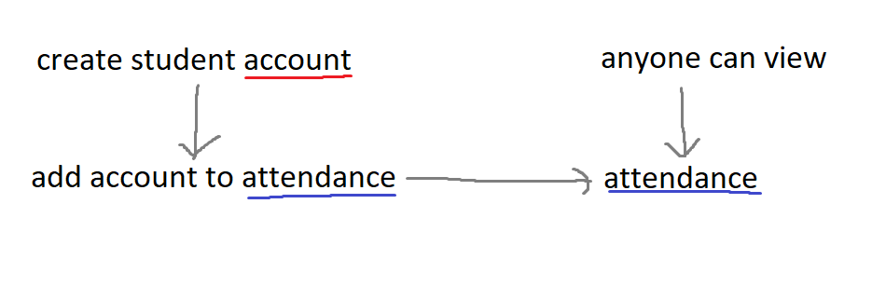
Example 3 flow
Red: account database, Blue: attendance database

Slide 6
Hashing
We usually don’t store passwords in plain sight (plaintext) on the database – we hash them
Instead of “password”, we store “5e884898da28047151d0e56f8dc6292773603d0d6aabbdd62a11ef721d1542d8”
Hashing is a one-way process
We usually use it with salting
Notes:
On salting (just read the salting section): https://www.thesslstore.com/blog/difference-encryption-hashing-salting/

Slide 7
Example 4: Attendance App Part 3 (Hashed Passwords and Account Types)
Functionality requested:
students can create a student account with a username and password (account database)
teachers can create a teacher account with a username and password (account database) - note: differentiate student and teacher account types
students can add themselves to the attendance list with their username and password (attendance database)
teachers can remove students from the attendance list with the teacher's username and password and the student's username (attendance database)
only teachers can view the attendance list (attendance database)

Slide 8
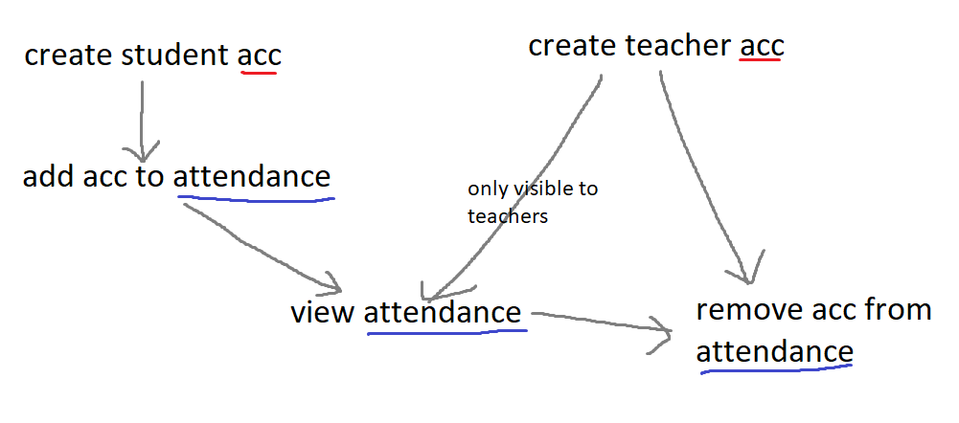
Example 4 flow
Red: account database, Blue: attendance database

Slide 9
JWT
JSON Web Token
Javascript Object Notation
Alternative to passing a username/password combination for authorization (note: authenticate vs authorize)
More secure
Easier to use
Similar to hashing

Slide 10
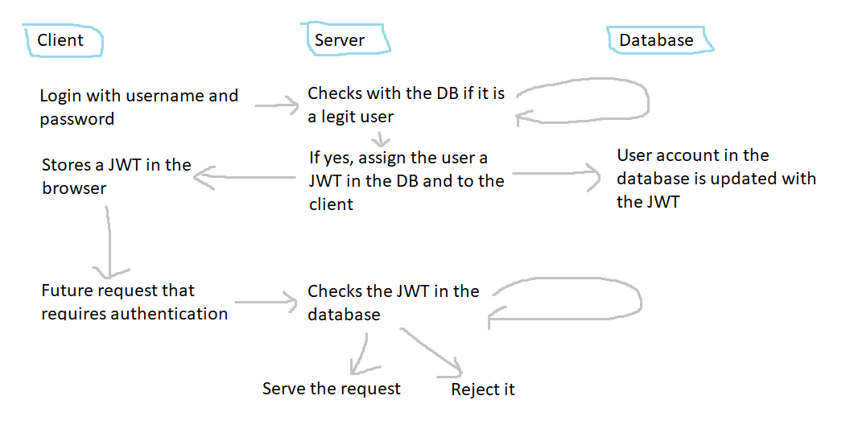
JWT flow

Slide 11
Example 5 – Attendance App Part 3 (JWT and Login/out)
Requested functionality:
students can create a student account with a username and password (account database)
teachers can create a teacher account with a username and password (account database) - note: differentiate student and teacher account types
students/teachers can login, generating a jwt (account database)
students can add themselves to the attendance list with their jwt (attendance database)
teachers can remove students from the attendance list with their jwt and the student's username (attendance database)
only teachers can view the attendance list (attendance database)

Slide 12
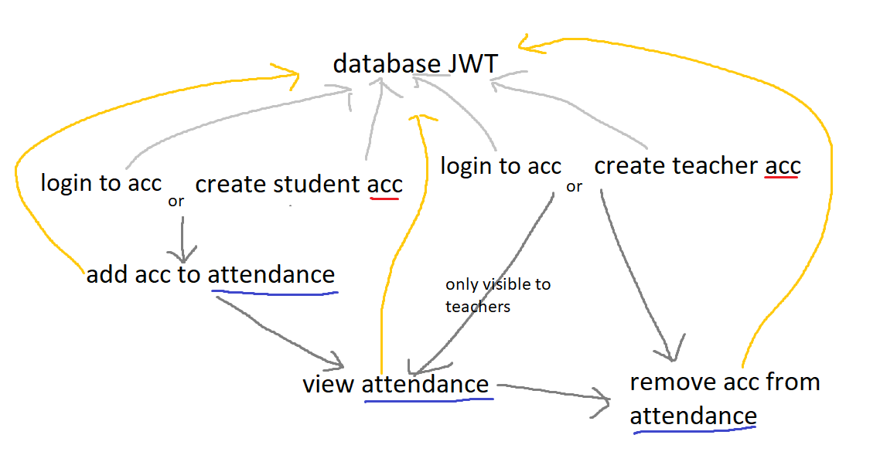
Example 5 flow
All endpoints are authenticated (grey) and authorized using JWT (orange)

Slide 13
Notes
The app is actually not completely secure
Increasing security corresponds to increased complexity in the backend
Typically secrets like your MongoDB connection uri and your JWT key would be kept secret in a separate location
Client-side sanitization
SQL Injections
Unsupported symbols
Client-side authentication and hashing
When is it a good idea?

Slide 14
Hosting with Heroku
https://devcenter.heroku.com/articles/getting-started-with-nodejs
https://devcenter.heroku.com/articles/preparing-a-codebase-for-heroku-deployment
https://devcenter.heroku.com/articles/deploying-nodejs#prerequisites

Slide 15
Rough outline of steps
install git + heroku cli
setup git repo (remote later) + procfile + port
create app
change myurl without trailing forwardslash
setup git remote
push
git add .
git commit -m “your message here“
git push heroku master

Slide 16
Alternatives
AWS
Google Cloud
ngrok
Google sites/GitHub Pages?

Slide 17
Moving ahead..
Renaming your Heroku app
Sockets
MySQL & PostgreSQL
OOP and Javascript paradigms
Notes:
https://devcenter.heroku.com/articles/renaming-apps

Slide 18
chill time

Slide 19
Thank you!
Have a good one
Anonymous feedback – link on Discord
Notes:
https://forms.gle/1nwxWbaV9LBg4NgG9

