Slide 1

Backend Dev Lesson 3
Authentication, Authorization and Flow

Slide 2

eCCA
eCCA sucks
Attendance check
Pretty tough content today – don’t suffer in silence
Stay on discord throughout. If you need help, you can PM me and share your screen. I’ll be checking in with you periodically throughout the exercises. Do help your friends out too.

Slide 3
Example 1: Recapping MongoDB
https://github.com/flyyee/css-backendcourse
Refer to Lesson 2 slides for traversing the console
Practice reading documentation

Slide 4
Example 2: Attendance App Part 1 (MongoDB + Express)
async (req, res)
Lesson 1 example 4: ES6 arrow function with multiple parameters.
await must be used in async function
Cursors
Find does not immediately get all the documents we want, only when we access them (cursor)
Good for large queries
But we want all the data immediately in an array

Slide 5
Example 3: Attendance App Part 2 (Basic Authentication)
Functionality requested by frontend engineers and designers
Students can create a student account with a name, username and password (account database)
Students can add themselves to the attendance list with their username and password (attendance database)
Anyone can view the attendance list (attendance database)
Hint: What does findOne return if there are no results?

Slide 6
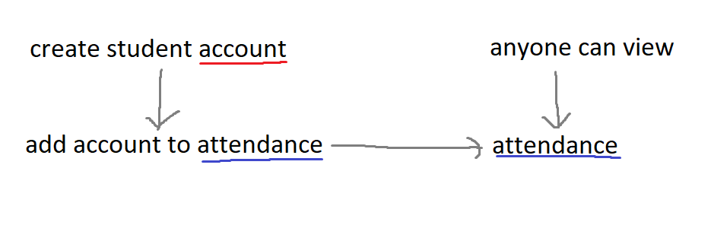
Example 3 flow
Red: account database, Blue: attendance database

Slide 7
Hashing
We usually don’t store passwords in plain sight (plaintext) on the database – we hash them
Instead of “password”, we store “5e884898da28047151d0e56f8dc6292773603d0d6aabbdd62a11ef721d1542d8”
Hashing is a one-way process
We usually use it with salting
Notes:
On salting (just read the salting section): https://www.thesslstore.com/blog/difference-encryption-hashing-salting/

Slide 8
Example 4: Attendance App Part 3 (Hashed Passwords and Account Types)
Functionality requested:
students can create a student account with a username and password (account database)
teachers can create a teacher account with a username and password (account database) - note: differentiate student and teacher account types
students can add themselves to the attendance list with their username and password (attendance database)
teachers can remove students from the attendance list with the teacher's username and password and the student's username (attendance database)
only teachers can view the attendance list (attendance database)

Slide 9
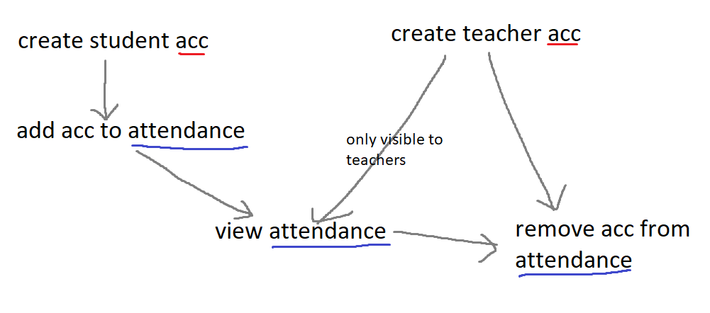
Example 4 flow
Red: account database, Blue: attendance database

Slide 10
JWT
JSON Web Token
Javascript Object Notation
Alternative to passing a username/password combination for authorization (note: authenticate vs authorize)
More secure
Easier to use
Similar to hashing

Slide 11
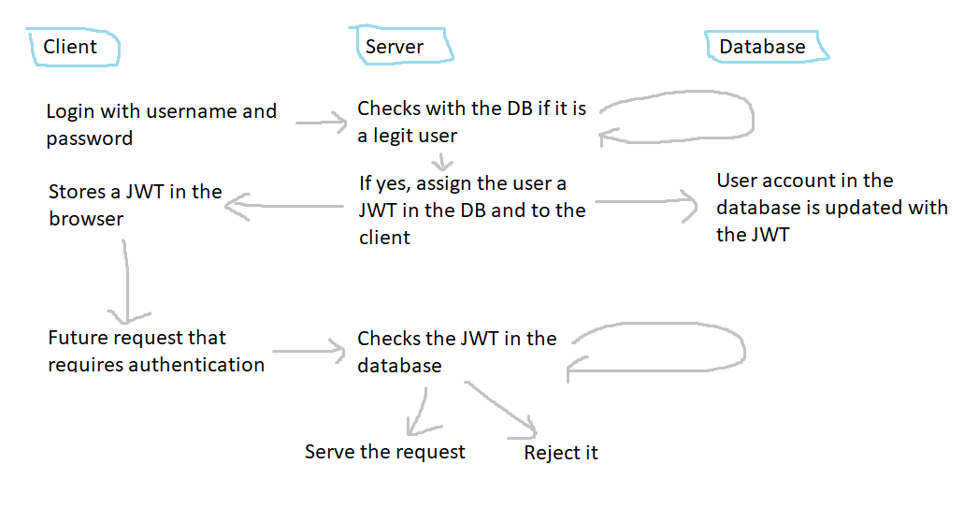
JWT flow

Slide 12
Example 5 – Attendance App Part 3 (JWT and Login/out)
Requested functionality:
students can create a student account with a username and password (account database)
teachers can create a teacher account with a username and password (account database) - note: differentiate student and teacher account types
students/teachers can login, generating a jwt (account database)
students can add themselves to the attendance list with their jwt (attendance database)
teachers can remove students from the attendance list with their jwt and the student's username (attendance database)
only teachers can view the attendance list (attendance database)

Slide 13
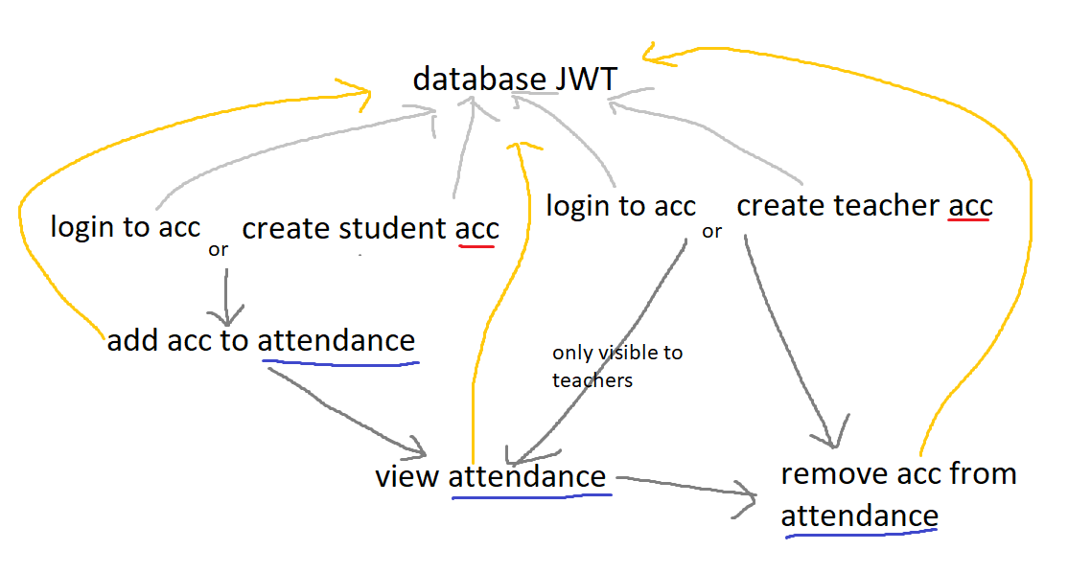
Example 5 flow
All endpoints are authenticated (grey) and authorized using JWT (orange)

Slide 14
Notes
The app is actually not completely secure
Increasing security corresponds to increased complexity in the backend
Typically secrets like your MongoDB connection uri and your JWT key would be kept secret in a separate location
Client-side sanitization
SQL Injections
Unsupported symbols
Client-side authentication and hashing
When is it a good idea?

Slide 15

Thank you

