Slide 1

Back-end Dev Lesson 2: Databases

Slide 2
Miscellaneous CMD operations
Git CMD
To see the files in your current directory: dir (Windows) or ls (Mac)
To change directory: cd <directory> (e.g. cd lesson1)
Paths: node ./lesson2/ex1_misc.js
Creating a folder: mkdir <foldername> (e.g. mkdir newfolder)
Tab autocomplete

Slide 3
Restarting Node
After making changes to your server code, you have to restart your server instance. The code that your server is currently running is the one that you wrote when you ran “node …”
Restart your server instance by quitting the Node server (with CTRL+C) and then running “node …” again.
Remember to save your code before running “node …” again or the server will be running with your old code.

Slide 4
Recap + Types of requests
https://github.com/flyyee/css-backendcourse

Slide 5
Query Parameters
- set of parameters attached to the end of a url
- To append query params to the end of a URL, a ? is added followed immediately by a query parameter
- To add multiple parameters, an ‘&’ is added in between each
- For example, website.com?name=Branch&products=[Journeys,Email,Universal%20Ads]
- These are the values you accessed as part of req.query with express

Slide 6
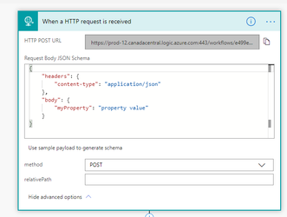
An alternative
We usually use POST requests to send form data instead.
Similar to GET, just that there usually is a body.
If you want to find out more: https://stackoverflow.com/questions/2946325/why-should-i-post-data-rather-than-get

Slide 7
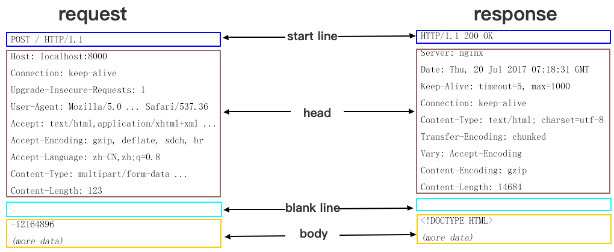

Slide 8
Good Coding Habits
Variables – makes everything easier to reference
DRY vs WET code - Don’t Repeat Yourself VS Write Everything Twice. Functions are a good alternative to having repeating blocks of code in a program.
Functions also increase the reusability of code.
View Example 3

Slide 9



Good Coding Habits
Abstraction is the concepts of handling complexity by hiding unnecessary details from the user. This is the philosophy at the heart of server-side development.
Notes:
https://stackify.com/oop-concept-abstraction/

Slide 10
Good Coding Habits
Reading documentation and API – Example 4
Uhh: https://nodejs.org/api/timers.html#timers_settimeout_callback_delay_args
Okay: https://nodejs.org/en/docs/guides/timers-in-node/
Hmm: (JS vs NodeJS) https://www.w3schools.com/jsref/met_win_settimeout.asp
https://developer.mozilla.org/en-US/docs/Web/API/WindowOrWorkerGlobalScope/setTimeout

Slide 11
Good Coding Habits
What is NPM
Reading a package’s documentation: https://www.npmjs.com/package/node-fetch
Reading APIs: https://exchangerate.host/#/docs

Slide 12
Good Coding Habits
Reading error logs
View Example 5
Naming variables (lowerCamelCase, UpperCamelCase, snake_case)

Slide 13
Good Coding Habits
Objects and classes and… abstraction
What can objects be used for?
An object represents… an object
It has specific properties
Objects are your friend in Javascript. To represent a water bottle, use an object! (at the end of Example 5) Same idea for representing students (last lesson)
Classes make this even smoother and easier. There are many good resources online to learning Classes (you can refer to Example 1 too)

Slide 14
Okay actual database stuff now

Slide 15
Why use databases?
Client-side storage
Server-side storage
Local storage
Database storage (cloud)
Space
Safety
Speed

Slide 16
PostgreSQL/MySQL/SQLite
Stores data traditionally – in “tables”.
Rows and columns store data as you would in a science practical
You can:
create/modify tables
add/delete rows
add/delete columns
view the contents of the table
Tables can also be interconnected
Notes:
More info: https://www.digitalocean.com/community/tutorials/sqlite-vs-mysql-vs-postgresql-a-comparison-of-relational-database-management-systems

Slide 17
Databases
You send a query to the database, essentially requesting for data.
It responds with the data
Sounds familiar?
SQLite Queries: https://mystery.knightlab.com/walkthrough.html You should read the section “What elements does a SQL query have?”

Slide 18
Easier stuff - MongoDB
SQLite is kinda cringe
MongoDB is a NoSQL database
Database -> Collections -> Documents (object)
BUT MongoDB has its limitations too: https://dzone.com/articles/mongodb-the-good-the-bad-and-the-ugly
Try out Example 6
Notes:
We aren’t learning how to use MongoDB very rigorously but it suffices for basic needs. https://www.guru99.com/what-is-mongodb.html

Slide 19
Mini-Project
Example 7
Recall what we did last lesson
Good luck!

