Slide 1
Datafest @ UCLA 2018
By Team Straggler: Nicolas Colosso, Daniel DeFoe, Kevin Foltz, Vivian Tai

Slide 2
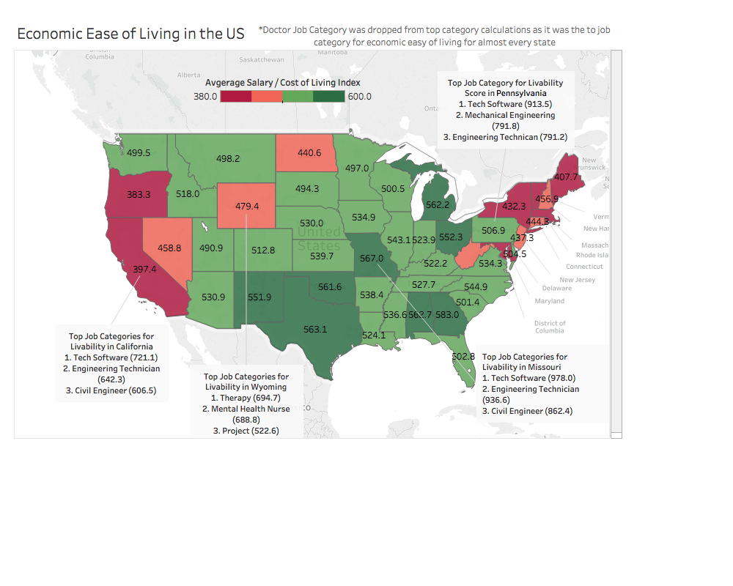
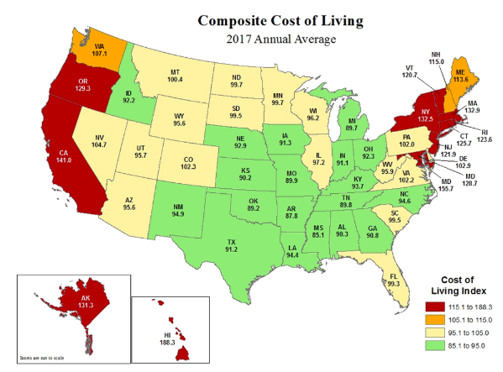
Compare and Contrast Cost of Living and Economic Ease of Living
Key Takeaway: When average salary is accounted for, it is revealed that high cost of living is counteracted by high wages in Washington and Massachusetts while low wages make ease of living worse in states like Nevada, Wyoming, and North Dakota.

Slide 3
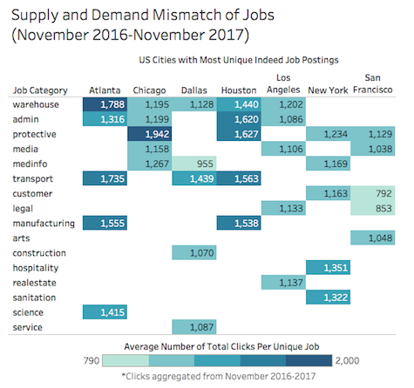
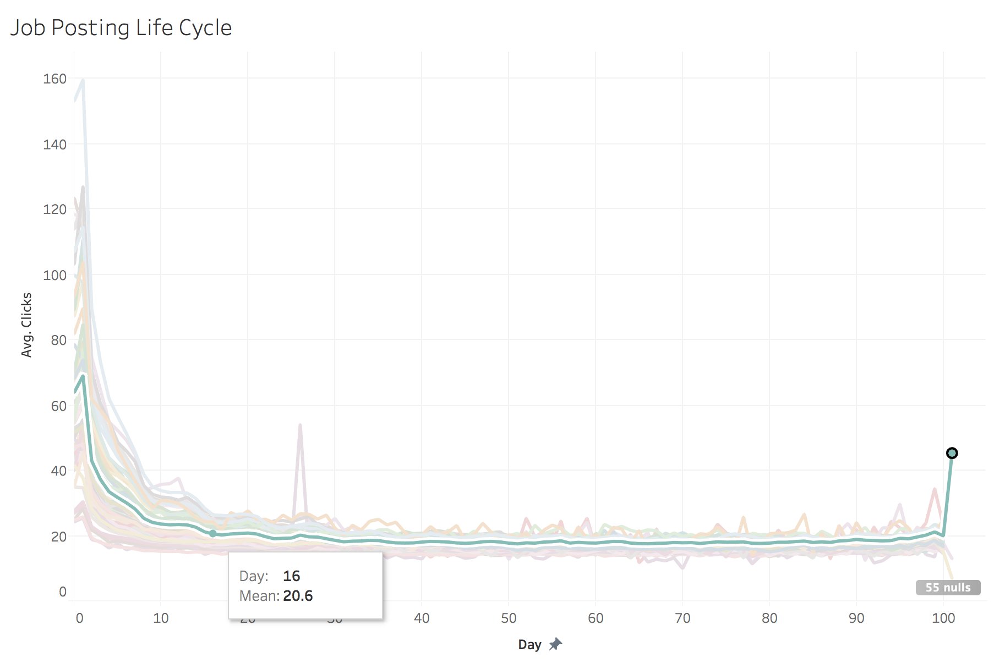
Job Demand and Job Posting Life Cycle
Supply and Demand Mismatch of Jobs in Top U.S. Cities (November 2016-2017)
Recommended Time of Refresh Based on Job Post Life Cycle
Key Takeaway: Indeed should encourage employers of these job categories to post more jobs to capture demand in these major cities
Key Takeaway: It is likely best for companies to refresh posts after 16 days for potential traffic spikes

