Slide 2
.Build the layout using a mobile first design:
Make sure the HTML file includes the viewport meta tag in the head of the document.
See Configuring the Viewport to understand why and how to add this tag.
Look at the provided mockup for the mobile device and add the same header, titles, content and footer information into your index.html file.
Use the provided images for the portfolio gallery images shown in the mockups.
Use a font from Google Fonts for the text.
Use CSS to style your layout to match the provided mobile mockup. Make sure your mobile design matches the mockup at 320px screen size.

Slide 3
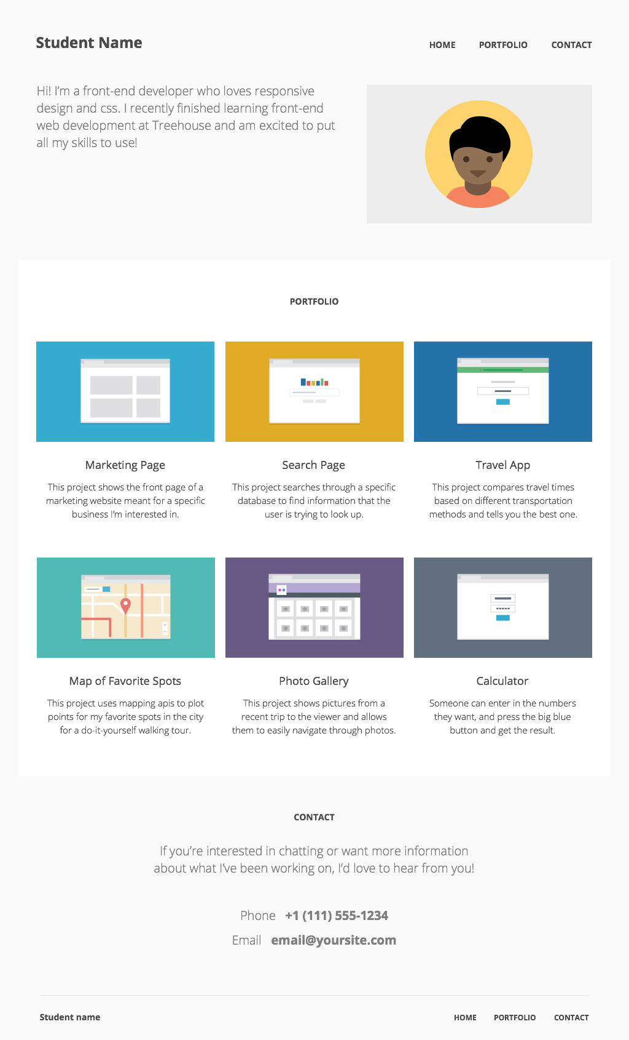

Slide 4
