Slide 1
Movie API Analysis
Project 8

Slide 2
Data Information
The Data was extracted with an Api call for the following Movies:
Parasite
Green Book
The Shape of Water
Moonlight
Spotlight
Birdman or (The Unexpected Virtue of Ignorance)
12 Years a Slave,134
Argo
The Artis
The King's Speech

Slide 3
Data Information
For each Movie the following returned data was saved to an CSV
Movie Title (string)
Runtime (integer)
Genre (string)
Award Wins (integer)
Award Nominations (integer)
Box Office (integer)

Slide 4
Goal of this analysis:
The goal of this analysis was to answer the following Questins with help of the OMDb API :
What was the runtime for each movie?
What movie had the longest runtime?
Is there any relationship between the length of the movie (runtime) and the number of awards a movie won?
How many awards and nominations did each movie receive?

Slide 5
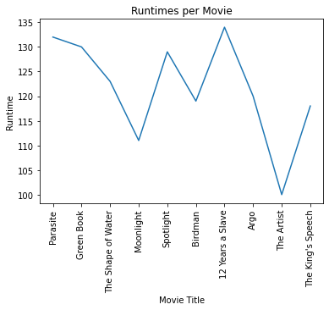
What was the runtime for each movie?

Slide 6
What was the runtime for each movie?
The Graphic shows very cearly that 12 years a slave (134 min) has the longst runtime and the artist (100 min) the shortest

Slide 7
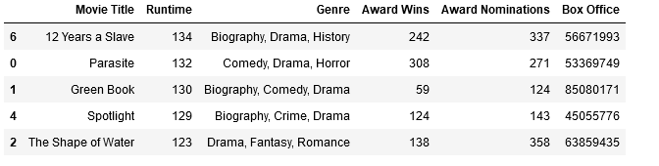
What movie had the longest runtime?
The Table shows very cearly that 12 years a slave (134 min) has the longst runtime and the artist (100 min) the shortest

Slide 8
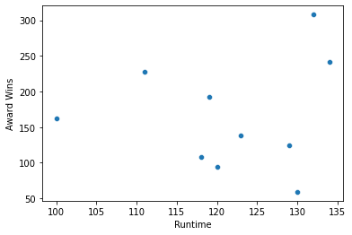
Is there any relationship between the length of the movie (runtime) and the number of awards a movie won?

Slide 9
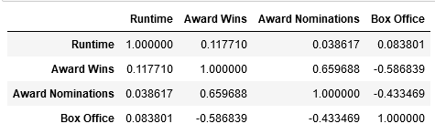
Is there any relationship between the length of the movie (runtime) and the number of awards a movie won?
NO!!! the graphic shows that there is no correlation between runtime and wins
the correlation coefficient is only: 0.0.117710

Slide 10
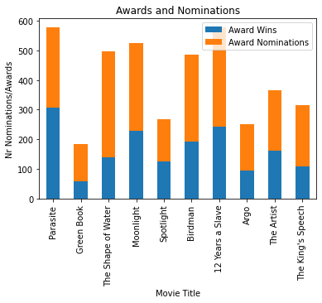
(Graph) How many awards and nominations did each movie receive?

Slide 11
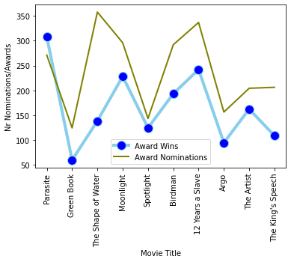
Graph) How many awards and nominations did each movie receive?

Slide 12
Graph) How many awards and nominations did each movie receive?
The Graphshows how many awards and nomination each Movie received.
Interesting is that Parasite received more awards than nominations

Slide 13
Conclusion
This Analysis gives an Short overview about Oscar Movies and their data. We showed the runtime of those moves. Which movie had the longest and shortest runtime. Realationship between length of a movie an number of awards. And how many award each movie did receive.
For this we used differtn tools like graphs Tables and barcharts.
In summary, this analysis gives a good overview of the Oscar films and their characteristics

