Slide 1
Delta Sigma Pi Recruitment
Disney+ Case Solution
September 3rd, 2026
Group 3

Slide 2
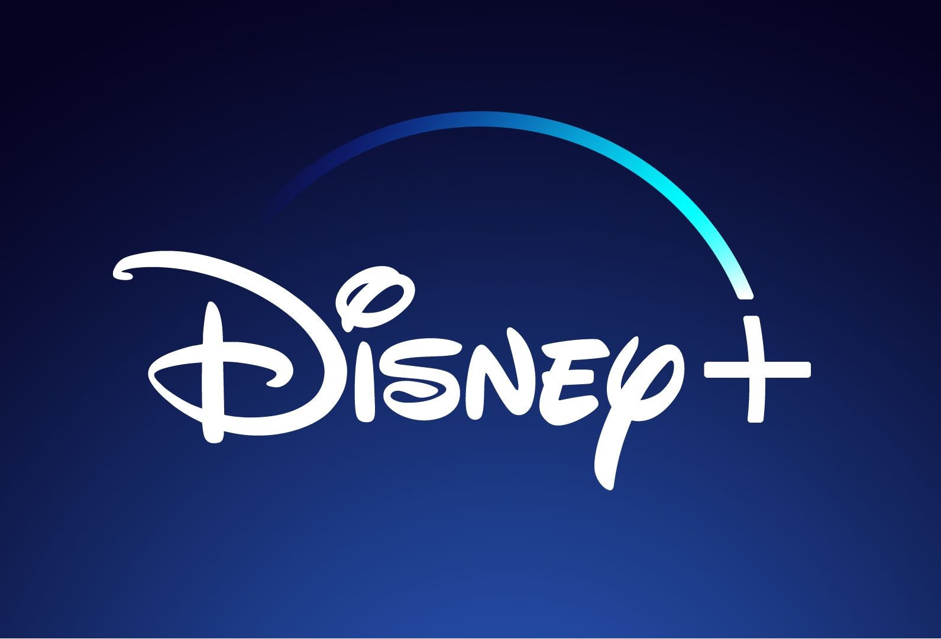




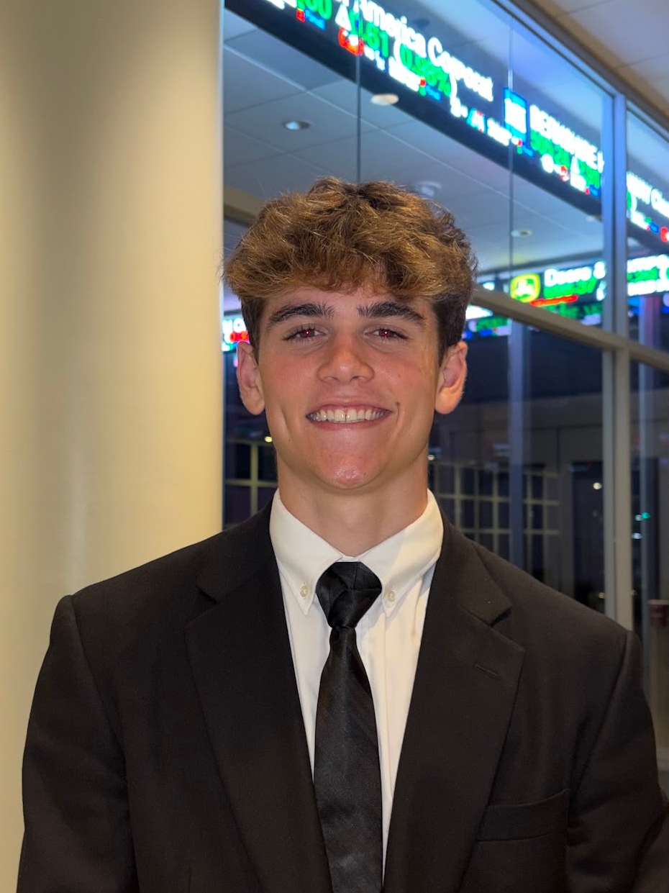
Meet the Team
Rylie Armstrong
Marketing
Joseph Robinson
Finance
Daniel Davis
Finance
Audrey Linton
Business
Reece Foster
Economics

Slide 3

Agenda
Current environment
S.W.O.T. analysis
Strategy
Implementation
KPIs
Current Environment
S.W.O.T. Analysis
Strategy
Implementation
Key Performance Indicators (KPIs)

Slide 4

Current Environment
Current environment
S.W.O.T. analysis
Strategy
Implementation
KPIs
Subscription Pressure
Competitive Intensity
Disney’s Challenge
Households are cutting down to two
core services
Paramount-WBD adds scale as Netflix holds strong lead in streaming
Disney+ must become a must-keep subscription by winning the second spot

Slide 5

S.W.O.T. Analysis
Current environment
S.W.O.T. analysis
Strategy
Implementation
KPIs
Strengths
Iconic IP portfolio
Diversified ecosystem
Massive scale
Weaknesses
Low engagement frequency
Reliance on blockbuster IP
Sports rights disadvantage
Opportunities
Expand beyond passive viewing
Capture new audiences
Connect physical & digital
Threats
Subscription fatigue
Paramount WBD merger
Marvel IP rights

Slide 6



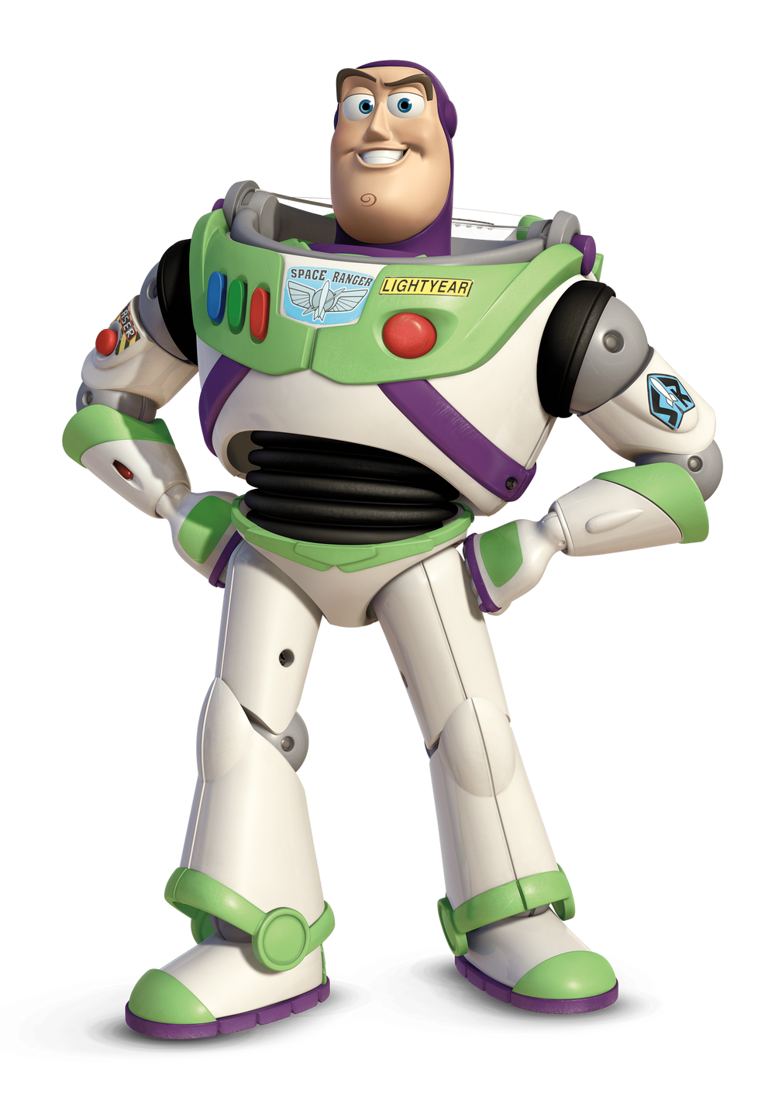

Strategy
Current environment
S.W.O.T. analysis
Strategy
Implementation
KPIs
Disney+ Gaming
Disney: Anime
Disney+ Park Perks
Games connected to Disney+ Content Ex. Disney Wordle
Interactive media (Choose-Your-Own-Adventure)
Game-Exclusive Disney+ Rewards
Star Wars Anime Series (Similar to Star Wars: Visions)
Produce Original Anime Film.
Disney+ Memories: A Personal Family Video Library
Park-Exclusive Disney+ rewards
Disney+ User-Exclusive Park Rewards

Slide 7
Strategy - Who is Our Audience?
Current environment
S.W.O.T. analysis
Strategy
Implementation
KPIs
Disney+ Games | Disney: Anime | Disney Park Perks
Party Games + Trivia Games: Targets families + young adults. Adds subscription value. Ex. Jackbox on Netflix | Star Wars Anime Series: Targets Gen Z, Millennials, and anime fans. Proven concept. Ex. Star Wars: Visions | Disney+ Memories: Targets families + park visitors. Incentivizes app subscription and use.
Interactive Media: Targets kids + teens. Ex. You vs Wild
Disney+ Rewards: Targets all users. Sets Disney+ Games apart from competitors and incentivizes play | Higher cost + privacy needs
Original Disney Anime Film:
Targets kids and families.
Also retains secondary appeal to young adults and anime fans.
Ex. Studio Ghibli Movies
Exclusive In-App + Park Rewards
Targets all subscribers + expands app-park integration.
Subscribers get rewards on the app and at the park.
Ex. In game items, merch, etc.

Slide 8
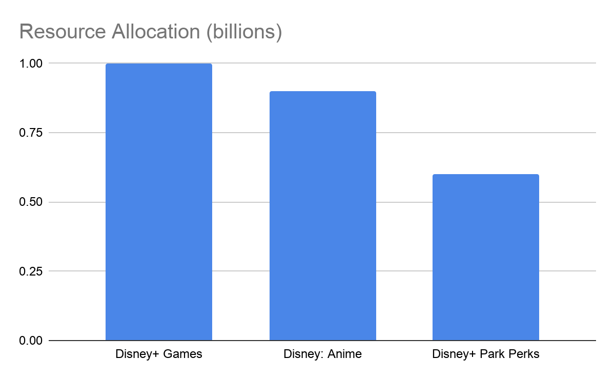
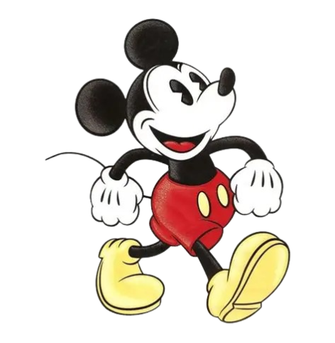
Implementation - Roadmap 2026-2031
Capital Fund Allocation
1 Billion
900 Million
600 Million
Current environment
S.W.O.T. analysis
Strategy
Implementation
KPIs
2026 - 2027: Launching New Features | Work and release of Disney+ Games Begin anime projects Incorporate and expand Park Perks
2028 - 2029: Scale Engagement | Expand Disney+ Games Release original film and Star Wars series. Continue to expand Park Perks + app features
2030 - 2031: Optimize and Grow | Scale successful games/anime projects Upgrade Park Perks tech + content flows.

Slide 9
Implementation - Risk & Mitigation
Current environment
S.W.O.T. analysis
Strategy
Implementation
KPIs
Pillar | Risk | Mitigation
Disney+ Games | Features may feel shallow | Test small pilots, keep what works.
Disney: Anime | Relying on one studio | Partner with multiple studios
Disney+ Park Perks | Higher cost + privacy needs | Introduce additions slowly
.

Slide 10
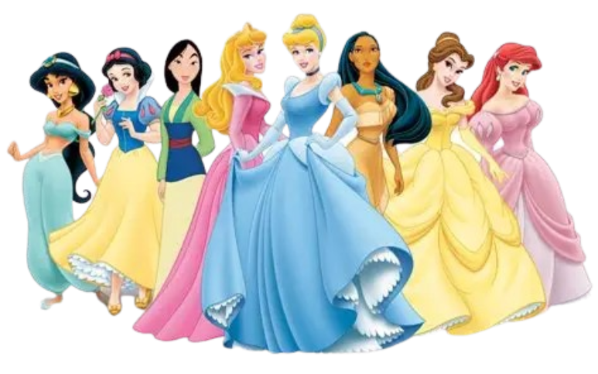
Key Performance Indicators
Current environment
S.W.O.T. analysis
Strategy
Implementation
KPIs
Engagement frequency rates
Disney+ churn rate
New IP viewership tracking
Customer lifetime value analysis
Our Measurable Goals:
10% increase in engagement frequency
20% decrease for churn rate.
IP Product will bring in 3x investment value.
Within 6 months of dropping parks rewards, have an increase of 5% in visitors at parks daily.

Slide 11
Thank you!
Q&A

