Slide 1


ESPERTO Watch
University of waterloo WEEF Proposal
Fall 2017

Slide 2

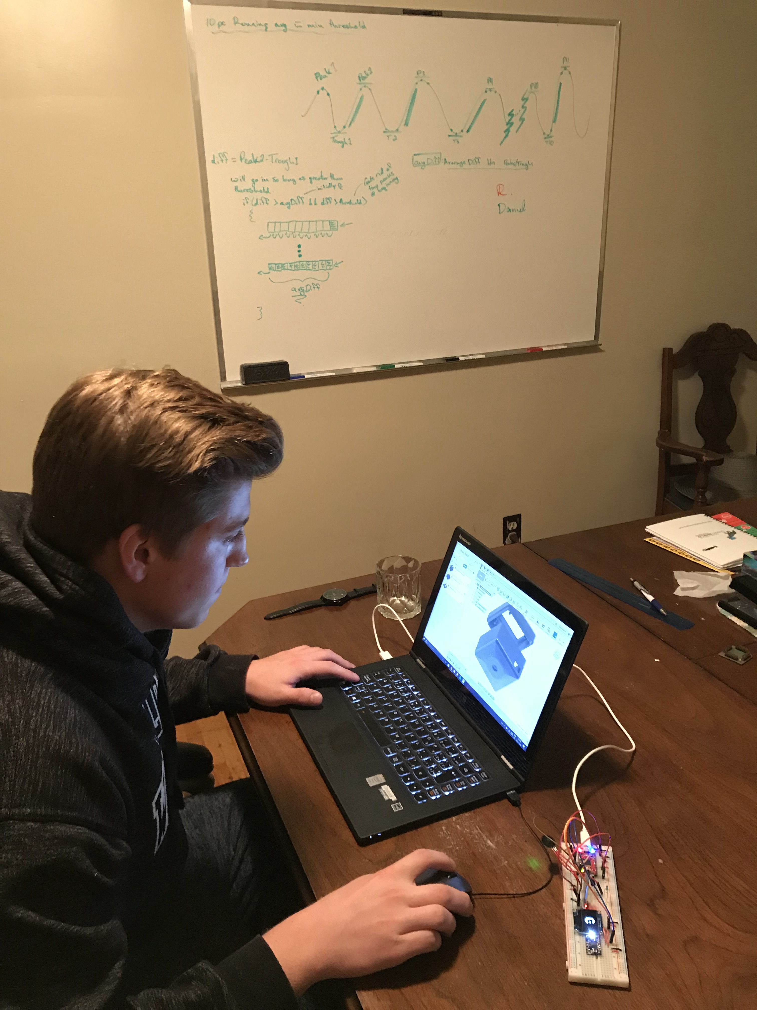
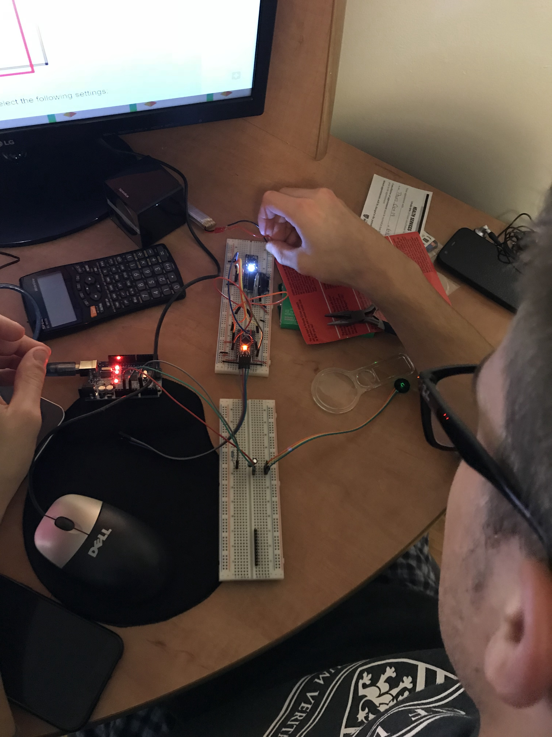
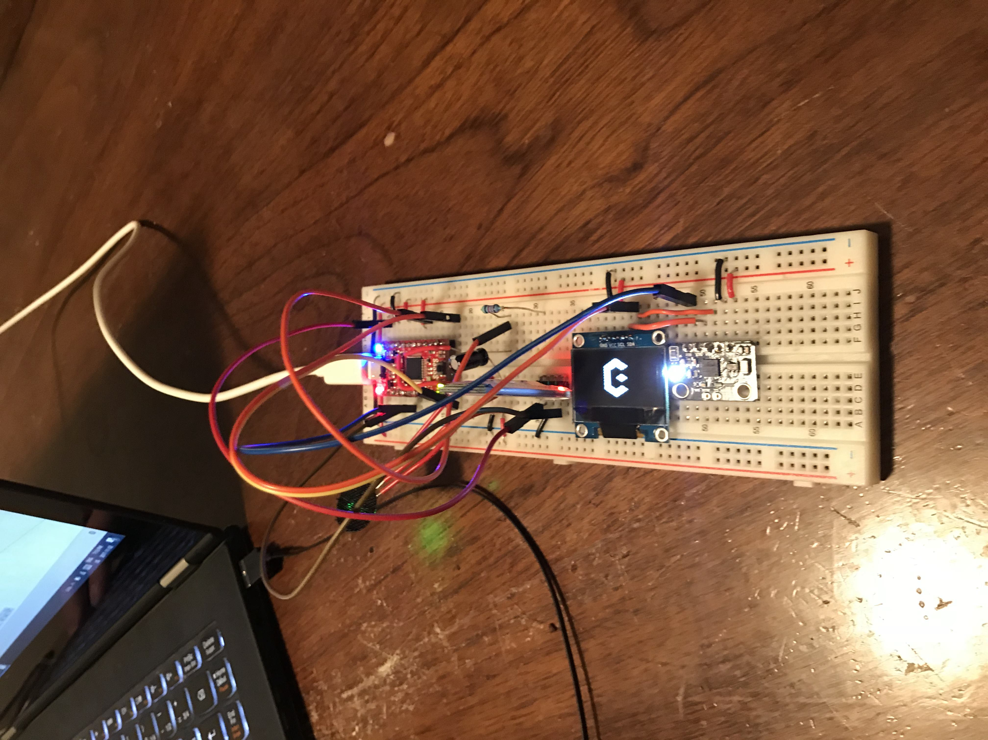
The beginning of esperto
At first, there were two . . .

Slide 3
Team statistics
Over 300 student hours have gone into developing, researching, and testing the Esperto smartwatch
More than 700 lines of development and test software written
3 prototypes built and plans to build 3 more
Students from 4 different programs with plans to begin working with students from other faculties and programs once funding is confirmed

Slide 4
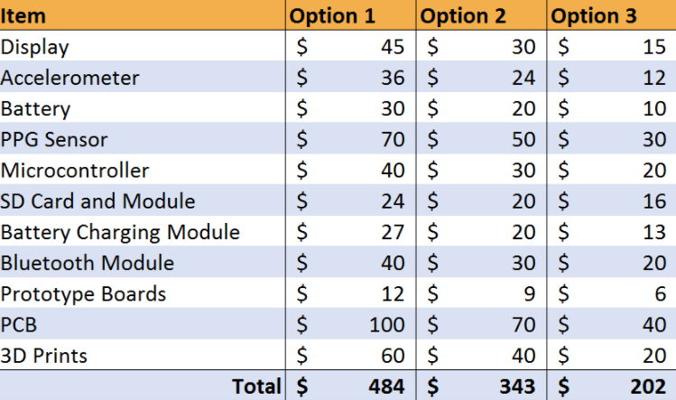
Funding Breakdown

Slide 5
Thank you for listening!
From the Esperto Team

