Slide 1



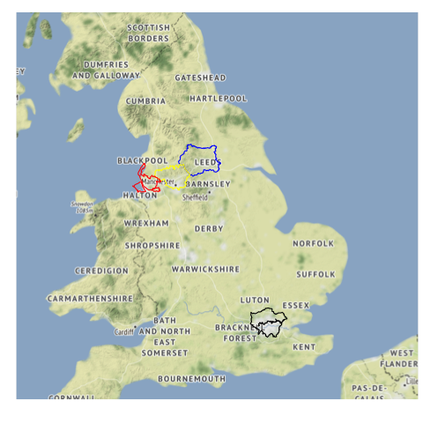
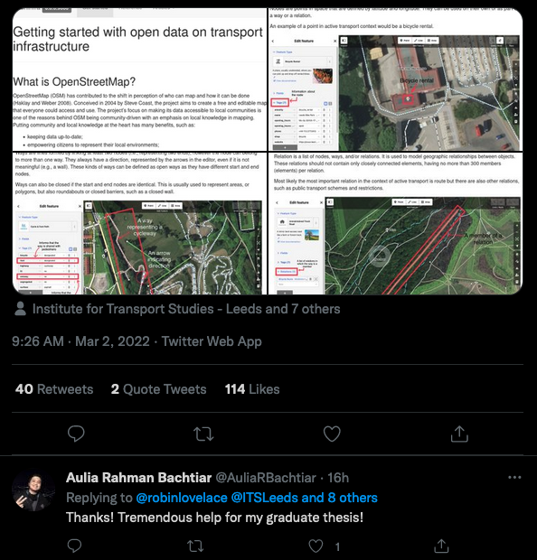
OpenInfra
Urban Analytics
Intern: Greta Timaite
Supervisors: Dr Robin Lovelace, Dr Victoria Houlden, Prof Ed Manley
Notes:
Hi everyone.
Not sure if you recall from my previous presentation but OpenInfra project aims to explore how OpenStreetMap (OSM) can be used to understand, prioritise, and design active travel infrastructure. A particular focus is also paid to accessibility and accessible pedestrian infrastructure. The idea is to scale up to the whole of England but up to know I’ve focused on 4 metropolitan areas: West Yorkshire, Greater Manchester, Merseyside, and Greater London. The main takeaway or insight is that OSM can provide a comprehensive overview of active travel network but if you want to dive deeper and find out about the infrastructure at a more granular level, the data becomes more and more sparse. In other words, a more specific an attribute is, the less data there is. This gets problematic for planning accessible infrastructure because there every detail matters.
In terms of the outputs, our extended abstract for GISRUK has been accepted, so I’ll be presenting there about our findings so far. Another output is the website which we set us as part of our idea to have a package. I’ve written a couple of vignettes and one is an introduction to OSM data in the context of transport research and how OpenInfra fits in this space. My supervisor Robin Lovelace tweeted about it and it got quite some attention (I’ve took the screenshot on the 3rd of March), which demonstrates that might have been needed. Time well spent on my part, I reckon.
So this is all on my behalf, I’m more than happy to answer you question.

