Slide 1
EE 445L – Embedded System Design Lab
Instrumentation amp
For more information read Section 8.2.3 in the book

Slide 2
Op amp review
Linear op amp circuit
Maps a transducer to the ADC
The five design rules
Negative Feedback
Rail-to-rail
Vx ~= Vy
Ix =0 and Iy = 0
Select resistors in the 1kΩ – 1MΩ range
Parameters
Linear equation: output as a function of input(s)
Input impedance
Output impedance
Offset voltage
Frequency response
Noise compare it to signal resolution
EE 445L – Bard, Valvano

Slide 3
OP AMP Example
(10) Exam Question 3. The output of a linear transducer is V₁, and V₁ is connected as the input to an amplifier. The amplifier has a transfer function of V₂ = 100 (V₁+0.02). The range of V₁ is -0.02 to 0.02 V. V₂ is connected as the input to an ADC. The ADC range is 0 to 4 V, and ADC precision is 10 bits. The sampling rate is 1000 Hz. What is the maximum allowable voltage noise of the amplifier, referred to its input? Show your work.

Slide 4
Instrumentation Amplifiers
Necessary condition (must be)
amplify a differential voltage
shown below as V2-V1
Sufficient condition (one or more may be true)
large gain (above 100),
a high input impedance, and
a good common mode rejection ratio. Or low noise
EE 445L – Bard, Valvano

Slide 5
INA122 Amp
INA122 is low-power single supply rail-to-rail instrumentation amp,
V_{out} = Gain*(V₁-V₂) + V_{ref}
(AD627 or INA122) Gain = 5+(200kΩ/R_{G})
V_{out} = V_{ref} when V₁ equals V₂
In Lab 9, ground pin 5 (V_{ref} = 0)
V_{out} = Gain *(V₁ – V₂)
EE 445L – Bard, McDermott, Valvano

Slide 6
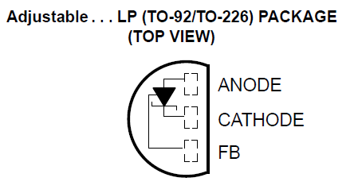
Shunt Diode Reference
LM4041CILPR
R_{s} sets maximum current
R₁,R₂ sets voltage
I_{z} = 80uA + V_{ref} /(R₂+R₁)
V_{d} = 1.233V (across R1)
V_{ref} = V_{d} (1 + R₂/R₁)
Max I_{ref} = (3.3- V_{ref})/R_{s} - I_{z}
EE 445L – Bard, McDermott, Valvano

Slide 7
EKG
Differential signal
2500 gain, good CMRR
Better (avoids saturation from CM)
Instrumentation amp gain is 10
Op amp gain is 200
EE 445L – Bard, McDermott, Valvano

Slide 8
Resistance bridge
Differential signal
Large Zin
EE 445L – Bard, McDermott, Valvano

Slide 9
Thermocouple Amp
Differential signal
Large Zin
Large gain
3.3V
3.3V
EE 445L – Bard, McDermott, Valvano

Slide 10
Summary
Necessary condition
Differential signal
E.g., resistance bridge, biopotentials
Sufficient conditions
High gain
Large input impedance
Good CMRR

