Slide 1
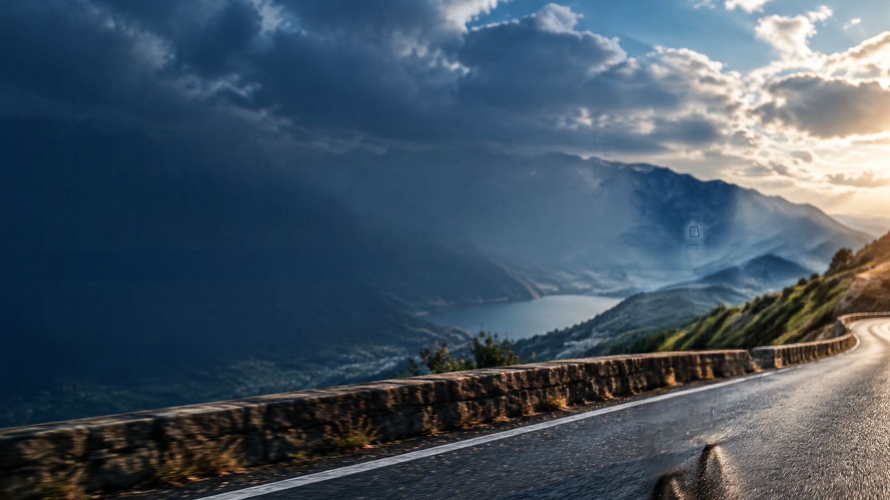
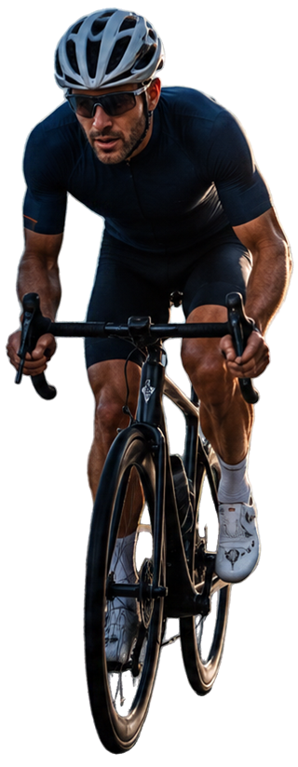
Ride the Data
Weather-driven cycle tourism
Analysis of cycling-friendly days in the Province of Sondrio

Slide 2
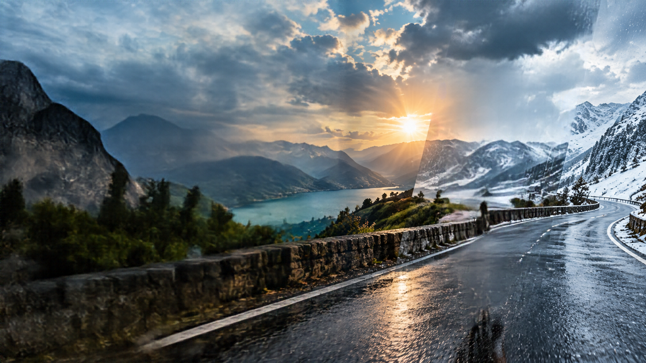

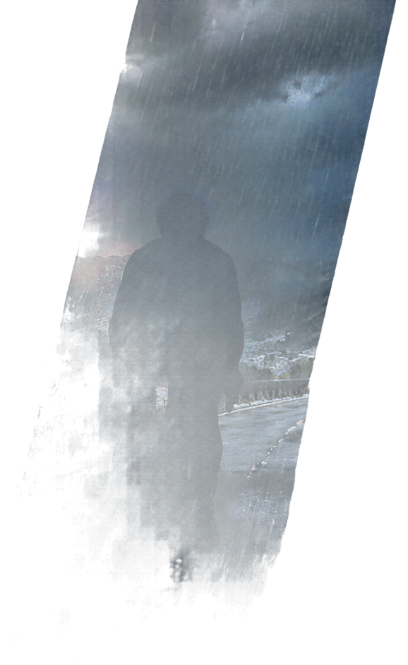
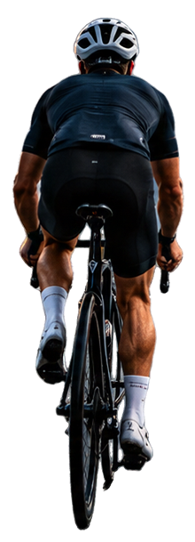
Why bothering
Weather and cycling?
Weather is probably the most important variable when choosing a cycling holiday
Unfavourable weather conditions can hinder even the experience of the most beautiful places
Further, each place has its own unique features that can suit better in different times of the year

Slide 3
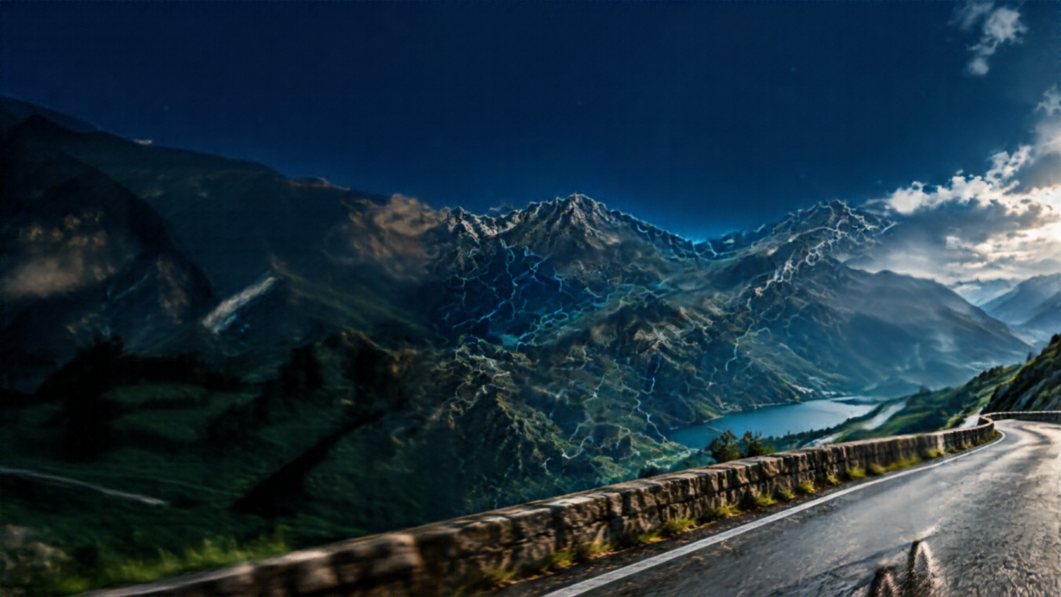

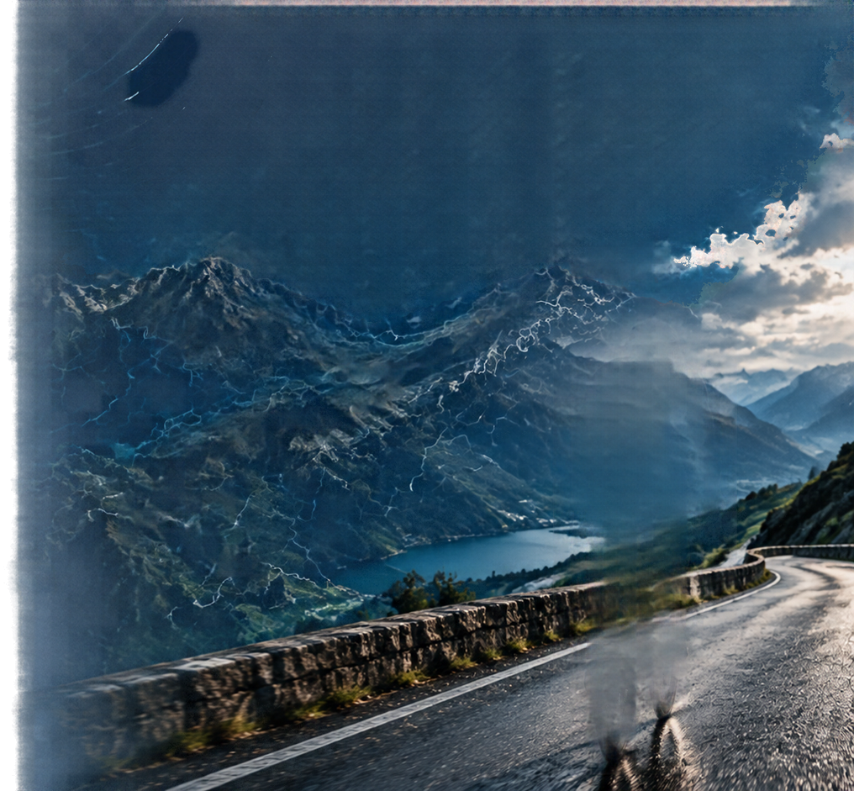
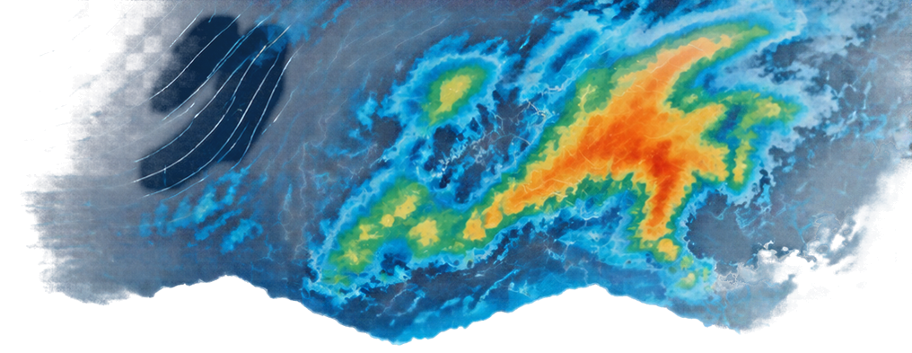
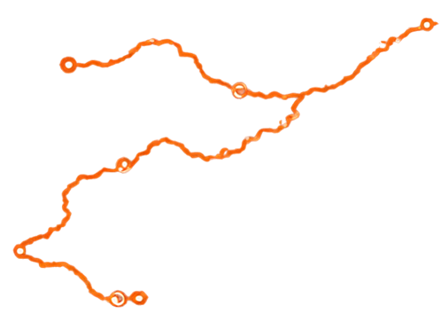
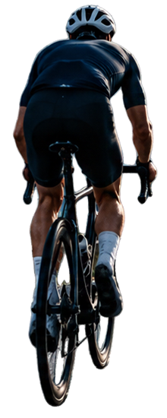
Project overview
Data retrieving
All 77 administrative centers, from 2020 to 2025
https://open-meteo.com/en/docs/historical-weather-api
Feature engineering
Weather score defined on weather criteria
Season parameters calculated on trend of weather scores
Data science
Administrative centers aggregated by similar patterns
Forecasting with different models

Slide 4
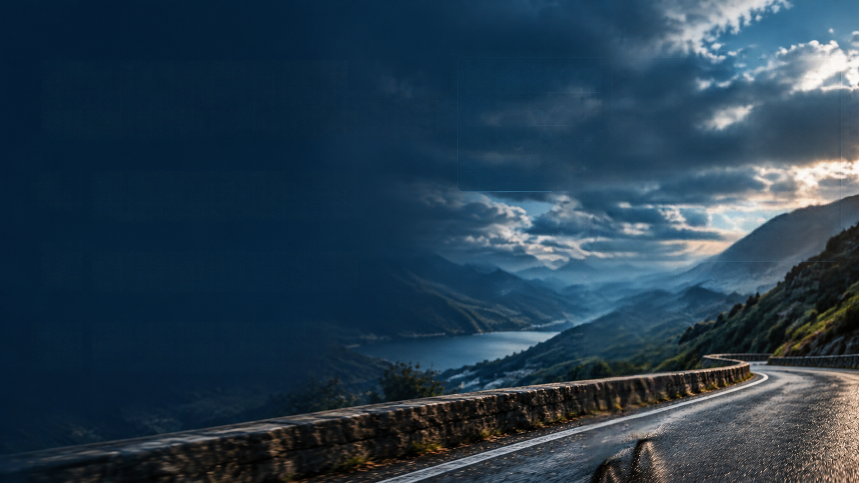
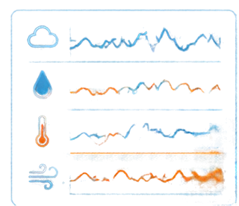
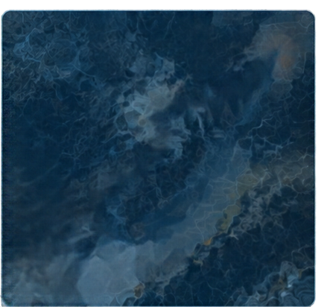
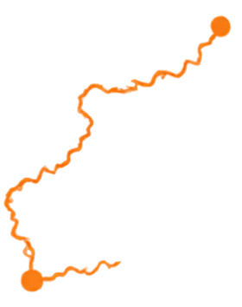

Forecasting
with ML models
1.
Season features:
start, end, duration, score…
2.
Different models to predict 2026:
historical features, Ridge regression, Random Forest
3.
Predictions of season features and comparison with past years

Slide 5
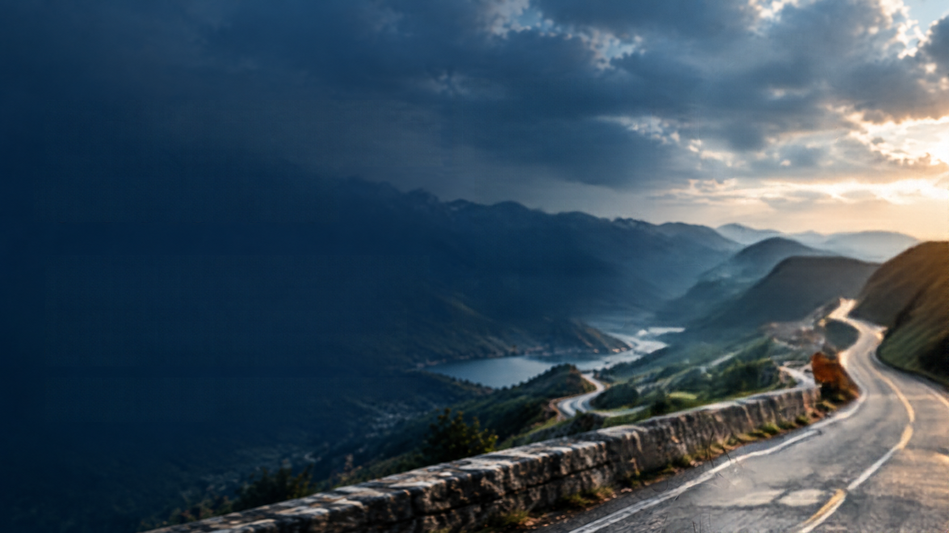

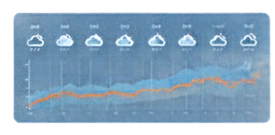
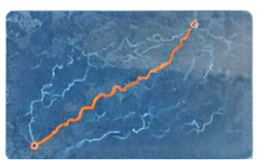

From data
to decisions
Explore the whole province, seeking for the best places to ride your bike
Discover places and seasons that you did not think were suitable for cycling

Slide 6

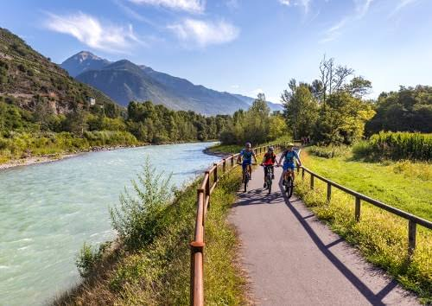
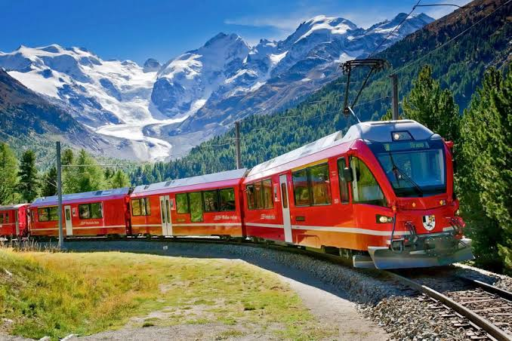
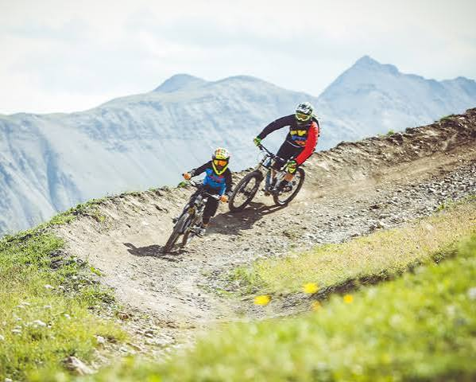
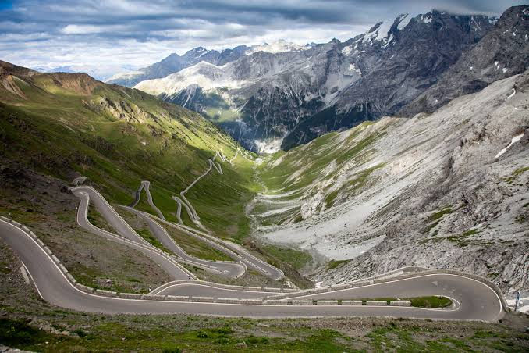
A huge potential
Sentiero Valtellina
Train lines
Bike parks
Roads and trails

Slide 7

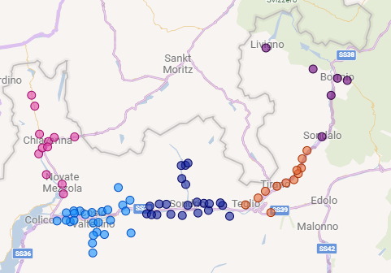
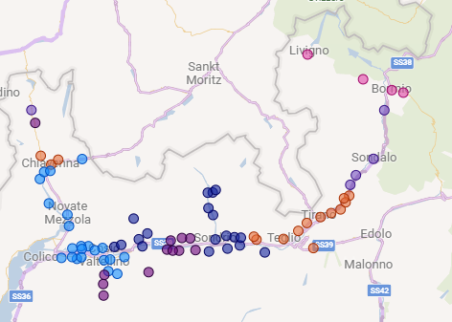
Example result: clustering
5 geographical divisions
6 climate clusters
According to available data, climate clusters are similar to geographical divisions, but not exactly equivalent

Slide 8

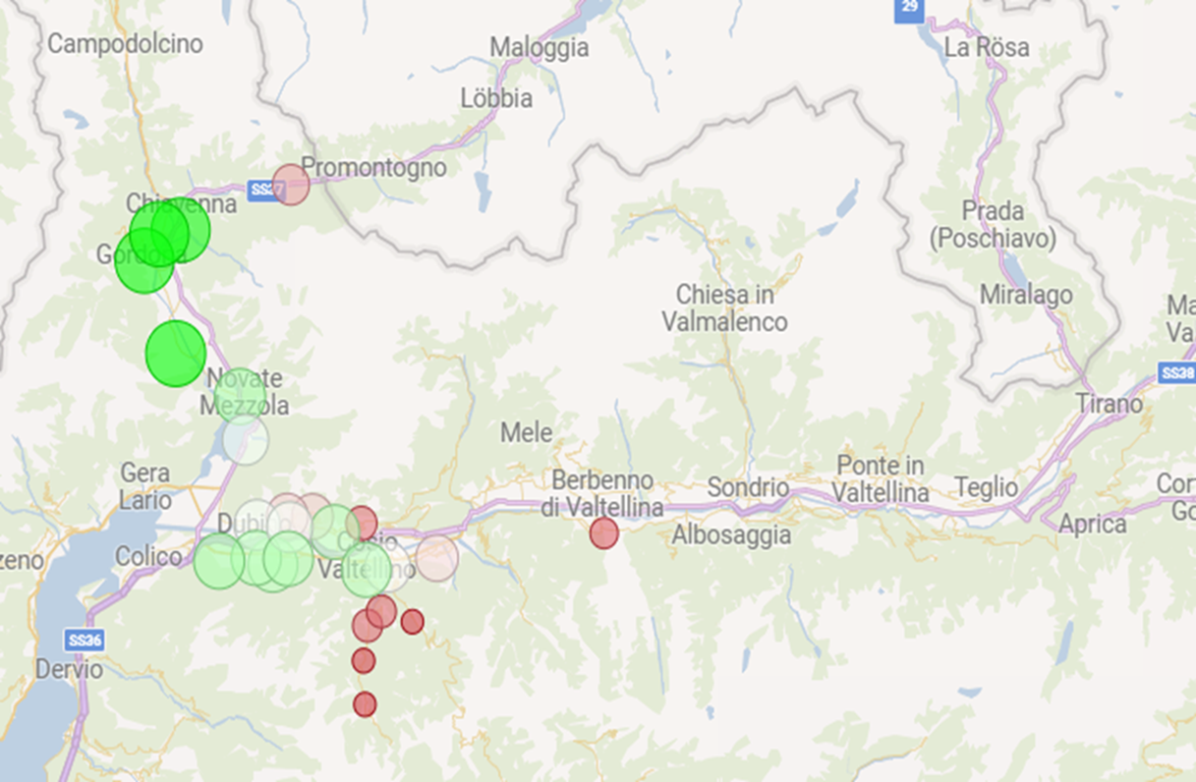
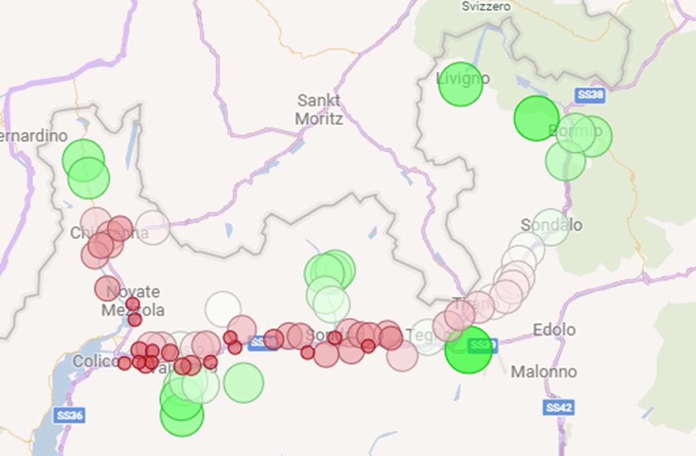
Example result: availability
Weather scores: May
Weather scores: August
Weather scores show high variability during seasons:
in spring, municipalities in the Western part of the province get warmer
in august, lateral valleys and high elevation places have just the right temperature for cycling

Slide 9

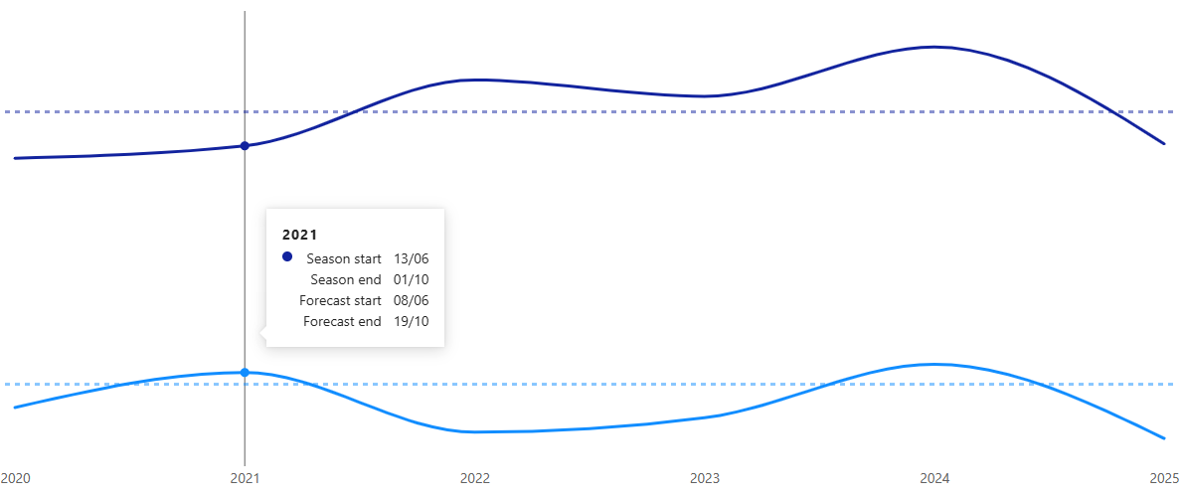
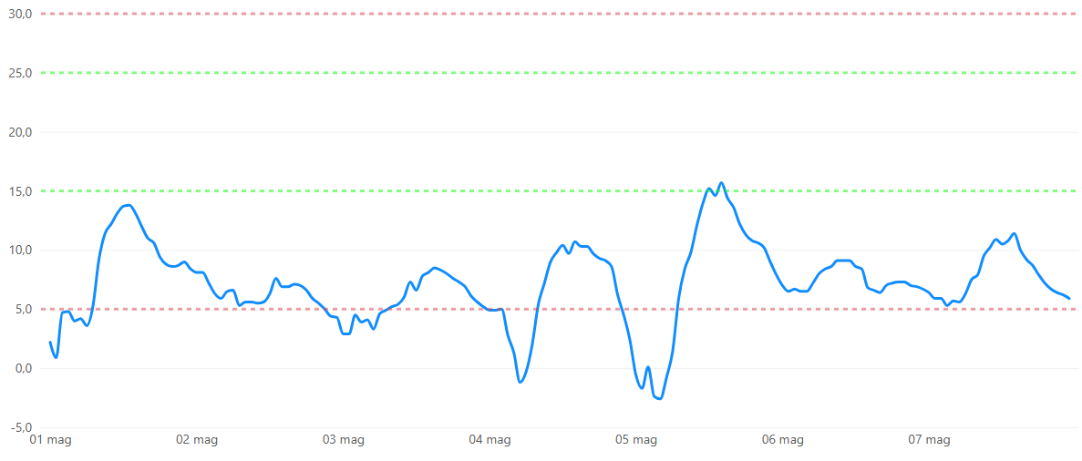
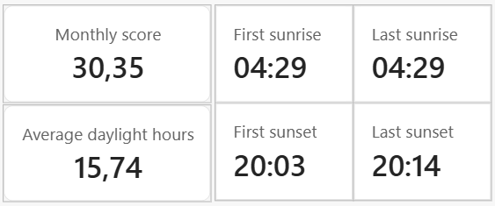
Example result: forecast and details
Historical season start and end vs forecast for 2026 (right)
Temperature hourly trend with acceptability and comfort limits, and details (below)

Slide 10
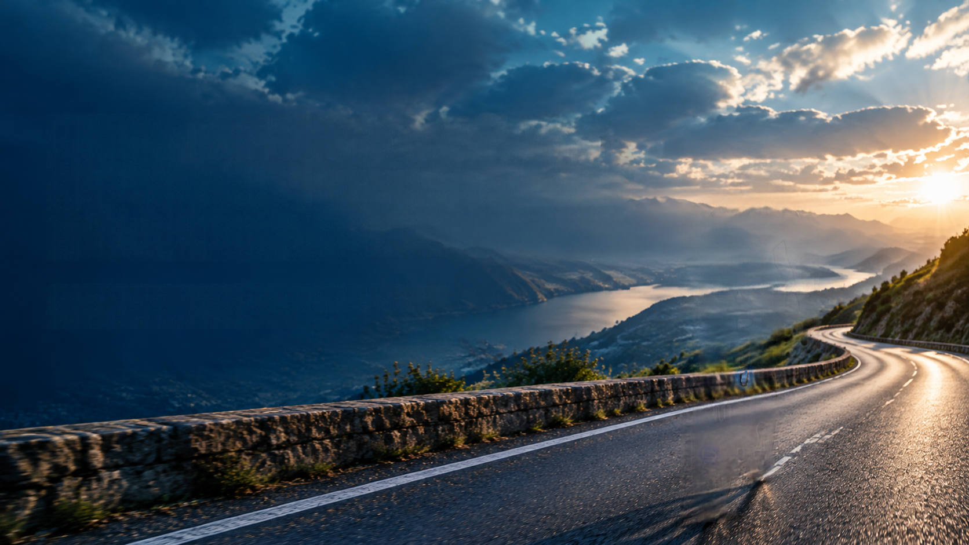
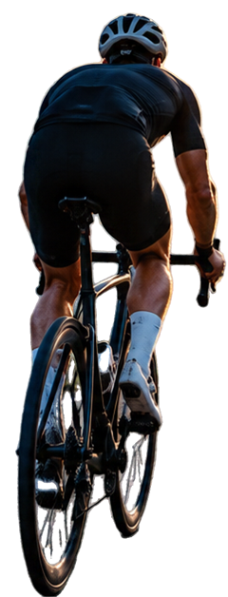
Data-driven
choices can make you discover the territory
Visit the province of Sondrio and its hidden gems

