Slide 1
HHE Data Science Laboratory · Politecnico di Milano
Marine Litter
Hazard Assessment
Sardinian Sea · ISPRA Monitoring Data 2018–2023 · MSFD Descriptor 10
ISPRA — Sistema Nazionale Protezione Ambiente · EU Marine Strategy Framework Directive
Notes:
Opening. This project builds a spatial hazard index for marine litter along the Sardinian coast using six years of ISPRA monitoring data (2018–2023). Eight data compartments were collected: beach litter, floating litter, microplastics, biological impact on sea turtles, sea currents and tourism pressure. The work aligns with MSFD Descriptor 10 (marine litter). Goal today: show how the data was integrated, what spatial patterns emerged, and how spatial statistics confirm them.

Slide 2
Research Question
How is marine-litter hazard distributed along the Sardinian coast, and what temporal and statistical patterns emerge from ISPRA monitoring data (2018–2023)?
WHY IT MATTERS
KNOWLEDGE GAP
OUR APPROACH
Mediterranean: 7% of global marine plastic, <1% of ocean surface
Sardinia: 1,849 km coastline · 13–16 M tourist-nights/year
Fragile habitats: Posidonia meadows, coralligenous reefs, Caretta caretta
No unified spatial hazard map for the Sardinian coast
ISPRA data collected but never integrated across compartments
No statistical test of spatial clustering at sub-regional scale
IPCC hazard framework at 12 km grid resolution
IDW interpolation + multi-compartment composite index
Moran's I · LISA · Getis-Ord GI* spatial statistics
Marine Litter Hazard Assessment · Sardinia · MSFD D10
01
Notes:
The research question is both spatial (where is hazard concentrated) and temporal (how does it change 2018–2023). Why it matters: the Mediterranean is a plastic hotspot and Sardinia combines a very long coastline with heavy seasonal tourism and sensitive habitats. The gap: ISPRA collects rich data but it had never been integrated across compartments or tested statistically at sub-regional scale. Our approach borrows the IPCC hazard framing, interpolates each compartment onto a common 12 km grid, builds a weighted composite, then validates the spatial pattern with Moran's I, LISA and Getis-Ord GI*.

Slide 3
01
SECTION 01
Data
sources · compartments · harmonisation
Notes:
Section 1 — Data. We cover where the data comes from, the eight compartments, and the harmonisation work needed because ISPRA file schemas drifted between 2018 and 2023.

Slide 4
8 DATA COMPARTMENTS
ISPRA MSFD Monitoring Data
01
Beach Litter
02
Floating Litter
03
Microplastics
Modulo 4
Modulo 2-bis
Modulo 2
6 sites · 36 surveys · items/100 m · EU JointList
21 stations · ship-based visual transect · material composition
336 trawl cells/yr (2018–22) · IDW concentration grid
04
Bio Impact
05
Sea Currents
06
Tourism
D10 strandings
CMEMS reanalysis
ISTAT
Entanglement + ingestion · Caretta caretta · CNR-IAS Oristano
Monthly u/v fields · transport driver · 72 records
Annual tourist-nights · anthropogenic pressure proxy
Marine Litter Hazard Assessment · Sardinia · MSFD D10
03
Notes:
Eight compartments, each tied to an ISPRA MSFD module or an open dataset. Beach litter (Modulo 4) is the backbone: items per 100 m transect at 6 sites. Floating litter (Modulo 2-bis) adds offshore signal from 21 stations. Microplastics come from Modulo 2 trawls. Biological impact uses turtle stranding records (entanglement + ingestion) from CNR-IAS Oristano. Sea currents (CMEMS reanalysis) and tourism (ISTAT) are the physical and anthropogenic drivers.

Slide 5
SCHEMA DRIFT 2018 → 2023
Data Harmonisation
Issue | Early format | Late format | Unified field
Survey ID | SampleID | CodiceCampionamento | → survey_id
Item count | NumeroItems | NumeroOggetti | → n_items
Transect length | Lunghezza | LunghezzaTransetto | → transect_m
Material names | Polimeri artificiali | Artificial polymer | → normalized EN
Coordinates | missing per row | station table | → filled per beach_id
▸ All beach files normalised to transect_m = 100 m (fixed MSFD protocol)
▸ Non-Sardinia records filtered by lat/lon bbox (38.5–41.6 N, 7.8–10.2 E) across all modules
raw XLSX → pandas normalize() → unified CSV → dashboard_data.json
Marine Litter Hazard Assessment · Sardinia · MSFD D10
04
Notes:
The biggest practical hurdle was schema drift: column names changed across years and material names switched between Italian and English. A pandas normalize() step maps every variant to a single unified field. We also fixed the protocol denominator (all transects to 100 m) and filtered out non-Sardinia records by bounding box. End product is one tidy dashboard_data.json that every downstream analysis reads.

Slide 6
02
SECTION 02
Exploratory Analysis
beach · floating · micro · bio · pressures
Notes:
Section 2 — Exploratory analysis. Compartment by compartment: beach litter trends and composition, floating litter, microplastics, biological impact, and the anthropogenic pressure / COVID natural experiment.

Slide 7
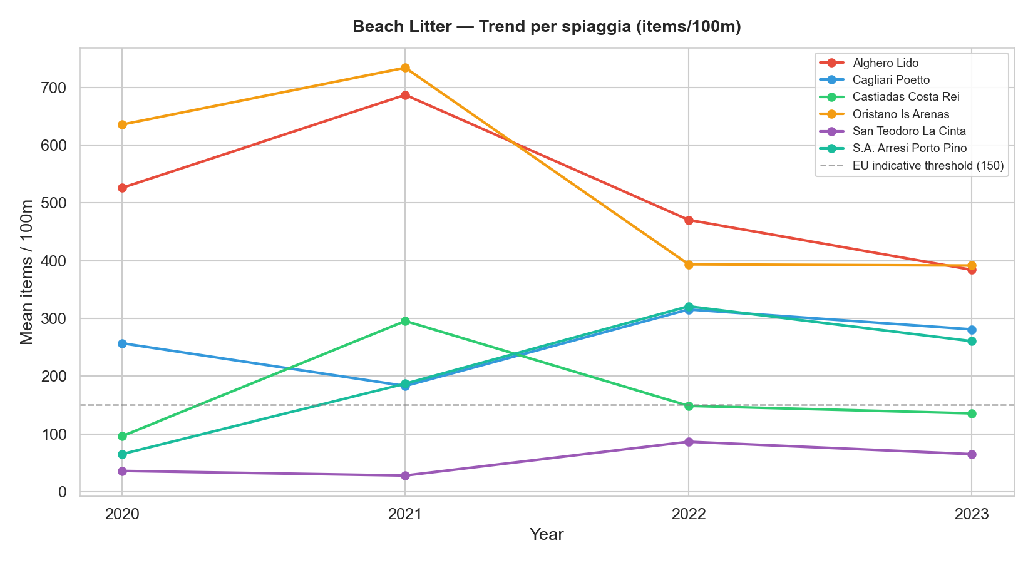
2018–2023
Beach Litter — Trend per Station
Key Findings
Oristano Is Arenas: highest density (avg 1,255 items/100 m)
Alghero Lido: second (avg 734)
San Teodoro La Cinta: lowest (avg 85)
EU indicative threshold: 150 items/100 m
West coast consistently > east coast
Strong inter-annual variability — survey timing & storms
Marine Litter Hazard Assessment · Sardinia · MSFD D10
06
Notes:
Beach litter per station over time. The west-coast sites Oristano Is Arenas and Alghero Lido dominate, both far above the EU indicative threshold of 150 items/100 m. East-coast San Teodoro is the cleanest. The west-vs-east gradient is the single most persistent pattern in the whole project and reappears later in the spatial statistics.

Slide 8
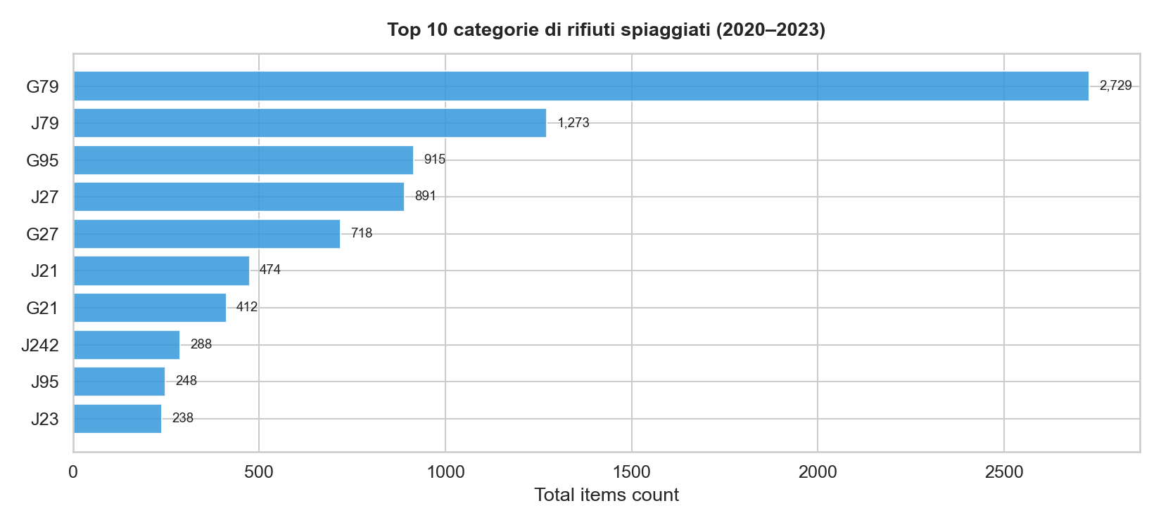
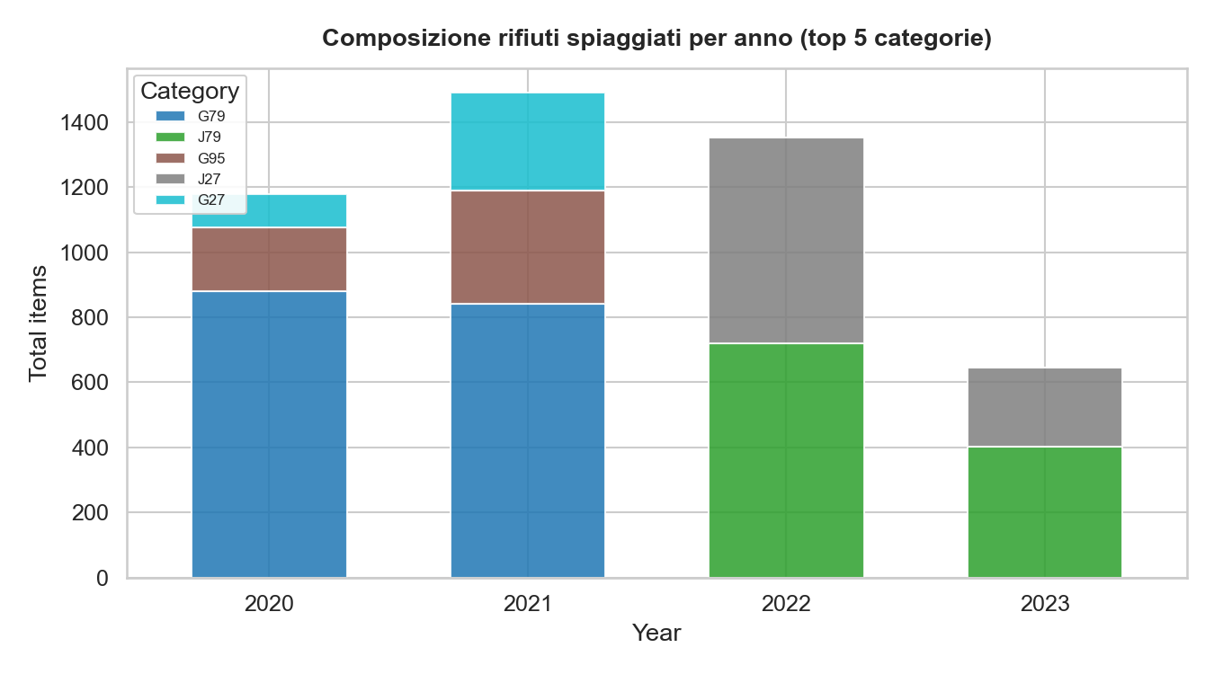
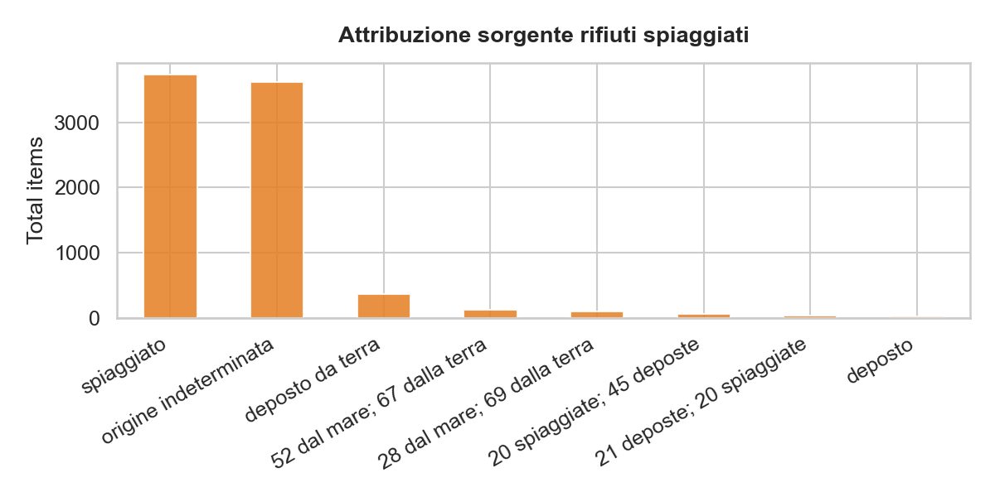
CATEGORY + SECTOR ATTRIBUTION
Beach Litter — Composition & Source
Single-use plastics & fishing-related items dominate; shoreline/recreational sources lead the attribution split.
Marine Litter Hazard Assessment · Sardinia · MSFD D10
07
Notes:
Composition: the top categories are dominated by plastic fragments and single-use / fishing-related items, coded with the EU JointList scheme (G79, J79, etc.). The source-attribution chart assigns items to likely origin — shoreline and recreational activities lead, with a sizeable indeterminate share that is typical for beached litter.

Slide 9
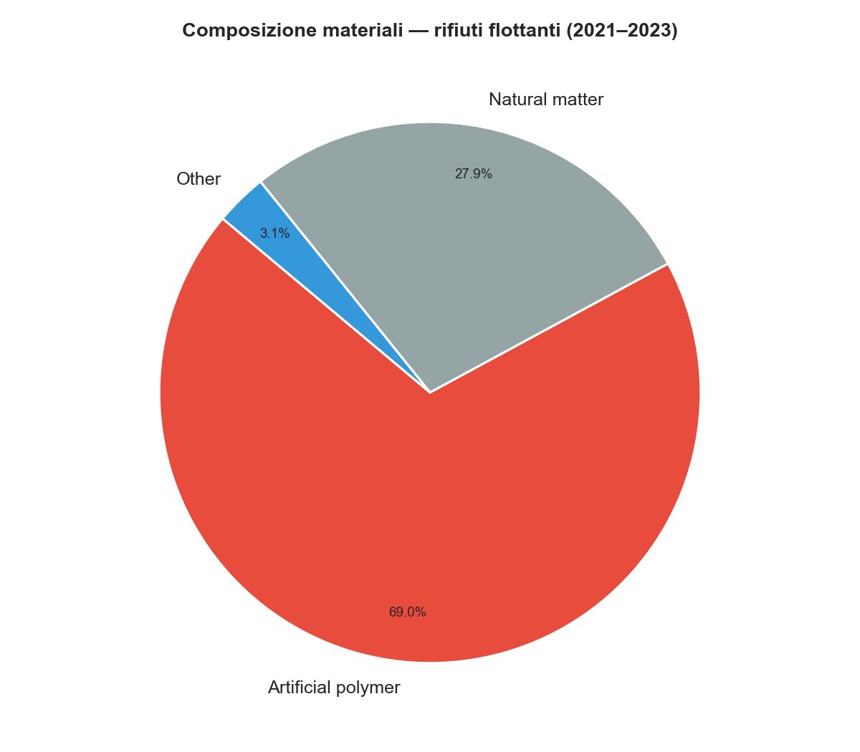
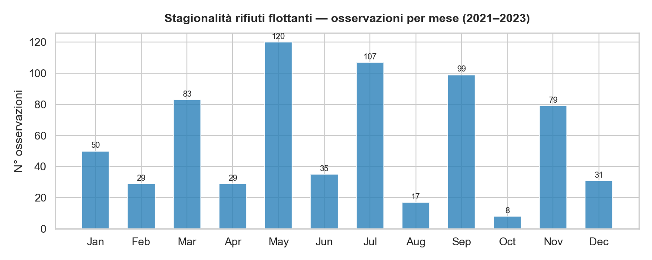
Floating Litter — Material & Seasonality
70% of floating litter is artificial polymer (2021–2023)
Observations stay elevated from late spring through autumn, driven by seasonal wind & current transport. Beach litter is even more plastic-dominated — 84% artificial polymer in 2023.
Marine Litter Hazard Assessment · Sardinia · MSFD D10
08
Notes:
Floating litter from the offshore visual transects. About 70% is artificial polymer (plastic). The monthly observation curve stays high from late spring through autumn, with peaks consistent with wind- and current-driven transport rather than purely local input. Beach litter is even more plastic-dominated — 84% artificial polymer in 2023.

Slide 10
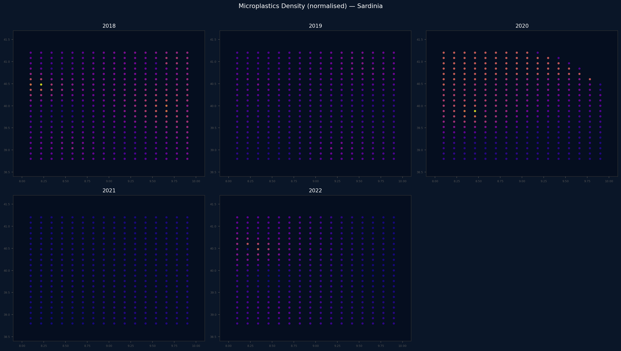
MODULO 2 · 2018–2022
Microplastics — IDW Concentration Grid
Modulo 2 trawl samples interpolated to 336 cells/year
IDW on regular 0.12° grid, coastal-masked
Higher concentrations off west & south coasts
Coverage 2018–2022 (2023 not yet released)
Marine Litter Hazard Assessment · Sardinia · MSFD D10
09
Notes:
Microplastics from Modulo 2 trawl sampling, interpolated with IDW onto the same 0.12-degree grid and masked to coastal waters. Concentrations are higher off the west and south coasts. Coverage runs 2018–2022; the 2023 module was not yet released. This layer is kept as a standalone toggle rather than in the composite because sampling density is uneven.

Slide 11
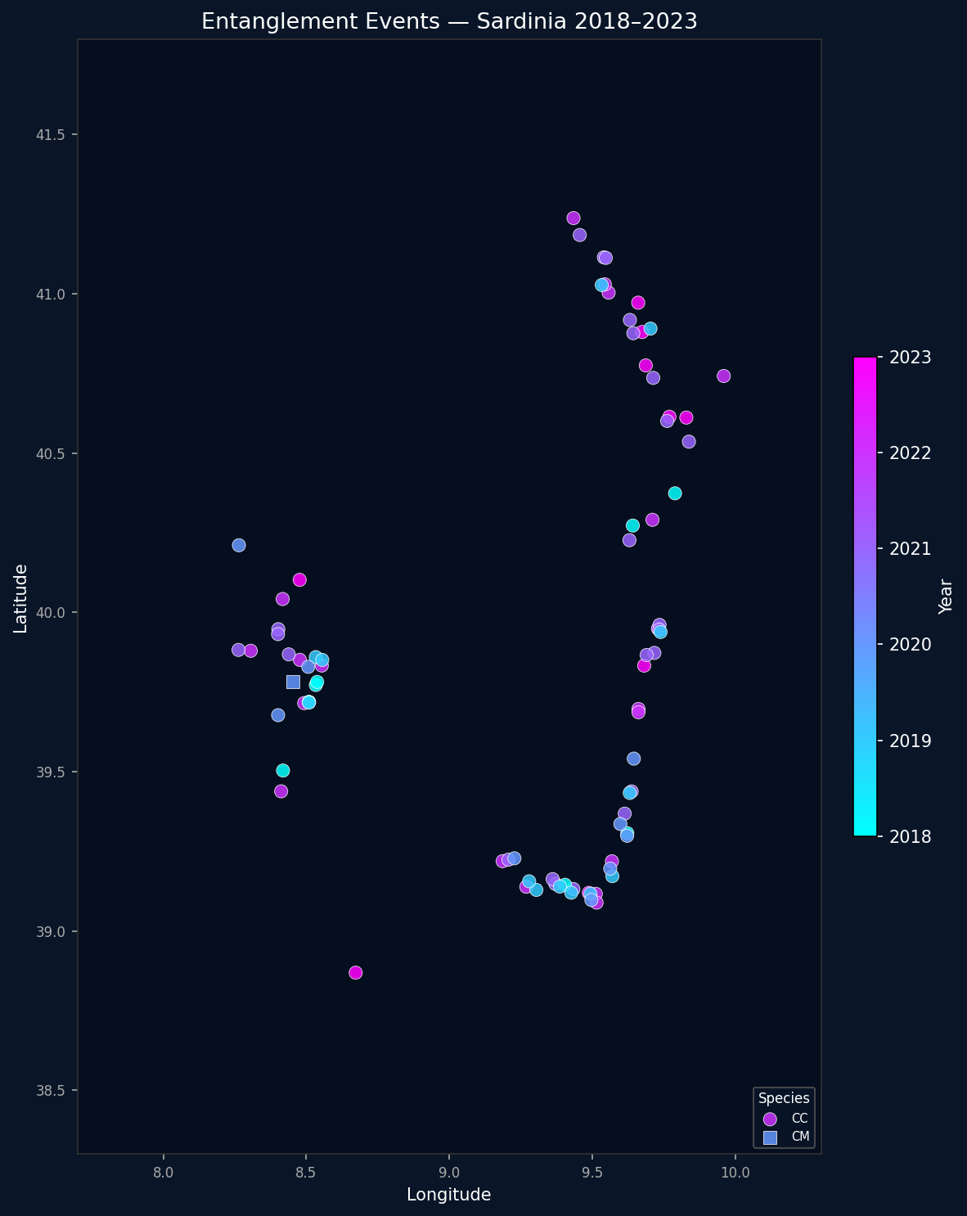
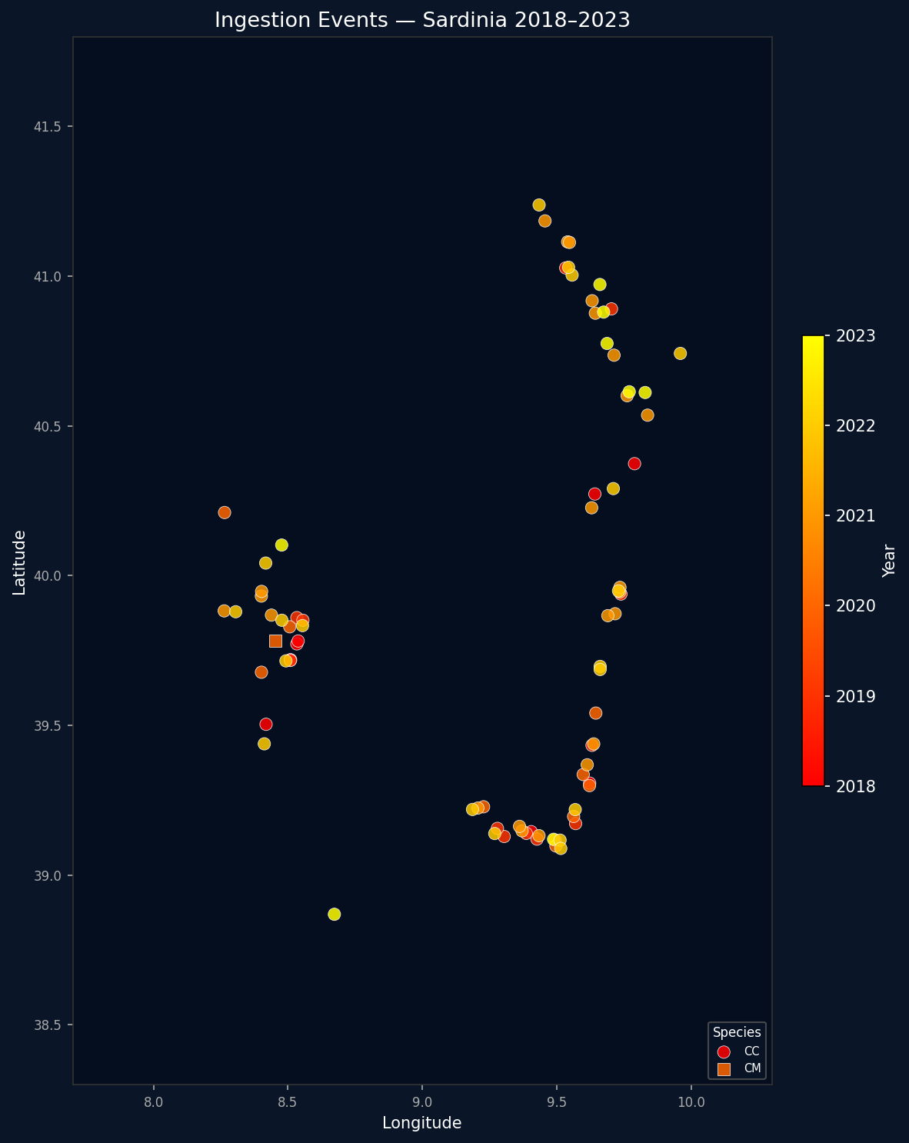
ENTANGLEMENT + INGESTION · CARETTA CARETTA
Biological Impact — Sea Turtles
Bio Score = (ENT + ING) / N_max
Combines entanglement and plastic-ingestion events on stranded loggerhead turtles (~99% Caretta caretta), normalised across years.
Peak 2021
2021: 46 combined events → score 1.00 (peak)
2022: 38 events → 0.72
2018 & 2023: lowest impact (≤18 events)
Ingestion dominated by sheet plastic (SHE) & fragments (FRA)
Marine Litter Hazard Assessment · Sardinia · MSFD D10
10
Notes:
Biological impact translates litter into harm to wildlife. We combine entanglement and ingestion events on stranded loggerhead turtles into a normalised Bio Score. The signal peaks sharply in 2021 (46 combined events, score 1.0) and stays high in 2022, then drops in 2023. Ingestion is dominated by sheet plastic and fragments. This compartment carries 20% of the composite weight.

Slide 12
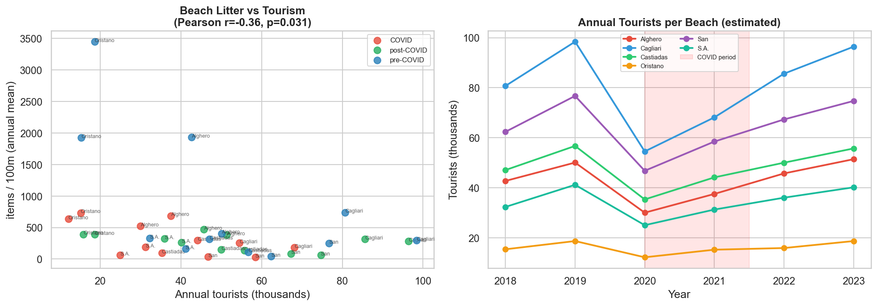
PRESSURE VS. LITTER SIGNAL
Anthropogenic Pressure — Tourism
Tourism is a pressure proxy, not a clean predictor. Annual tourist-nights and beach litter are weakly / negatively correlated (Spearman r ≈ −0.44) — high-litter west-coast sites are not the busiest tourist beaches. This points to transport and legacy litter, not just local input.
Marine Litter Hazard Assessment · Sardinia · MSFD D10
11
Notes:
Tourism is the main anthropogenic pressure, proxied by annual tourist-nights. Intuitively more tourists should mean more litter, but the data shows a weak, even negative correlation (Spearman about −0.44): the dirtiest west-coast beaches are not the busiest tourist destinations. That mismatch tells us beach litter on this coast is driven substantially by currents and accumulated legacy litter, not only by on-site visitor input.

Slide 13
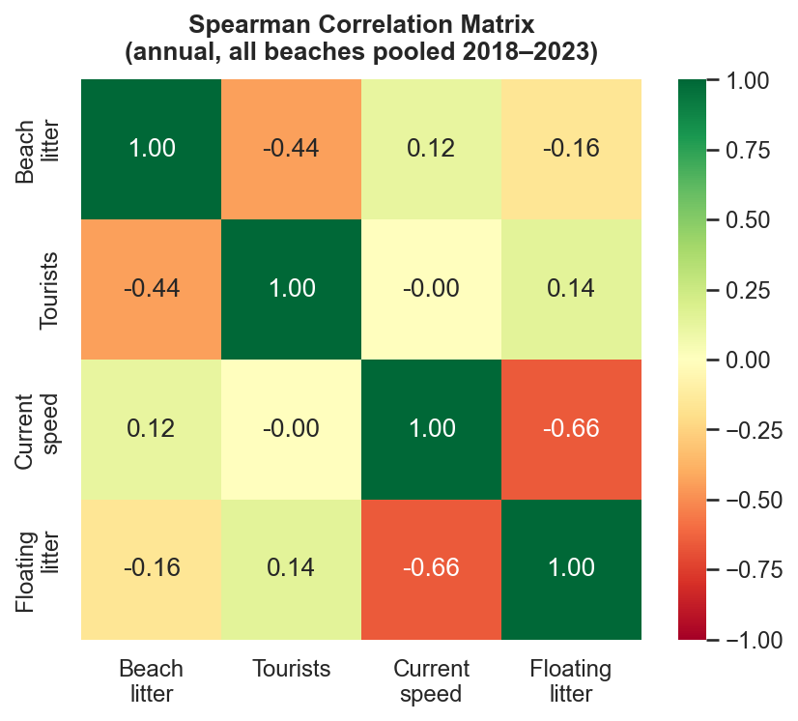
Cross-Compartment Correlations
Reading the matrix
Spearman rank correlation across hazard components (annual, pooled)
Beach litter ↔ tourists: moderate negative (−0.44)
Current speed ↔ floating litter: strong negative (−0.66)
Tourism not a dominant positive driver — supports transport hypothesis
Justifies a weighted composite rather than a single proxy
Marine Litter Hazard Assessment · Sardinia · MSFD D10
12
Notes:
The Spearman correlation matrix. Two relationships stand out: beach litter is moderately negatively correlated with tourists (−0.44) and current speed is strongly negatively correlated with floating litter (−0.66) — faster currents disperse floating material away from the transects. No single variable dominates positively, which is exactly why we use a weighted composite.

Slide 14
Special Focus
COVID-19
A Natural Experiment
pre · during · post — isolating human vs. natural drivers (2018–2023)
Notes:
Special focus. The 2020 lockdown created an unplanned natural experiment: tourism collapsed for one season while the physical ocean kept running. By splitting the timeline into pre-COVID (2018–19), COVID (2020) and post-COVID (2021–23) we can separate the human-driven part of the litter signal from the current-driven part.

Slide 15
DEFINITION & EXPOSURE
Three Periods — The Tourism Shock
PRE-COVID
COVID
POST-COVID
2018–2019
2020
2021–2023
14.3M
8.7M
13.4M
tourist-nights / yr (baseline)
−39% vs. baseline (lockdown)
recovery to ~94% of baseline
The design. Tourism (the main human pressure) dropped sharply in 2020 while sea currents — the natural transport driver — stayed almost constant (13.2 → 12.4 → 11.8 cm/s). Any litter change that tracks tourism is human-driven; anything that persists is transport / legacy.
Marine Litter Hazard Assessment · Sardinia · MSFD D10
14
Notes:
The setup. Tourist-nights fell from a ~14.3 million baseline to 8.7 million in 2020 — a 39% drop — then recovered to 13.4 million by 2021–23. Crucially, mean current speed barely moved across the three periods (13.2, 12.4, 11.8 cm/s), so the natural transport engine was effectively held constant. That is what makes 2020 a clean lever.

Slide 16
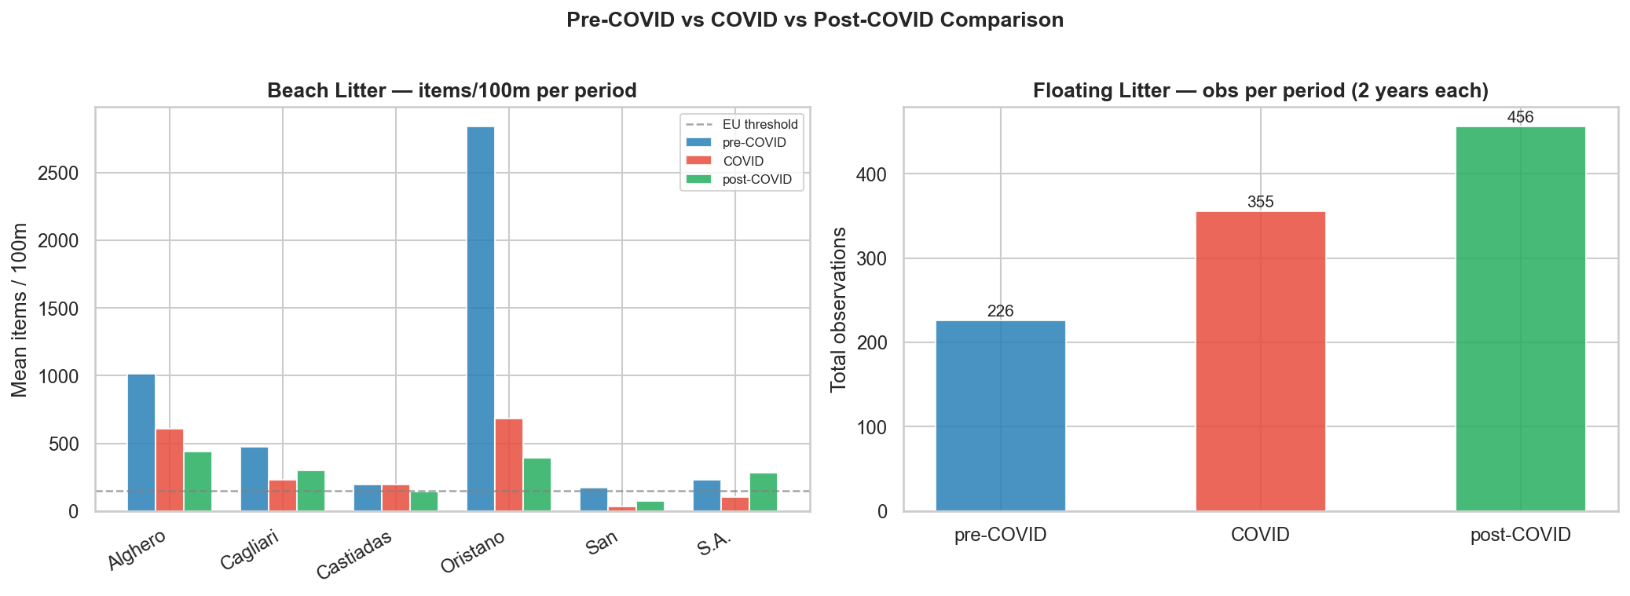
PRE · DURING · POST BY COMPARTMENT
COVID Response — What Changed
Metric | Pre | COVID | Post
Beach litter (mean items/100 m) | 830 | 269 | 298
Beach litter (median) | 324 | 176 | 288
Floating obs (count) | 226 | 124 | 687
Bio events (ENT+ING) | 44 | 20 | 101
Current speed (cm/s) | 13.2 | 12.4 | 11.8
Signal
Beach litter fell −68% with tourism collapse
Currents ~unchanged — natural driver held constant
Floating rise post-COVID = mostly sampling effort
Marine Litter Hazard Assessment · Sardinia · MSFD D10
15
Notes:
The measured response. Beach litter dropped hard during 2020 — mean from 830 to 269 items/100 m, a 68% fall — closely tracking the tourism collapse. Currents were essentially flat, our held-constant control. Floating observations and bio events look higher post-COVID, but a large part of the floating jump reflects increased sampling effort in later years.

Slide 17
HUMAN VS. NATURAL DRIVERS
COVID — Interpretation
What it confirms
Caveats
Beach litter has a real local-human component — it fell ~68% when tourism collapsed
Currents (natural driver) stayed constant → good experimental control
Litter did NOT return to pre-COVID mean → legacy litter & transport persist
Pre-COVID mean inflated by a few extreme surveys (median drop smaller: 324 → 176)
Floating & bio rises post-2020 partly reflect more sampling, not more litter
Single lockdown year → low statistical power, treat as indicative
Take-away: beach litter is partly human-driven and partly transported — which is exactly why a multi-compartment, current-aware hazard index is needed.
Marine Litter Hazard Assessment · Sardinia · MSFD D10
16
Notes:
Interpretation. The experiment confirms beach litter has a genuine local-human component: it dropped about 68% when tourism collapsed, against a constant-current control. But it did not fall to zero and did not rebound to the pre-COVID mean, so legacy litter and current transport clearly persist. Bottom line — both human and natural drivers operate, which justifies the multi-compartment, current-aware index.

Slide 18
03
SECTION 03
Composite Hazard Index
methodology · maps · coastal segments
Notes:
Section 3 — the composite hazard index itself: how it is built, what the maps show, and how we refine it from grid cells to coastal municipalities.

Slide 19
Composite Hazard — Methodology
1
NORMALISE
Min-max each compartment → 0–1 per station. Global normalisation across all years for temporal comparability.
2
INTERPOLATE
IDW on regular 0.12° (~12 km) grid over Sardinia + buffer. 289 cells, coastal-masked.
3
COMPOSITE
Weighted mean: Beach+Float 35% · Plastic 25% · Currents 20% · Bio 20%.
4
CLASSIFY
5 classes: Very Low <0.2 · Low · Medium · High · Very High >0.8.
Very Low
Low
Medium
High
Very High
Marine Litter Hazard Assessment · Sardinia · MSFD D10
18
Notes:
Four steps. One: normalise every compartment to 0–1 with global min-max, so colours are comparable across years. Two: interpolate each station network onto a common 0.12-degree (~12 km) grid with IDW, 289 cells, masked to the coast. Three: combine with fixed weights — beach+floating 35%, plastic 25%, currents 20%, bio 20%. Four: classify into five hazard bands. The weights are a defensible default, not a fitted model — easy to adjust in the dashboard.

Slide 20
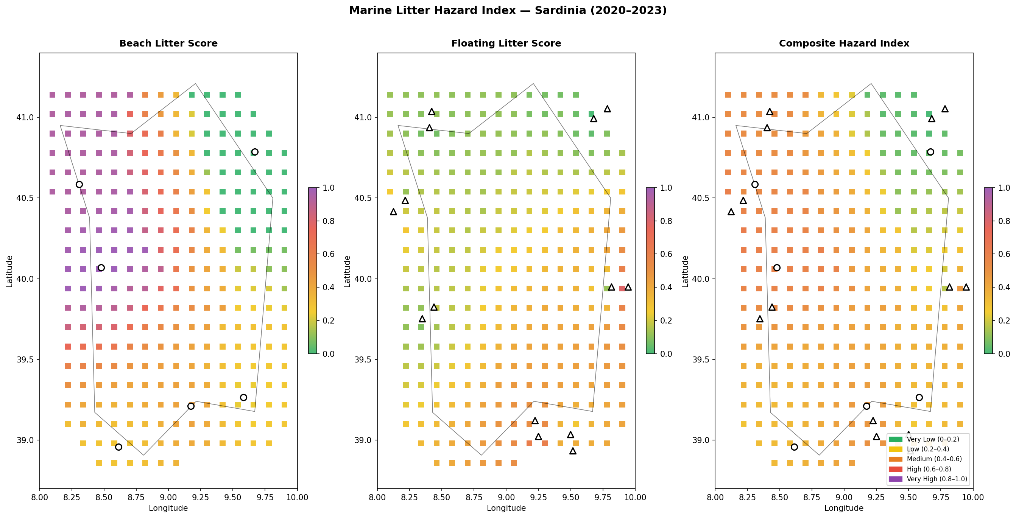
BEACH · FLOATING · COMPOSITE
Composite Hazard Index — Map
Beach score · Floating score · Composite hazard. ● beach stations ▲ offshore stations
Marine Litter Hazard Assessment · Sardinia · MSFD D10
19
Notes:
The composite map, shown as three panels: beach score, floating score, and the combined hazard index. The beach panel drives the strong west-coast signal; floating is more diffuse. In the composite (right), the high-hazard zone sits clearly along the west coast around Alghero and Oristano, with the east coast much lower.

Slide 21
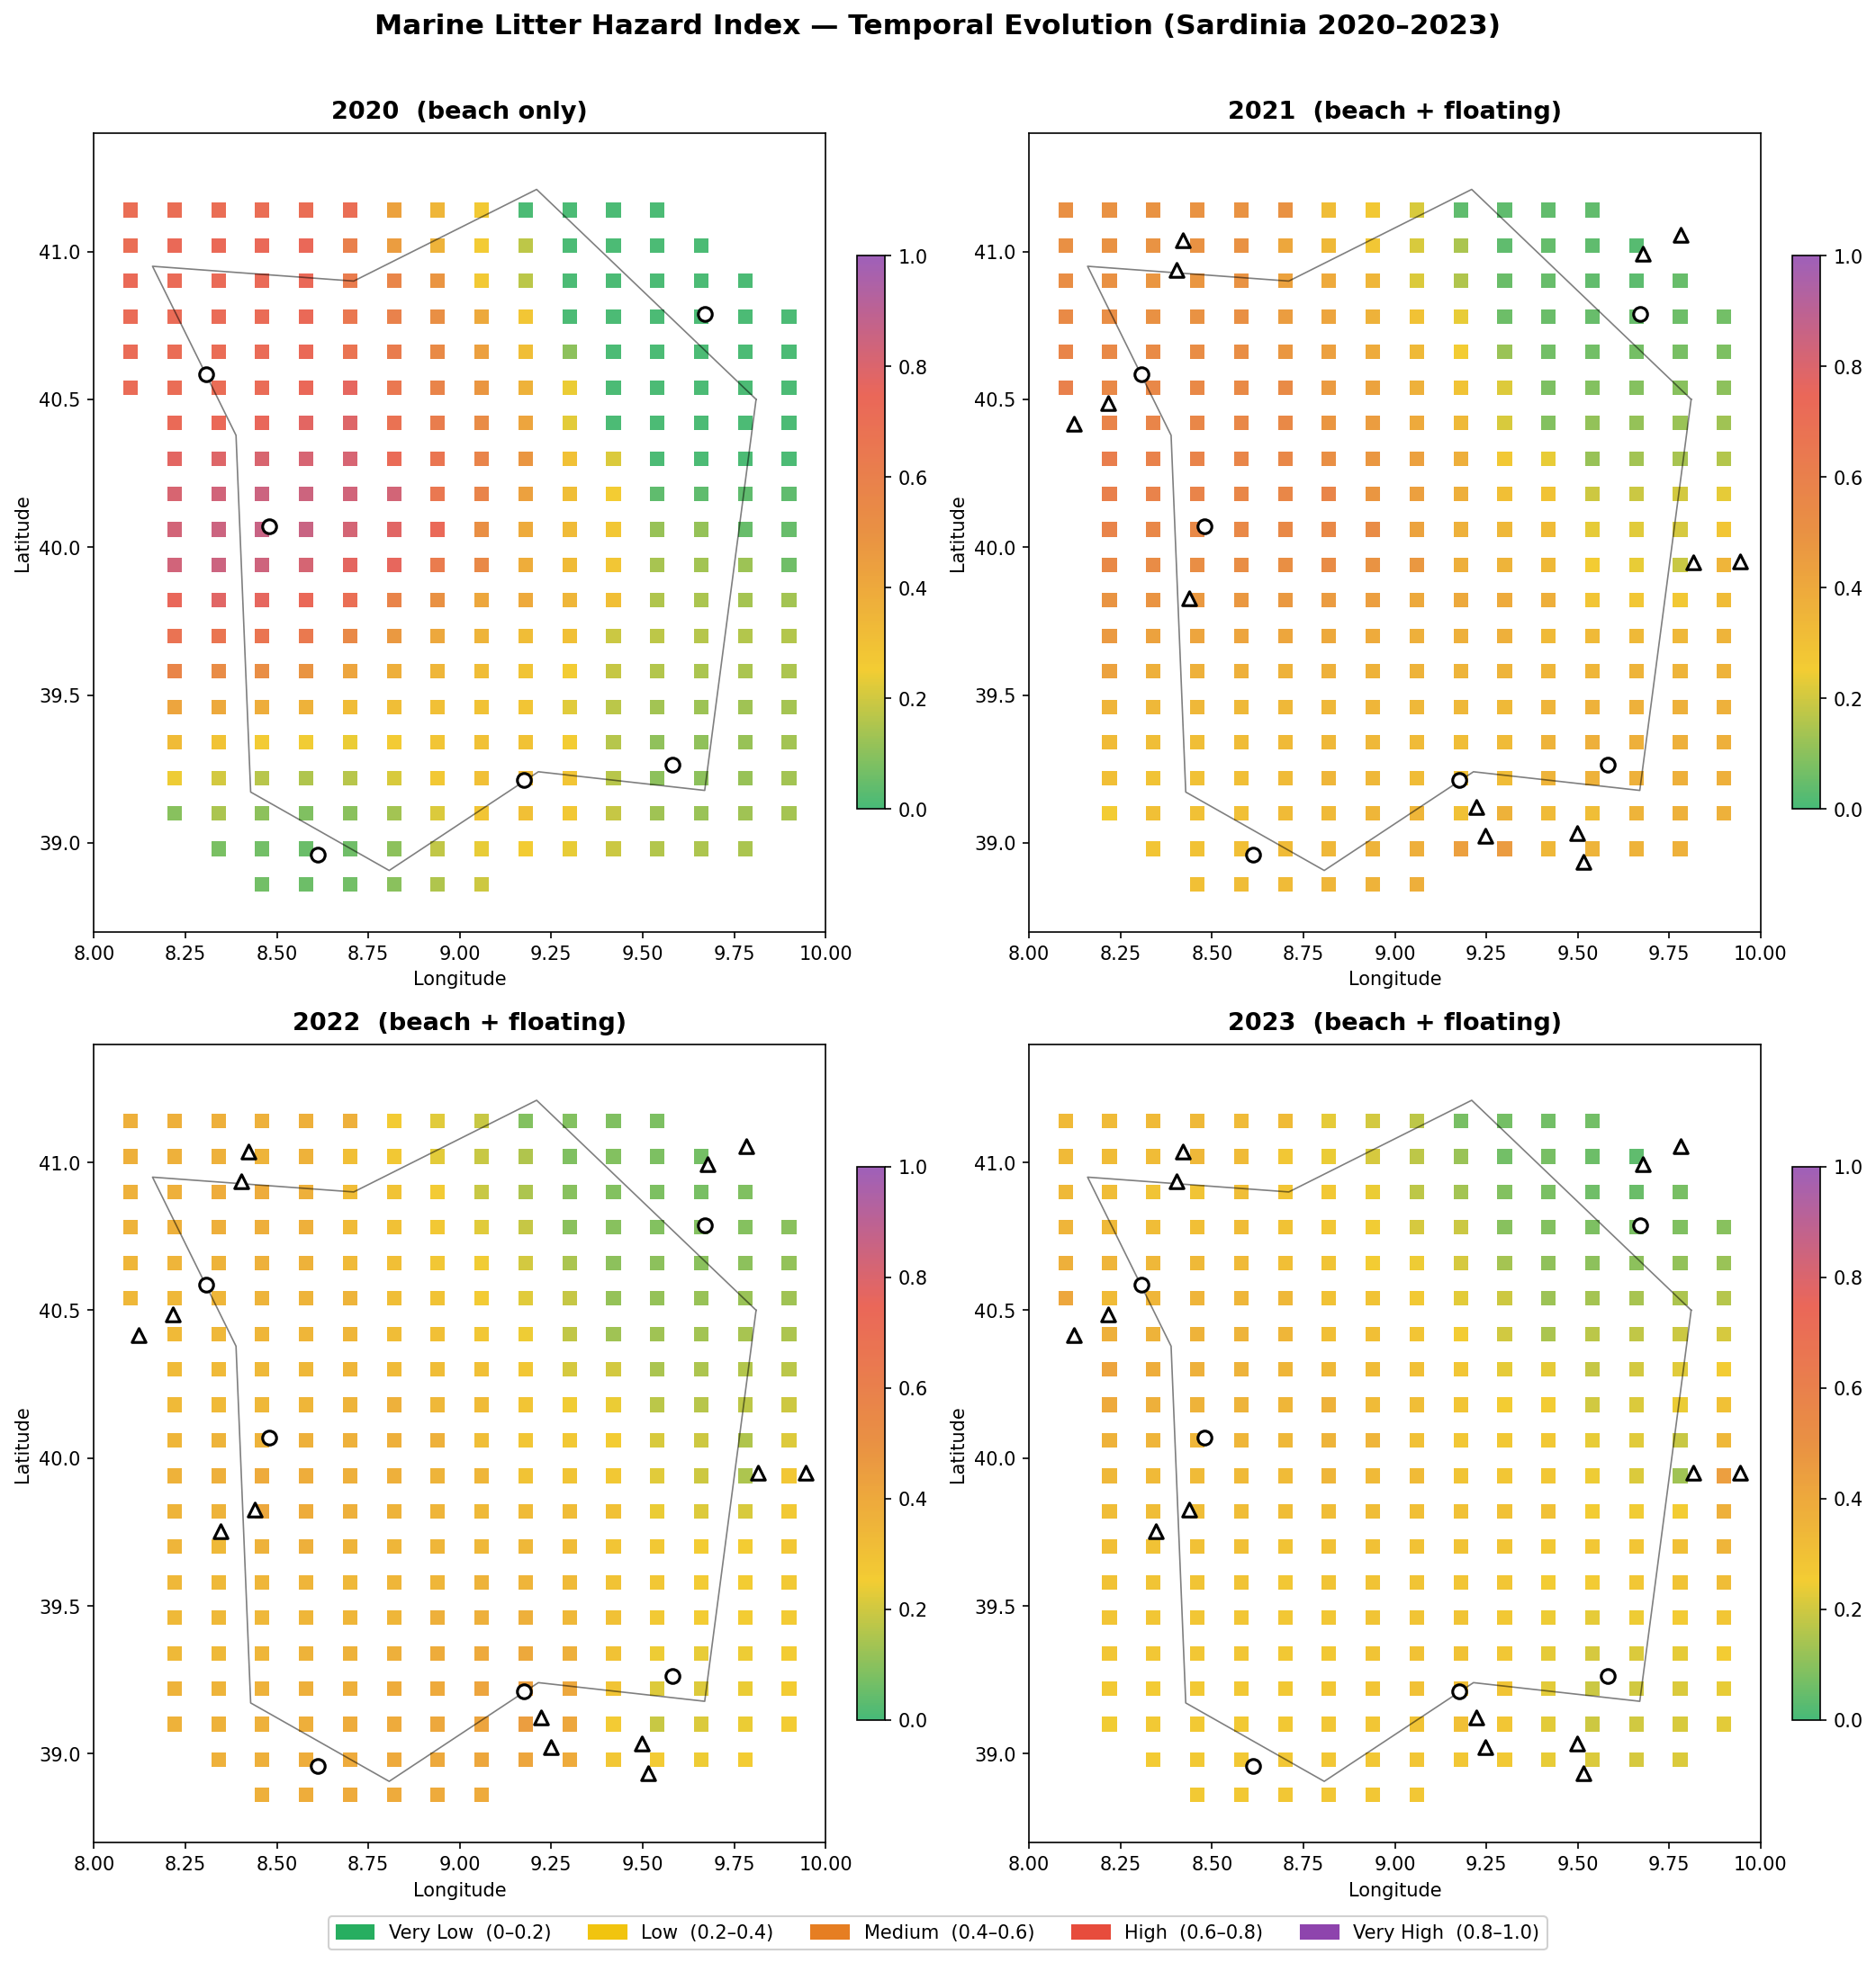
Temporal Evolution — Hazard 2018–2023
Patterns over time
Globally-normalised → colours comparable across years
West-coast corridor persists every year
Bio compartment lifts 2021–2022 hazard
No clear monotonic trend — inter-annual variability dominates
Marine Litter Hazard Assessment · Sardinia · MSFD D10
20
Notes:
Year-by-year hazard maps, globally normalised so colours mean the same thing every year. The headline is stability: the west-coast corridor lights up in every single year. The 2021–2022 maps run a little hotter, lifted by the biological-impact peak. There is no clean upward or downward trend — inter-annual variability dominates over any six-year signal.

Slide 22
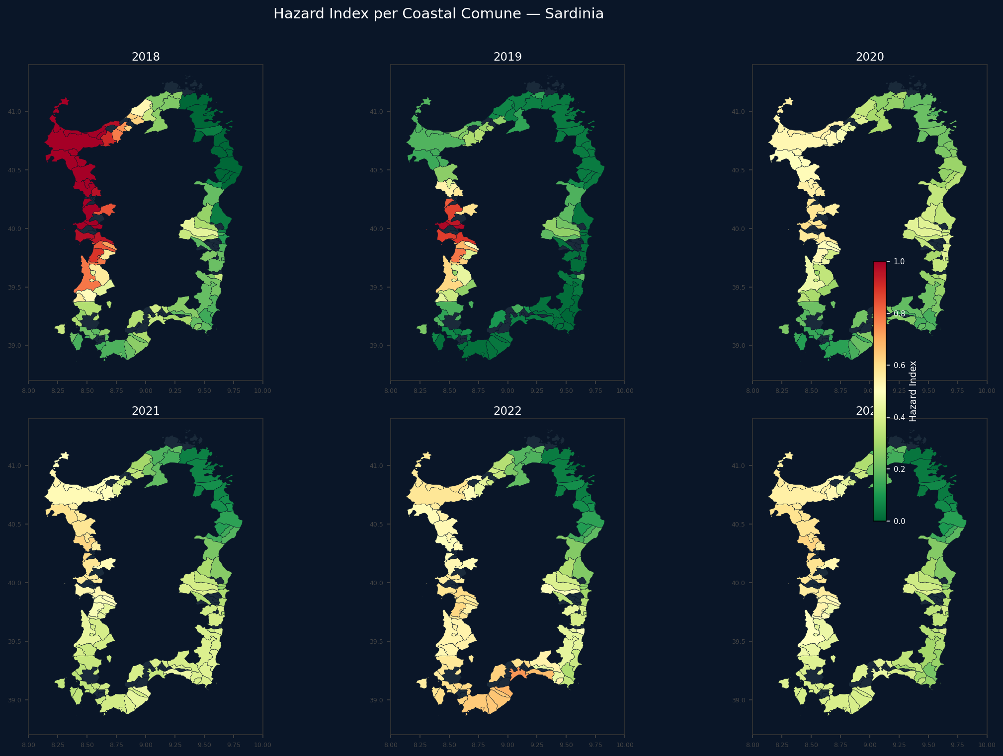
126 COASTAL COMUNI
Coastal Segment Refinement
From grid to admin units
Grid cells aggregated into 126 coastal municipalities
Shapely point-in-polygon + nearest-centroid fallback
Translates hazard into actionable management units
Supports local policy & clean-up prioritisation
Marine Litter Hazard Assessment · Sardinia · MSFD D10
21
Notes:
A grid is good for analysis but not for management. Here we aggregate the grid hazard into 126 coastal municipalities using Shapely point-in-polygon assignment, with a nearest-centroid fallback for cells just offshore. The result speaks the language of decision-makers: each comune gets a hazard value per year, so clean-up resources and policy can be prioritised by administrative unit rather than abstract cells.

Slide 23
04
SECTION 04
Spatial Autocorrelation
moran's I · LISA · getis-ord GI*
Notes:
Section 4 — the statistical core. So far the west-coast pattern is visual. Now we test it: is the clustering real or could it arise by chance? Global Moran's I, LISA, and Getis-Ord GI* answer where and how strongly.

Slide 24
LEC12 GEOSPATIAL MODELS
Spatial Statistics — Why & How
Global Moran's I
Local Moran's I (LISA)
Getis-Ord GI*
One scalar per year. Tests whether high-hazard cells cluster in space vs. random. Queen contiguity, row-standardised W, 999-permutation p-value.
Per-cell statistic → HH / LL / HL / LH. Locates exactly where clustering occurs and flags spatial outliers.
Per-cell z-score of local concentration. Grades hotspot / coldspot intensity in standard-deviation units.
Built from scratch in NumPy (no PySAL dependency) — scripts/analysis_10_spatial_models.py
Marine Litter Hazard Assessment · Sardinia · MSFD D10
23
Notes:
Three complementary tools, all from the LEC12 geospatial lecture. Global Moran's I gives one number per year: is hazard clustered or random? LISA breaks that down per cell into High-High, Low-Low and the two outlier types, so we see exactly where clustering happens. Getis-Ord GI* grades hotspot intensity as a z-score. All implemented from scratch in NumPy in analysis_10_spatial_models.py.

Slide 25
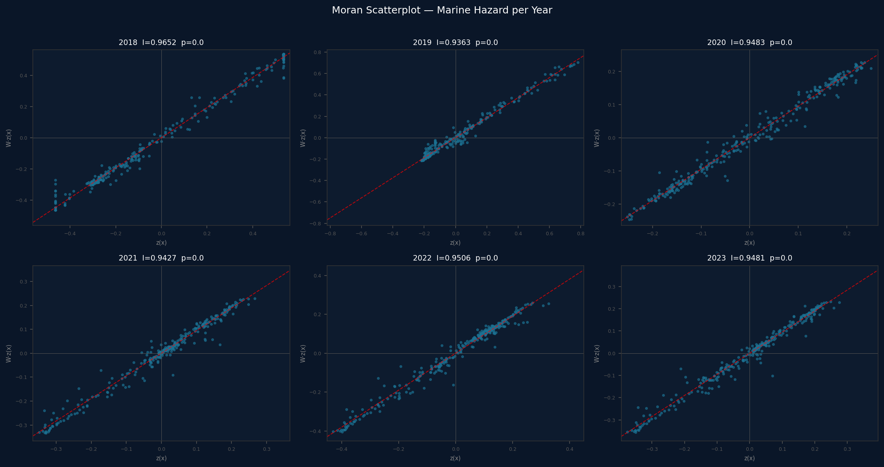
Global Moran's I — Significant Clustering
Year | Moran's I | z | p
2018 | 0.965 | 31.4 | 0.000
2019 | 0.936 | 31.1 | 0.000
2020 | 0.948 | 32.0 | 0.000
2021 | 0.943 | 30.0 | 0.000
2022 | 0.951 | 30.4 | 0.000
2023 | 0.948 | 30.4 | 0.000
I ≈ 0.95 every year, p = 0.000. Hazard is strongly and significantly clustered in space — not random noise. The pattern is stable across all six years.
Marine Litter Hazard Assessment · Sardinia · MSFD D10
24
Notes:
Global Moran's I is essentially 0.95 every year with p = 0.000 from the permutation test — about 30 standard deviations above the random expectation. The chance that this west-coast clustering is a fluke is effectively zero. One caveat: IDW interpolation itself smooths neighbouring cells, so part of this very high autocorrelation is inherited from the interpolation — the direction and significance are robust, the exact magnitude less so.

Slide 26
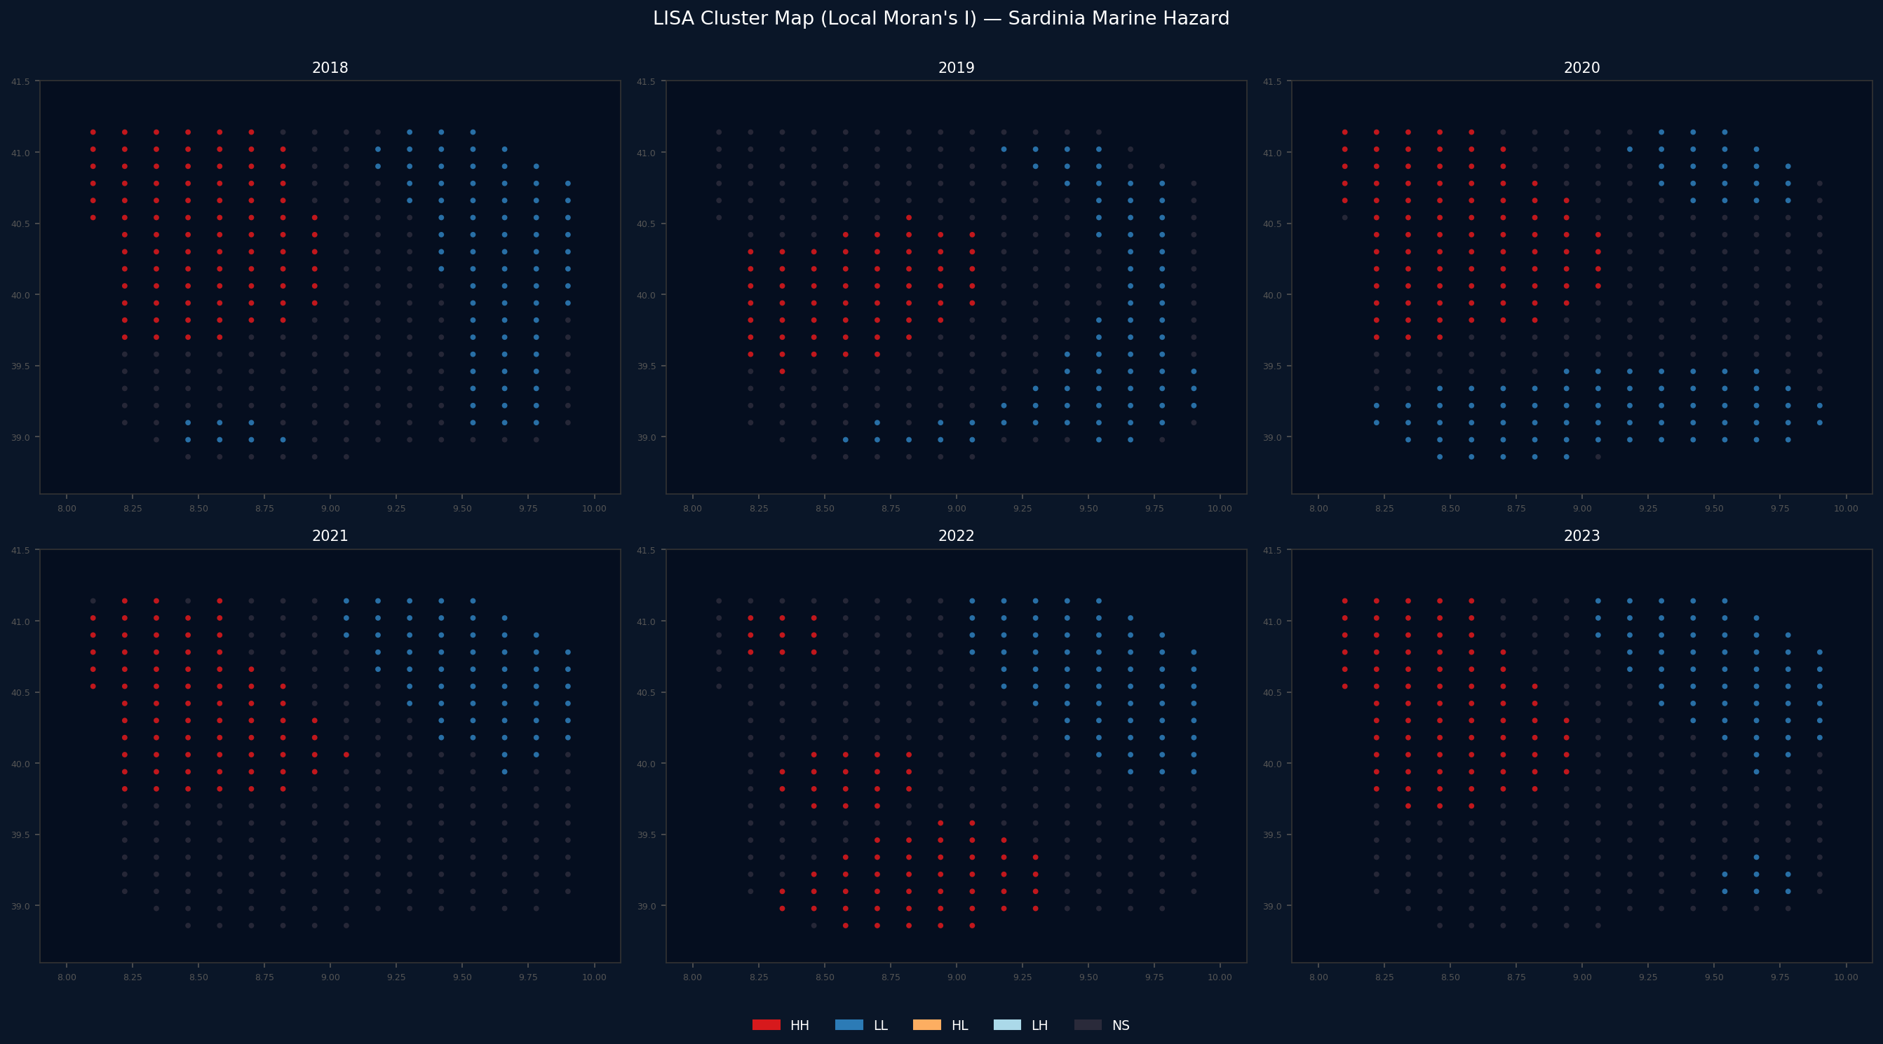
LISA Cluster Map — Local Moran's I
HH Hotspot
LL Coldspot
HL Outlier
LH Outlier
West coast = HH hotspot (Alghero–Oristano corridor)
East coast = LL coldspot
Zero HL/LH outliers → coherent spatial pattern
~77 HH + ~63 LL significant cells (2023)
Marine Litter Hazard Assessment · Sardinia · MSFD D10
25
Notes:
LISA localises the clustering. Red cells are High-High hotspots — high hazard surrounded by high hazard — and they form a continuous corridor down the west coast from Alghero to Oristano. Blue Low-Low coldspots cover the east coast. The striking result is zero HL or LH outliers: there are no isolated anomalies, the pattern is spatially coherent.

Slide 27
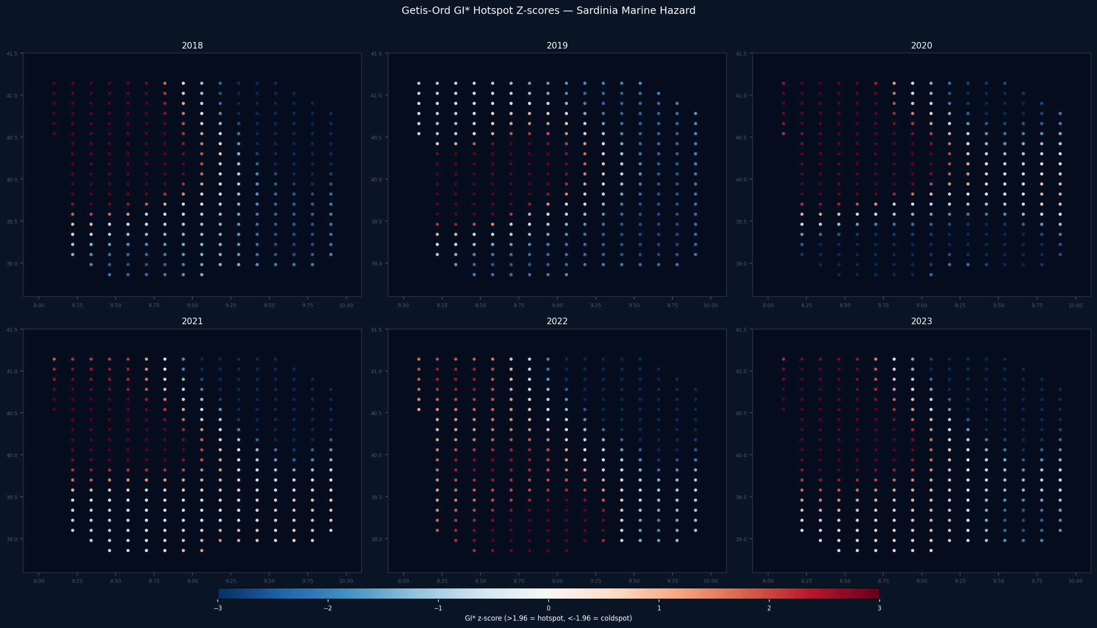
Getis-Ord GI* — Hotspot Intensity
Per-cell z-score of local concentration
z > 1.96 → significant hotspot (red)
z < −1.96 → significant coldspot (blue)
~80 hotspot / ~65 coldspot cells per year
Confirms & grades the LISA HH corridor
Marine Litter Hazard Assessment · Sardinia · MSFD D10
26
Notes:
Getis-Ord GI* adds intensity. Where LISA classifies cells into types, GI* gives each cell a continuous z-score: above +1.96 is a significant hotspot (red), below −1.96 a significant coldspot (blue). Around 80 hotspot and 65 coldspot cells per year. It lets you rank severity — a hotspot at z = 4 is more intense than one at z = 2 — useful for prioritising the worst cells within the corridor.

Slide 28
Key Findings
Hotspots
Patterns
West-coast corridor (Alghero–Oristano) = highest hazard
Oristano Is Arenas: max beach litter (1,255 items/100 m)
East coast (San Teodoro) = statistically-confirmed coldspot
Clustering significant every year (Moran I ≈ 0.95, p < 0.001)
84% of beach litter is artificial polymer
Floating litter elevated late spring–autumn — current-driven
Bio impact peaks 2021 (turtle strandings)
COVID: beach litter −68% with tourism → human + transport drivers
Marine Litter Hazard Assessment · Sardinia · MSFD D10
27
Notes:
Pulling it together. Hotspots: a clear west-coast corridor from Alghero to Oristano, with Oristano Is Arenas the single worst beach, and a statistically-confirmed east-coast coldspot; the clustering is significant every year. Patterns: plastics dominate every compartment, floating litter is seasonal and current-driven, biological impact peaked in 2021, and the COVID experiment showed beach litter is both human- and transport-driven.

Slide 29
Limitations & Next Steps
Limitations
Next Steps
6 beach stations → sparse coverage, IDW smooths heavily
Seafloor compartment synthetic (no ISPRA Sardinia module)
Scores relative (min–max), not absolute concentrations
Autocorrelation partly inherited from IDW smoothing
Expert-set weights, not learned from data
Promote microplastics into the index once 2023 released
Replace synthetic seafloor with real MEDITS trawl data
Bi-variate Moran (beach vs. floating) coupling
Spatial regression: SAR / SEM / GWR for drivers
Validate vs. citizen-science clean-ups · per-comune brief
Marine Litter Hazard Assessment · Sardinia · MSFD D10
28
Notes:
Honest limitations. Only six beach stations means IDW smooths aggressively and the autocorrelation is partly an artefact of that smoothing. The seafloor compartment is currently synthetic. Scores are relative, not absolute concentrations. Next steps: promote microplastics into the index once 2023 is released, bring in real MEDITS trawl data for seafloor, add bi-variate Moran, move to spatial regression (SAR/SEM/GWR), validate against citizen-science clean-up data, and produce a per-comune policy brief.

Slide 30
Thank You
GitHub
daniele22-u/hhe-labsardinia
Data
ISPRA — Sistema Nazionale per la Protezione dell'Ambiente
Framework
EU Marine Strategy Framework Directive · Descriptor 10
Methods
IDW · Composite Index · Moran's I · LISA · Getis-Ord GI*
HHE Data Science Laboratory · Politecnico di Milano · 2026
Notes:
Closing. To recap: we integrated eight ISPRA compartments into a single spatial hazard index for the Sardinian coast, used a COVID natural experiment to separate human from natural drivers, and confirmed a stable, statistically significant west-coast hotspot corridor with Moran's I, LISA and GI*. Everything — data, scripts and an interactive dashboard — is on GitHub. Happy to take questions.

