Slide 1
Deep Learning for Cardiac Segmentation: semi-automatic method to build Left Ventricle mesh
Politecnico di Milano
A.A. 2020/21
ADVANCED NUMERICAL METHODS FOR COUPLED PROBLEMS WITH APPLICATION TO LIVING SYSTEMS
Daniele Ceccarelli

Slide 2
Project Outline
[ https://github.com/danielececcarelli/DL_cardiac_segmentation ]
2D automatic segmentation for Short Axis MRI Endocardium
2D automatic segmentation for S-A MRI Myocardium
3D Mesh building and shape refining
4D Mesh Segmentation during a cardiac cycle
3D-UNet Automatic Segmentation [Future work]
Transfer Learning from other medical images segmentation task [Future work]

Slide 3
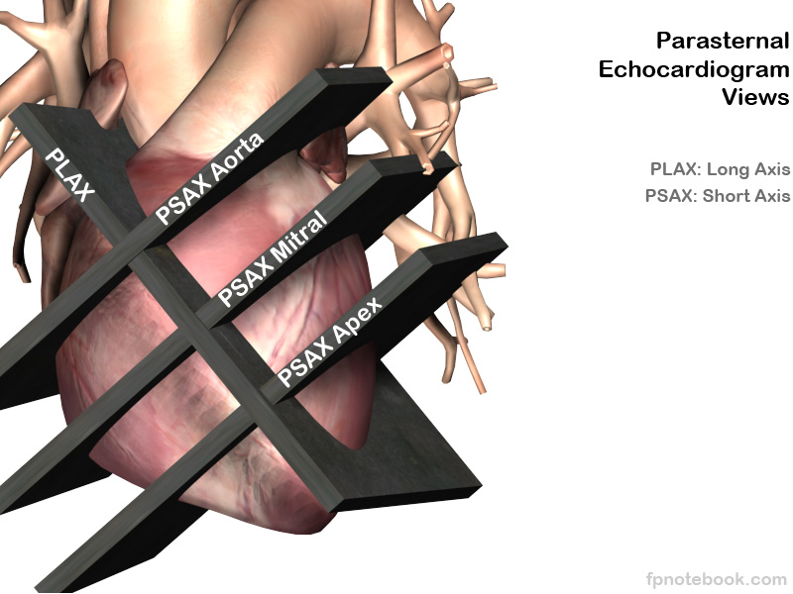
Short Axis MRI Cardiac images
4D images of shape (n_x, n_y, n_z, t)
Where:
n_x and n_y are around 200/300
n_z is very small, from 5 to 15/20
t goes from 10 to 30, but we have manual
contour only for ED and ES
For every patient we have manual contours of Left Ventricle (and RV) at two different moment:
- End-Systolic (ES)
- End-Diastolic (ED)

Slide 4
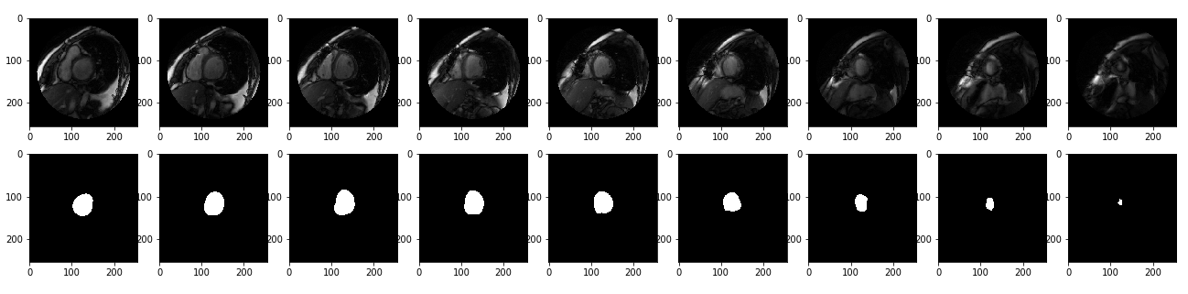
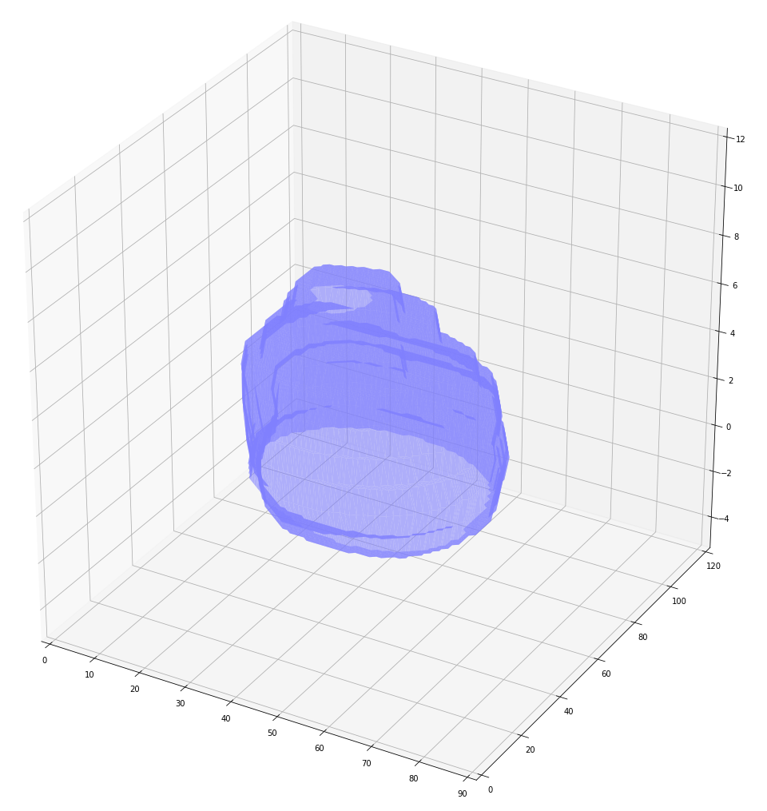
Example:
Above, an example of a Short Axis MRI for a patient: 9 images along the short axis and the relative segmentation of the inner endocardium of Left Ventricle.
On the right, an example of the possible 3D segmentation we can get from these images.
(made by me using mpl_toolkits.mplot3d.art3d Poly3DCollection python function to build the volume starting from the slices)

Slide 5
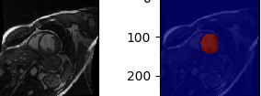
Short Axis MRI Datasets: Sunnybrook
Sunnybrook data (already preprocessed here:
https://github.com/mshunshin/SegNetCMR/tree/master/Data)
100 patients, 2 different time (ED and ES) for each
→ 200 3D patients images (x,y,z) → trasformed in 1000 2D images
Contour: Inner endocardium of Left Ventricle

Slide 6
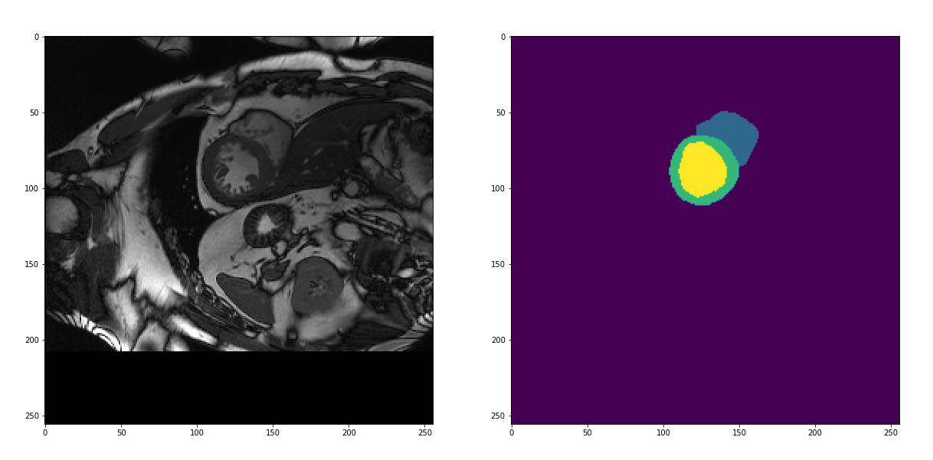
Short Axis MRI Datasets: ACDC dataset
ACDC dataset: https://www.creatis.insa-lyon.fr/Challenge/acdc/databases.html
95 patient at ED and ES → 190 3D images (n_X x n_Y x n_Z) (where n_Z is 8-11 more or less)
→ 1812 2D images, reshaped by me to 256x256 with padding to zeros around the images
Contour:
Inner LV(yellow),
Outer LV(bluemarine)
and RV(blue)

Slide 7
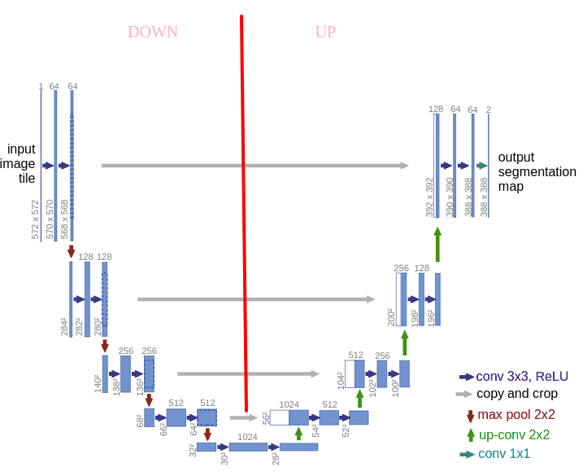
First Model: Unet VGG16 for Sunnybrook
Net: Unet with VGG16 architecture
Input: (256,256,1)
Output: (256,256,1), binary 0/1 classification
Initial weights: ImageNet
Model build with Tensorflow &
segmentation_models library
(https://github.com/qubvel/segmentation_models)
Epochs: 100
Optimizer: Adam
Learning rate: 10^-3
Batch size: 8
Loss: DICE Loss
Metric: IOU Score
Train set: 450
Validation set: 76
Test set: 230

Slide 8
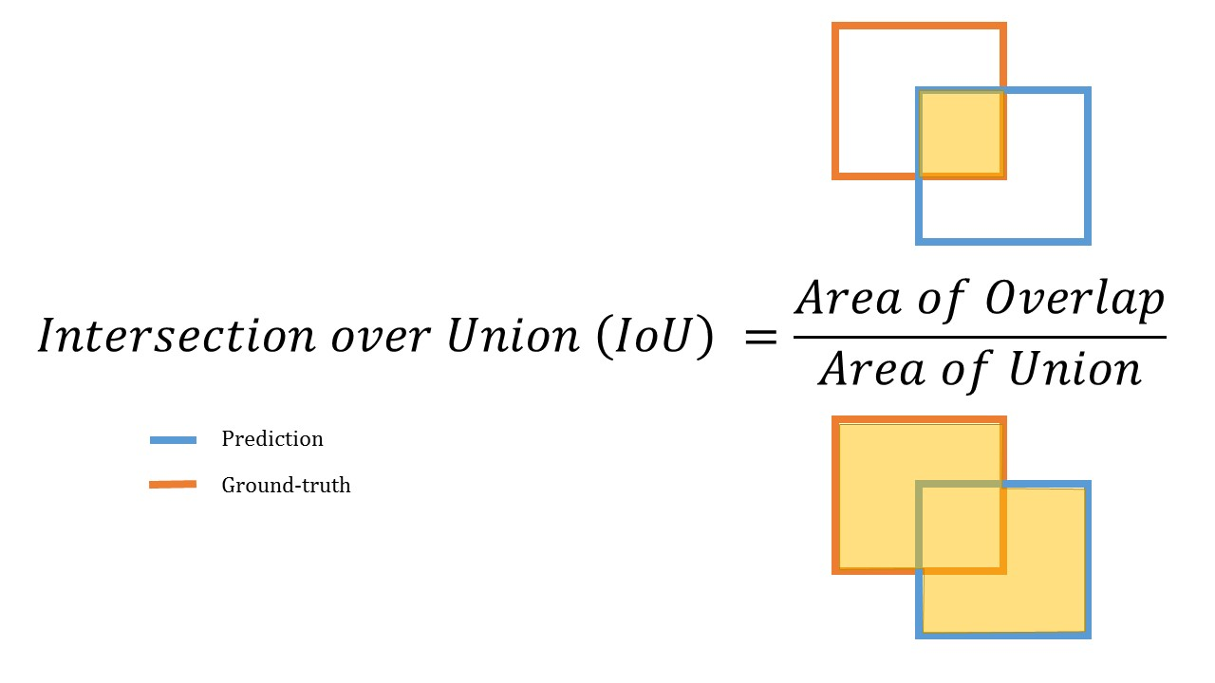
Loss and Metric: Definition
Loss: Dice Loss
Metric: IoU Score

Slide 9
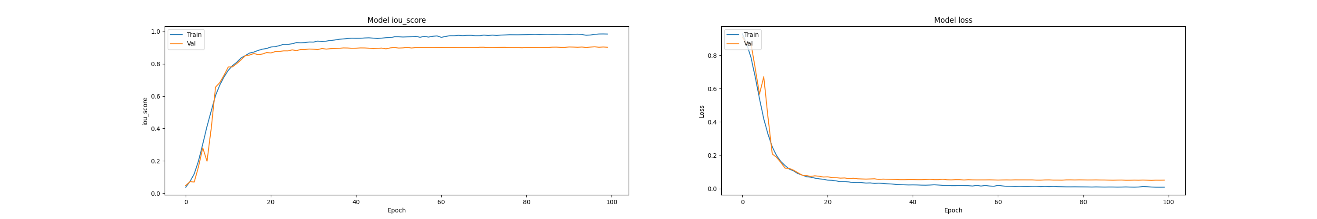
Loss and Metric: Result

Slide 10
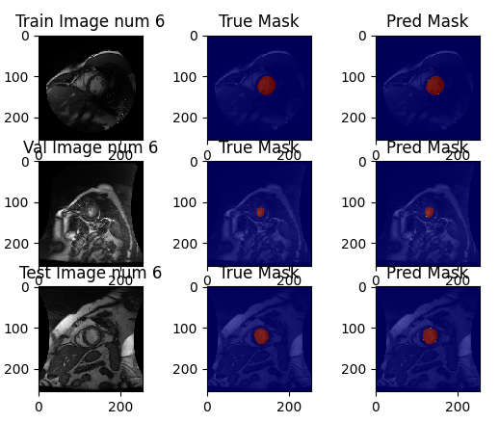
Prediction: train/val/test example

Slide 11
Second Model: Unet VGG16 for Sunnybrook
Net: Unet with VGG16 architecture
Input: (256,256,1)
Output: (256,256,4),
now it is a multiclass classification
(4 classes: Inner LV, Outer LV, RV and background)
Initial weights: ImageNet
Loss: Soft DICE (with weights 0.5 for background) + Categorical Focal Loss
Metric: IOU Score
Train set: 1200
Validation set: 200
Test set: 412

Slide 12
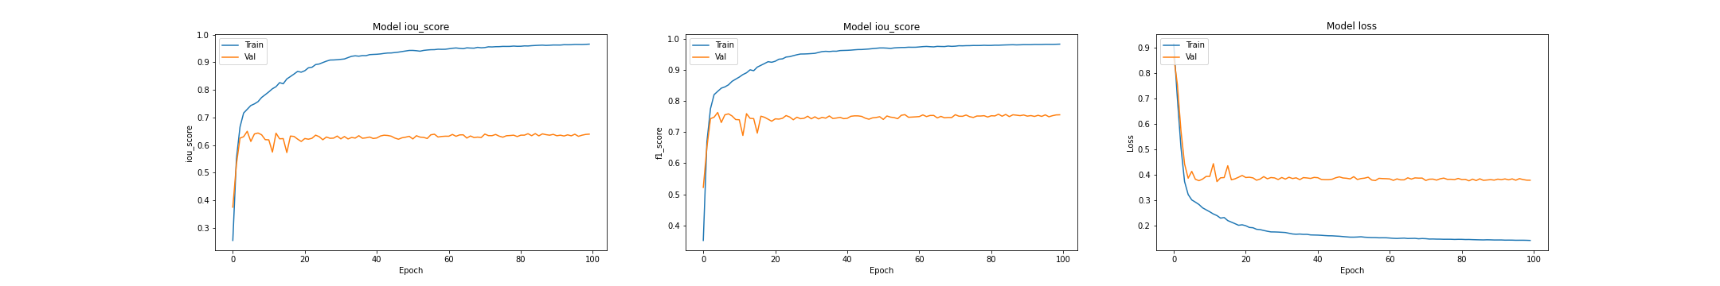
Results: Loss and Metrics
Here the results of loss and metrics are very different from train set to validation set: this is a symptom of overfitting. To overcome this problem we need more data (augmentation) or using a smaller net with less parameters

Slide 13
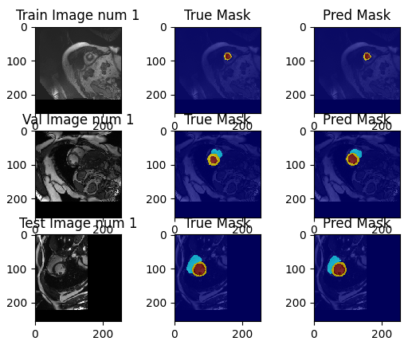
Prediction: train/val/test example

Slide 14
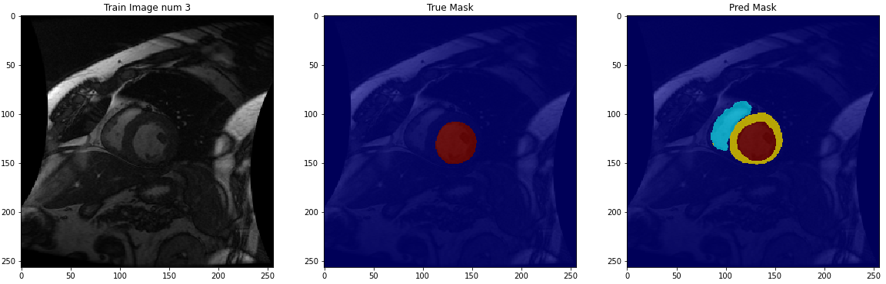
Predict classes of sunnybrook data using the Net trained with acdc
We can use the net trained with ACDC data to segment all the three classes (Inner LV, outer LV and RV) on Sunnybrook data, where we have manual contour only for Inner LV
Of course in True Mask we have only the Inner LV (since in Sunnybrook this is the only manual contour we have) while in the prediction we can segment all the three classes (and compared to the real image it seems quite good)

Slide 15
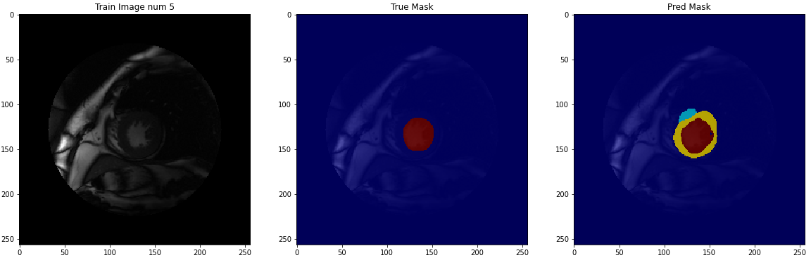
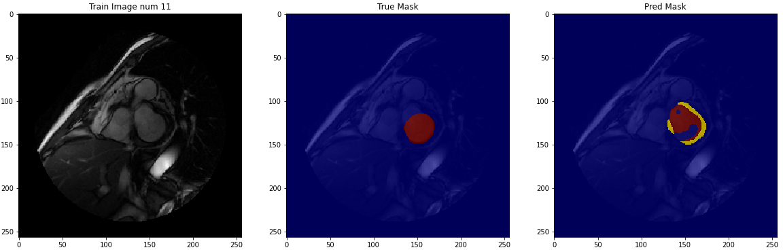
Predict classes of sunnybrook data using the Net trained with acdc
Of course the results can be not perfect, both because we are using the net trained with Acdc dataset on a different dataset (Sunnybrook) and both because the we need a fine-tuning on this net (to improve prediction result on validation set for instance)

Slide 16
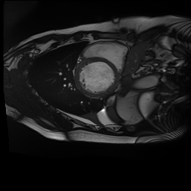

Merge the two datasets to segment Myocardium
Since our final aim is to build a mesh of Left Ventricle, we need to segment both inner endocardium and outer epicardium, or at least the ring between them, the Myocardium
To achieve this, we can merge the two datasets and preprocess the data in order to mask only the myocardium, like in the example below:
After merging the datasets, we come up with a total of 1812+420 = 2232
(2D-images)

Slide 17
Augmentation
With data augmentation we can train on different images in every epochs, created from our training-set with a composition of transformation like:
Random-sized crop
Horizontal and Vertical flip
Random rotation with an angle in [-90°,90°]
Blur the image
Random change of brightness
Since we are going to segment these images, we have to apply the same transformations also to the mask

Slide 18
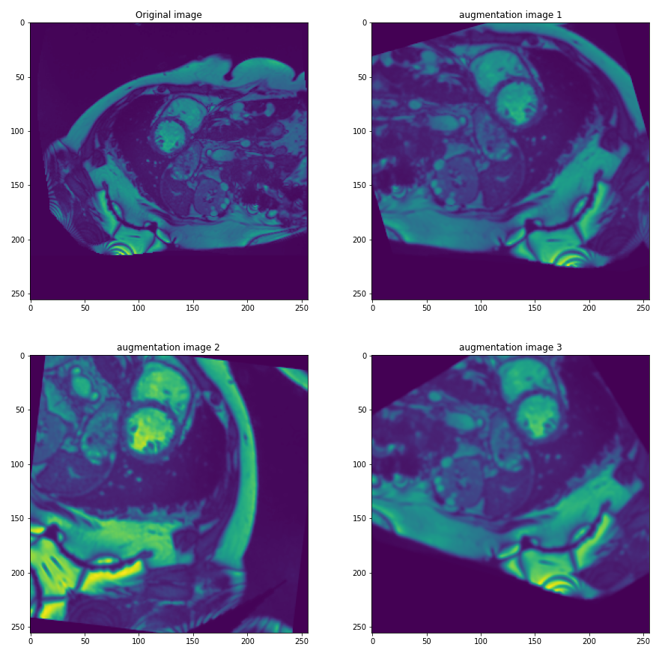
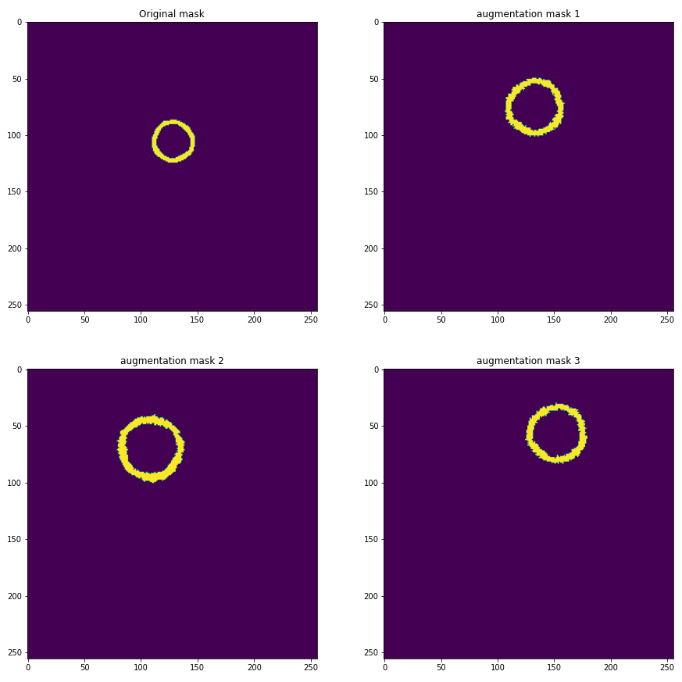
Augmentation: an example

Slide 19
Final model: Unet with VGG16
Net: Unet with VGG16 architecture + 2 additional layers of Dropout (to help preventing overfitting)
Input: (256,256,1)
Output: (256,256,1)
Initial weights: ImageNet
First layer of Dropout before VGG16 with drop rate = 0.1
Second layer of Dropout after the last layer of Unet with drop rate = 0.05
Loss: Soft DICE
Metric: IOU Score
Train set: 1887
Validation set: 104
Test set: 234

Slide 20
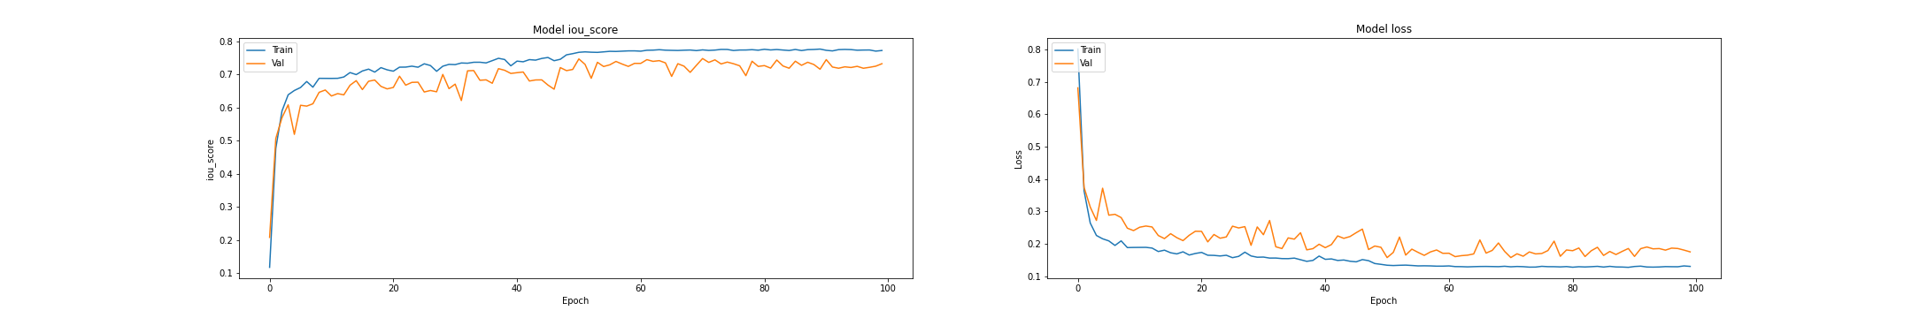
Result: Loss and Metric

Slide 21
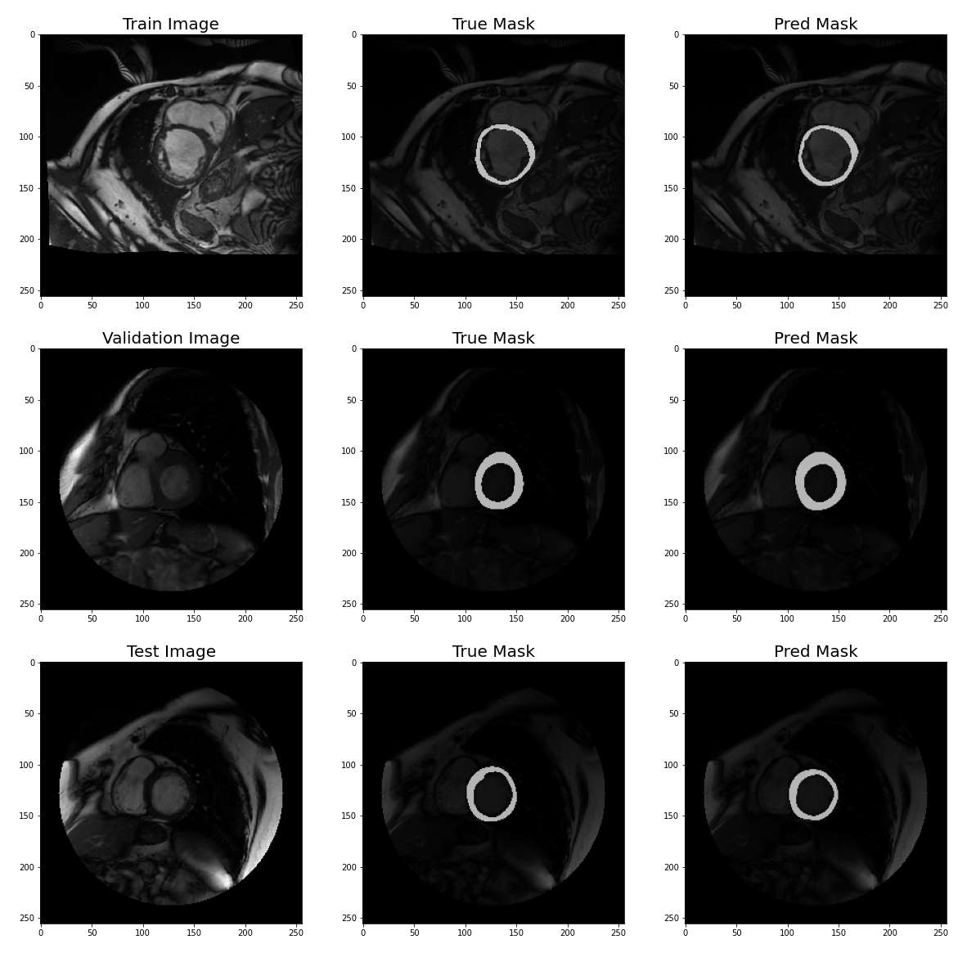
Result: example of train/val/test

Slide 22
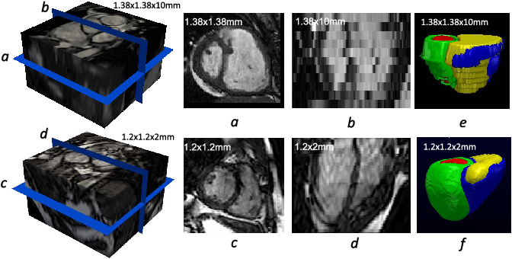
Volume building: problem of resolution
Source: Automatic 3D Bi-Ventricular Segmentation of Cardiac Images by a Shape-Refined Multi-Task Deep Learning Approach; https://arxiv.org/abs/1808.08578

Slide 23
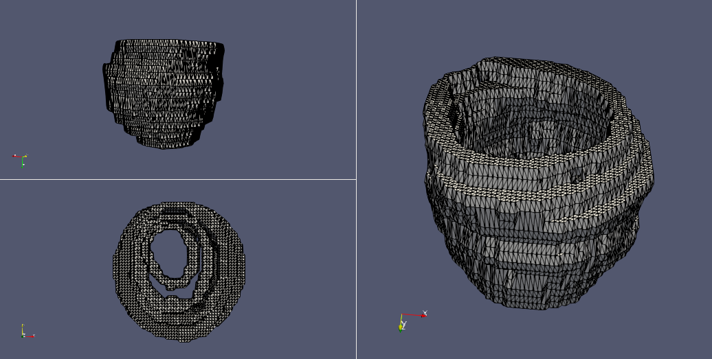
Volume building: problem of resolution

Slide 24
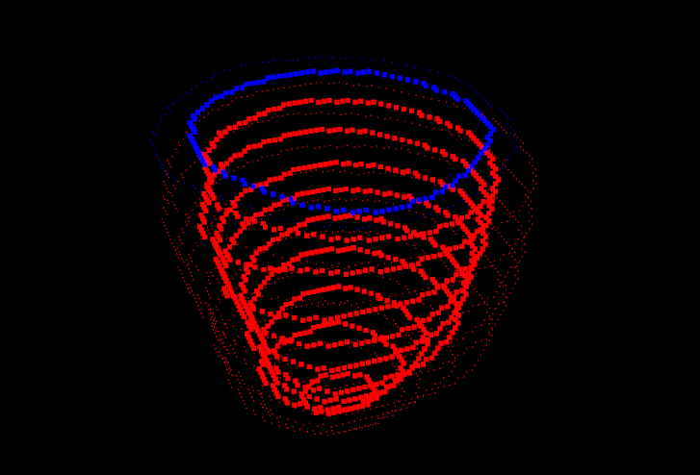
Shape refinement: algorithm (OpenCV)
Pipeline for shape refinement and building volume:
Extract the endo and epi from ring images using OpenCV
Extract contours of both endo and epi from the slices
(Optionally) Shift correction for the contours
Create the volume
Add the apex if required
(Points from 2 to 5 taken from
https://github.com/cbutakoff/tools/)

Slide 25
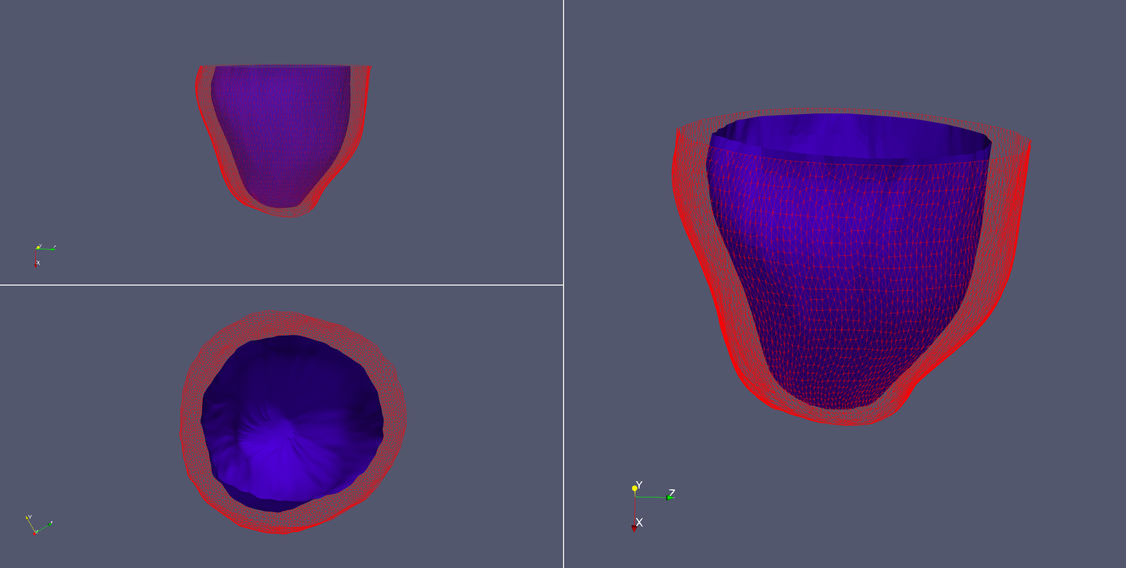
Shape refinement: an example

Slide 26
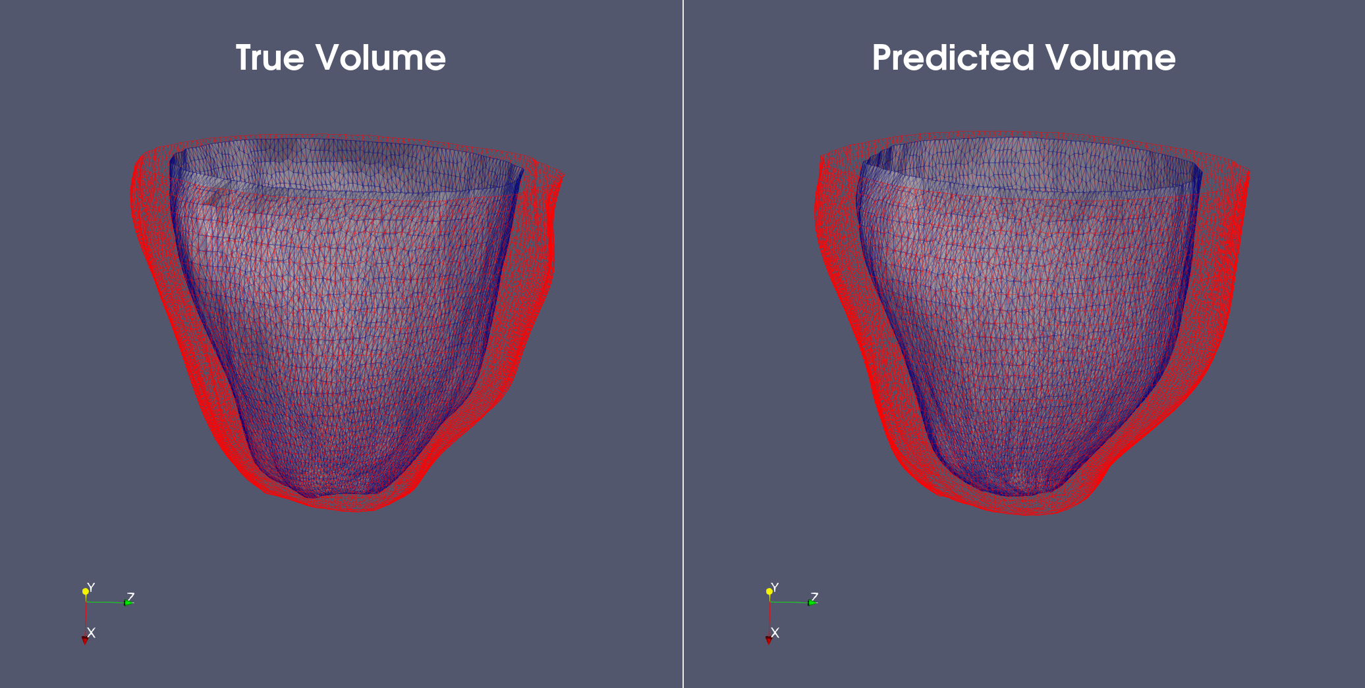
Shape refinement: True vs Pred on test patient

Slide 27
4D segmentation of ACDC Dataset
In the ACDC Dataset we are provided with 4D MRI images → (256, 256, N. Slices, N. Frames)
We have the 3D images of LV during a complete cardiac cycle; we can use our algorithm for a 4D segmentation of the LV volume
Unfortunately we have manual contours only for ED and ES, so we can’t compute errors for every time frames

Slide 28
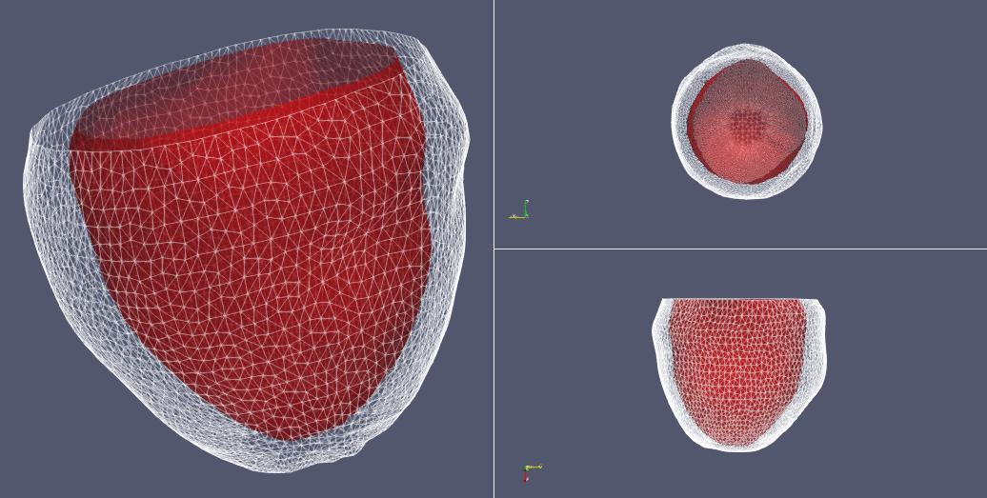
4D segmentation: an example

