Slide 1

UK Population
The main Trends

Slide 2
UK Population – The main Trends
1
Number of People Analysis
2
Country Analysis
3
Age Analysis
4
Cross Analysis of Country and Age

Slide 3
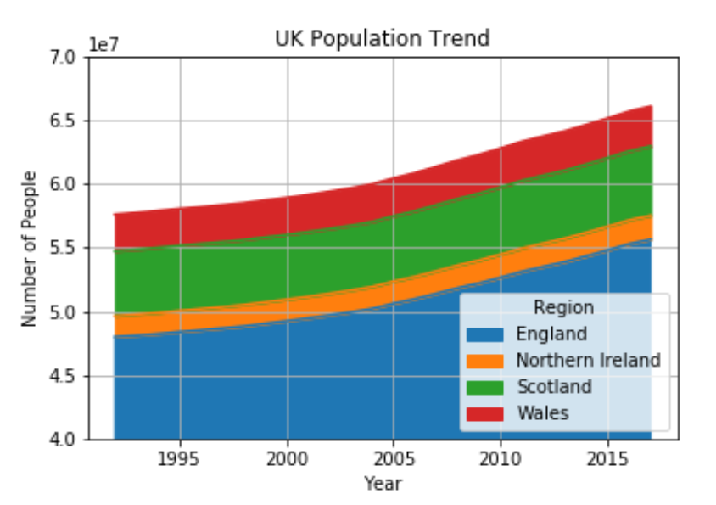
1. Number of People Analysis
Constant growth of total population (growth rate of 500k people/year in the last 5 years)
The total population growth is mainly due to the growth of England population

Slide 4
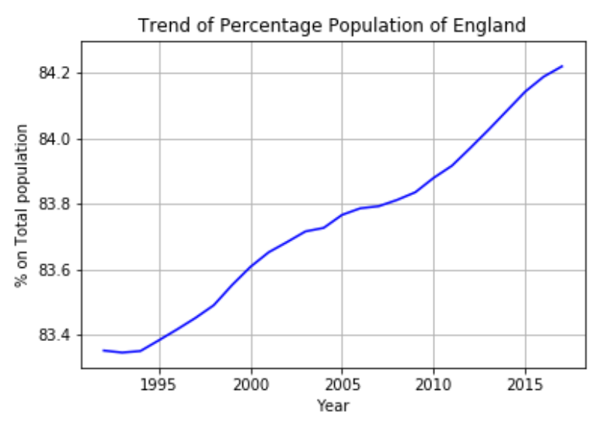
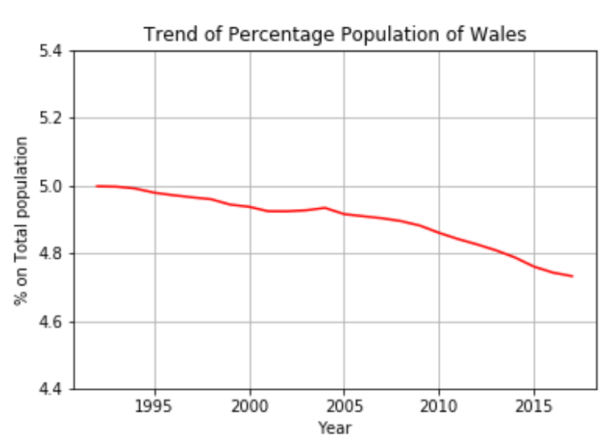
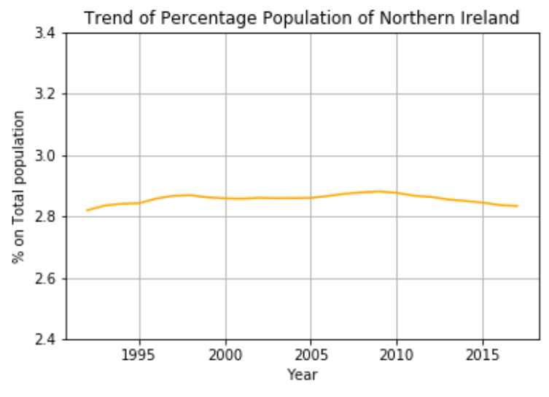
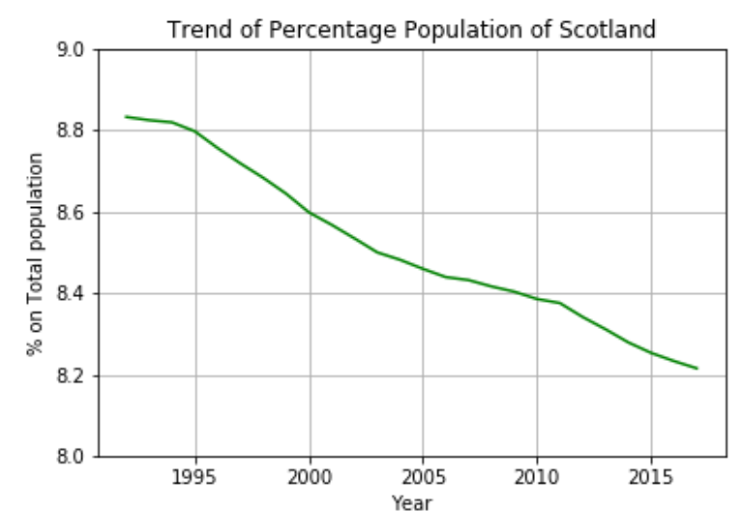
2. Country Analysis
Population is concentraing in England that is by far the most peopled country
UK population is slowly leaving Scotland, Wales and Northern Ireland are stable

Slide 5
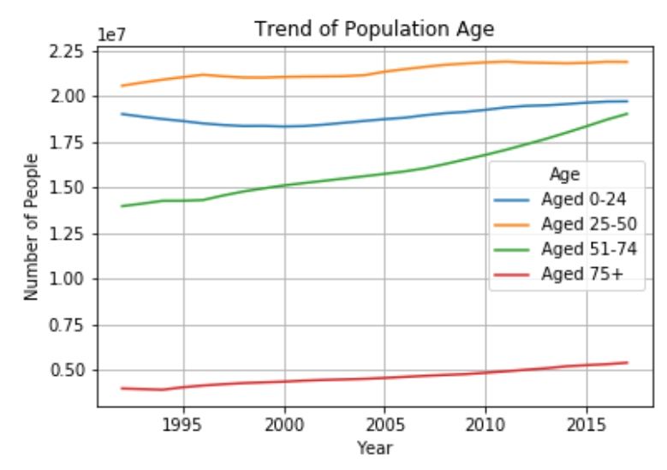
3. Age Analysis
Population is ageing because people older than 50 are strongly growing in recent years
The main part of population is between 25 and 50 years old

Slide 6
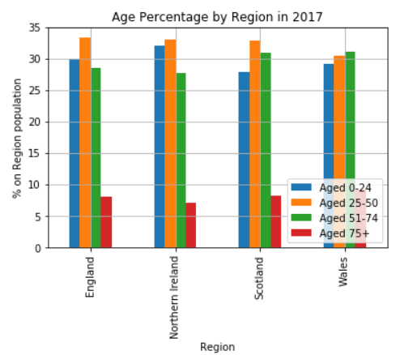
4. Cross Analysis of Country and Age
Wales has the largest percentage of over 50 year old people
Northern Ireland has the largest percentage of under 50 years old people

