Slide 1
Splay Tree
Cameron Castillo // Daniel Diaz
Vincent Zhuang // Carl Kakisis
Notes:
CARL

Slide 2

Table of Contents
What is a Splay Tree?
Splay Tree Balancing Act
Simple rotation (Zig and Zag)
Zig-zig
Zag-zag
Zig-zag
Zag-zig
Time complexity
Use cases
Credits
Notes:
CARL

Slide 3
What is a splay tree?
Notes:
DANIEL

Slide 4
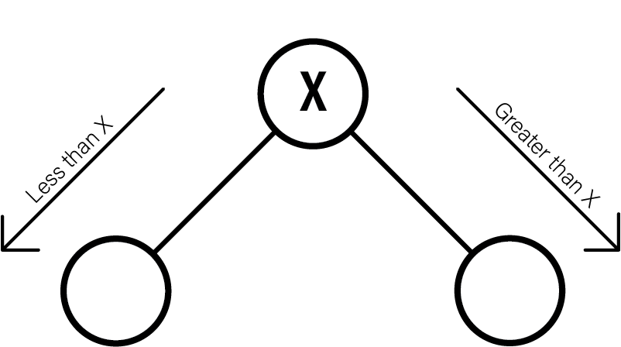
At its heart, a splay tree is a form of a binary search tree
All values to the left of the root will be less than the root
All values to the left of a node will be less than the node
All values to the right of the root will be greater than the root
All values to the right of a node will be greater than the node
1. What is a Splay Tree?
Notes:
DANIEL

Slide 5
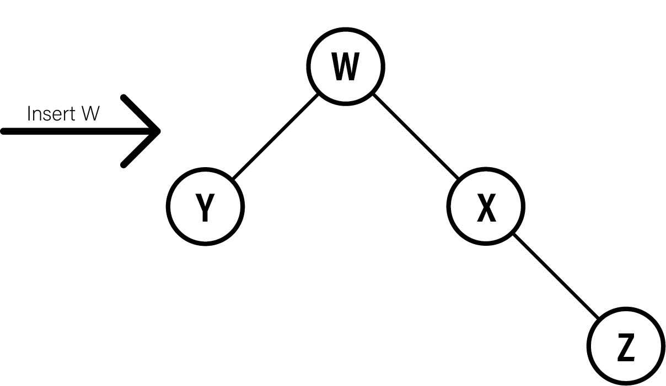
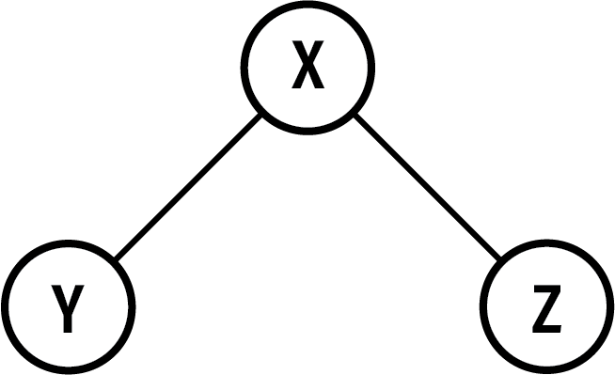
When inserting into a splay tree, the inserted value becomes the root, and the existing nodes are rebalanced.
One caveat:
1. What is a Splay Tree?
Notes:
DANIEL

Slide 6
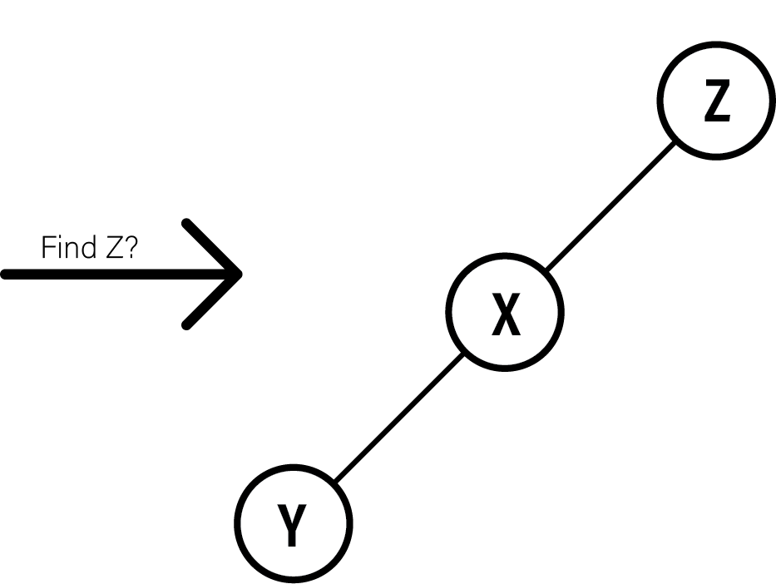
When searching for a node in a splay tree, the found value becomes the root, and the existing nodes are rebalanced.
Another caveat:
1. What is a Splay Tree?
Notes:
DANIEL

Slide 7
These two caveats allow for O(1)/instant access to the most recently inserted or searched-for node.
Insert
Search
1. What is a Splay Tree?
Notes:
DANIEL

Slide 8
Splay tree Balancing Act
Notes:
CAMERON

Slide 9
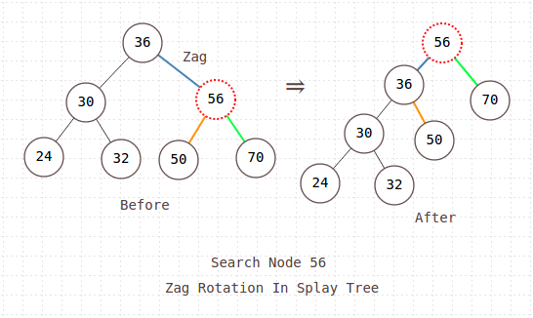
What Makes a Splay Tree Different?
The notion of what it means for a splay tree to be balanced is different from other self-balancing trees.
Splay trees do not have balancing checks for differing heights of subtrees, so its shape is less constrained.
All a splay tree cares about is that recently accessed nodes are near the top.
Upon insertion or access of an item, the tree is adjusted so that item is at the top.
Upon deletion, the item is first brought to the top and then deleted.
2. Splay Tree Balancing Act
Notes:
CAMERON

Slide 10
Balancing Types
Simple rotation (Zig and Zag)
Zig-zig
Zag-zag
Zag-zig
Zig-zag
2. Splay Tree Balancing Act
Notes:
CAMERON

Slide 11
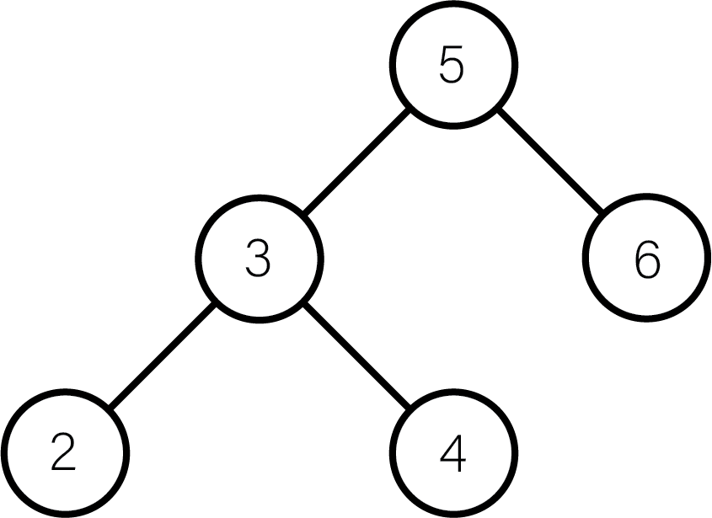
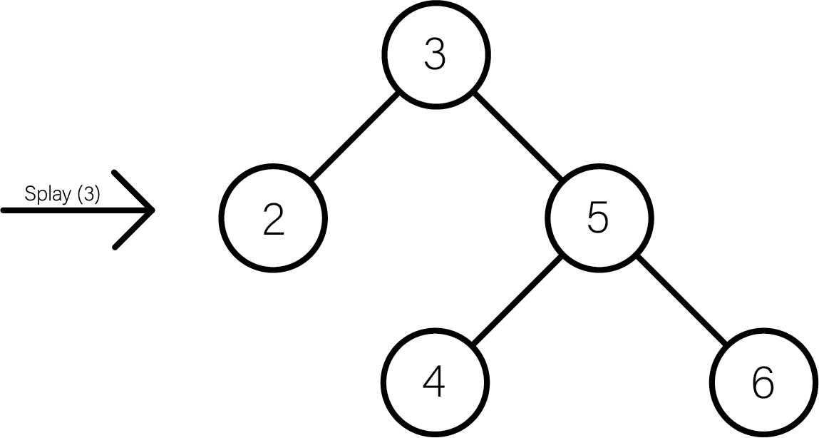

Zig (Right)
The Zig Rotation in a splay tree is similar to the single right rotation in AVL Tree rotations.
In zig rotation, every node moves one position to the right from its current position.
2. Splay Tree Balancing Act (Zig)
Notes:
CAMERON
The first of the simple rotations is the zig rotation, or a right rotation in its simplest form

Slide 12
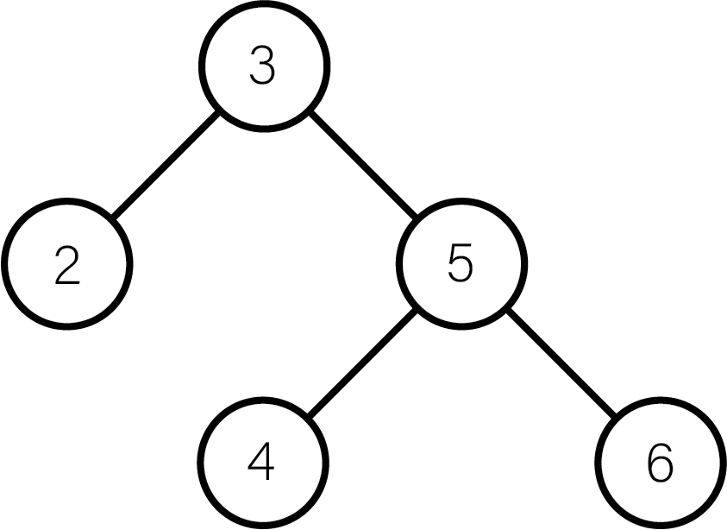
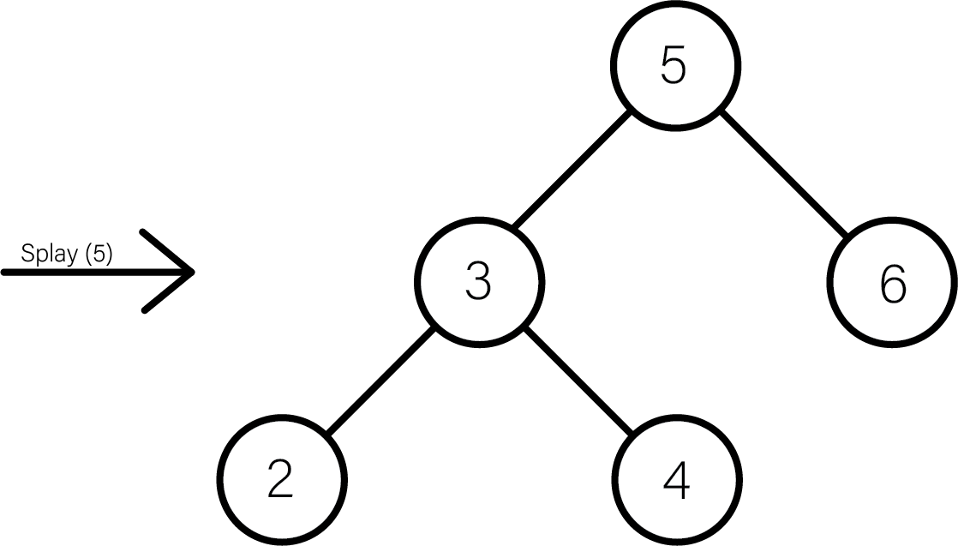
Zag (Left)
The Zag Rotation in splay tree is similar to the single left rotation in AVL Tree rotations.
In zag rotation, every node moves one position to the left from its current position.
2. Splay Tree Balancing Act (Zag)
Notes:
CAMERON
The second simple rotation is a zag rotation, or a simple left rotation
WHY?
5 IS THE RIGHT CHILD OF 3
EITHER A ZIG OR A ZAG DETERMINES THE COMPOSITION OF THE TREE
And now Vincent will get into the more complex rotation sequences

Slide 13
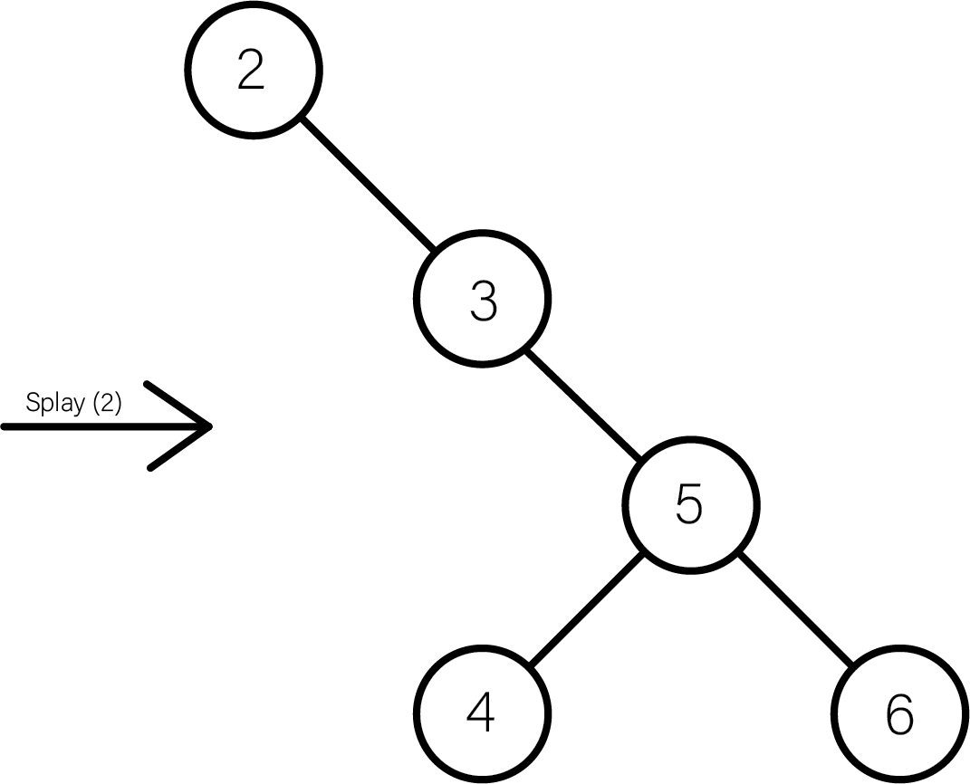
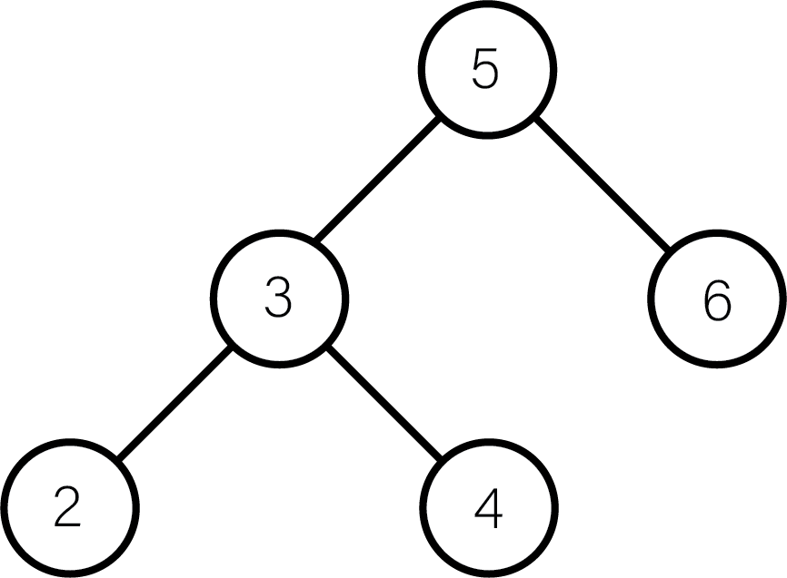
Zig-Zig Rotation (Double Right)
The Zig-Zig Rotation in splay tree is a double zig rotation.
In zig-zig rotation, every node moves two positions to the right from its current position.
2. Splay Tree Balancing Act (Zig-zig)
Notes:
VINCENT
WHY?
2 IS THE LEFT CHILD OF A LEFT CHILD

Slide 14
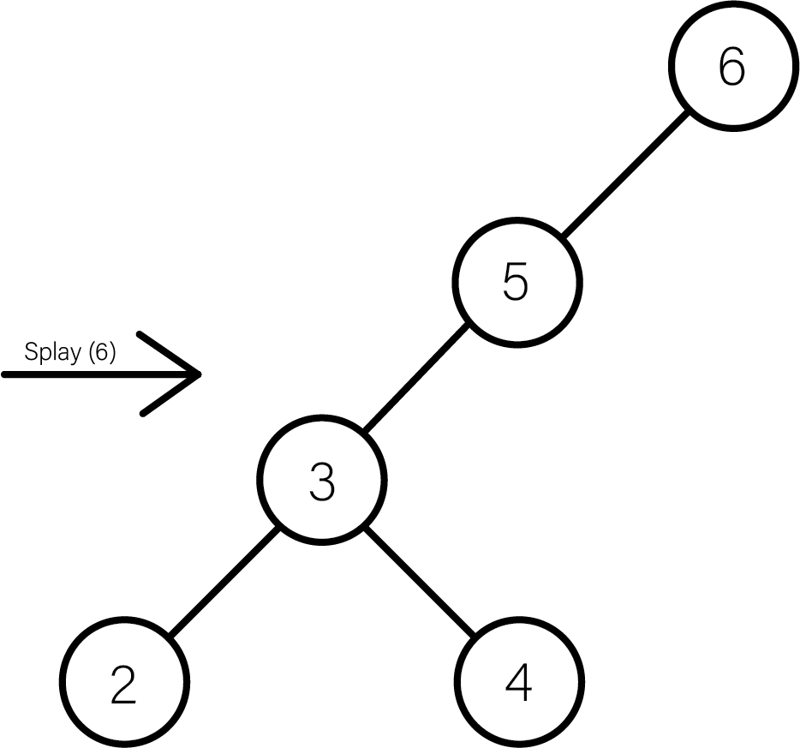
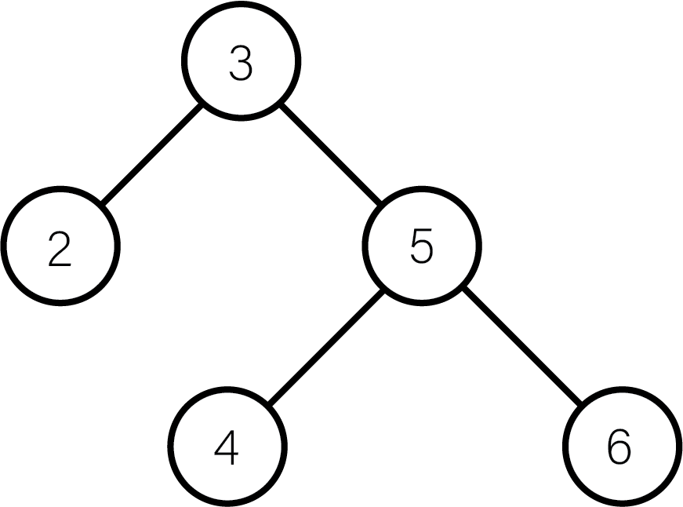
Zag-Zag Rotation (Double Left)
The Zag-Zag Rotation in splay tree is a double zag rotation.
In zag-zag rotation, every node moves two positions to the left from its current position.
2. Splay Tree Balancing Act (Zag-zag)
Notes:
VINCENT
WHY?
6 IS THE RIGHT CHILD OF A RIGHT CHILD

Slide 15
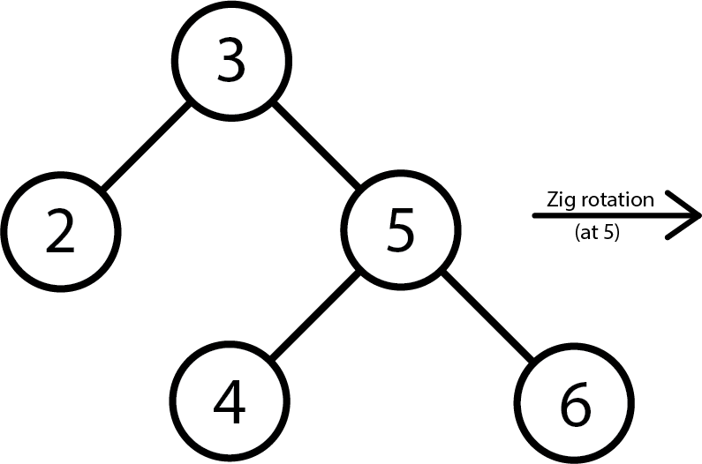
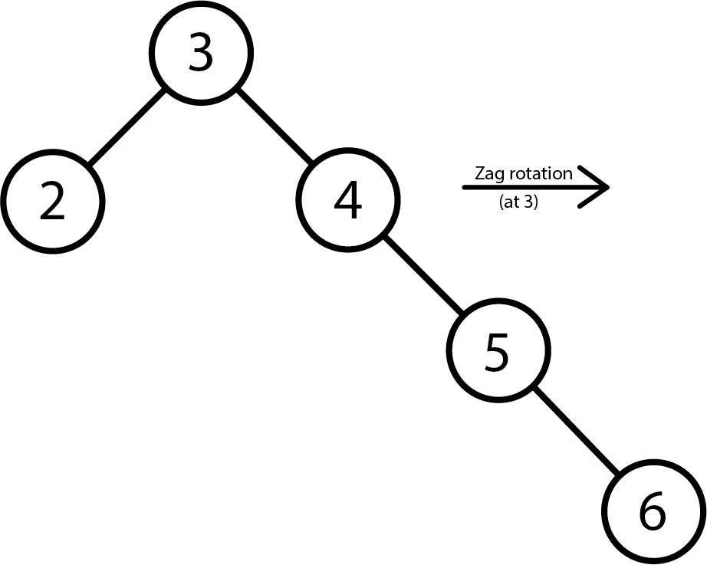
Zig-Zag Rotation
The Zig-Zag Rotation in splay tree is a sequence of zig rotation followed by zag rotation.
Splay (4)
In zig-zag rotation, every node moves one position to the right, followed by one position to the left from its current position.
2. Splay Tree Balancing Act (Zig-zag)
Notes:
VINCENT
WHY?
4 IS THE LEFT CHILD OF A RIGHT CHILD

Slide 16
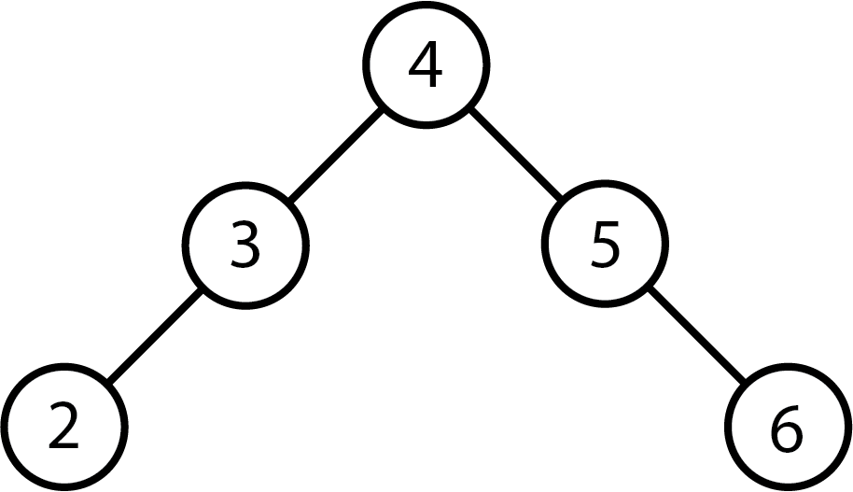
Zig-Zag Rotation (continued)
Splay (4)
2. Splay Tree Balancing Act (Zig-zag)
Notes:
VINCENT
4 IS THE LEFT CHILD OF A RIGHT CHILD

Slide 17
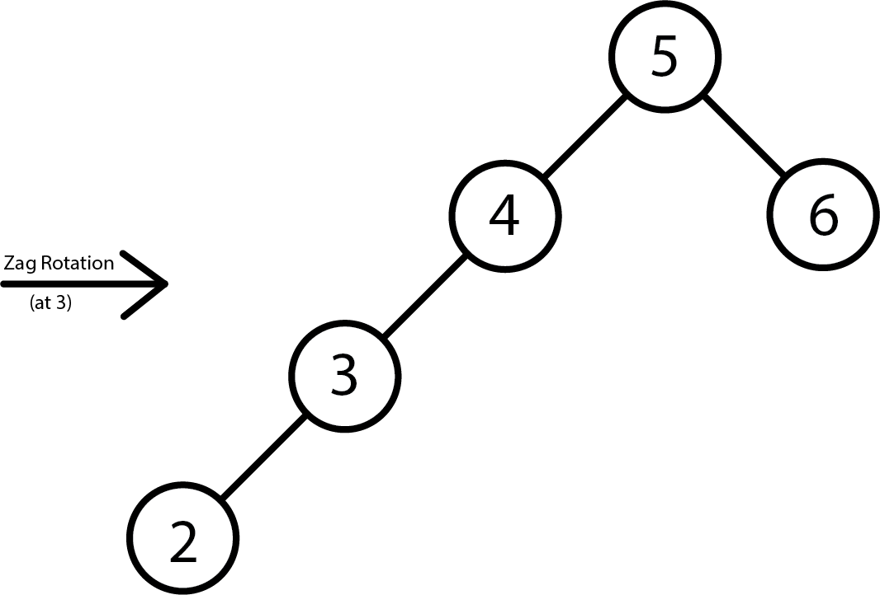
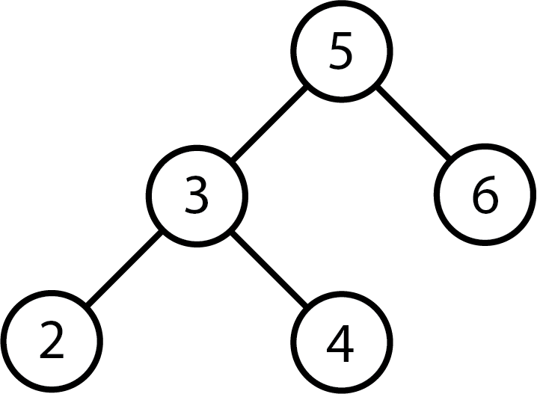
Splay (4)
Zag-Zig Rotation
The Zag-Zig Rotation in splay tree is a sequence of zag rotation followed by zig rotation.
In zag-zig rotation, every node moves one position to the left, followed by one position to the right from its current position.
2. Splay Tree Balancing Act (Zag-zig)
Notes:
VINCENT
4 IS THE RIGHT CHILD OF A LEFT CHILD

Slide 18
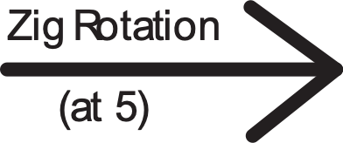
Splay (4)
Zag-Zig Rotation (continued)
2. Splay Tree Balancing Act (Zag-zig)
Notes:
VINCENT

Slide 19
Time Complexity
Notes:
CARL

Slide 20
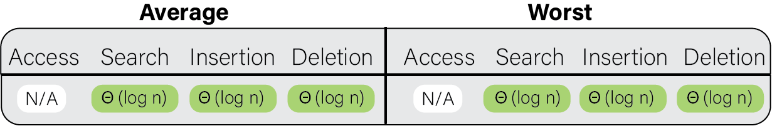
Overall time complexity
Since all operations also splay the tree on the node, the tree ends up roughly balancing itself, this results in a Θ(log n) amortized worst case time complexity for all operations.
3. Time Complexity
https://www.bigocheatsheet.com/
Notes:
CARL

Slide 21
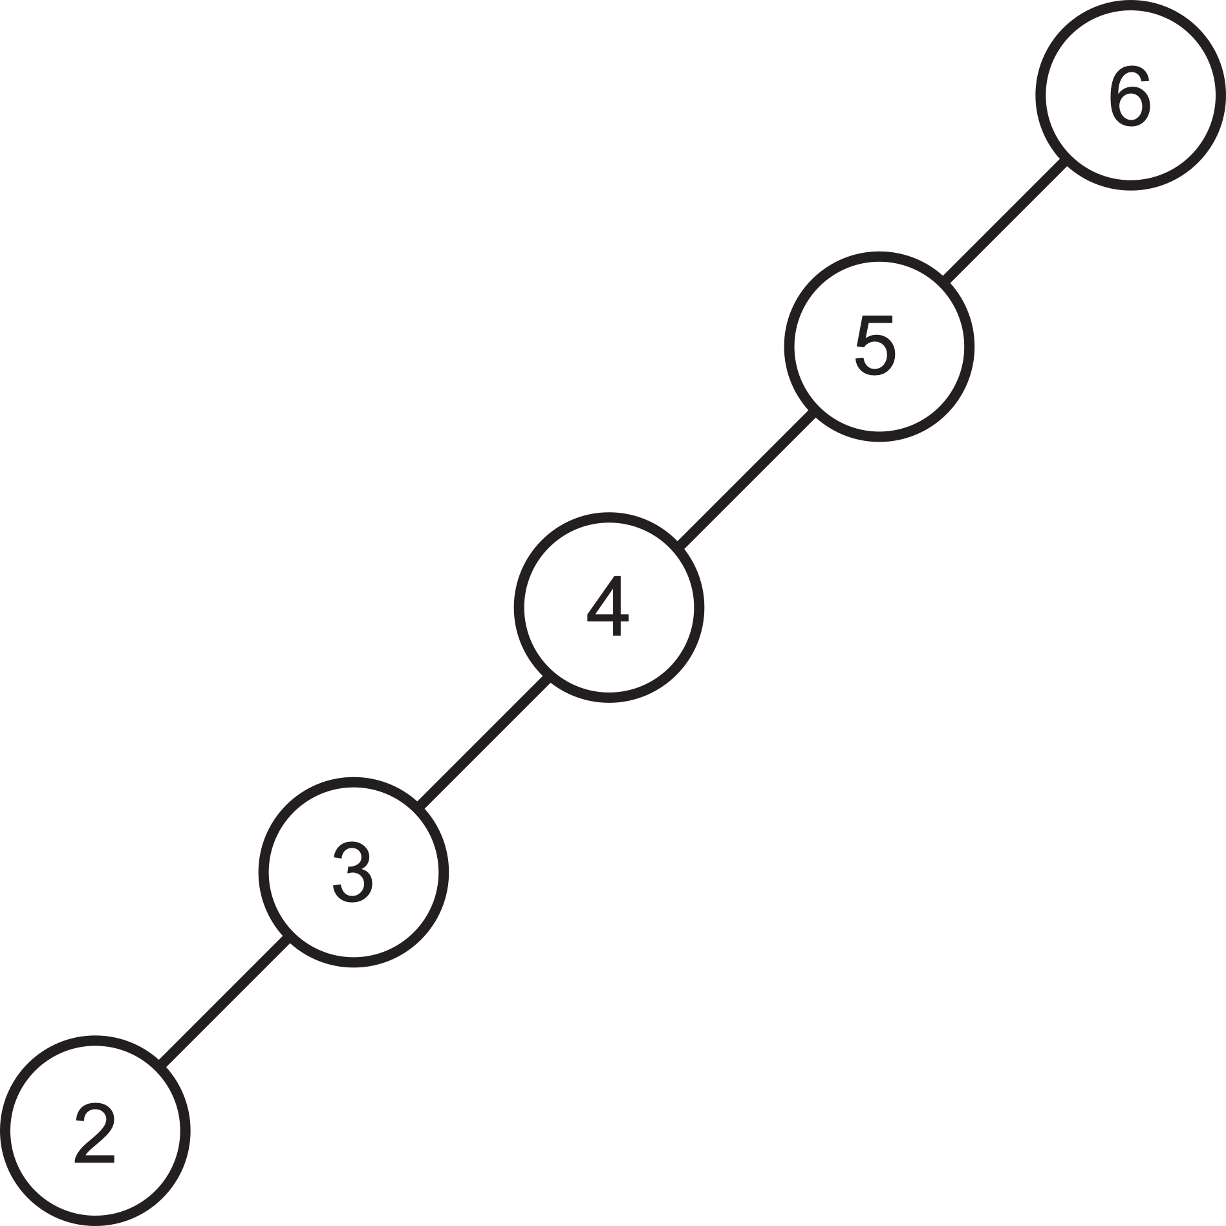
The worst-case height of a splay tree is O(n), this could be the case if all nodes were accessed in ascending order
Worst-case height is essentially when the tree looks like a linked list.
3. Time Complexity
Notes:
CARL

Slide 22
Time Complexity Advantages
Extremely useful when it’s likely that the same nodes will be accessed multiple times in a short period.
Much easier to implement and code than AVL or Red-black trees.
As splay trees bubble nodes up to the root on access, nearby successive accesses will be very quick.
Splay trees require less space as no balance information is required.
Can be much more efficient if usage pattern is skewed. Good heuristics can have amortized running time similar to the running time of the best structure.
3. Time Complexity
Notes:
CARL

Slide 23
Time Complexity Disadvantages
Splay trees can change even when they are accessed in a read-only manner. This complicates the use of splay trees in a multi-threaded environment.
Specifically, extra management is needed if multiple threads are allowed to perform search operations.
The main disadvantage of splay trees is that the height of a splay tree can be linear.
After accessing all n elements in non-decreasing order, Since the height of a tree corresponds to the worst-case access time, this means that the actual cost of an operation can be slow.
3. Time Complexity
Notes:
DANIEL

Slide 24
Use Cases
Notes:
VINCENT

Slide 25
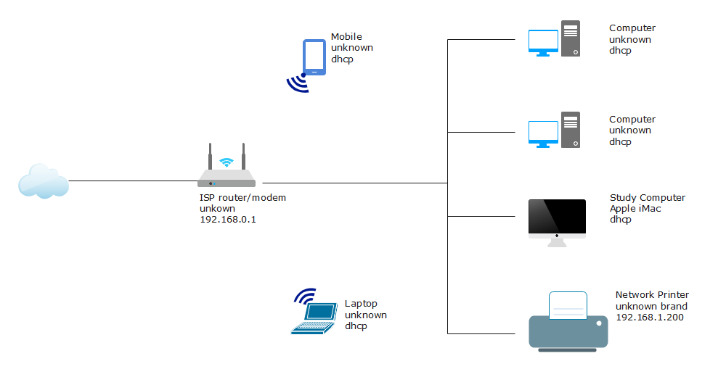
Network Routers
4. Use cases
https://www.edrawsoft.com/article/home-network-diagram.html
Notes:
VINCENT
Can be used to implement a lookup table in a network router
No overhead - if you allocate 10 MB to storage you get 10 MB worth of data without adjusting your run-times
Recent access preference - recent data is more easily accessed, and routers access more recent data frequently (new network nodes are likely to talk, and most networks are not used evenly)
Dups are fine - can be useful depending on what you are storing
Simple implementation - routers are typically run on fairly weak processors and are incredibly difficult to update, so simplicity is nice
Some of these issues have been solved, and in many cases hash tables are used for networking

Slide 26
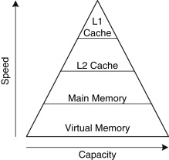
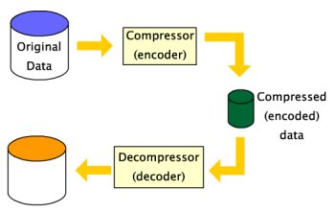
Implementation of caches
Memory allocators
Garbage collectors
Data compression
Ropes (replacement of string used for long text strings)
Windows (in the virtual memory, networking, and file system code)
sciencedirect.com/topics/computer-science/l2-cache
https://citizenchoice.in/course/computer-networks-theory/Chapter%205/9-data-compression-1
4. Use cases
Notes:
VINCENT

Slide 27
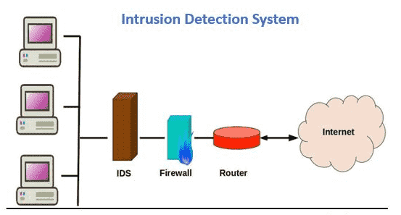

Intrusion detection systems (IDS) which are an essential part of the security infrastructure. They are used to detect, identify and stop intruders.
The GCC compiler and GNU C++ library, the sed string editor, the most popular implementation of Unix malloc, Linux loadable kernel modules.
https://ar.m.wikipedia.org/wiki/%D9%85%D9%84%D9%81:GNU_Compiler_Collection_logo.svg
https://www.comodo.com/ids-in-security.php
4. Use cases
Notes:
CAMERON
One of the fastest types of binary search trees
Takes advantage of Region of Interest – samples in a data set identified for a particular purpose

Slide 28
Credits
http://cs.indstate.edu/~rcheruku/splaytree.pdf
https://astikanand.github.io/techblogs/advanced-data-structures/splay-tree
https://www.cs.cornell.edu/courses/cs3110/2013sp/recitations/rec08-splay/rec08.html
Notes:
CAMERON

Slide 29




Thank you
Cameron Castillo // Daniel Diaz
Vincent Zhuang // Carl Kakisis

Slide 30
Live Code
Notes:
CAMERON

Slide 31
QUESTIONS?
Notes:
CAMERON

