Slide 1
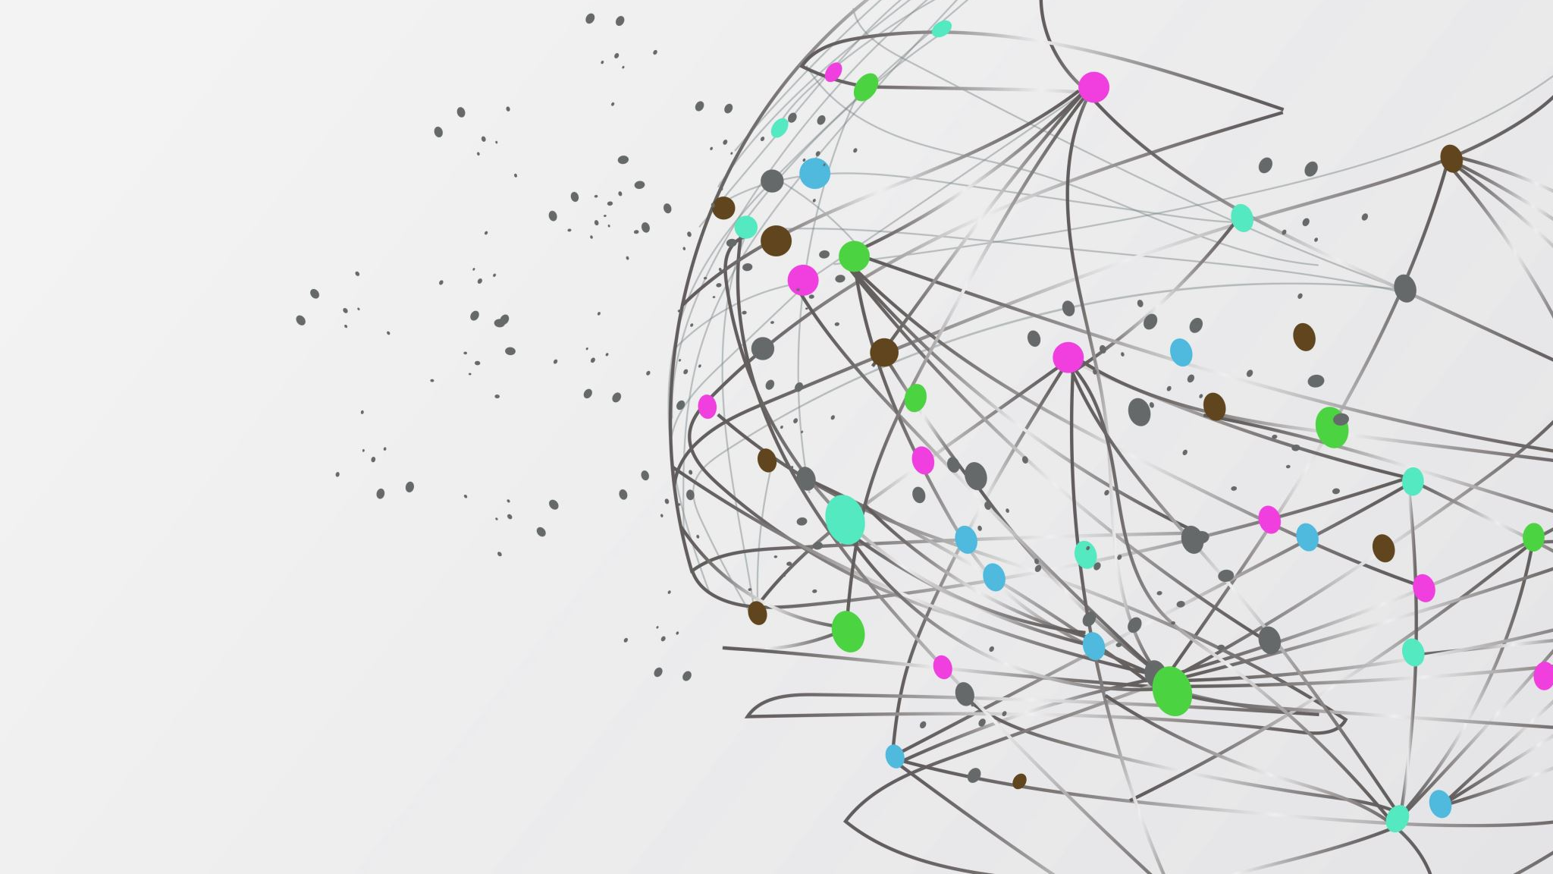
toot.ai
Jim | Daniele | Filippo | Otto
AI Platform-as-a-Service

Slide 2
Demo
Interacting with toot.ai
Inferring a solution from knowledge
Learning new knowledge

