Slide 1
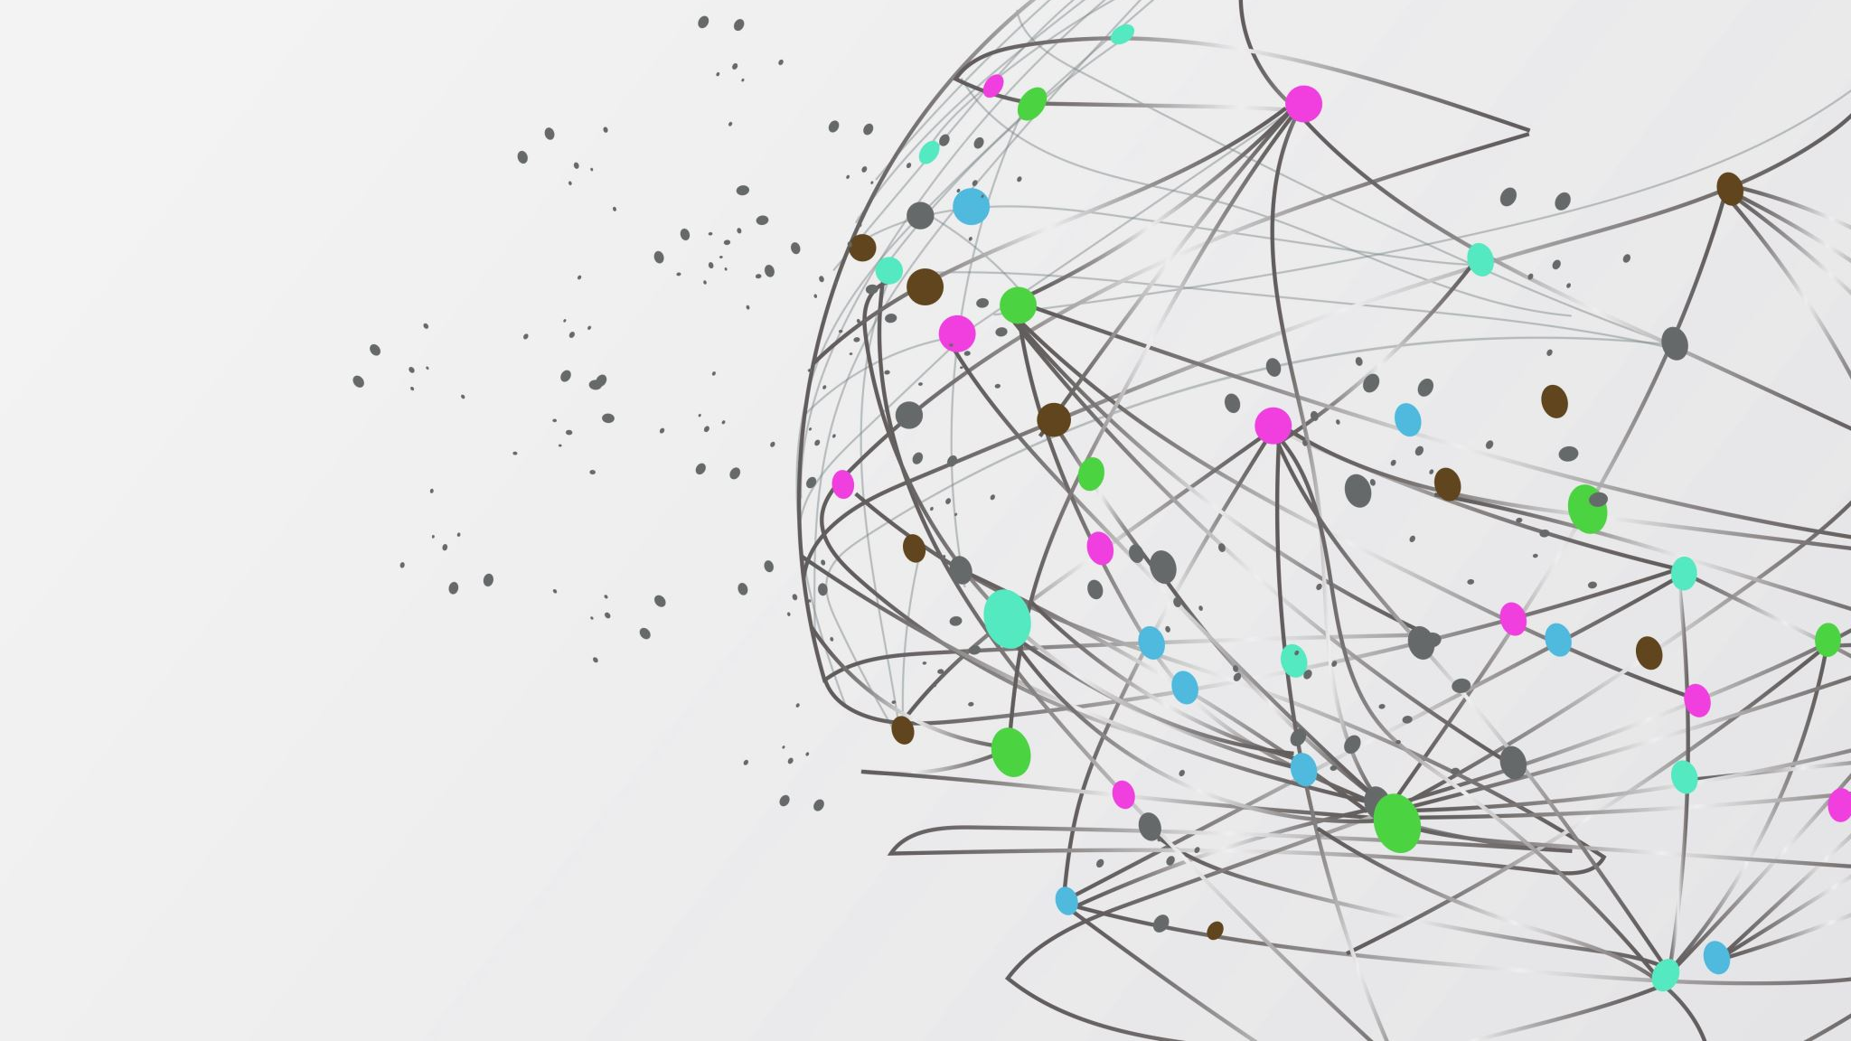
toot.ai
Jim | Daniele | Filippo | Otto
knowledge as a platform

Slide 2


Slide 3


Slide 4
Machine Learning
Human-Computer Interactions
Knowledge-Based Reasoning
Data Mining

Slide 5

15,000 servers
Error every 10 minutes
Manual fix takes 1h
Cost reaches 50€ per issue
We reduce the cost to 1€

Slide 6

€20bn in Western Europe alone
It would cost only
€400m to toot it

Slide 7


Slide 8


