Slide 1
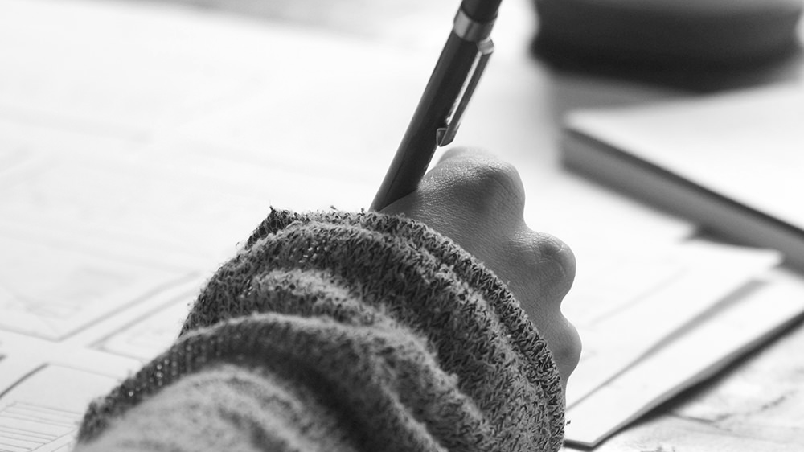

ArtReader Learn Faster, Learn More

Slide 2
INSTRUCTIONS FOR USE
Open this document in Google Slides (if you are at slidescarnival.com use the button below this presentation) You have to be signed in to your Google account
EDIT IN GOOGLE SLIDES
Go to the File menu and select Make a copy.
You will get a copy of this document on your Google Drive and will be able to edit, add or delete slides.
EDIT IN POWERPOINT®
Go to the File menu and select Download as Microsoft PowerPoint. You will get a .pptx file that you can edit in PowerPoint.
Remember to download and install the fonts used in this presentation (you’ll find the links to the font files needed in the Presentation design slide)
More info on how to use this template at www.slidescarnival.com/help-use-presentation-template This template is free to use under Creative Commons Attribution license. If you use the graphic assets (photos, icons and typographies) provided with this presentation you must keep the Credits slide.

Slide 3
Eccoci!
Siamo Daniele Genta e Davide Massimino
Siamo qui per presentarvi il nostro progetto d’esame, Art Reader

Slide 4
Idea e progetto
1
Let’s start with the first set of slides

Slide 5
Il nostro intento era quello di portare una piattaforma in grado di mettere insieme diverse realtà artistiche, senza vincoli.

Slide 6
THIS IS A SLIDE TITLE
Here you have a list of items
And some text
But remember not to overload your slides with content
You audience will listen to you or read the content, but won’t do both.

Slide 7
BIG
CONCEPT
Bring the attention of your audience over a key concept using icons or illustrations

Slide 8
SPLIT YOUR CONTENT
WHITE
Is the color of milk and fresh snow, the color produced by the combination of all the colors of the visible spectrum.
BLACK
Is the color of coal, ebony, and of outer space. It is the darkest color, the result of the absence of or complete absorption of light.

Slide 9
IN 2 OR 3 COLUMNS
YELLOW
Is the color of gold, butter and ripe lemons. In the spectrum of visible light, yellow is found between green and orange.
BLUE
Is the colour of the clear sky and the deep sea. It is located between violet and green on the optical spectrum.
RED
Is the color of blood, and because of this it has historically been associated with sacrifice, danger and courage.

Slide 10
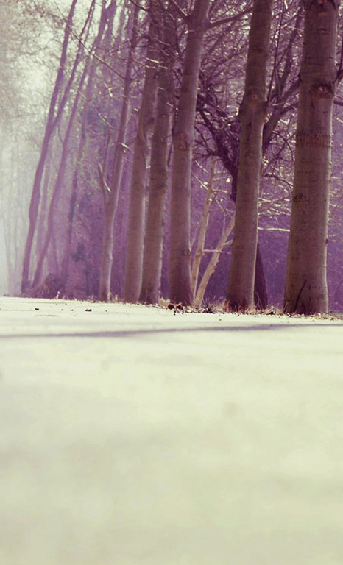
A PICTURE IS WORTH A THOUSAND WORDS

Slide 11
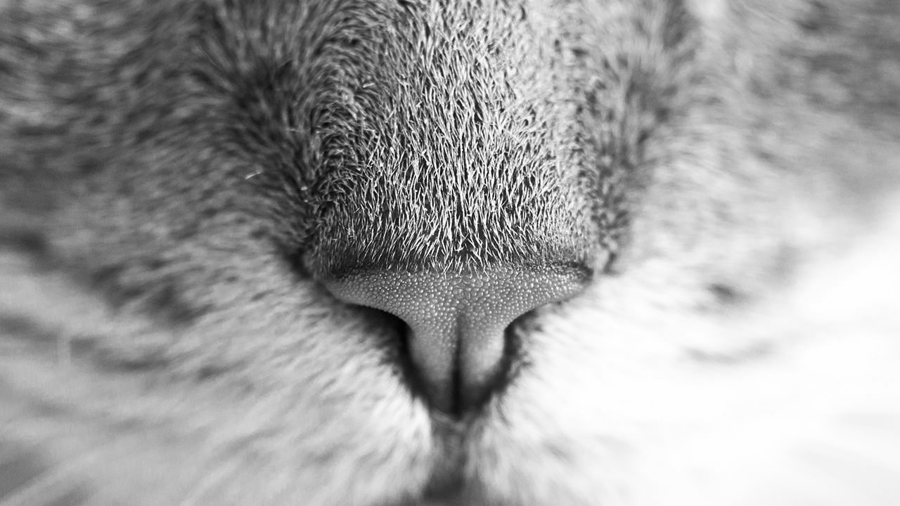
WANT BIG IMPACT?
USE BIG IMAGE.

Slide 12
Come è strutturato il nostro progetto
Database
Server
Client
(Android & Web)

Slide 13
AND TABLES
 | A | B | C
Yellow | 10 | 20 | 7
Blue | 30 | 15 | 10
Orange | 5 | 24 | 16

Slide 14
Alcuni dei musei inseriti
Tate Modern
Louvre
Nation Gallery

Slide 15
5,000+
Righe di codice scritte

Slide 16
2000
2000
1000
Lato server
Lato web
Grafica

Slide 17
Come abbiamo lavorato?
API Server
Integrazione web e mobile app
Stili e grafiche

Slide 18
LET’S REVIEW SOME CONCEPTS
Yellow
Is the color of gold, butter and ripe lemons. In the spectrum of visible light, yellow is found between green and orange.
Blue
Is the colour of the clear sky and the deep sea. It is located between violet and green on the optical spectrum.
Red
Is the color of blood, and because of this it has historically been associated with sacrifice, danger and courage.

Slide 19
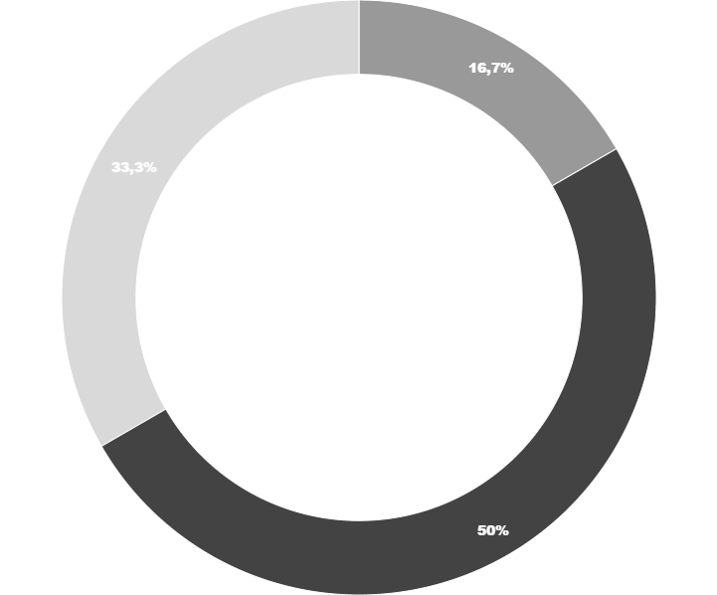
You can copy&paste graphs from Google Sheets

Slide 20
La nostra applicazione
Place your screenshot here

Slide 21
Il nostro sito web
Place your screenshot here
Show and explain your web, app or software projects using these gadget templates.

Slide 22
Il sito è responsive
Place your screenshot here
Adattabile anche per tablet e telefoni

Slide 23
Grazie!

Slide 24
CREDITS
Special thanks to all the people who made and released these awesome resources for free:
Presentation template by SlidesCarnival
Photographs by Unsplash

Slide 25

Presentation design
This presentation uses the following typographies:
Titles: Montserrat
Body copy: Didact Gothic
You can download the fonts on this page:
https://www.google.com/fonts#UsePlace:use/Collection:Montserrat:400,700|Didact+Gothic
Click on the “arrow button” that appears on the top right
You don’t need to keep this slide in your presentation. It’s only here to serve you as a design guide if you need to create new slides or download the fonts to edit the presentation in PowerPoint®

Slide 26
SlidesCarnival icons are editable shapes.
This means that you can:
Resize them without losing quality.
Change line color, width and style.
Isn’t that nice? :)
Examples:

