Slide 1
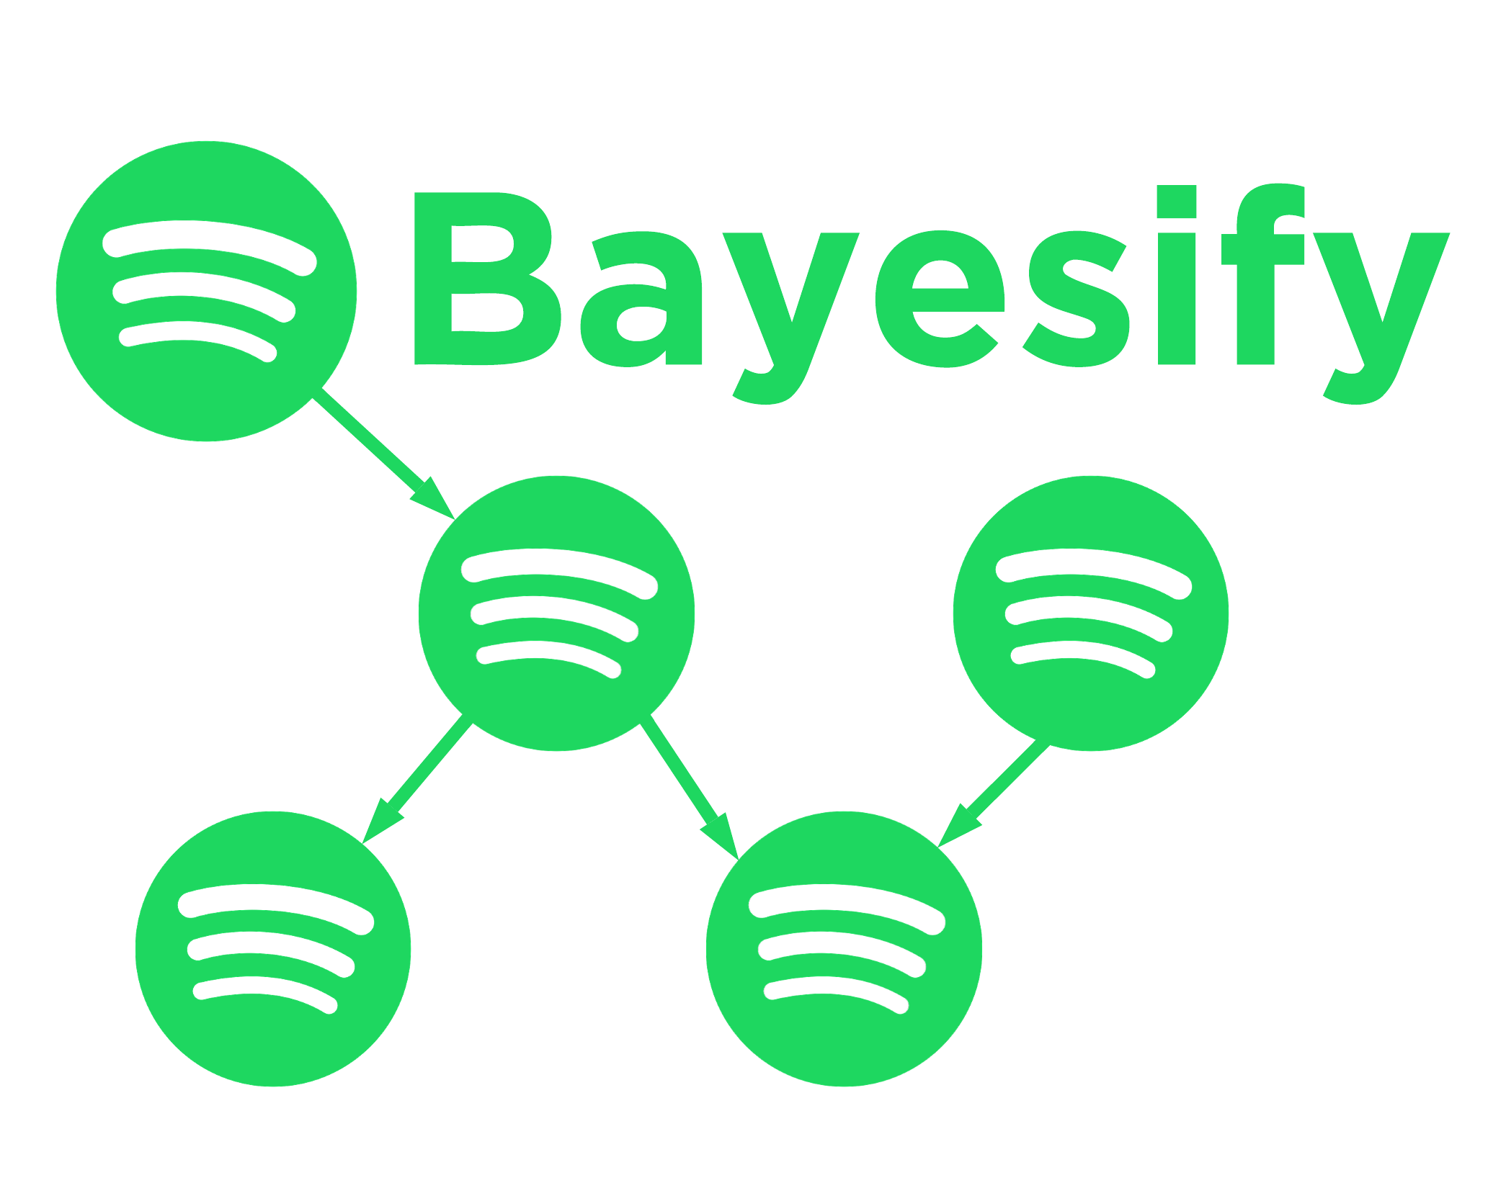
Fundamentals of Artificial Intelligence and Knowledge Representation, Module 3
A personal music taste analysis using Bayesian Networks
Napolitano Daniele
Artificial Intelligence, University of Bologna
March 10, 2023

Slide 2
Objectives
1.
2.
Bayesify
Build the dataset.
Create two Bayesian Models.
3.
Perform inferences (different queries and methods).
4.
Build a prototype for a use case application.

Slide 3
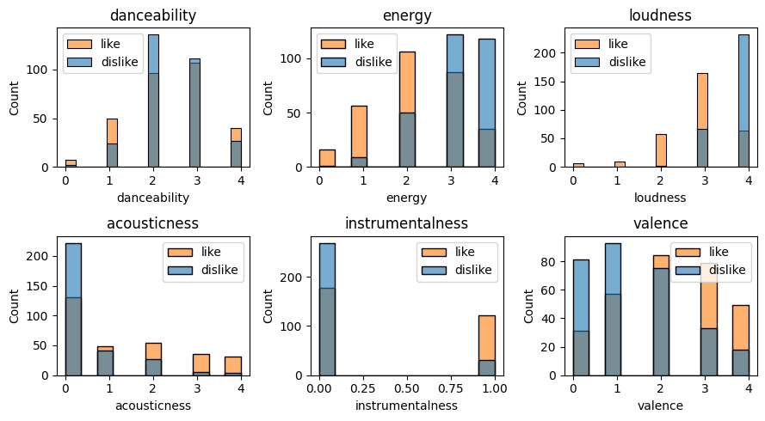
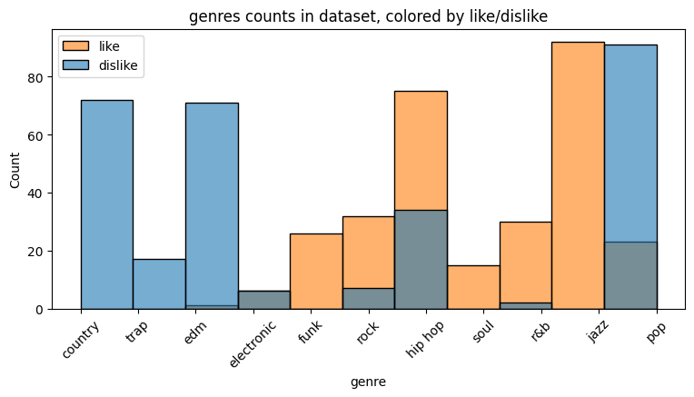
Dataset
Bayesify
1.
Histograms of all the features, coloured by like.
All the values are discrete.

Slide 4
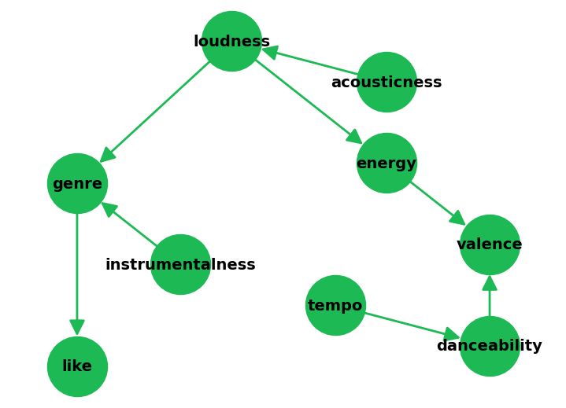
Models
Bayesify
2.
1. Domain Knowledge Model
Features are linked based on domain knowledge and intuition
The process was difficult and required some trials and errors
Like is only connected to genre

Slide 5
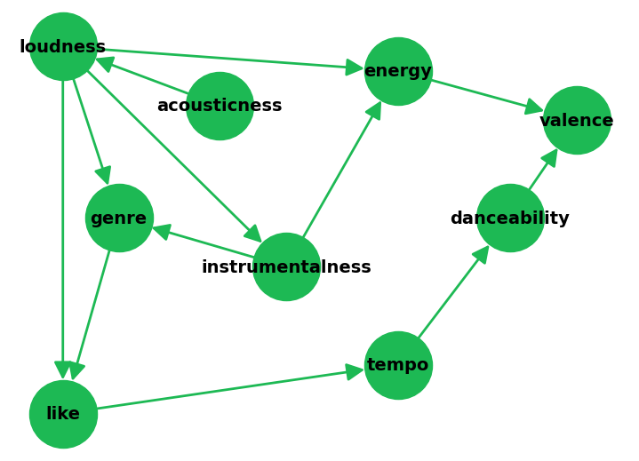
2. Models
2. Hill Climb Search Model
The structude was learned using Hill Climb Search with BDeu score as heuristics to guide search
Some links are the same as the other model (like loudness to genre)
Like now has two parents, but it is connected to tempo (semantically incorrect)
For both models, CPDs are estimated from the dataset, using Maximum Likelyhood Estimation (MLE) .

Slide 6
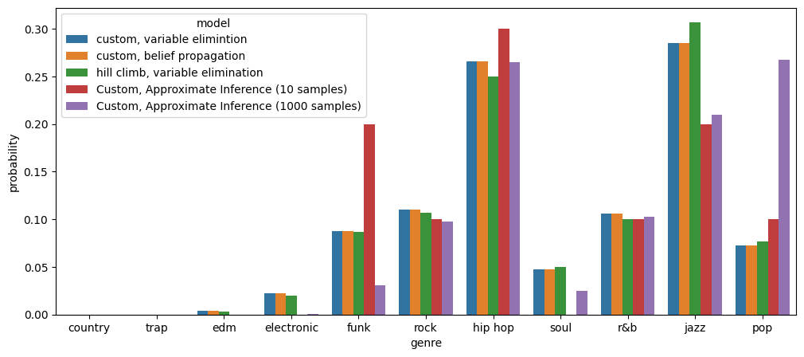
Inference
Bayesify
3.
P(genre|like=1)
EXACT INFERENCE
Variable Elimination and Belief Propagation are almost identical.
Custom and Hill Climb models gave similar results (variable elimination).
APPROXIMATE INFERENCE
Anomalous results for pop music, especially with high number of samples.

Slide 7
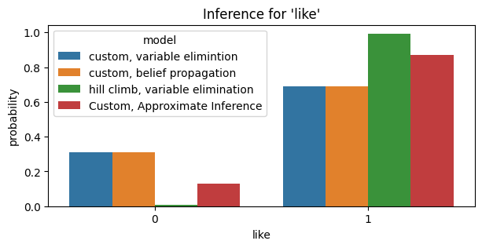
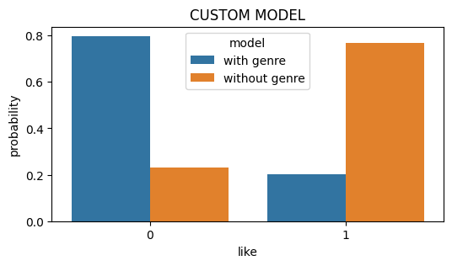
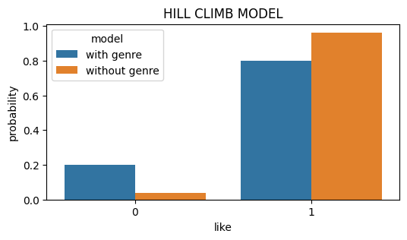
3. Inference
P(like), given all the other features as evidence
Those features are taken from a song I like.
Analyzing the influence of «genre»
P(like), given the same features as before, but changing genre to «pop» (wich is associated to disliked songs)
As expected, the probability for like=1 is higher than 50% for every method and model tested.
This time, approximate inference gave better results.
The Custom Model gave totally different results when not considering the genre, being much more influenced by it respect to the Hill Climb Model.

Slide 8
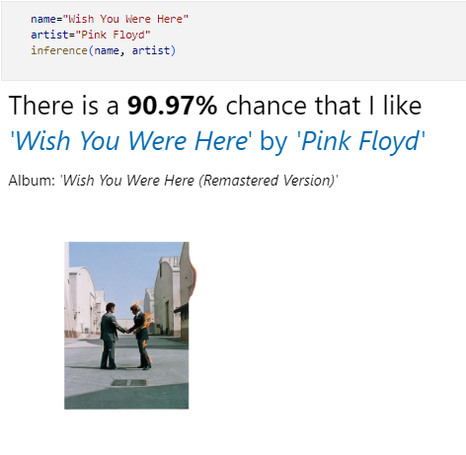
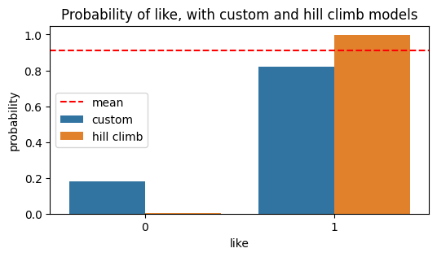
Bayesify
Use Case Application
4.
Given a song name and artist, the features will be retrieved from Spotify and fed to the model, which will return the probability that I like it.
The final probability is the mean between custom and Hill Climb models, using Variable Elimination.

Slide 9
Conclusions
Bayesify
Building the dataset helped in the process of designing the causal network.
The model is based on subjective preferences: it might not work as well if fitted with someone else’s data.
The most difficult part was designing the network, but automatic model generation techniques are valid alternatives.

Slide 10

Thank you for listening
Bayesify
Daniele Napolitano
daniele.napolitano4@studio.unibo.it
Project link on GitHub:
https://github.com/danielenapo/Bayesify

