Slide 1
King County
House Price Prediction
Predicting home sale prices and spotting luxury properties with Machine Learning
Daniel · Ironhack
Notes:
Intro (~20s): Hi everyone. This is my final project, King County House Price Prediction. The goal is to predict home sale prices and identify luxury homes using machine learning on 21,000+ real property sales near Seattle.

Slide 2
PROJECT OVERVIEW
What the project sets out to do
Using one year of King County home sales (May 2014 – May 2015), the project answers three questions with three different families of ML models.
01
02
03
Predict price
Spot luxury homes
Segment the market
Regression on the continuous sale price, and learn which features drive it most.
Classification: is a house ≥ $650,000? Identify what sets premium homes apart.
Unsupervised KMeans clustering to find natural groups of homes — no price used.
King County House Price Prediction
2
Notes:
Overview (~30s): One dataset, three tasks. First, regression to predict the exact price. Second, classification to flag luxury homes over $650k. Third, unsupervised clustering to segment the market. Each task answers a different business question.

Slide 3
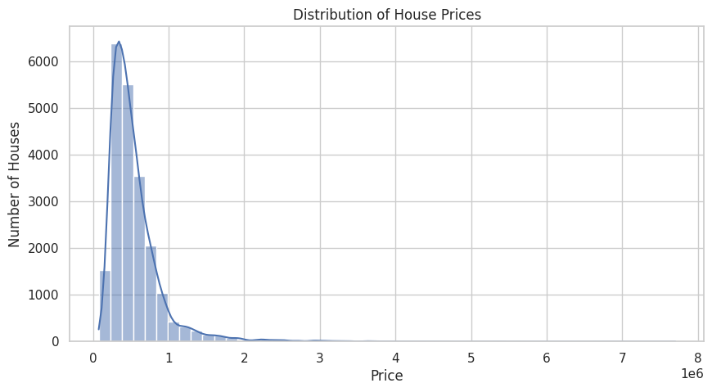
PROJECT OVERVIEW
The dataset at a glance
21,613
21
$540k
24.6%
home sales
raw features
average price
are luxury (≥$650k)
Right‑skewed target. Most homes sell in the low‑to‑mid range with a long tail of very expensive properties (up to $7.7M). A log transformation is applied so models train on a well‑behaved distribution.
King County House Price Prediction
3
Notes:
Dataset (~30s): 21,613 sales, 21 features, no missing values. Average price is $540k but the distribution is heavily right-skewed — a few mansions up to $7.7M pull the mean up. That's why I log-transform the price before modelling. About a quarter of homes are luxury.

Slide 4
IMPLEMENTATION DETAILS
From raw data to model‑ready features
Load &
explore
›
Clean &
engineer features
›
Prevent
target leakage
›
Pipeline:
scale + encode
›
Train & compare
models
Engineered features
house_age
sale year − year built
was_renovated / years_since_renovation
renovation history
has_basement
basement present or not
sale_year / sale_month
parsed from the sale date
⚠ No target leakage
Features built from price (log_price, luxury_home, price_per_sqft) plus IDs and dates are dropped from the predictors so the model can never see the answer it's trying to predict.
King County House Price Prediction
4
Notes:
Implementation 1 (~30s): The flow is load, clean, engineer, then a scikit-learn pipeline. I created features like house age, renovation history, basement flag, and parsed the date. A key best practice: I removed every feature derived from price so there's no target leakage — the model only sees legitimate property attributes.

Slide 5
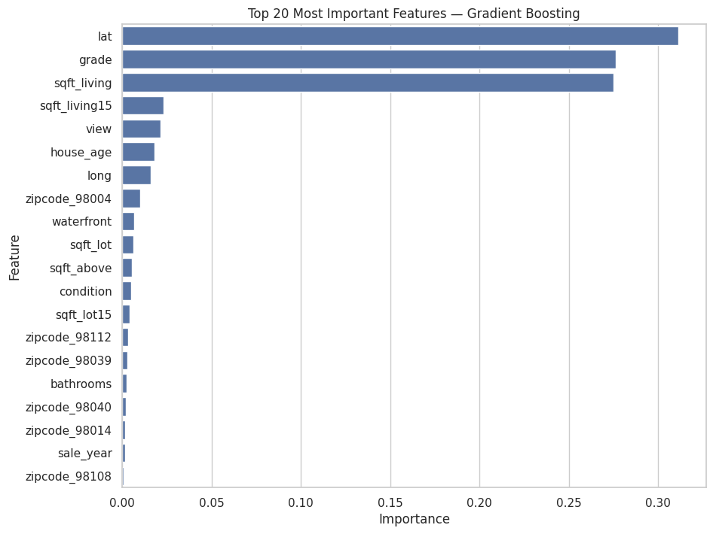
IMPLEMENTATION DETAILS
A consistent, reproducible modelling setup
Unified Pipeline
StandardScaler for numeric + OneHotEncoder for zipcode, so preprocessing is identical for every model.
Log‑target wrapper
TransformedTargetRegressor (log1p / expm1) keeps errors interpretable in dollars.
Fair comparison
Same 80/20 split (random_state=42); models ranked by Test RMSE & F1.
7 regressors · 4 classifiers
From Linear/Ridge/Lasso to tree ensembles, plus KMeans for segmentation.
Top price drivers: location (lat), grade & living area
King County House Price Prediction
5
Notes:
Implementation 2 (~30s): Every model runs through the same pipeline, wrapped so it learns on log-price but reports dollar errors. I compared 7 regressors and 4 classifiers on the exact same split. The feature importance chart shows the three biggest price drivers are location, build grade, and living area.

Slide 6
CHALLENGES & SOLUTIONS
Problems faced — and how they were solved
Strongly skewed prices
Models trained on raw price underperformed.
✓ Applied a log1p target transform, then inverse‑transformed predictions back to dollars.
Risk of target leakage
Several handy columns were derived from price.
✓ Explicitly excluded every price‑derived feature from the predictor set.
High‑cardinality zipcode
70+ zip codes can't be fed as raw numbers.
✓ One‑hot encoded zipcode inside the pipeline with handle_unknown='ignore'.
Comparing many models fairly
Easy to get inconsistent, non‑reproducible results.
✓ Single reusable evaluation function + fixed random_state for every model.
King County House Price Prediction
6
Notes:
Challenges (~35s): Four main hurdles. Skewed prices — fixed with a log transform. Leakage risk — fixed by dropping price-derived columns. Many zip codes — one-hot encoded inside the pipeline. And keeping model comparison fair — solved with one reusable evaluation function and a fixed random seed.

Slide 7
TOOLS & TECHNOLOGIES
The stack behind the analysis
1
Python 3.11
2
pandas + NumPy
3
Matplotlib + Seaborn
Core language for the whole pipeline
Data wrangling & feature engineering
EDA and all visualizations
4
scikit‑learn
5
SciPy
6
Jupyter Notebook
Pipelines, models, KMeans, metrics
Welch's t‑test for hypothesis testing
Interactive, reproducible workflow
Why this stack: the scikit‑learn + pandas ecosystem is the industry standard for tabular ML — fast to prototype, easy to keep reproducible, and rich enough to cover regression, classification and clustering in one place.
King County House Price Prediction
7
Notes:
Tools (~25s): A standard, reproducible Python data stack — pandas and NumPy for data, Matplotlib and Seaborn for visuals, scikit-learn for all the modelling, SciPy for the statistical test, all inside Jupyter. I chose it because it's the industry standard for tabular ML and lets me cover all three tasks in one environment.

Slide 8
WORKFLOW & PROJECT MANAGEMENT
How the work was organised
The project was run as a single, linear notebook that doubles as documentation — each stage builds on the previous one and is reproducible end‑to‑end.
Structured notebook
Reproducibility first
Iterative evaluation
One clear section per stage (EDA → regression → classification → clustering) with markdown narration.
Fixed seeds, pipelines and helper functions so any result can be regenerated on demand.
Models added one at a time and ranked on a shared metrics table before picking a winner.
What worked: keeping everything in one reproducible pipeline. To improve: split code into modules and add cross‑validated tuning.
King County House Price Prediction
8
Notes:
Project management (~25s): I treated the notebook as both code and documentation — one section per stage, fully reproducible with fixed seeds and reusable functions. What worked was keeping everything in one consistent pipeline. If I extended it, I'd modularise the code and add cross-validated hyperparameter tuning.

Slide 9
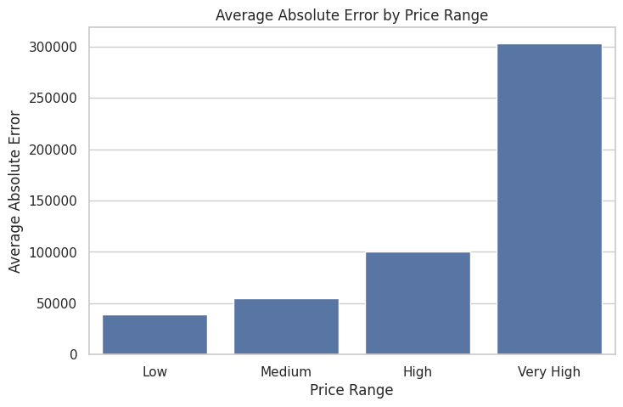
THE BIGGEST OBSTACLE
The model is much weaker on luxury homes
~$48k
~$158k
avg error · non‑luxury
avg error · luxury
What I learned
Aggregate metrics hide segment failure.
An R² of 0.88 looked great until I broke errors down by price band and saw the high‑end was poorly served.
In hindsight: I'd model the luxury tail separately, gather more high‑end samples, and report error per segment from the start.
Error rises steeply with price
Notes:
Major obstacle (~40s): My biggest lesson. The headline R² of 0.88 looked excellent, but when I broke errors down by price band, the model was off by ~$48k on normal homes and ~$158k on luxury homes. Aggregate metrics hid a real weakness on the expensive segment. In hindsight I'd model the luxury tail separately and always report error per segment, not just overall.

Slide 10
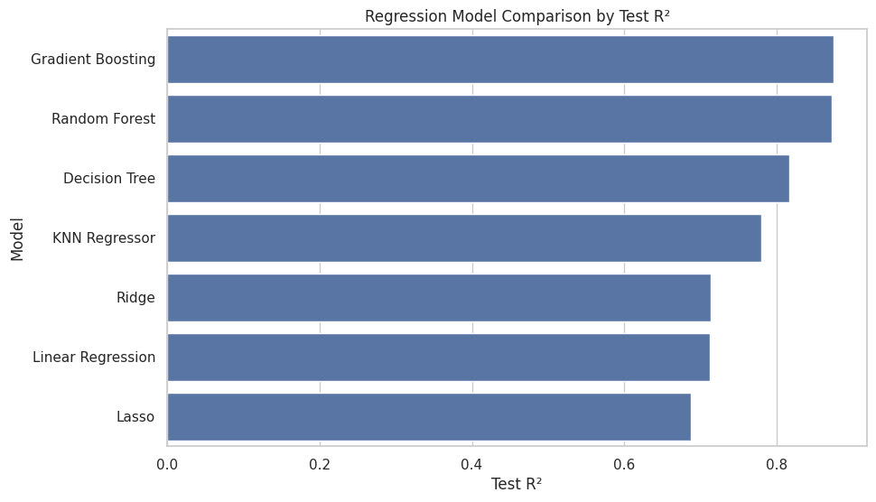
CONCLUSION & INSIGHTS
Did the project meet its objectives?
0.88
93%
3
Test R² — Gradient Boosting explains ~88% of price variance
accuracy classifying luxury vs non‑luxury homes
drivers dominate price: location, grade & living area
Main learnings
✓ All three objectives were met:
accurate price prediction, reliable luxury detection, and a clean two‑segment market.
✓ Ensembles beat linear models
thanks to non‑linear feature interactions.
✓ Gradient Boosting won by balancing accuracy with almost no overfitting.
King County House Price Prediction
10
Notes:
Conclusions 1 (~30s): All three goals were met. Gradient Boosting explains about 88% of price variance and classifies luxury homes with 93% accuracy. Three features dominate: location, grade, and living area. The tree ensembles clearly beat the linear models because they capture non-linear interactions.

Slide 11
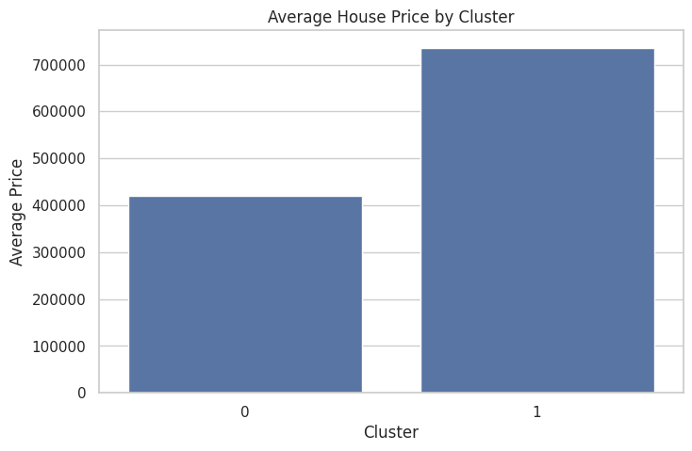
CONCLUSION & INSIGHTS
A surprising finding & what it means
The market splits cleanly in two — without using price
KMeans on physical & location features alone recovered a Premium and a Standard segment that closely track price — strong evidence those attributes truly define value.
Premium
Standard
$736k
avg price
46% luxury · grade 8.6
$420k
avg price
12% luxury · grade 7.1
Implications: useful for automated valuation, pricing premium listings, and targeting marketing by segment.
Still open: why luxury error stays high, and whether external data (schools, transit) would close the gap.
King County House Price Prediction
11
Notes:
Conclusions 2 (~35s): The most surprising insight — clustering on physical and location features alone, with no price, recovered a premium and a standard segment that track price almost perfectly. That confirms those attributes really define value. Practically, this supports automated valuation and segment-based marketing. The open question is why luxury error stays high, and whether external data would help.

Slide 12
Thank you!
King County House Price Prediction
Questions?
Daniel
Notes:
Close (~10s): That's the project — predicting prices, flagging luxury homes, and segmenting the market. Thank you, and I'm happy to take any questions. Now I'll switch to the notebook for the demo.

