Slide 1
FINAL PROJECT · DATA SCIENCE & MACHINE LEARNING BOOTCAMP
Institutional Valuation System
Can an automated fundamental valuation model
identify stocks that beat the market?
Daniel Fernández
2,305 companies screened · 8,487 lines of Python · web app in daily use
IVS · Institutional Valuation System
01
Notes:
00:00 · 40 s
Good morning. My name is Daniel Fernández, and this is my final project: the
Institutional Valuation System.
First, a thank you to Joseph: he saw my post about this app on LinkedIn and let
me bring it in as my final project, so I have been working on it since April.
It has two parts. A tool I built to put a value on companies, which I use every
day to run a real portfolio. And a test: I checked whether the scores it gives
out matched what the market did afterwards.

Slide 2
01 · WHAT THIS IS
What I built, and what I checked
A valuation system I use every day, and a check of whether its own score lined up with what the market did next.
THE SYSTEM
THE DATASET
THE CHECK
A valuation engine — DCF, CAPM, WACC, Monte Carlo — wrapped in a web app: 19 Python modules, 28 REST endpoints, 23 React components.
The engine screened 2,305 companies and valued 1,437 of them. Its own output became my dataset: 1,437 rows and 32 features.
I then labelled every company with what actually happened over the next 18 trading sessions, and trained models to see whether the score predicted it.
The whole cycle —collecting, cleaning, exploring, modelling and Gen AI— runs on data I generated myself, not on a Kaggle CSV.
IVS · Institutional Valuation System
02
Notes:
00:40 · 45 s
Three things, left to right.
The system. A tool that values companies, with a web app around it. Nineteen
Python files on the back end, twenty-three screens and components on the front.
The data. The tool looked at 2,305 companies and fully valued 1,437 of them. Those
results became my data set: 1,437 rows and 32 columns. I did not download it from
anywhere.
And the test. For each company I wrote down what really happened over the next 18
market days, and then trained models to see if my score could predict it.

Slide 3
02 · CURRICULUM COVERAGE
Every module, and where it lives in this project
The 14 weeks of the bootcamp, mapped onto real files of the system.
Python & OOP
NumPy
Pandas
Probability
20+ classes and dataclasses:
CompanyProfile, PortfolioDatabase
10,000 valuations computed at once,
not one by one in a loop
The whole cleaning pipeline:
groupby · merge · concat · corr
Growth and cost of money drawn at
random — a range, not one price
Hypothesis testing
EDA · one & two variables
Visualization
Supervised ML
Mann-Whitney U on the verdicts:
p = 0.0031
Notebook 03, plus the live
correlation matrix in the app
matplotlib/seaborn in notebooks,
Recharts in the product
Logistic regression · random forest
· gradient boosting
Model evaluation
Scikit-learn pipelines
Working with text
Gen AI
ROC-AUC, confusion matrix,
precision/recall, grid search
Scaler inside the Pipeline, so test
data never helps fit it
Matches a question to the reports
by the words they share
Searches my own reports, and the
prompt forbids inventing figures
Deliberately not used: Deep Learning and Computer Vision (no images here — 1,437 × 32 tabular rows do not justify a network) · clustering (left as future work: sector-relative peer groups) · Streamlit and Tableau (replaced by a FastAPI + React app)
IVS · Institutional Valuation System
03
Notes:
01:25 · 55 s
This slide puts the fourteen weeks of the course next to the real files of my
project. I will not read all twelve boxes — there are four groups.
In green, the Python basics: classes, NumPy and pandas.
In amber, statistics: probability, checking whether a difference is real, and
looking at the data one and two columns at a time.
In light green, machine learning: three types of model, and how I measured them.
And in red, working with text, and generative AI.
The part I do want to point at is the strip at the bottom. There is no deep
learning and no computer vision here. I have no images, and 1,437 rows of a table
do not need a neural network. And instead of Streamlit or Tableau, I built the app.

Slide 4
03 · THE DATA
A dataset of my own, not a download
No pre-existing CSV: the universe, the features and the label are produced by the system itself.
Yahoo Finance · screener endpoint
US small/mid-cap universe, $300M – $10B
2,305 tickers
Yahoo Finance · yfinance
Financial statements and price history
1,437 valued
Own valuation engine
DCF · Excess Return · AFFO → features
1,437 × 32
Prices after the scan date
Target variable beats_market
1,421 labelled
Target · beats_market — did the stock beat the S&P 500 between the scan date (2026-08-04) and the following close (2026-08-26, 18 sessions)? Base rate: 45.1% → nearly balanced classes.
The hard part of collection was not finding data: Yahoo returns only 250 rows per query and caps pagination.
IVS · Institutional Valuation System
04
Notes:
02:20 · 40 s
Four steps to build the data. Yahoo's screener gives me the list: American
companies, small and medium size, from 300 million to 10 billion dollars. That is
2,305 of them. yfinance gives me their accounts and their past prices. My valuation
tool turns that into 32 columns per company.
Then the answer column: did each company beat the S&P 500 over the next 18 market
days? Yes for 45 percent, so the two groups are about even.
The important part is that the answer comes from prices later than the data.

Slide 5
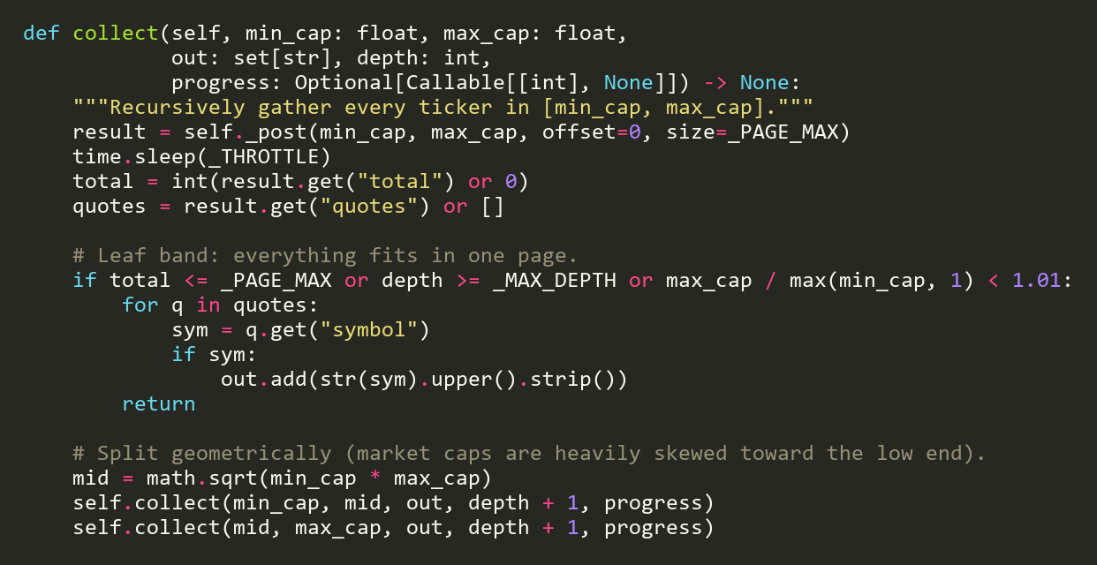
04 · COLLECTION
backend/universe_fetcher.py
Recursive partition of the universe
Yahoo caps every query at 250 rows. The fix is to split the range, not the page.
Split the market-cap range into bands and recursively subdivide any band that comes back full. The union of the leaf bands is the whole universe: 2,305 tickers.
IVS · Institutional Valuation System
05
Notes:
03:00 · 30 s
How I collect it. Yahoo only gives 250 rows per request, so you cannot ask for
everything at once. I ask for a size range, and if it comes back full I cut that
range in two and ask again.
The line to notice is where I cut: at the square root, not in the middle. Most
companies are small, so cutting in the middle would leave one half nearly empty.

Slide 6
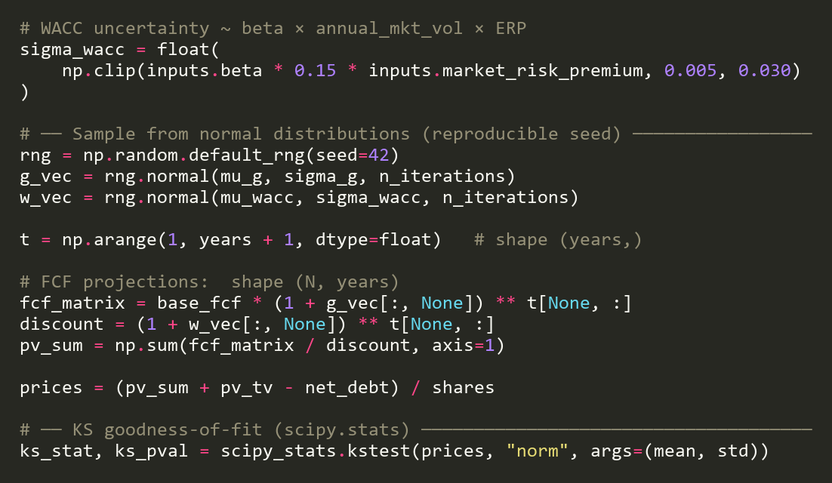
05 · PROBABILITY
backend/montecarlo_engine.py
Monte Carlo: 10,000 valuations instead of one
A single DCF gives one number. Sampling the assumptions gives a distribution.
Growth and the cost of money are drawn at random around my estimate, and the 10,000 valuations are computed all at once instead of one by one. The answer is a range, not a price.
IVS · Institutional Valuation System
06
Notes:
03:30 · 25 s · [CUT IF LATE]
Very quickly, the Monte Carlo. One valuation gives you one number, and it rests on
guesses about growth and the cost of money. So the tool runs ten thousand instead,
picking those guesses at random around my estimate — all ten thousand at once.
So the answer is a range, not a price.

Slide 7
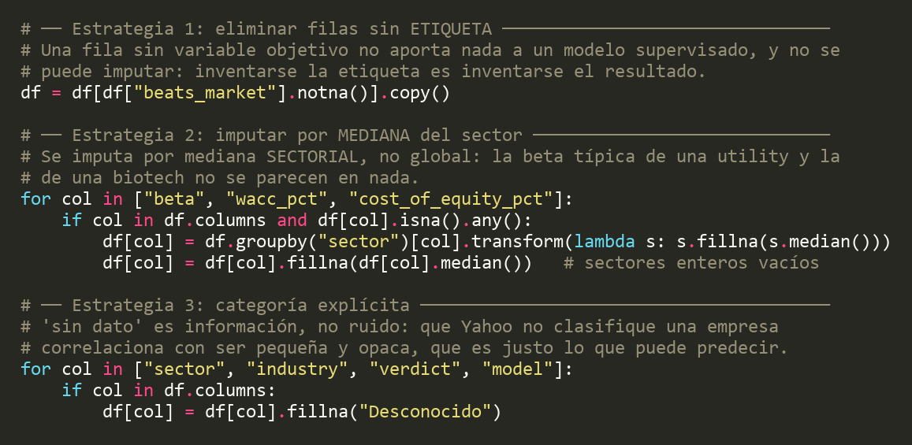
06 · CLEANING
notebooks/02_Preparacion_y_Limpieza.ipynb
Missing values: three strategies, not one
The choice does not depend on the column, it depends on WHY the value is missing.
Imputing beta with the global median would have put a utility's beta inside a biotech. That is why imputation is sector-wise.
IVS · Institutional Valuation System
07
Notes:
03:55 · 30 s
Missing values, three different fixes. If the answer is missing I delete the row —
you cannot make up the answer.
If a risk number is missing, I fill it with the middle value for that company's
sector, not for the whole market: a power company and a biotech are nothing alike.
And a missing category becomes "unknown", on purpose — the companies Yahoo cannot
classify tend to be small and obscure.

Slide 8
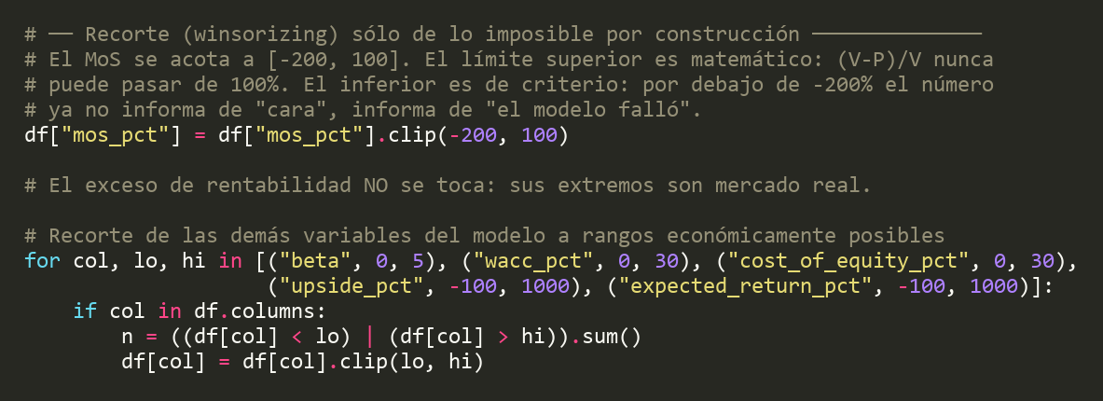
07 · CLEANING
notebooks/02_Preparacion_y_Limpieza.ipynb
Outliers: deleting them would be the classic mistake
In stock returns the extremes are not noise — they are the phenomenon under study.
I cut only what cannot exist — a margin of safety above 100 — and leave untouched what is rare but real: the returns themselves.
IVS · Institutional Valuation System
08
Notes:
04:25 · 30 s
Outliers. The obvious move here is to delete them, and I did not.
With share prices, the extremes are the whole point. A biotech can go up 300
percent in one day if a drug is approved. So I only cut the numbers that cannot
exist — my margin of safety can never be above 100. The returns themselves I leave
exactly as they are.

Slide 9
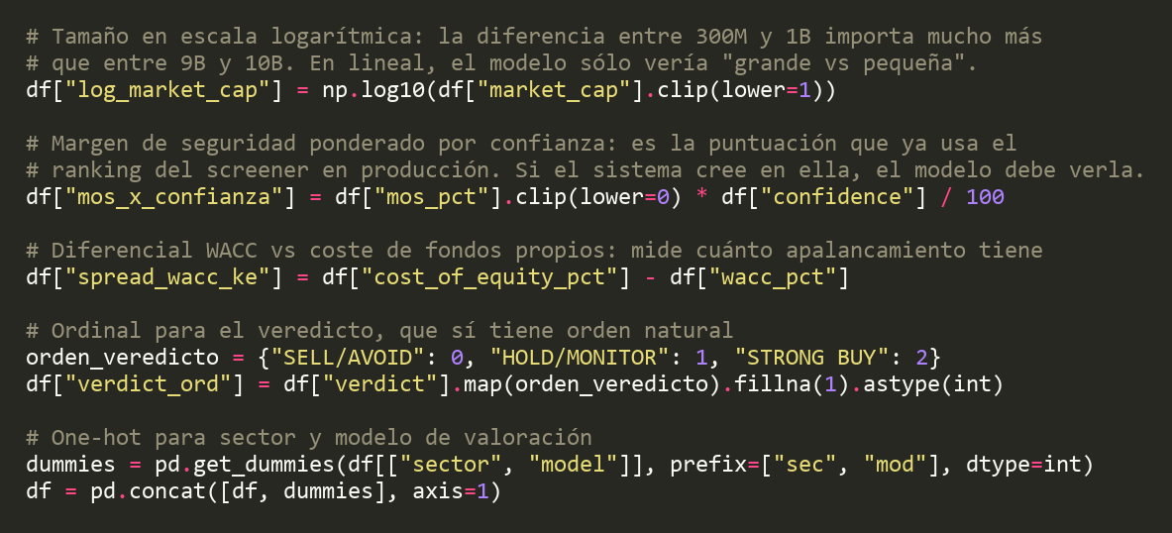
08 · FEATURE ENGINEERING
notebooks/02_Preparacion_y_Limpieza.ipynb
New variables, and encoding with intent
Two new features from domain knowledge, and two different encodings for two different kinds of category.
Ordinal for the verdict, because SELL < HOLD < BUY is a real order. One-hot for sector, because an integer code would tell the model that 'Energy > Technology', which means nothing.
IVS · Institutional Valuation System
09
Notes:
04:55 · 25 s
Two decisions. Company size goes in as a logarithm, because the jump from 300
million to 1 billion matters more than from 9 to 10 billion.
And the categories: the verdict gets numbers in order, sell, hold, buy. But the
sector gets one yes-or-no column each, so the model never thinks one sector is
bigger than another.

Slide 10
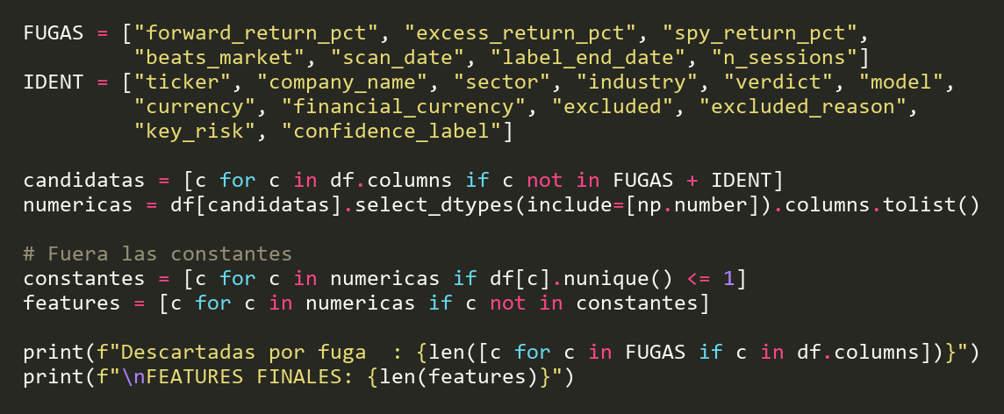
09 · DATA LEAKAGE
notebooks/02_Preparacion_y_Limpieza.ipynb
The bug that would have given me 100% accuracy
Seven columns are derived from the label. Feeding them back in is reading the answer off the exam paper.
From 60+ columns down to 32: the seven that come from the answer are out, names and tickers are out, and so is any column where every company had the same value.
IVS · Institutional Valuation System
10
Notes:
05:20 · 40 s
This one I do want to stop on, because it is the mistake that would have ruined
the project, and I made it.
The first time I trained a model, the score came out suspiciously high. Seven of my
columns were calculated from the answer itself — the future return, for example. If
I leave those in, the model is not predicting anything. It already has the answer
in front of it.
So there is a written list, and those columns go out. That takes me from over 60
columns down to 32.

Slide 11
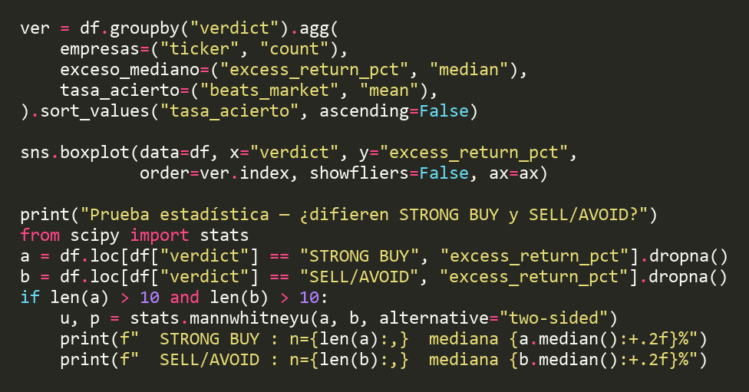
10 · EDA
notebooks/03_Analisis_Exploratorio_EDA.ipynb
Hypothesis testing: picking the right test
Do the system's STRONG BUY and SELL/AVOID verdicts actually separate returns?
Mann-Whitney U, not the usual t-test: a few enormous winners and losers pull returns around, so a test that assumes a bell curve would give me a number I could not trust. Result: p = 0.0031.
IVS · Institutional Valuation System
11
Notes:
06:00 · 30 s
Before any machine learning, one check. My system already gives verdicts: strong
buy, hold, sell. Do those verdicts actually separate the returns?
I used a test that does not assume a bell curve, because a few enormous winners
and losers pull returns around, and the usual test would give me a number I could
not trust.
The strong buys did do better, and the difference is real.

Slide 12
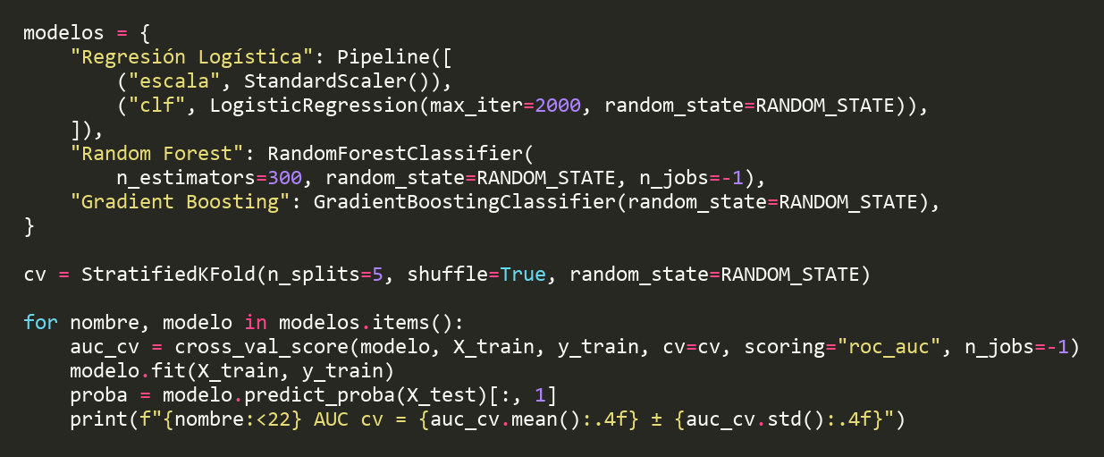
11 · MODELLING
notebooks/04_Machine_Learning.ipynb
Three families, stratified cross-validation
Three different sets of assumptions, so the conclusion does not rest on one arbitrary choice.
The scaling step goes inside the Pipeline: doing it first would let the test data help set the scale, and that is cheating. And every split keeps the same 45/55 mix of winners and losers.
IVS · Institutional Valuation System
12
Notes:
06:30 · 35 s
Three types of model: logistic regression, random forest and gradient boosting.
Two details. First, the scaling step goes inside the pipeline, so it is redone on
every split. If I scaled everything first, the test data would help set the scale,
and that is cheating.
Second, every split keeps the same mix of winners and losers.
The three scores: 0.672, 0.675 and 0.688. Very close, which already tells me the
type of model is not what matters here.

Slide 13
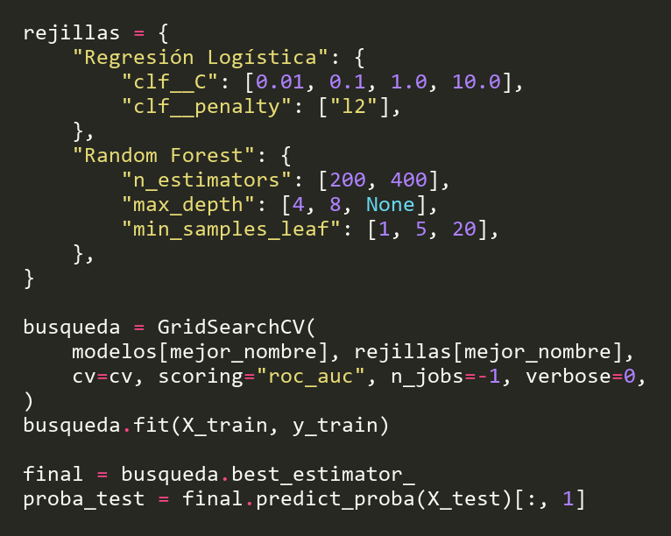
12 · TUNING
notebooks/04_Machine_Learning.ipynb
GridSearchCV, and why ROC-AUC is the metric
Accuracy would reward a model that just predicts the majority class.
ROC-AUC does not depend on where I draw the buy / don't-buy line: it asks whether the ORDER is better than chance. The test data is used once, on the last line.
IVS · Institutional Valuation System
13
Notes:
07:05 · 25 s
Then I tuned the best one, trying combinations of settings.
The measure I chose is ROC-AUC rather than plain accuracy. With a 45-55 split, a
model that always says "no" is right 55 percent of the time and completely useless.
And the test data is used once, on the last line.

Slide 14
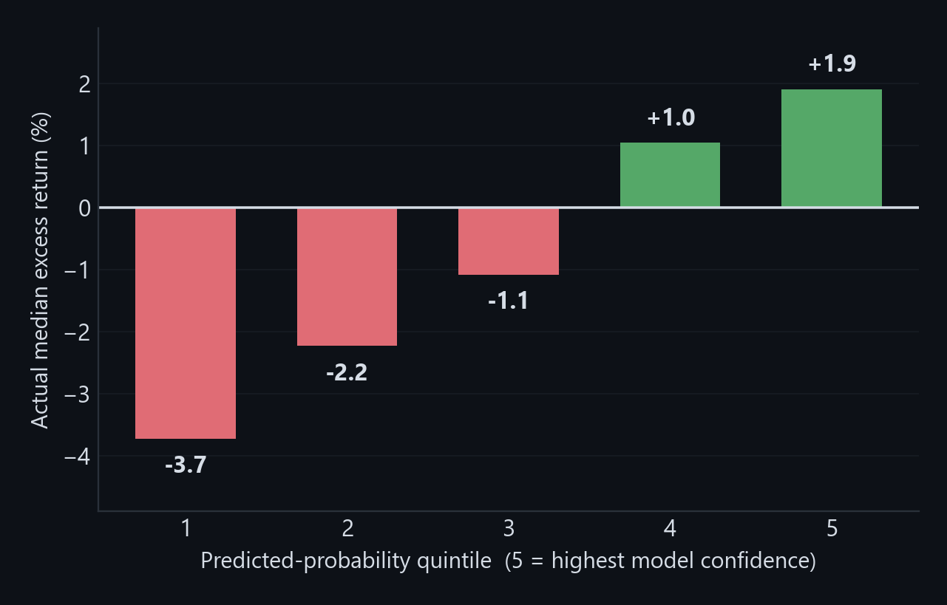
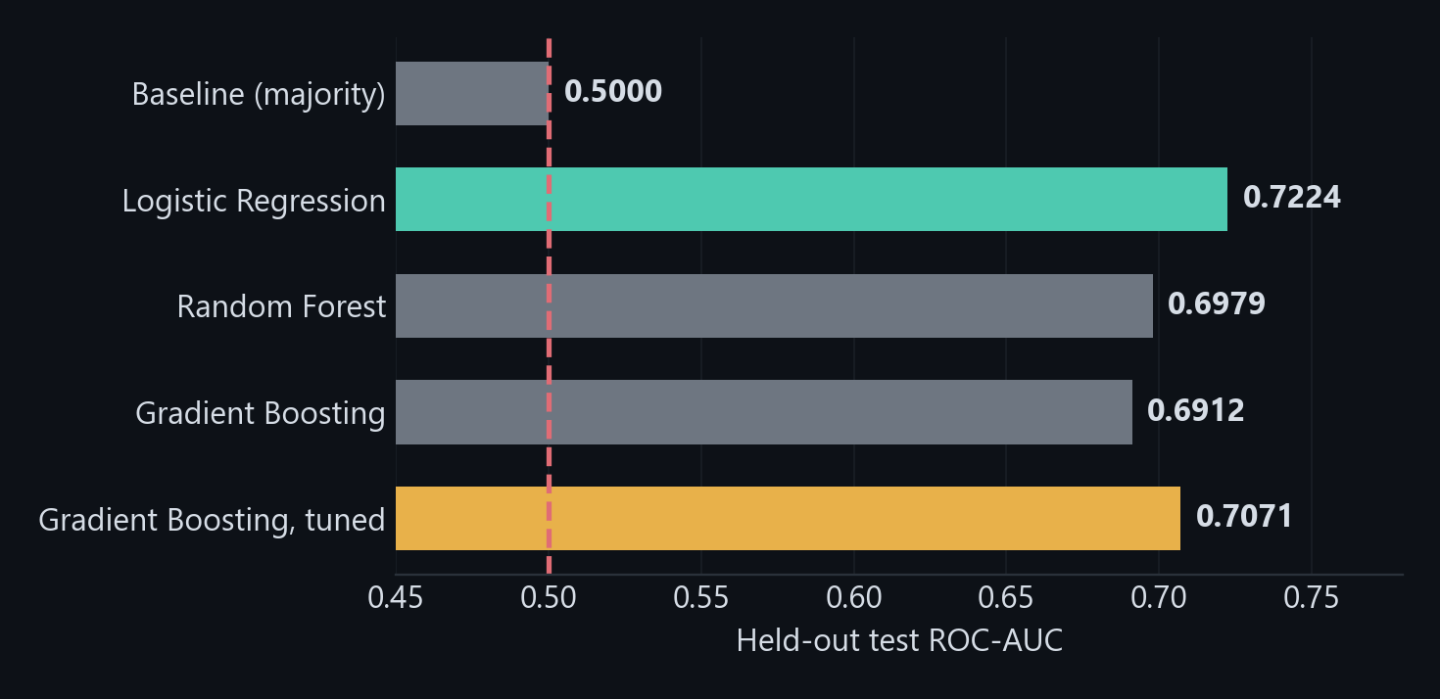
13 · RESULT
AUC 0.71 — and it ranks by return
Held-out test set, 285 companies the model never saw during training or tuning.
The order holds all the way down: the bottom group lost −3.7% against the index and the top one gained +1.9% — a gap of 5.64 points between the companies the model liked least and most.
IVS · Institutional Valuation System
14
Notes:
07:30 · 45 s
The results, on 285 companies the model had never seen.
On the left, all the models. Pure guessing gives 0.5. My tuned model gives 0.707.
One honest note: the simple logistic regression got 0.722, a little better. I kept
the other one because I chose it before looking at the test data, and swapping
afterwards is exactly what you are not supposed to do.
The chart on the right matters more to me. I split the companies into five groups
by score, and the order holds: the bottom group lost 3.7 percent against the
index, and the top group gained 1.9.

Slide 15
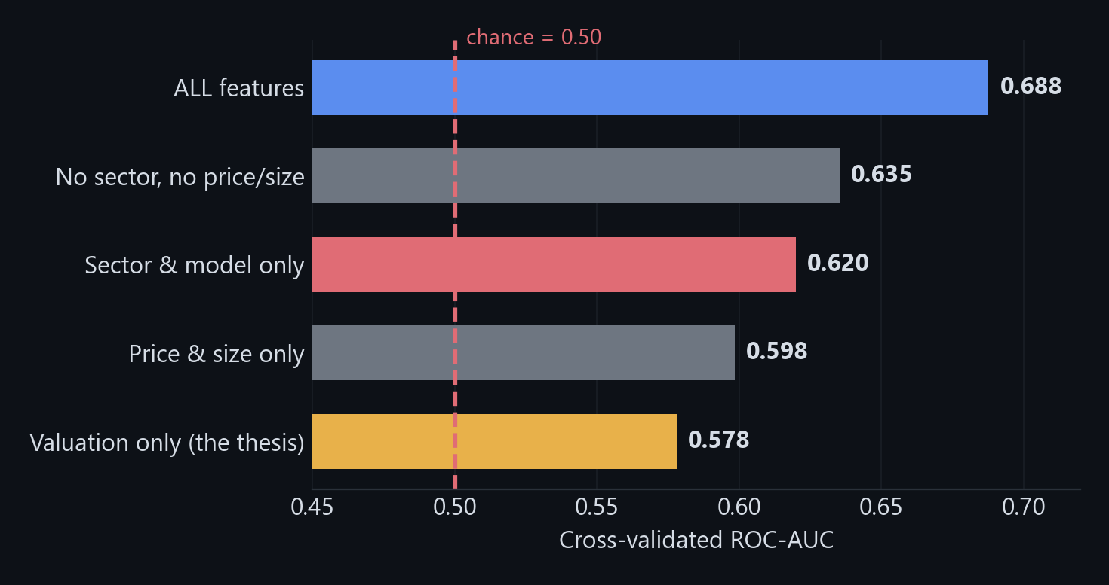
14 · THE BIGGEST CHALLENGE
Where the signal actually comes from
I retrained the same model on one block of features at a time, to see which block was carrying the score.
Valuation only: 0.578
The DCF thesis — margin of safety, confidence, upside, verdict — barely beats a coin flip.
Sector & model only: 0.620
15 dummy variables carrying no valuation information beat the entire thesis.
Most of the 0.688 comes from sector, not from valuation. So I use the score to rank candidates, and I do not present it as evidence of valuation skill.
IVS · Institutional Valuation System
15
Notes:
08:15 · 55 s
This was the hardest part of the project, and the part I am most sure about.
I had 0.688 and I was happy with it. But a score does not tell you where it comes
from. So I trained the same model again and again, each time with only one group of
columns, to see which group was doing the work.
Keep only the valuation columns — margin of safety, confidence, verdict,
everything the idea is built on — and it falls to 0.578. Almost a coin toss.
Keep only the sector, with no valuation information at all, and I get 0.620. Better
than all of my valuation work.
So most of the score is simply which sector a company is in. That is why I use it
to sort candidates, and claim no more than that.

Slide 16
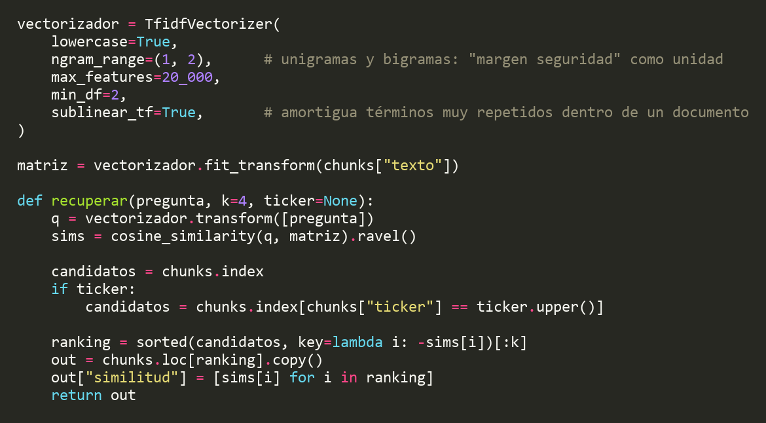
15 · GEN AI
notebooks/05_Gen_AI_Asistente.ipynb
RAG over the theses the system writes itself
70 reports written by the valuation engine — 35 factsheets and 35 investment theses on 35 companies — cut into 552 searchable pieces.
A question is matched to the pieces that share the most words with it, keeping pairs of words together so 'margen de seguridad' stays one idea. The top hit came from the right company 36 times out of 36 — an easy test, because the ticker is almost a unique word.
IVS · Institutional Valuation System
16
Notes:
09:10 · 30 s
The generative AI part. My tool writes its own reports — 70 of them, on 35
companies — so I built an assistant that searches them and answers questions.
I cut them into 552 pieces and match a question to the pieces that share the most
words with it. The top answer was the right company 36 times out of 36 — an easy
test, because the ticker is almost a unique word.

Slide 17
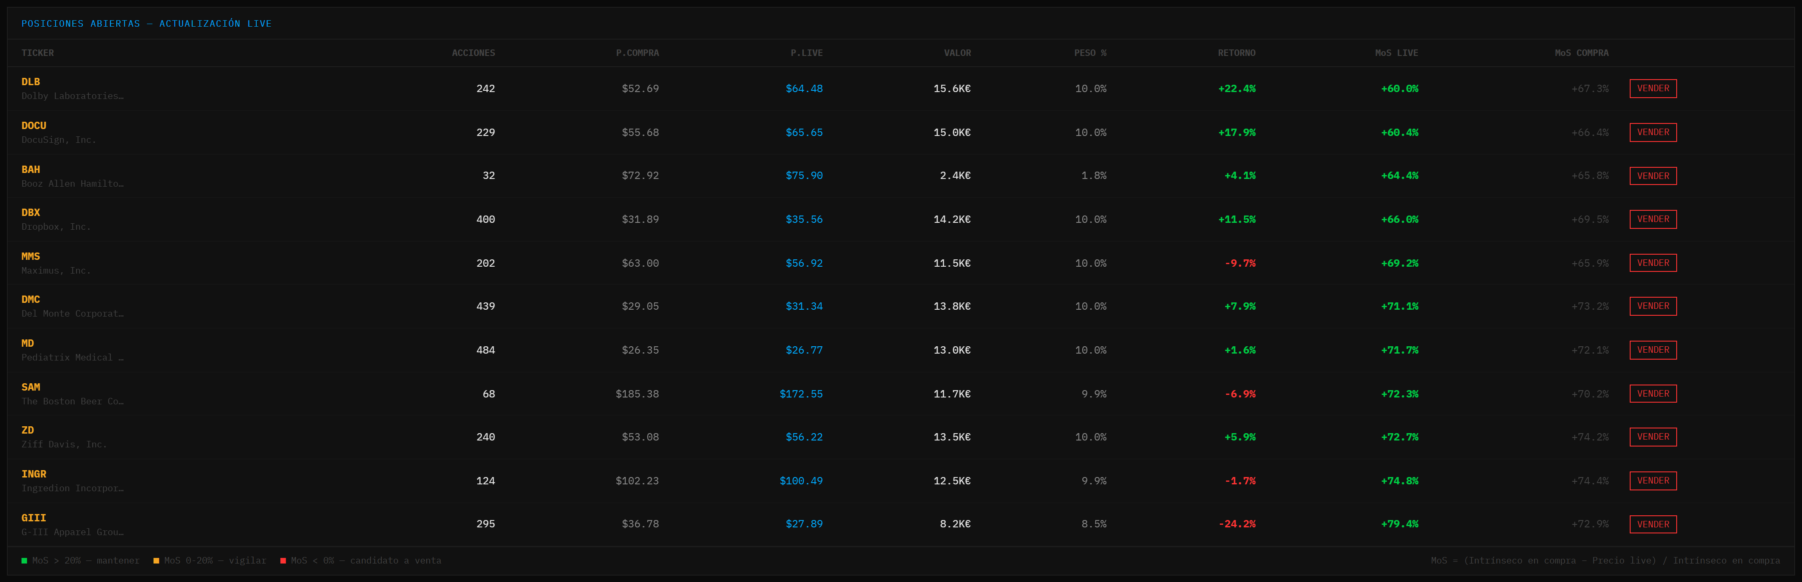
16 · THE PRODUCT
It is not a notebook: it is an app I use
FastAPI + React. 28 REST endpoints, 23 React components, live prices from yfinance.
Real portfolio, €100,000 of initial capital, 11 positions sized by the system's own margin-of-safety ranking. €131.5K today, +31.5%.
IVS · Institutional Valuation System
17
Notes:
09:40 · 35 s
The last part is the product, because this is not just a notebook. It is a real
app: the prices on this screen are downloaded when the page loads.
This is my actual portfolio. 100,000 euros to start, 11 companies, and the sizes
come from my own ranking. Today it is worth 131,500 euros, up 31.5 percent.
And the column on the right recalculates the margin against today's price, so it
tells me what to think about selling.

Slide 18
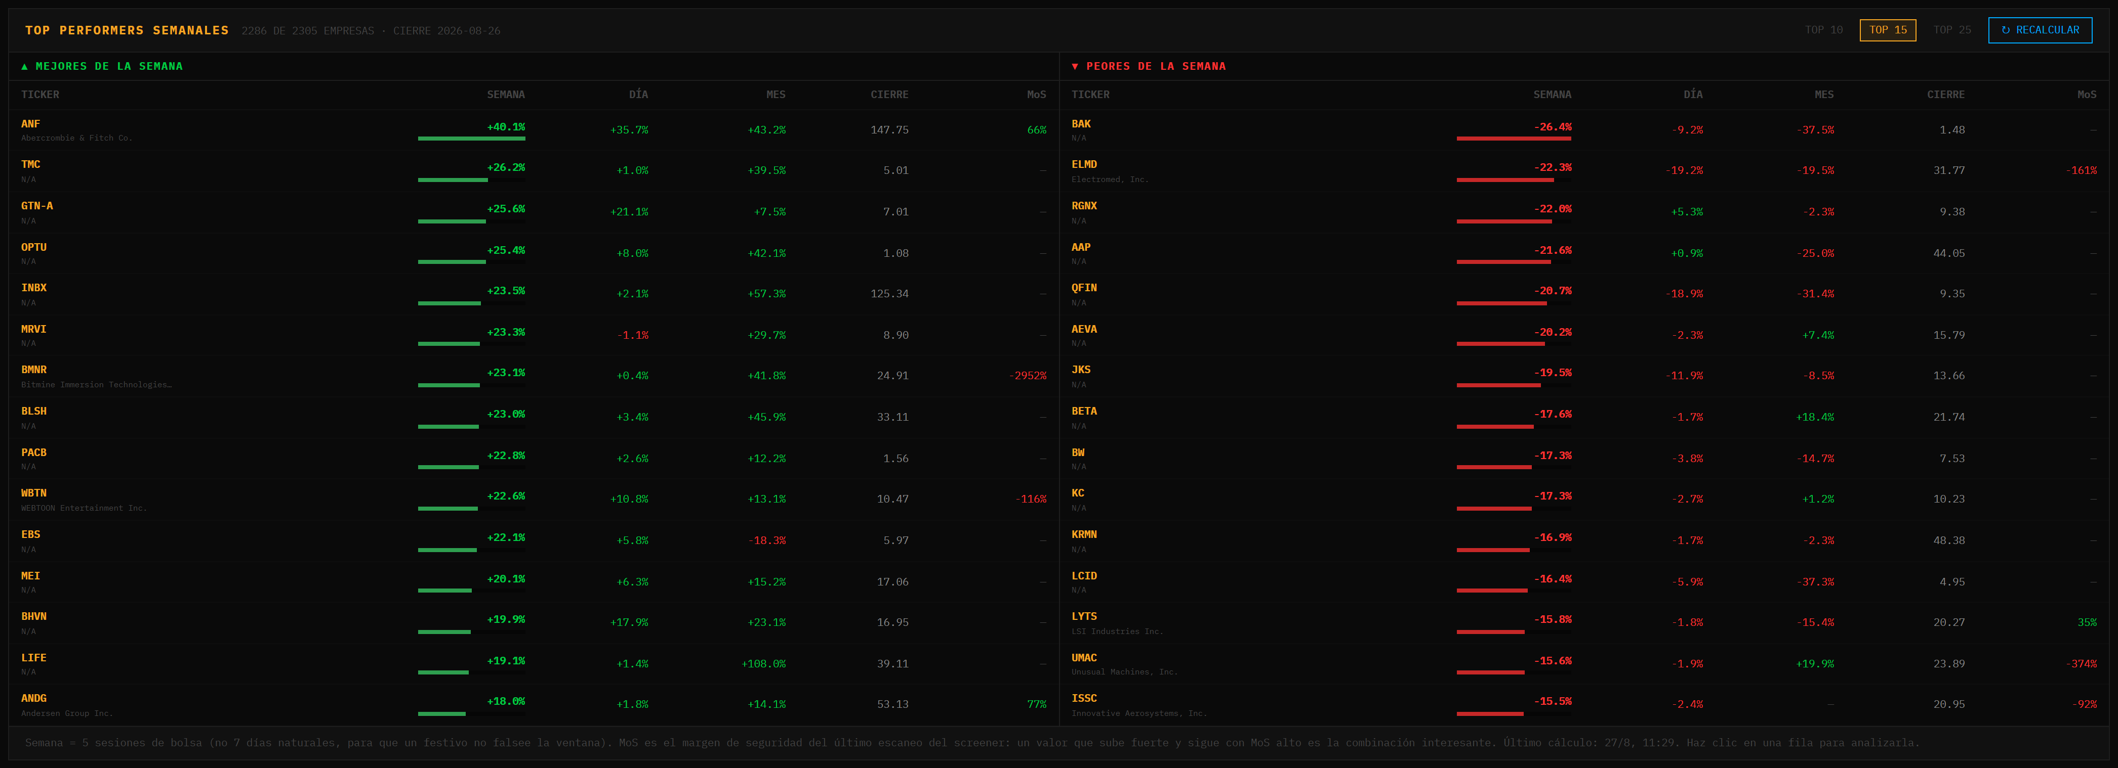
17 · THE SCREENER
The whole universe, ranked every week
Best and worst over the last five market sessions, across 2,286 of the 2,305 companies. Last computed 2026-08-27.
A background job walks the full universe in batches of 150. And "week" means five market sessions, not seven calendar days — so a public holiday cannot fake the window.
IVS · Institutional Valuation System
18
Notes:
10:15 · 30 s
This is the screener, over the whole universe. Every week it ranks the best and the
worst performers across 2,286 of the 2,305 companies — a job that runs in the
background and downloads them in batches of 150.
One detail I like: a week here means five market sessions, not seven days.
Otherwise a public holiday would make the week look flat.

Slide 19
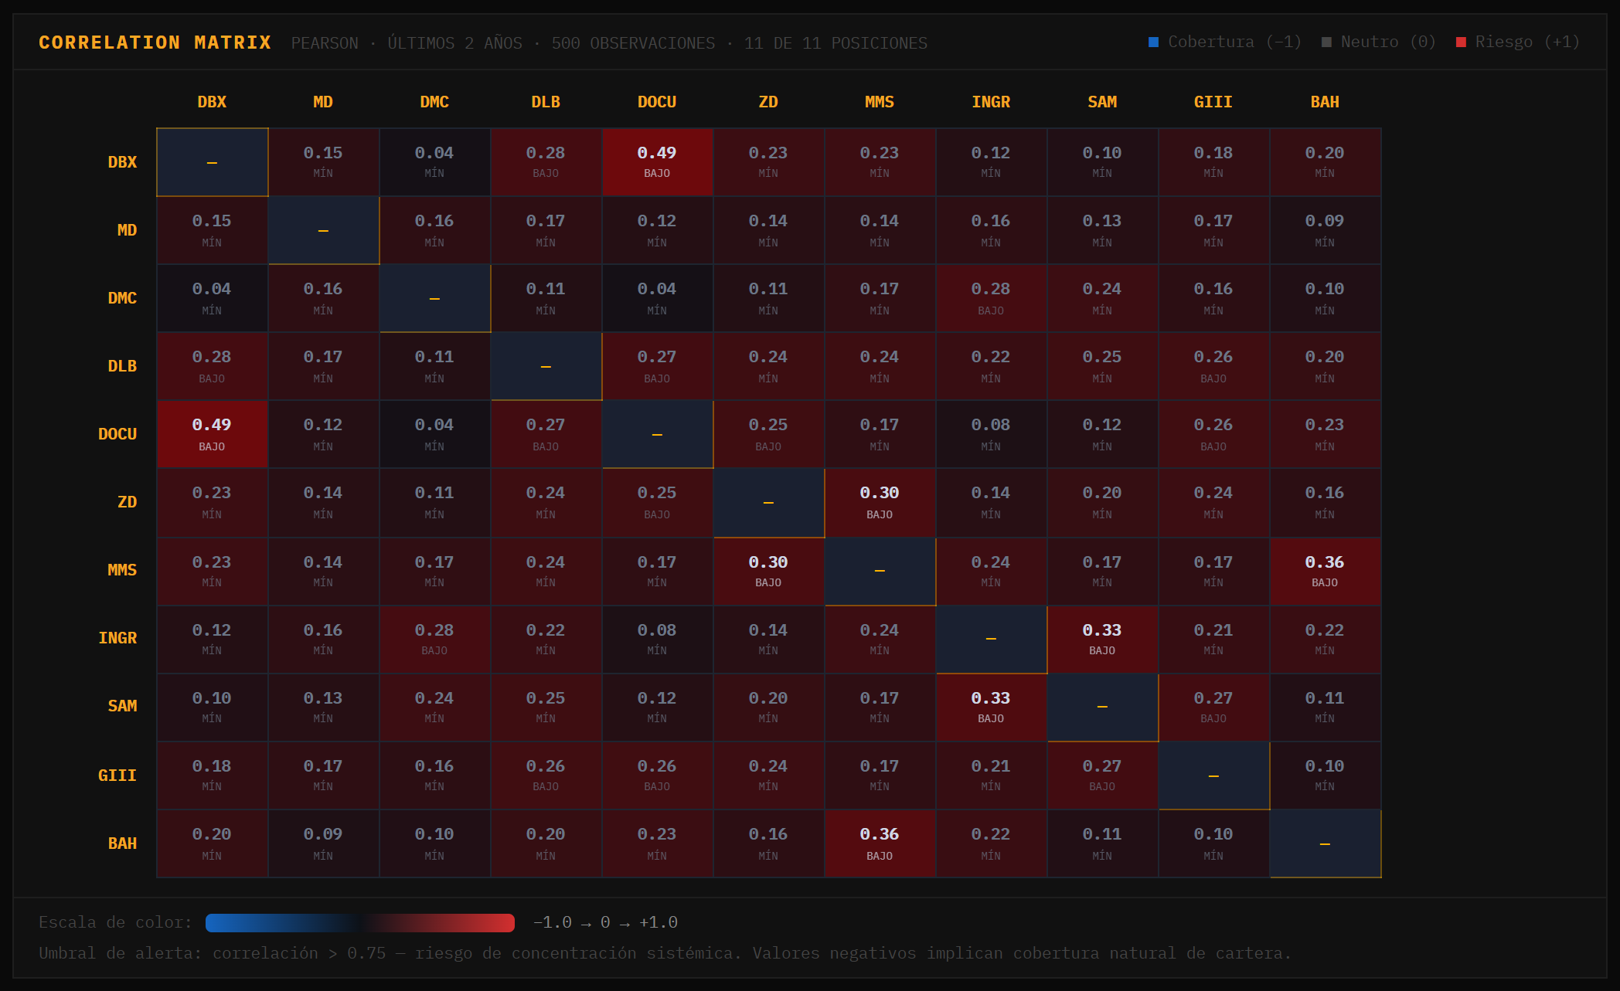
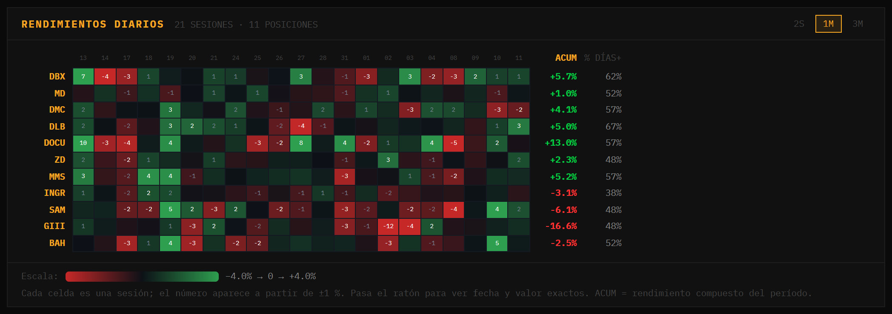
18 · RISK ANALYTICS
Diversification, measured rather than assumed
Pearson correlation over 500 sessions, and a per-session returns heatmap.
Highest pair is 0.49 (DBX–DOCU, both software) and the alert threshold is 0.75: no hidden concentration. Eleven names that genuinely move apart.
IVS · Institutional Valuation System
19
Notes:
10:45 · 30 s
Risk, measured instead of assumed. On the left, how much my companies move
together, over 500 days. The closest pair is 0.49, Dropbox and DocuSign, and they
are both software companies. My warning level is 0.75, so nothing is hidden here.
On the right, every company against every day. And the title says how many of the
eleven it actually covers.

Slide 20
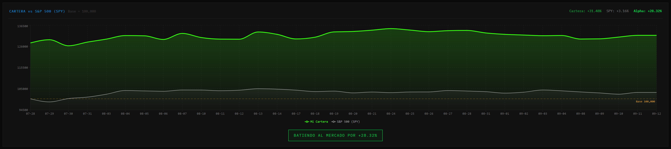
19 · VERSUS THE MARKET
Portfolio against the S&P 500
Both rebased to 100,000 on the first session, 2026-07-28 to today.
Portfolio +31.48% versus SPY +3.16% — +28.32 points over 33 sessions. A track record, not a proof: 33 sessions and 11 names.
IVS · Institutional Valuation System
20
Notes:
11:15 · 35 s
My portfolio against the S&P 500. Both start at 100,000, so you can compare them.
Mine is up 31.5 percent, the index 3.2.
And I want to be clear about what that is. It is 33 days and eleven companies. It
is the real record of the system, but it is far too short to say that I am good at
this. Part of the gap was already there on the first day.

Slide 21
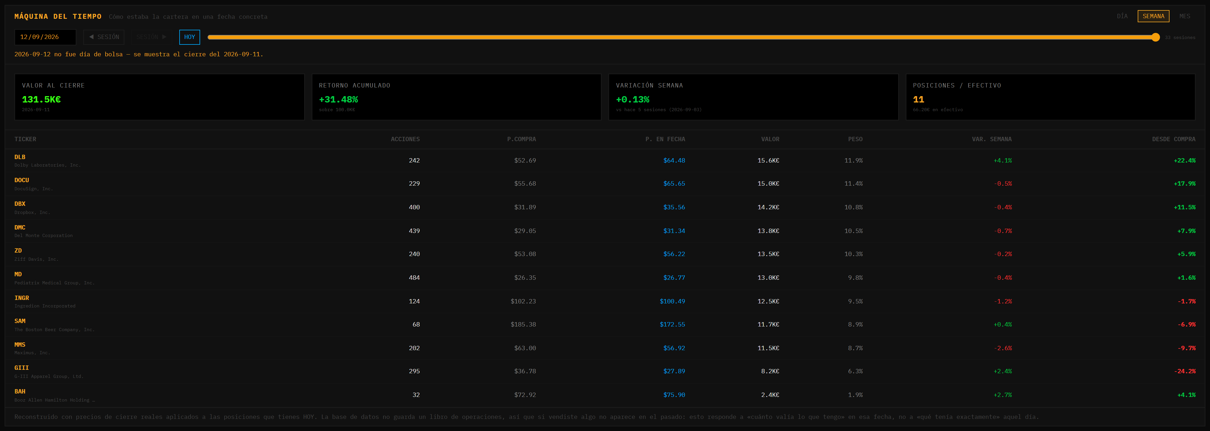
20 · TIME MACHINE
Any past session, reconstructed
A slider that walks trading sessions — not calendar days, so it never lands on a weekend.
Reconstructed from real closing prices, and the panel states its own limit: the database is not a trade ledger, so it answers 'what was today's portfolio worth then', not 'what did I hold that day'.
IVS · Institutional Valuation System
21
Notes:
11:50 · 25 s · [CUT IF LATE]
One feature I like. This rebuilds the portfolio on any past day, and the slider
moves by market days, so it never lands on a Sunday.
Building it found a real bug: my cash was being worked out in a way that went
negative once I reinvested profits.

Slide 22
21 · WHAT I LEARNED
Where the measurement is thin, and what I would build next
The three things I would fix first if I kept working on this.
LIMITS OF WHAT I MEASURED
WHAT I WOULD DO NEXT
One window only
Walk-forward testing
Features from a single scan date and an 18-session label. No walk-forward across multiple periods.
Repeat the whole label pipeline across many scan dates and pool the results.
Survivorship
Sector-relative model
The universe is today's screener output: companies already delisted are not in it.
Predict excess return versus sector peers, not versus the index — that is the clustering lesson applied.
Sector dominates
Close the MLOps loop
The ablation showed it, so returns would have to be measured against sector peers.
The model is trained in a notebook; it should be served by the same API the app already talks to.
The system is in production and every notebook re-runs end to end. The signal I found is mostly sector, so the honest use of the score today is ranking candidates, not claiming an edge.
IVS · Institutional Valuation System
22
Notes:
12:15 · 40 s
To finish, the three things I would fix first.
It is one moment in time: one date, one 18-day window. Companies that have already
disappeared are not on my list. And the sector explains most of the score, so
returns should be compared with companies in the same sector.
So the next steps are: repeat all of it on many different dates, compare against
the same sector, and serve the model from the app instead of a notebook.
The system works and I use it. The score sorts candidates. Thank you.

Slide 23
Institutional Valuation System
Thank you. Questions?
19
8,487
28
2,305
1,437
Python modules
lines
REST endpoints
universe
companies valued
IVS · Institutional Valuation System
23
Notes:
12:55 · Q&A
Closing line: "Thank you — I am happy to take questions."
PREPARED ANSWERS — plain, short, and only things you can defend.
Why not deep learning?
I have a table with 1,437 rows. A neural network needs much more data, and it
would just memorise this one. And my ablation says the limit is the data, not the
model.
Why ROC-AUC and not accuracy?
Because 45 percent of companies beat the market. A model that always says "no" is
right 55 percent of the time and is worth nothing. ROC-AUC looks at whether the
ORDER is right, not at one yes-or-no line.
Is the plus 31 percent proof that this works?
No, and I would not claim that. It is 33 days and eleven companies, and part of
the gap was already there before the window starts.
How do you know the model was not cheating?
Seven columns were calculated from the answer, and I take them out before I split
the data. The proof is that the score went DOWN to something believable once I did.
What would you need to trust the signal?
Repeat the whole thing on many different dates, and compare each company with
others in its own sector. That is the honest version of the test.
Why SQLite and not a bigger database?
One user, one portfolio, a few hundred kilobytes. Anything bigger would be extra
work for no benefit.
Why is there no Tableau?
The dashboards are inside my own app instead. Same analysis, but where I actually
use it. I know it was part of the course.
The top performers screen is dated August — why?
It is a cached calculation over the whole universe; it takes about two minutes to
rebuild and I run it when I need it. The date is shown on the panel on purpose.
Can you show the app?
Yes. It runs on my machine, and the screenshots in these slides were taken from it
today.
If you do not know an answer:
"I did not test that, so I would not want to guess. What I did measure is ..."
— and go back to the ablation or to the five-group chart.

