Slide 1
Physical Layer for a Quantum Communication Channel with Discrete Variables
Mariana Ferreira Ramos
Quantum Mining Meeting
17th May 2019

Slide 2
Quantum Physical Layer with discrete variables
QTxBasis
ModeSelection
QTxBits
QTx
QChannel
QRx
DataOut
ModeSelection
QBER UB
QRxBasis
DVQuantum_TxRx
Bit synchronism.
Mode synchronism.
Polarization compensation.
HOW?
Emulator in netXpto simulator.
2 FPGA’s (1 for QTx and 1 for QRx).

Slide 3
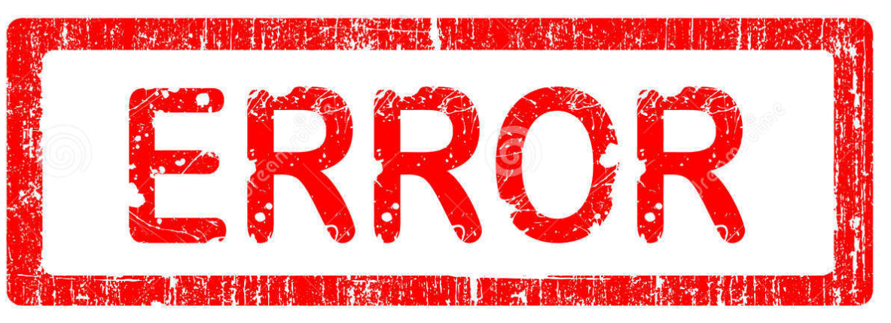


Quantum Physical Layer
QTx
QRx
Quantum Communication Channel
4 Possible Polarization States.
2 Non-orthogonal basis.
Bit ‘0’ and ‘1’.
2 Possible measurement basis.
Diagonal and Linear.
Attenuation depends on the optical fiber length.
Polarization random drift which depends on the birefringence of the optical fiber.

Slide 4

Quantum Physical Layer Polarization Basis Aligment
EPC
Quantum Communication Channel
Measurements
Feedback signal
Polarization Basis Alignment Algorithm

Slide 5
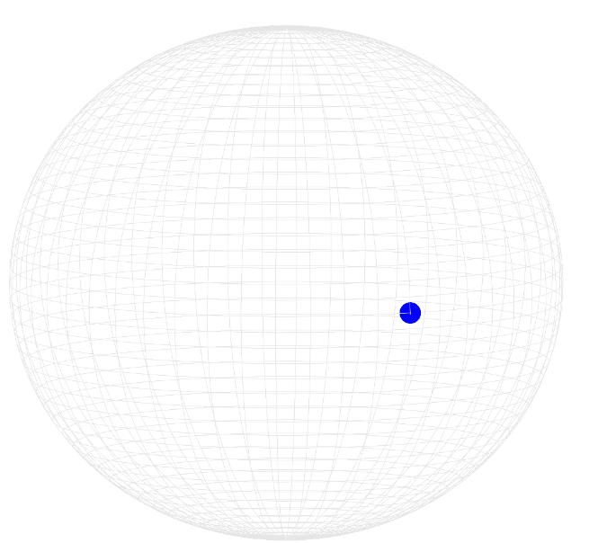
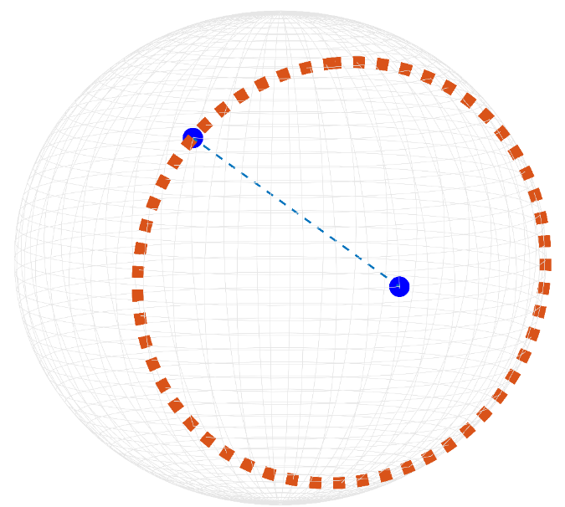
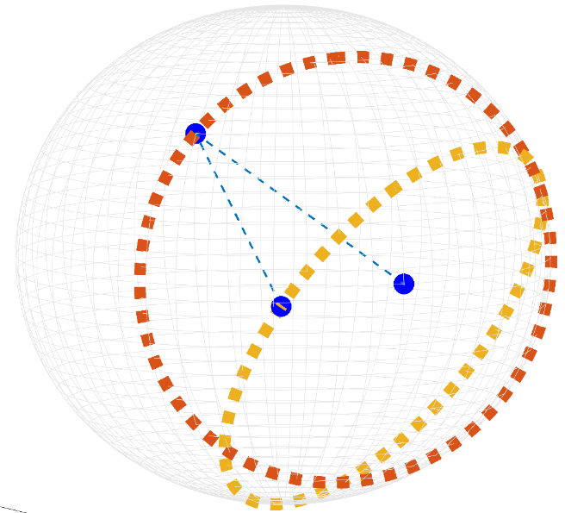
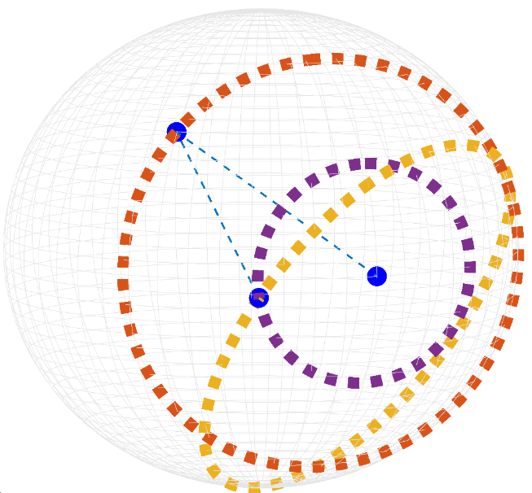
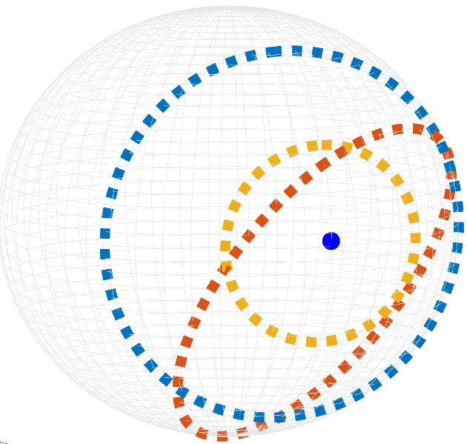
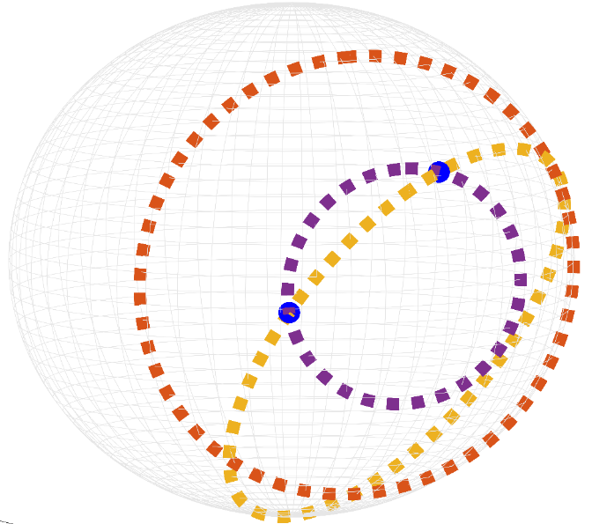
Quantum Physical Layer Polarization Basis Aligment
1
0

Slide 6
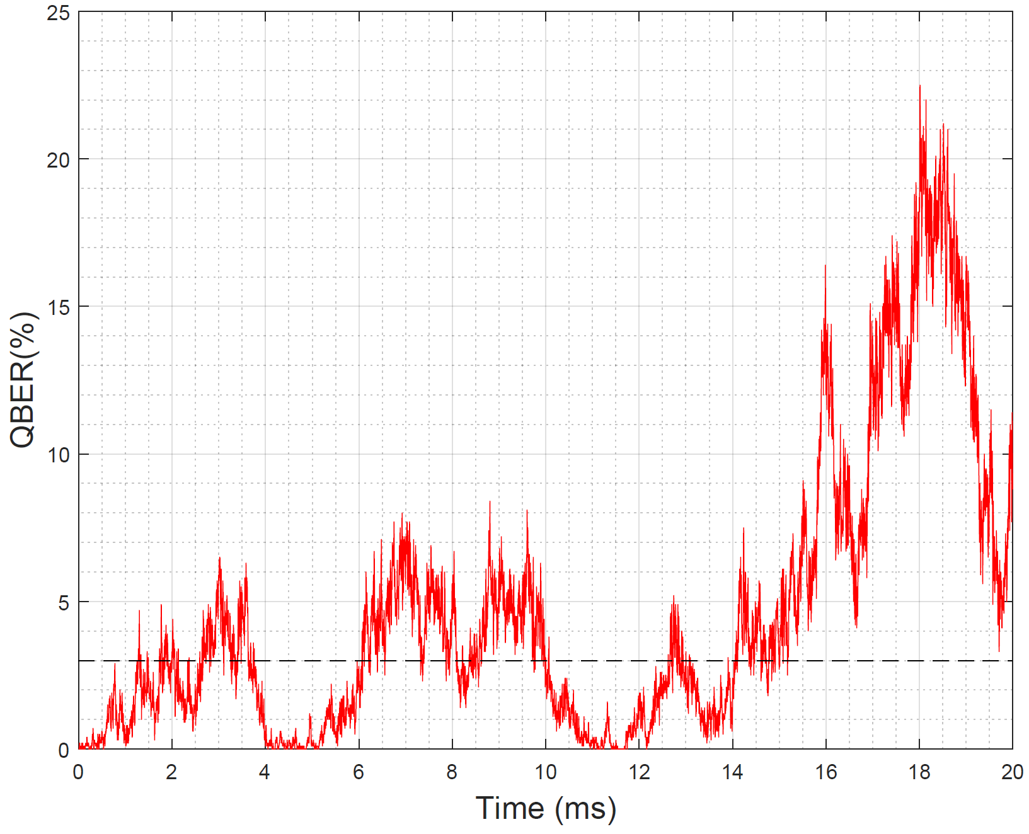
Quantum Physical Layer Polarization Basis Aligment
Transmission window of 1 ms under heavy external conditions.
QBER estimation sliding window of 1 ms.
1 qubit in each 100 transmitted qubits to polarization control.
Switch to actuation mode as soon as the QBER rises a 2% boundary below the 3% user-defined threshold.
Data qubits with 0.1 photons in average.
Control qubits with an amplitude high enough to guarantee that at least 1 photon reaches the receiver.

Slide 7
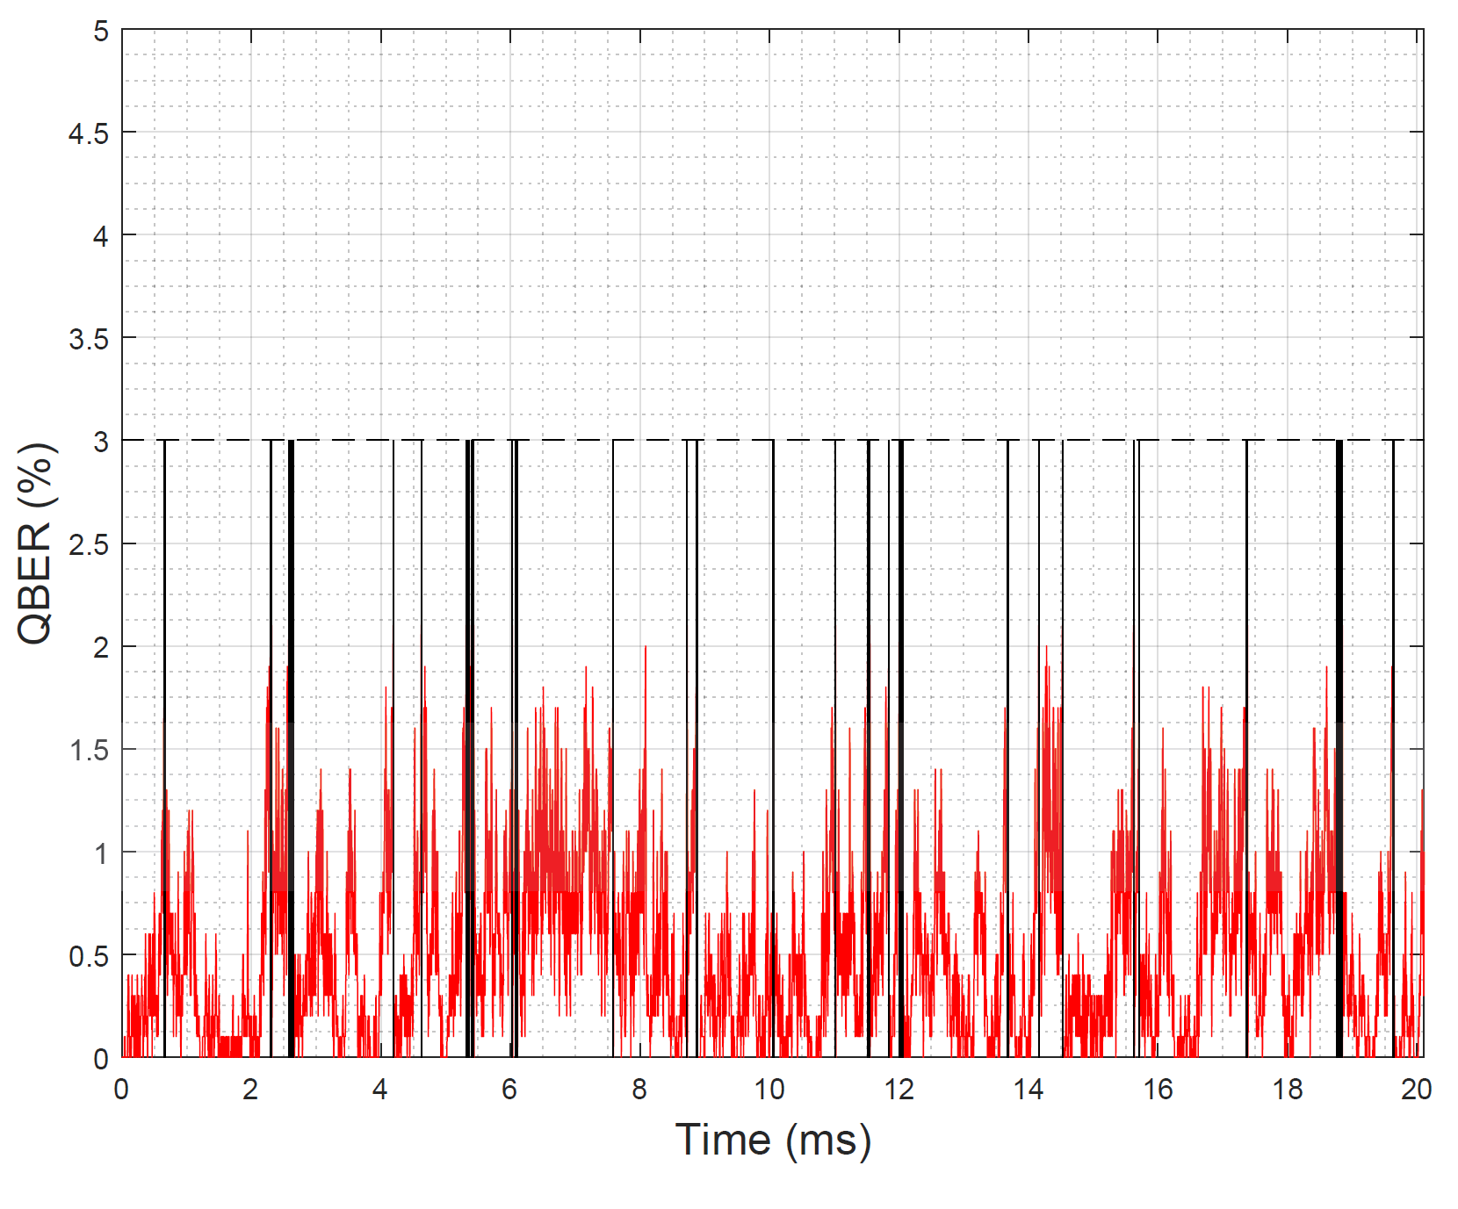
Quantum Physical Layer Polarization Basis Aligment
Data transmission is interrupted during algorithm’s actuation mode.
Overhead below 1.5%.
Average channel QBER below 1%.
Maximum QBER of 2.1% during data transmission.

Slide 8
Quantum Physical Layer
QTx
QChannel
QRx
QTxBasis
ModeSelection
EPC
DataOut
QTxBits
ModeSelection
Quantum Communication Channel
QRxBasis
QBER UB
Measurements
DVQuantum_TxRx
Feedback signal
Polarization Basis Alignment Algorithm
Full Quantum Physical Layer for discrete variables transmission using Polarization Encoding.

Slide 9
Outputs
M. F. Ramos, N. A. Silva, N. J. Muga, and A. N. Pinto, “Algorithm for compensation random drifts in polarization encoding quantum communications,” submitted for journal publication, March 2019.
Armando N. Pinto, Mariana F. Ramos, Andoni C. Santos, Nuno A. Silva, and Nelson J. Muga, “The Impact of Fiber Random Birefringence in Polarization-Encoded Quantum Communications”, submitted for conference publication, April 2019.
M. F. Ramos, N. A. Silva, N. J. Muga, and A. N. Pinto, “Fast Polarization Basis Alignment For Quantum Communications,” submitted for conference publication, May 2019.

