Slide 1
Quantum Communication Channel using Discrete Variables
Nuno A. Silva
Mariana F. Ramos
Nelson J. Muga
Quantum Mining Meeting
17th May 2019

Slide 2


Quantum Physical Layer with discrete variables
QTx
QRx
QChannel
ALICE
BOB
Quantum communication channel using discrete variables to encode information.
Alice is able to encode 4 states of polarization using 2 non-orthogonal bases.
Bob is able to choose one out of two bases to perform the measurements.
10 km of uni-directional quantum channel.

Slide 3
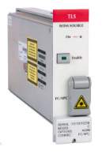
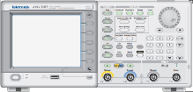


ALICE
EPC
Filter
$$λ_{Q}$$
MZ modulator
VOA
FIBER
WDM
MZ modulator
$$λ_{R}$$
EPC controller
AWG

Slide 4
ALICE
One of the 4 states of polarization is randomly chosen.
Polarization encoding is performed using an electronic polarization controller, using 4 values of voltage (1 for each waveplate).
Additional synchronism signal in a different wavelength.
Quantum signal is pulsed using a MZM modulator in order to obtain in average 0.1 photons per pulse.
Both quantum and synchronism signals are coupled using a wavelength multiplexer.

Slide 5
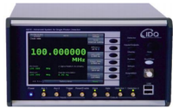
BOB
EPC
Filter
PBS3
FIBER
WDM
Data Out
PIN
EPC controller
Trigger
Trigger
Data Out

Slide 6
BOB
Bob chooses one of two possible bases to measure single photons.
Two single-photon detectors: one to measure bit ‘0’ and other to measure bit ‘1’.
Quantum and synchronism signals are splitted using a wavelength multiplexer.
Data is processed by the EPC controller unit.
Synchronism is guaranteed using the additional signal sent by Alice.

