Slide 1
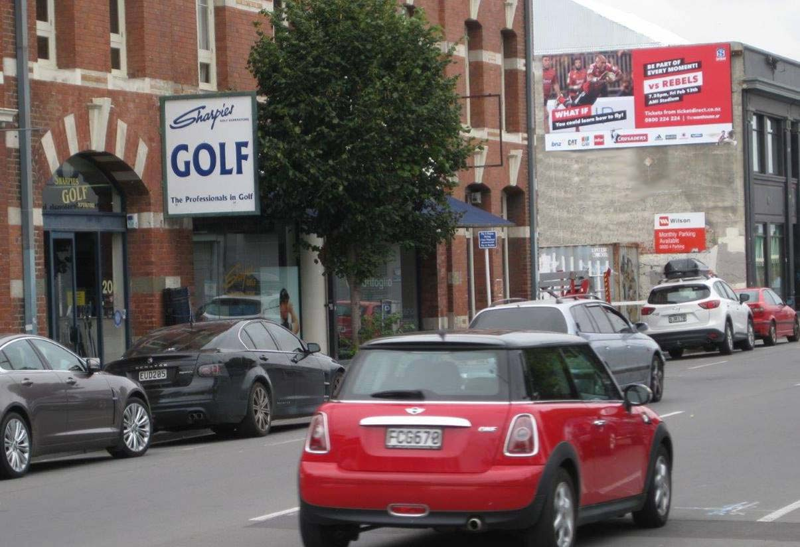
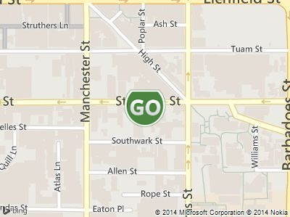
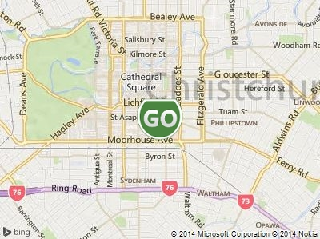
~Image1:uid_panel:PANELPHOTOS:2~
~Image2:uid_panel:MapClose:3~
~Image3:uid_panel:MapFar:4~
[TITLE]
Christchurch
Description
Features
Located within Christchurch’s inner four avenues/CBD, this three laned one way street is busier than ever feeding into the city since the quake. This is one of the few roads within CBD linking the City from East to West from Fitzgerald Ave directly to the hospital and en route to Riccarton. Located just 100 metres from Christchurch Polytechnic and close to the Bus Shelter
21,115
6 x 3m
No
$4,000
$395
DAILY VISUALS
BILLBOARD SIZE
FLOODLIT
MONTHLY RENTAL
INSTALL

