Slide 1
Parallel word embedding --- Distributed Tensorflow
Zhiping Fu, Zhiping_Fu@student.uml.edu
Weiwei Li, Weiwei_Li@student.uml.edu
Yufeng Yuan, Yufeng_Yuan@student.uml.edu
4/27/2017

Slide 2
content
Idea and motivation
Proposed system architecture
Implementation
Result
Future work
Assignment
references

Slide 3
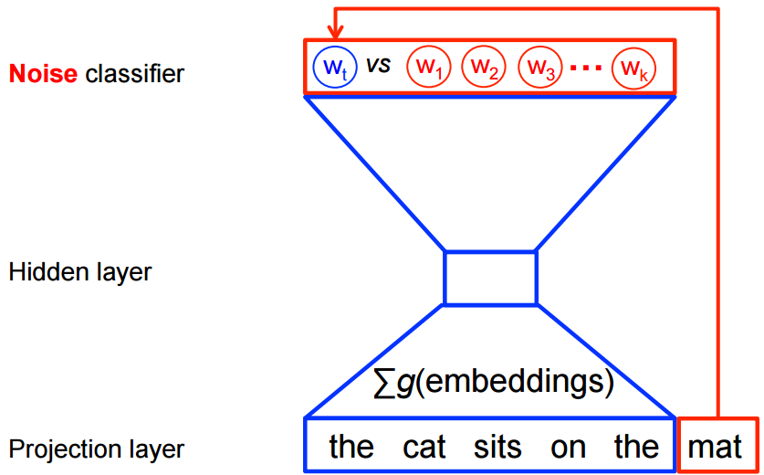

PS based word embedding
d: vector dimension, 100 ~ 500
w: context window size, 5 ~ 10
n: the number of random negative examples per context word, 5 ~ 10
$r\left(w,n,d\right)=\left(2+w∗n\right)∗d∗4$
w=10, n = 10, d=500, r(10, 10, 500) = 200,000 bytes
dataset with 50 billion words and one week training latency, required at least 1300Gbits/sec [3]

Slide 4

Idea[3]
Column-wise partitioning
Computing done at PS shards
Word index traffic
Implementation
Programing Language: Java and Scala.
Hadoop YARN: worker management.
Slider: launch worker process in YARN.
Spark: vocabulary generation(map-reduce).
Hadoop Distributed file System ( HDFS): dataset storage.
Netty client-server library: RPC layer, communication.
$r\left(w,n,d\right)=\left(2+w∗n\right)∗4$, reduce “d”

Slide 5
content
Idea and motivation
Proposed system architecture
Implementation
Result
Future work
Assignment
references

Slide 6
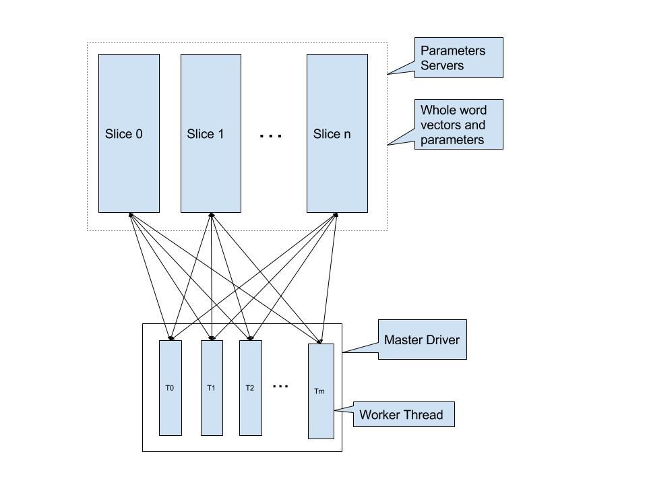
Our system architecture
Distributed Tensorflow
Sub computing graph
CBOW and Skip-gram model
Dynamic context window
Negative Sampling
replace full softmax function
Subsampling of Frequent Words
Programming language: Python
Code size: more than 1000

Slide 7
content
Idea and motivation
Proposed system architecture
Implementation
Result
Future work
Assignment
references

Slide 8
Master driver
Load vocabulary
Setup sub computing graph and sub Tensorflow session
Setup worker thread
Setup checker thread to do evaluation of current word vectors
Wait until all workers are done, and assemble the word vectors

Slide 9
Worker thread
Scan work directory to get the whole training files list
Tokenize one training file, map to index according to the vocabulary table
Generate training word pair and subsampling index, and send them to all Slice sub graphs
Gather partial dot production result from all Slices, do sigmoid, and send back to all Slice sub graphs

Slide 10
How to run?
Setup Slice Servers
python Large_Scale_Word2Vector.py --ps_hosts=localhost:2222,localhost:2223 --job_name=ps --task_index=0
python Large_Scale_Word2Vector.py --ps_hosts=localhost:2222,localhost:2223 --job_name=ps --task_index=1
Setup master driver
python Large_Scale_Word2Vector.py --ps_hosts=localhost:2222,localhost:2223 --job_name=master --work_folder=.

Slide 11
content
Idea and motivation
Proposed system architecture
Implementation
Result
Future work
Assignment
references

Slide 12
Train parameters
Movie review dataset: vocabulary reaches 60656 with word frequency large than 5, and the tokenized words reach 26,031,113.
Training parameters
Start learning rate: 0.025
Negative samples: 10
High frequency sampling rate: 0.001
Word vector dimension: 100
Context window size: 5
4 worker thread, 2 Slice Servers, one single machine
AWS computing optimized VM, 4-kenel, 16G memory
10 iterations one day

Slide 13
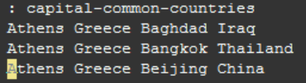
 | Skg-15 | Skg-45 | Cbow-15 | Cbow-45
Family(462) | 160 | 169 | 46 | 120
Currency(40) | 0 | 0 | 0 | 0
City-in-state(1500) | 74 | 52 | 0 | 6
Capital-common-countries(420) | 180 | 98 | 2 | 25
Capital-world(815) | 249 | 162 | 1 | 15
Gram1-adjective-to-adverb(992) | 14 | 69 | 0 | 6
Gram2-opposite(756) | 4 | 4 | 0 | 2
Gram3-comparative(1332) | 50 | 59 | 1 | 17
Gram4-superlative(1056) | 27 | 33 | 2 | 13
Gram5-present-participle(930) | 145 | 214 | 11 | 88
Gram6-nationality-adjective(1371) | 901 | 924 | 38 | 217
Gram7-past-tense(1482) | 127 | 263 | 30 | 103
Gram8-plural(1190) | 370 | 370 | 24 | 143
Gram9-plural-verbs(812) | 119 | 131 | 7 | 42
total | 0.18 | 0.19 | 0.01 | 0.06
test questions are from [6]

Slide 14
 | Skg-15 | Skg-45 | Cbow-15 | Cbow-45
good | 'really', 'better', 'but', 'though', '.' | 'really', 'better', 'well', 'but', 'very' | 'one', 'but', 'is', 'really', ',' | 'better', 'much', 'done', 'well', 'was'
bad | 'terrible', 'awful', 'ok', 'worst', 'least' | 'terrible', 'awful', 'worst', 'worse', 'seriously' | '...', 'really', 'just', 'could', 'like' | 'awful', 'worse', 'worst', 'terrible', 'seriously'
excellent | 'great', 'superb', 'terrific', 'performances', 'outstanding' | 'superb', 'outstanding', 'great', 'terrific', 'fine' | 'wonderful', 'performances', 'cast', 'always', 'brilliant' | 'brilliant', 'superb', 'outstanding', 'fantastic', 'performances'
man | 'his', 'he', 'who', 'a', 'as' | 'he', 'his', 'who', 'himself', 'him' | 'he', 'who', 'him', 'men', 'girl' | 'himself', 'his', 'who', 'him', 'sees'
woman | 'her', 'she', 'herself','husband', 'mother' | 'her', 'she', 'herself', 'girl', 'husband' | 'she', 'who', 'mother', 'he', 'wife' | 'himself', 'his', 'who', 'him', 'sees'
teacher | 'school', 'teachers', 'students', 'student', 'teenager' | 'school', 'students', 'teachers', 'teaching', 'student' | 'brother', 'eventually', 'parents', 'loves', 'meet' | 'parents', 'mother', 'student', 'loves', 'daughters'
apple | 'break', 'broken', 'broke', 'along', 'pie' | 'bottle', 'drinking', 'wine', 'drink', 'drunk' | 'writer/director', 'bust', 'keeps', 'incompetent', 'alive' | 'discontinuity', 'floor', 'sits', 'table', 'band'
red | 'wearing', 'blue', 'around', 'hair', 'a' | 'blue', 'wearing', 'hat', 'wear', 'black' | 'guy', 'walk', 'gets', 'front', 'enter' | 'blue', 'wearing', 'shadow', 'cigarette', 'torch'
Skip-gram works well than cbow model
Captures more semantics

Slide 15
content
Idea and motivation
Proposed system architecture
Implementation
Result
Future work
Assignment
references

Slide 16
Future work
Auto deployment tool to simplify to the system setup process;
Combine with Spark and HDFS to support larger dataset and enhance data parallelism.

Slide 17
content
Idea and motivation
Proposed system architecture
Implementation
Result
Future work
Assignment
references

Slide 18
assignment
 | Task
Zhiping Fu | Skip-gram model, skip-gram model training
Weiwei Li | CBOW model, CBOW model training
Yufeng Yuan | System solution review, build vocabulary, articles tokenize

Slide 19
content
Idea and motivation
Proposed system architecture
Implementation
Result
Future work
Assignment
references

Slide 20
references
[1] Mikolov, T., Chen, K., Corrado, G., & Dean, J. (2013). Efficient estimation of word representations in vector space. arXiv preprint arXiv:1301.3781.
[2] Mikolov, T., Sutskever, I., Chen, K., Corrado, G. S., & Dean, J. (2013). Distributed representations of words and phrases and their compositionality. In Advances in neural information processing systems (pp. 3111-3119).
[3] Ordentlich, E., Yang, L., Feng, A., Cnudde, P., Grbovic, M., Djuric, N., ... & Owens, G. (2016, October). Network-Efficient Distributed Word2vec Training System for Large Vocabularies. In Proceedings of the 25th ACM International on Conference on Information and Knowledge Management (pp. 1139-1148). ACM.
[4] https://www.tensorflow.org/deploy/distributed
[5] Maas, A. L., Daly, R. E., Pham, P. T., Huang, D., Ng, A. Y., & Potts, C. (2011, June). Learning word vectors for sentiment analysis. In Proceedings of the 49th Annual Meeting of the Association for Computational Linguistics: Human Language Technologies-Volume 1 (pp. 142-150). Association for Computational Linguistics.
[6] http://download.tensorflow.org/data/questions-words.txt

Slide 21
Q&A
THANKS!

