Slide 1
Parallel word embedding
Zhiping Fu, Weiwei li and Yufeng yuan
2/16/2017

Slide 2
content
Motivation
Related work
Proposed research
Evaluation

Slide 3
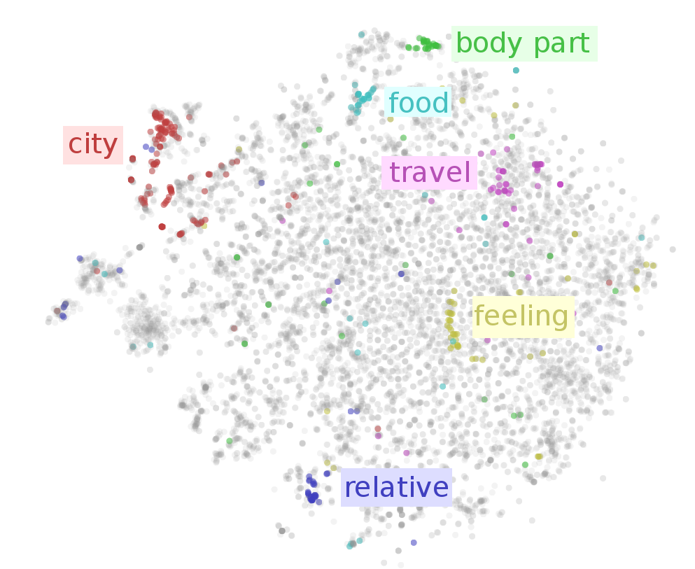
motivation
What is word embedding?
Word → Vector
First step of Neural Network
Language Model (NNLM)

Slide 4
motivation
Advantages
lower dimensions
context related (word sequence)
Syntax and semantic include
Easy to use

Slide 5
content
Motivation
Related work
Proposed research
Evaluation

Slide 6
Feedforward Neural Net Language Model (NNLM)
Bengio at el., 2003
Unsupervised → supervised

Slide 7
CBOW & SKIP-GRAM
Mikolov et al., 2013
Continuous Bag-of-Words Model (CBWM)
Continuous Skip-gram Model (Skip-gram)

Slide 8
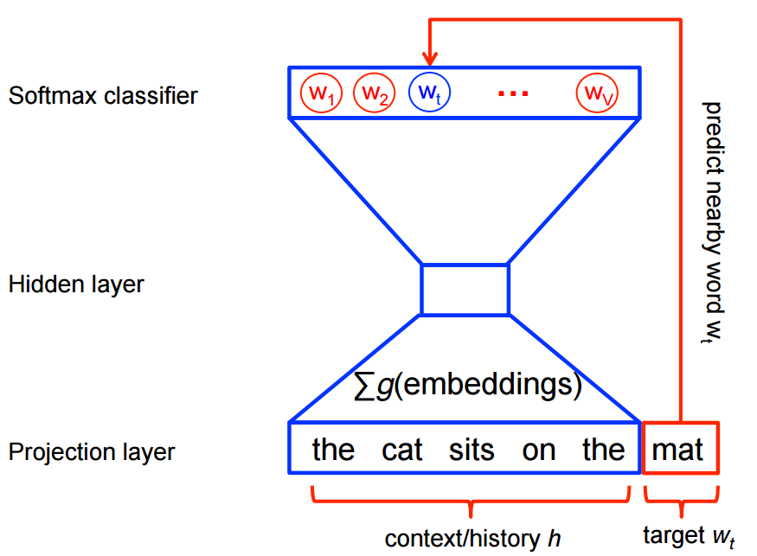
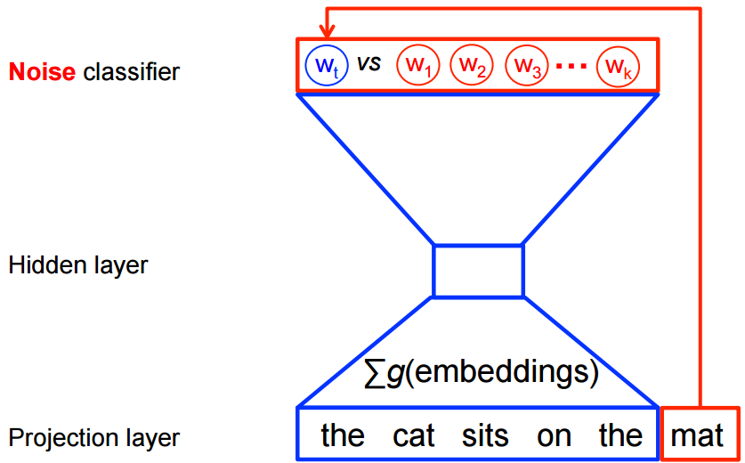
Problems &solutions
Size of output layer is too big
Solutions
Hierarchical Softmax
Negative sampling-Noise Contrastive Estimation (NCE)
Subsampling of frequent words

Slide 9
content
Motivation
Related work
Proposed research
Evaluation

Slide 10
Out project: parallel word embedding
CBOW and Skip-gram include
Suitable for big corpus, TB level
High parallelism, include data and model level parallelism
Reasonable training time
Java and python
Hadoop, Spark and Tensorflow

Slide 11
content
Motivation
Related work
Proposed research
Evaluation

Slide 12

Word vector
$Word2Vect$
Word2vec is a group of related models that are used to produce word embeddings. These models are shallow, two-layer neural networks that are trained to reconstruct linguistic contexts of words.
Word2vec takes as its input a large corpus of text and produces a vector space, typically of several hundred dimensions, with each unique word in the corpus being assigned a corresponding vector in the space.

Slide 13
Word vector
Word vectors are positioned in the vector space
such that words that share common contexts
in the corpus are located in close proximity
to one another in the space.
Word2vec maps each word to a vector,
which expresses the relationship between words.

Slide 14
Word vector
Word2Vect maps the relationship between
the word of male to the closet word
female.
Man to Woman
Uncle to Aunt
King to Queen
And it maps the relationship between a noun
to its plural form.
King to Kings
Queen to Queens
The vectors representing the same relationship keep
parallel.

Slide 15

Word vector
Check if ${(V}_{kings}− V_{king})$ parallel to ${(V}_{queens}− V_{queen})$
Vector offset method
$\vec{ab}=V_{b}−V_{a}, \vec{cd}=V_{b}−V_{a}$
If $\vec{ab}∥\vec{cd}, \cos{(V_{b}}−V_{a} , V_{d} −V_{c})=1$
king to kings vs. queen to queens
$\cos{(V_{kings}}−V_{king} , V_{queens} −V_{queen})=1$
The relationship between words projected to
that of vectors.

Slide 16
Test data set
Movie review corpus:100,000 movie reviews
The size of vocabulary table reaches 89,527

Slide 17
Test data set
The test set contains 19558 questions
14 categories
capital-common-countries, capital-world
currency, city-in-state, family, gram1-adjective-to-adverb
gram2-opposite, gram3-comparative, gram4-superlative
gram5-present-participle, gram6-nationality-adjective
gram7-past-tense, gram8-plural and gram9-plural-verbs

Slide 18
Thank you!!!

