Slide 1
Parallel word embedding
Zhiping Fu, Weiwei li and Yufeng yuan
2/2/2017

Slide 2
content
Motivation
Related work
Proposed research
Evaluation

Slide 3
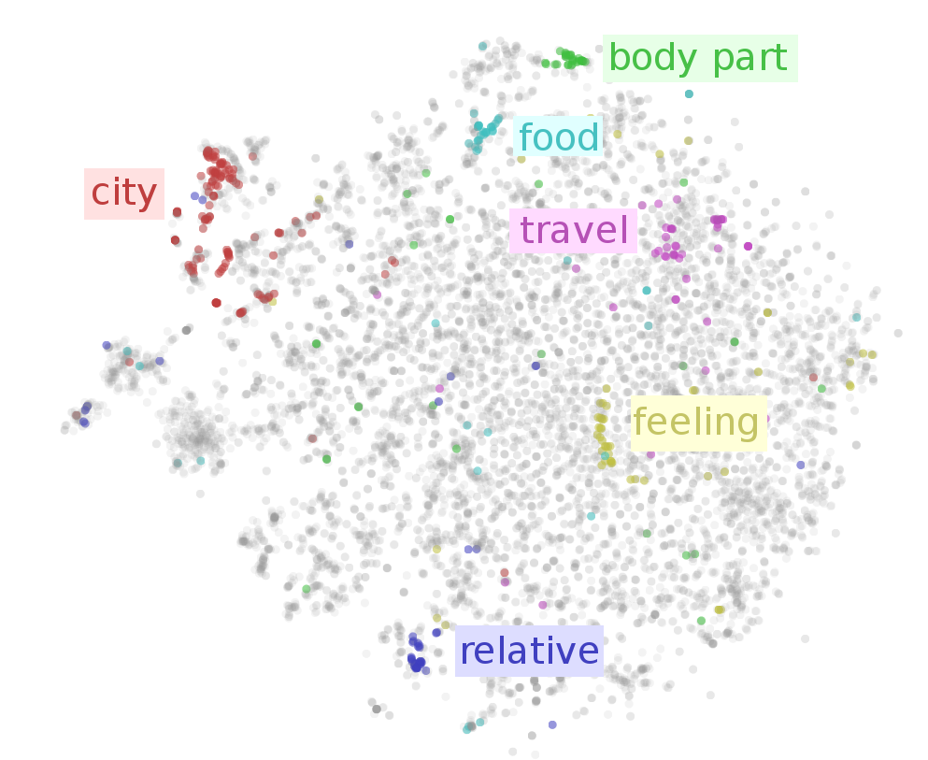
motivation
What is word embedding?
Word → vector
First step for NLP tasks
Advantages
lower dimensions
context related (word sequence)
Syntax and semantic include
Easy to use

Slide 4
content
Motivation
Related work
Proposed research
Evaluation

Slide 5
Feedforward Neural Net Language Model (NNLM)
Bengio at el., 2003
Unsupervised → supervised

Slide 6
CBOW & SKIP-GRAM
Mikolov et al., 2013
Continuous Bag-of-Words Model (CBWM)
Continuous Skip-gram Model (Skip-gram)

Slide 7
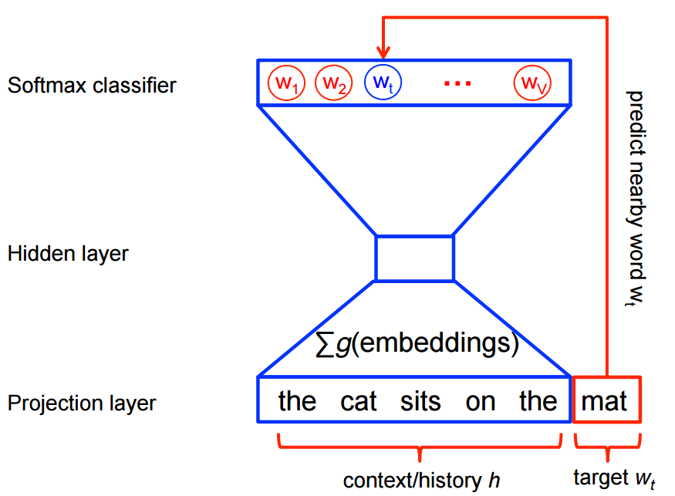
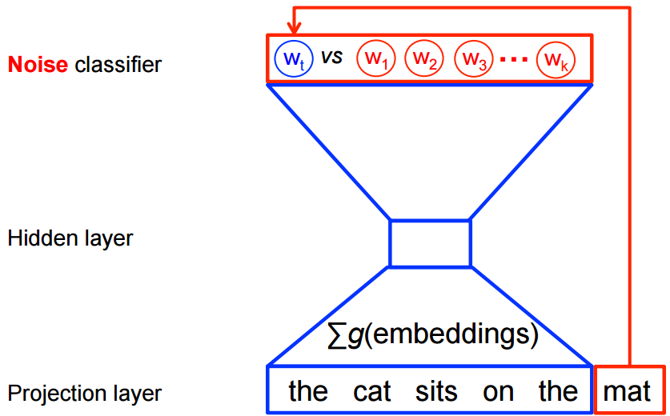
Problems &solutions
Size of output layer is too big
Solutions
Hierarchical Softmax
Negative sampling-Noise Contrastive Estimation (NCE)
Subsampling of frequent words

Slide 8
content
Motivation
Related work
Proposed research
Evaluation

Slide 9
Out project: parallel word embedding
CBOW and Skip-gram include
Suitable for big corpus, TB level
High parallelism, include data and model level parallelism
Reasonable training time
Java and python
Hadoop, Spark and Tensorflow

Slide 10
Test data set
movie review corpus:100,000 movie reviews
the size of vocabulary table reaches 89,527

Slide 11
content
Motivation
Related work
Proposed research
Evaluation

Slide 12

Word vector
${(V}_{kings}− V_{king})$ parallel to ${(V}_{queens}− V_{queen})$
vector offset method
test analogy question: a:b vs. c:d
king : kings vs. queen : queens
$\cos{(V_{b}}−V_{a} , V_{d} −V_{c})$ should be near to one

Slide 13
Test data set
The test set contains 19558 questions
14 categories
capital-common-countries, capital-world
currency, city-in-state, family, gram1-adjective-to-adverb
gram2-opposite, gram3-comparative, gram4-superlative
gram5-present-participle, gram6-nationality-adjective
gram7-past-tense, gram8-plural and gram9-plural-verbs

Slide 14
Thank you!!!

