Slide 1


ABTesting Framework > Introduction

Slide 2
Index
What’s an AB Test ?
Who does what ?
Life cycle of an AB Test
Data model
What can we modify?
List of the available segmentations ?
Creation of an AB Test
How works the eligibility process
How to debug an AB Test
Questions ?

Slide 3
1/ What’s an AB Test ?
  An AB(C, D, E, …) Test is the display or the render of a modified feature for a given population.
Test A
Group 10 (tested)
Group 20 (tested)
Group 30 (control)
Behaviour Alpha
Behaviour Béta
Behaviour “default”
Conf CSS : Yellow
Conf Button: Yellow
Conf Button : Red
Conf CSS : Green
Conf Button : Green

Slide 4
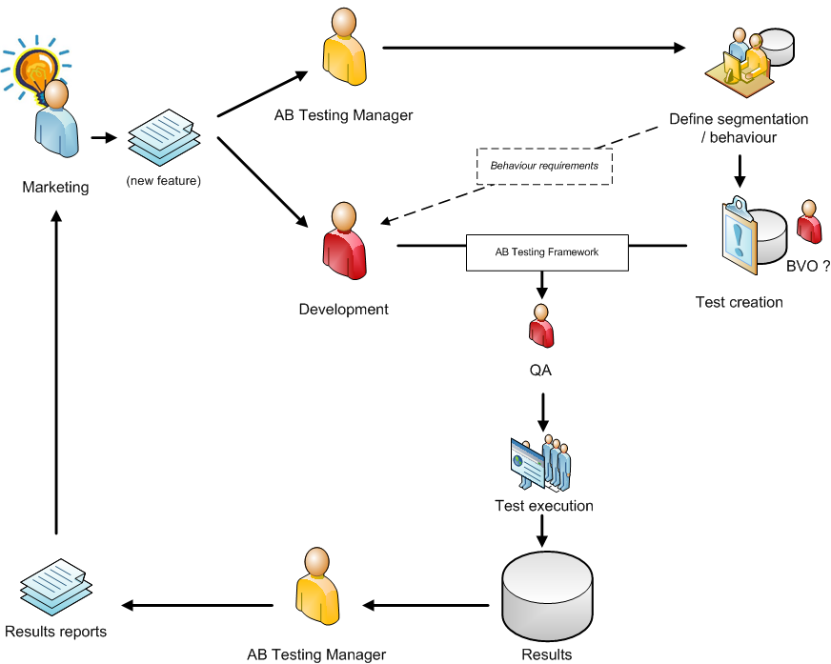
2/ Who does what?

Slide 5
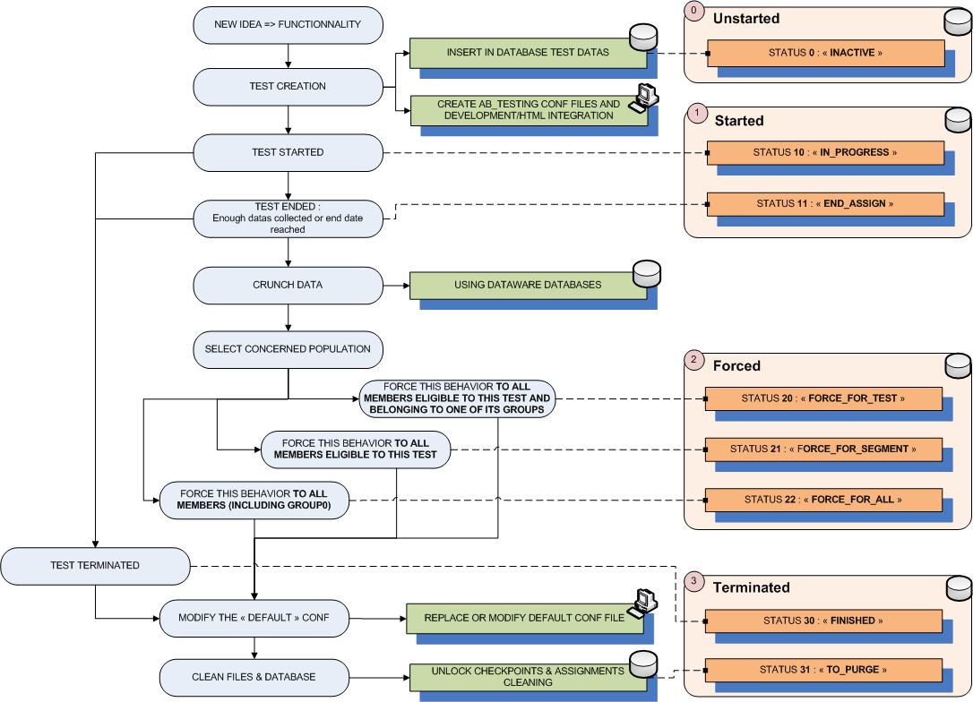
3/ Life cycle of an ABTest
1
2
3
4

Slide 6
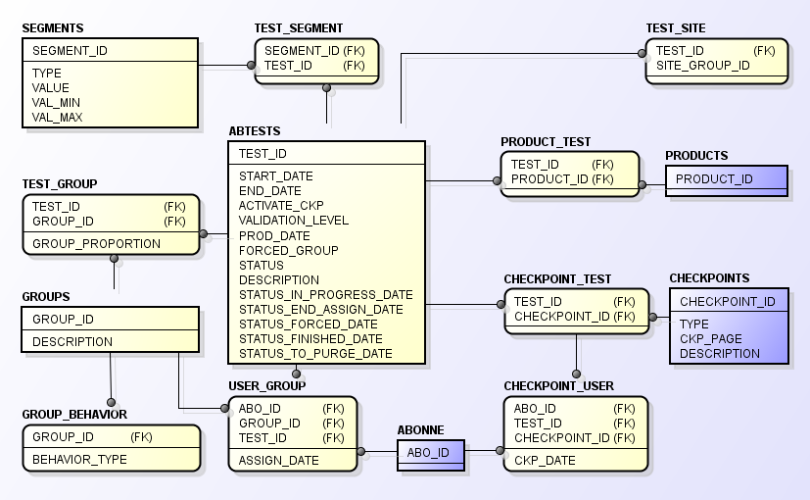
4/ Data Model

Slide 7
5/ What can we modify ?
For now, the framework supports the following behaviors :
  Website configuration variables
  Template sections
  Economic Model
In a few months, the framework should be able to manage new behaviors :
  Rate Card (Payment pages)
  HTML
  CSS
  Functions

Slide 8
6/ List of the segmentation available ?
Type | Description | Val_Min | Value | Val_Max | Additional information
KVK | Member’s KVK | - | HF / FH / HH / FF | - | Only one entry by KVK
AGE | Members’s age | <int> | <int> | <int> | Should be between 18-99
HAS_PHOTO | Members has a moderated photo | - | 0 (no) / 1 (yes) | -
HAS_EMAIL_VALID | Members has a confirmed e-mail | - | 0 (no) / 1 (yes) | -
HAS_PASS | Member has a pass | - | 0 (no) / 1 (yes) | -
HAD_PASS | Member had a pass | - | 0 (no) / 1 (yes) | -
AREA | Member’s Area | <string> | <string> | <string>
COUNTRY | Member’s country | - | <string> | -
POSTCODE | Member’s postcode | <string> | <string> | <string>
CMK | Website Marketing Code | <int> | <int> | <int>
TEST_ID | Existing test id | - | <int> | -
GROUP_ID | Existing Group Id | - | <int> | -
ABO_ID | Using last digit of an aboid | <int> | <int> | <int> | Should be between 0-9
REGISTRATION_DATE | Member’s registration date | <string> | <string> | <string> | Format : yyyy-mm-dd hh:mm:ss
LAST_CONNECTION_DATE | Member’s last connection date | <string> | <string> | <string> | Format : yyyy-mm-dd hh:mm:ss
It is possible to exclude a segmentation by prefixing it with a ‘!’

Slide 9
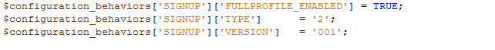
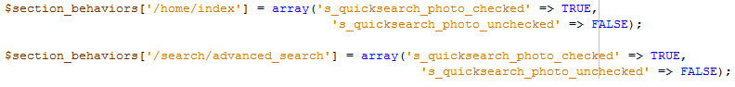
7/ Creation of an AB Test
The creation of an ABTest is currently done with a PHP script. We are working on a backoffice to simplify the creation of ABTests and the management of the Framework.
Usually, each tested group implies the creation of a configuration file that contains the website configuration variables to override or the template id sections to show or hide.
These files are located in /libs/product/sites/conf/behaviors/<behavior_type>/<behavior_type>_<test_id>_<group_id>.inc
Example of an ABTesting configuration file for a « configuration » behavior :
Example of an ABTesting configuration file for a « section » behavior :

Slide 10
8/ How works the eligibility process ?
At each authentification, the framework is initialized in order to get the data of the active ABTest.
We have a 4h cache for each queries (except those that requires the member’s aboid as a parameter).
For each ABTest not affected, The framework will check the segmentation to define if the member is eligible to the ABTest.
As soon as a member matches the ABTesting segmentation, The framework will get the groups proportion data and will make a random to affect him to a group.
When the eligibility process is done, the member’s ABTesting data are stocked in session.

Slide 11
8/ How works the eligibility process ?
Happy Meetic Member
Eligibility
Registration / Authentication
Getting every active ABTests available for the website
Eligible ?
no
yes
Assign the user to a group (A, B, N, …)
Set the ABTesting Data in Session
Home

Slide 12
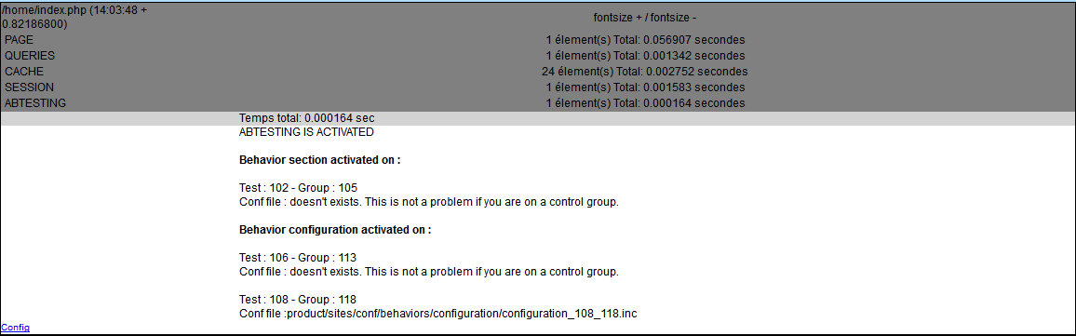
9/ How to debug an ABTest
Some ABTesting informations about the loggued account are available through the VISUALDEBUG feature.

Slide 13
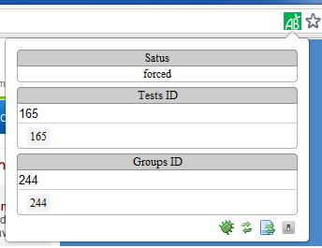
9/ How to debug an ABTest
A browser module compatible with Chrome, Firefox, Safari and Internet Explorer (version >= 7) that simulates the render of an ABTest by forcing the Test ID and the Group ID is almost ready and should be available soon.
This module is client side only so it won’t execute any queries.
Lien de l’extension : http://www.meetic.fr.dev/tools/cactu/?zone=abtesting#chromeExtension

Slide 14
10/ Questions ?
Thank you ☺
Any questions ?

