Slide 1
Computer Graphics “Ray Casting”
Based on slides by Chen Goldberg & Moab Arar
Apr 16

Slide 2
Creating a Virtual World
And Display it!

Slide 3
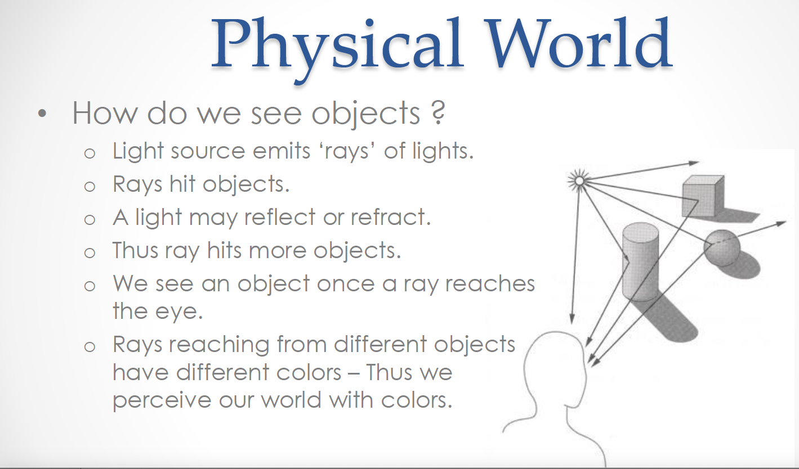

Slide 4
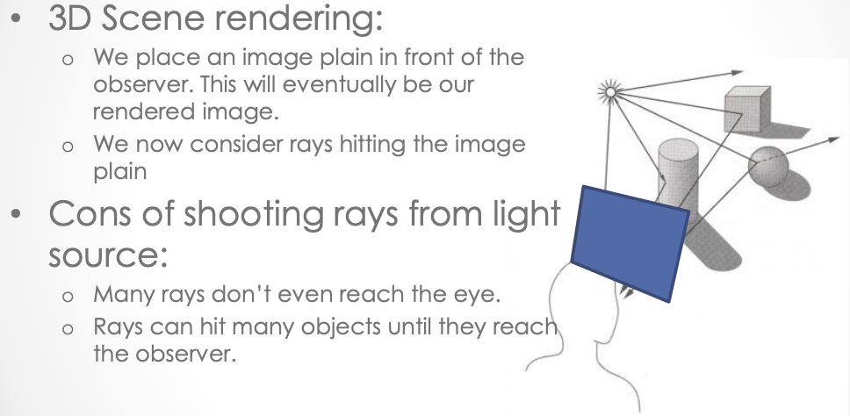
Our 1st 3D rendering Alg.

Slide 5
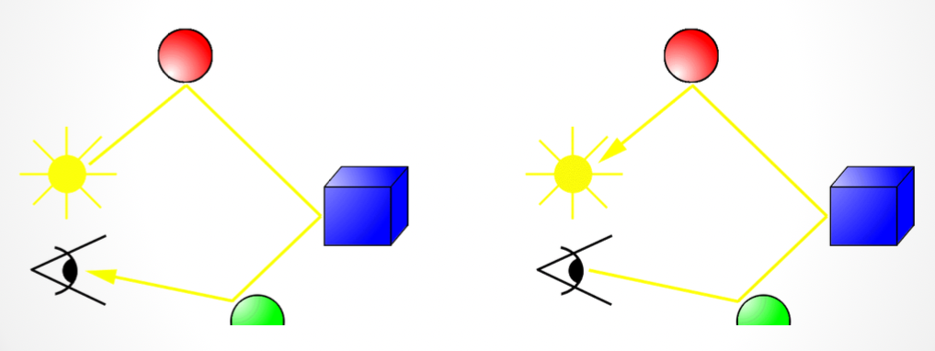
Our 1st 3D rendering Alg.
Instead of tracing every ray from the light source lets shoot rays from the observer until it reaches the light source

Slide 6
Our 1st 3D rendering Alg.
Problem: rays can hit many objects unti they reay the light source

Slide 7
Our 1st 3D rendering Alg.
Instead – we trace each ray until it hits at most n objects

Slide 8
Our 1st 3D rendering Alg.
Instead – we trace each ray until it hits at most n objects
n=1 – Ray Casting (Today)
N>1 – Ray Tracing (later this course)

Slide 9
Ray Casting
Rendering a 3D scene
חלק מהשקפים מעובדים משקפים של פרדו דוראנד, טומס פנקהאוסר, דניאל כהן-אור וליאור שפירא.

Slide 10
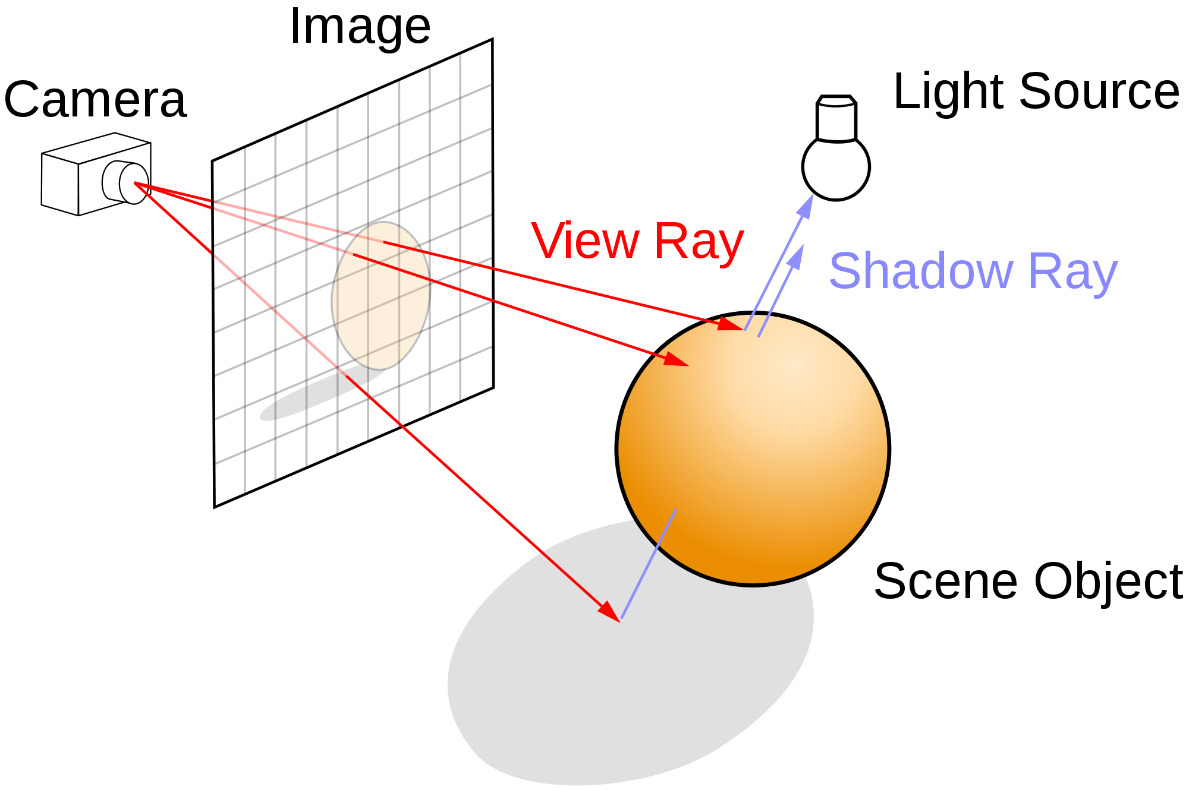
Ray Casting

Slide 11
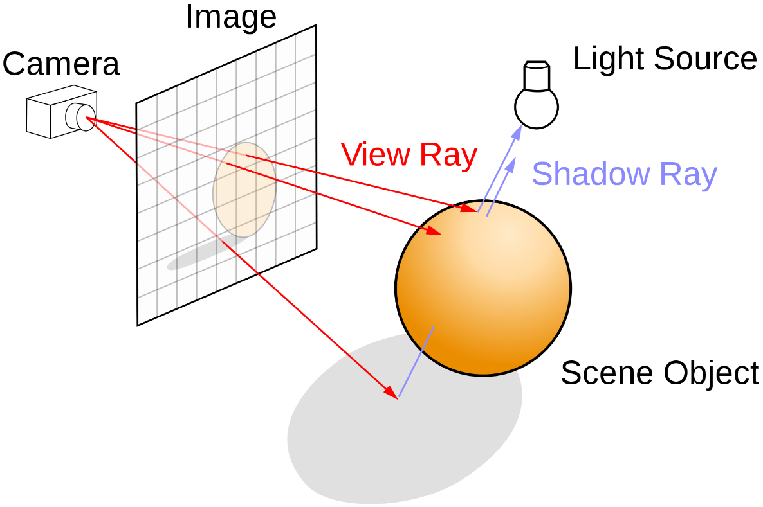
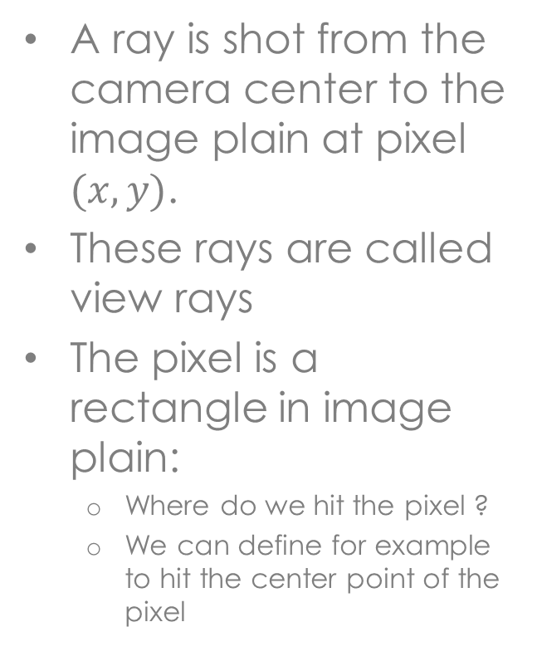
Ray Casting
A ray is shot from the camera center to the image plain at pixel $(x,y)$.
These rays are called view rays
The pixel is a rectangle in image plain:
Where do we hit the pixel ?
We can define for example to hit the center point of the pixel

Slide 12
Ray Casting
If the ray hits the object
We paint the pixel (x,y) with the object color
What is the object color ? (Later)
Otherwise ?
What does it mean to not hit an object ?
We can use a default value (e.g., sky-blue)

Slide 13
Ray Casting
Image RayCast(Camera camera, Scene scene, int width, int height)
{
Image image = new Image(width, height);
for (int i = 0; i < width; i++) {
for (int j = 0; j < height; j++) {
Ray ray = ConstructRayThroughPixel(camera, i, j);
Intersection hit = FindIntersection(ray, scene);
image[i][j] = GetColor(hit);
}
}
return image;
}

Slide 14
Ray Casting
Image RayCast(Camera camera, Scene scene, int width, int height)
{
Image image = new Image(width, height);
for (int i = 0; i < width; i++) {
for (int j = 0; j < height; j++) {
Ray ray = ConstructRayThroughPixel(camera, i, j);
Intersection hit = FindIntersection(ray, scene);
image[i][j] = GetColor(hit);
}
}
return image;
}

Slide 15
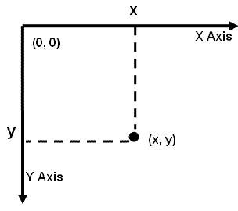

Step 1 – Construct a ray
In order to construct the ray we need to map each pixel $(i,j)$ to determine its corresponding point (x,y) on the plane.
Width
Height

Slide 16
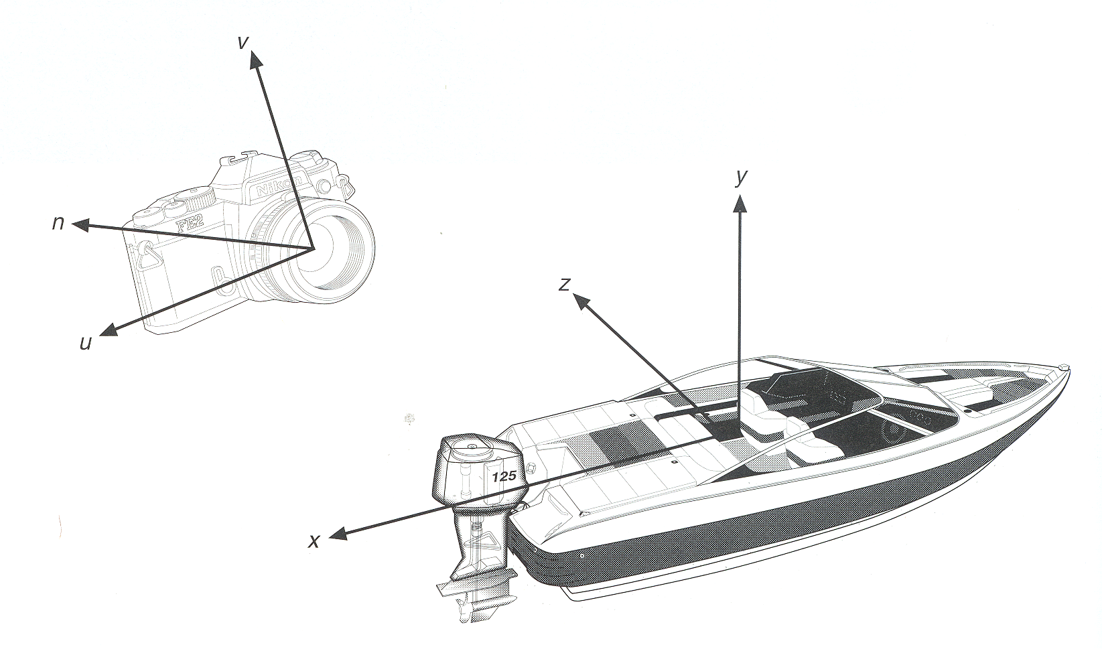
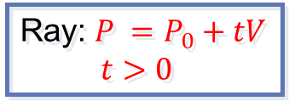



Constructing Ray Through a Pixel
up direction = v_{up}
View
Plane
back
towards
$$P_{0}$$
$$V$$
right = v_{right}
Ray: $P =P_{0}+tV$
$t>0$
$$P$$
IMPORTANT!!!!!

Slide 17
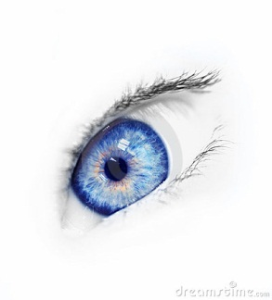

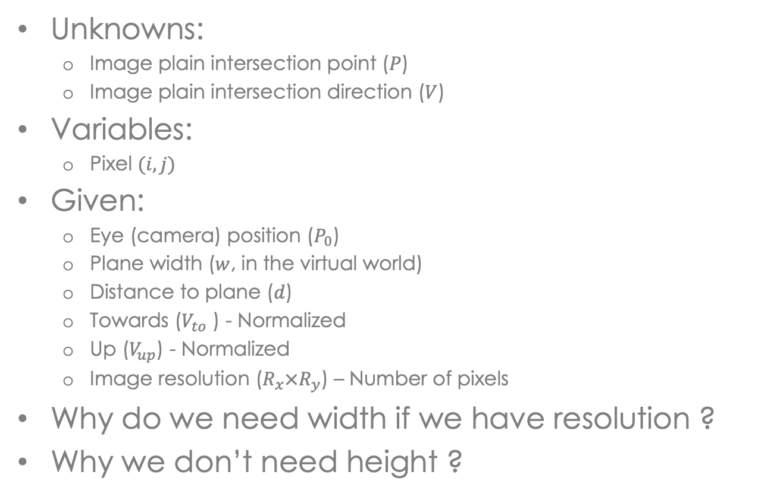




Image Space → View Plane Space
Unknowns:
Image plain intersection point ($P$)
Image plain intersection direction ($V$)
Variables:
Pixel $(i,j)$
Given:
Eye (camera) position ($P_{0}$)
Plane width ($w$, in the virtual world)
Distance to plane ($d$)
Towards ($V_{to}$ ) - Normalized
Up ($V_{up}$) - Normalized
Image resolution ($R_{x}×R_{y}$) – Number of pixels
Why do we need width if we have resolution ?
Why we don’t need height ?
$$P0$$
towards
$$w$$
$$d$$
$$V$$
up
$$P$$
Notes:
[1] Because Width in model coordinates (or world coordinates)
[2] Because we assume pixels are squares.

Slide 18

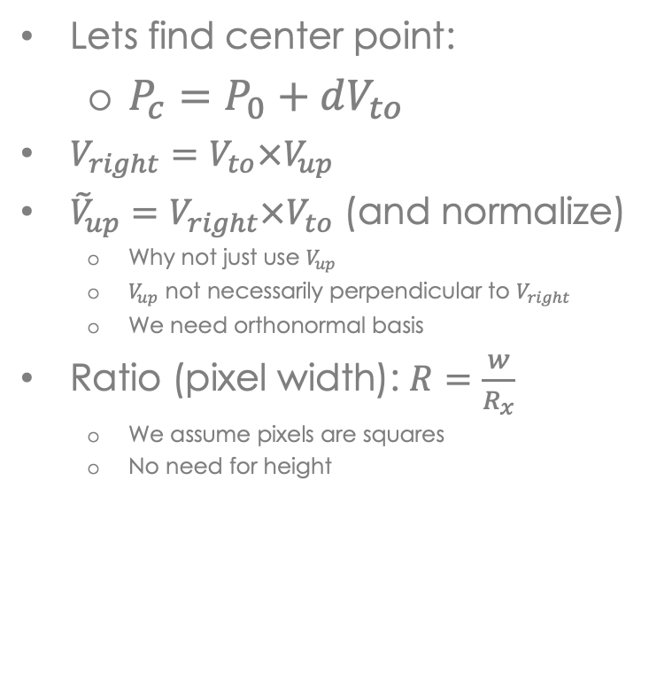

Image Space → View Plane Space
Lets find center point:
$P_{c}=P_{0}+dV_{to}$
$V_{right}=V_{to}×V_{up}$
${\tilde{V}}_{up}=V_{right}×V_{to}$ (and normalize)
Why not just use $V_{up}$
$V_{up}$ not necessarily perpendicular to $V_{right}$
We need orthonormal basis
Ratio (pixel width): $R=\frac{w}{R_{x}}$
We assume pixels are squares
No need for height
$$P0$$
towards
$$Pc$$
$$w$$
$$d$$
$$V$$
up
right

Slide 19

Image Space → View Plane Space
Image center: $P_{c}=P_{0}+dV_{to}$
$V_{right}=V_{to}×V_{up}$ (and normalize)
${\tilde{V}}_{up}=V_{right}×V_{to}$ (and normalize)
Ratio (pixel width): $R=\frac{w}{R_{x}}$
Lets find intersection point relative to center point
We want $(\left\lfloor \frac{R_{x}}{2}\right\rfloor$, $\left\lfloor \frac{R_{y}}{2}\right\rfloor$) => $P_{c}$
$$P=P_{c}+\left(j−\left\lfloor \frac{R_{x}}{2}\right\rfloor \right)R V_{right}−\left(i−\left\lfloor \frac{R_{y}}{2}\right\rfloor \right)R {\tilde{V}}_{up}$$
$$P0$$
towards
$$Pc$$
$$w$$
$$d$$
$$V$$
up
right
$$P$$

Slide 20
Ray Casting
Image RayCast(Camera camera, Scene scene, int width, int height)
{
Image image = new Image(width, height);
for (int i = 0; i < width; i++) {
for (int j = 0; j < height; j++) {
Ray ray = ConstructRayThroughPixel(camera, i, j);
Intersection hit = FindIntersection(ray, scene);
image[i][j] = GetColor(hit);
}
}
return image;
}

Slide 21

Step 2 – Find intersection
Iterate over all objects in the scene:
Find intersection with the ray
Consider the first intersection point (closest to the camera)
How do you determine which object is closest ?
Recall our ray $R\left(t\right)= P_{0} +V⋅t$
Find minimal $t$

Slide 22
Sphere-Ray Intersection
Ray: P = P₀ + tV
Sphere: |P - O|² - r ² = 0
P’
P
V
r
P₀
O

Slide 23
Sphere-Ray Intersection
Ray: P = P₀ + tV
Sphere: |P - O|² - r ² = 0
Substituting for P, we get:
|P₀ + tV - O|² - r ² = 0
Solve quadratic equation:
at² + bt + c = 0
where:
a = 1
b = 2 V • (P₀ - O)
c = |P₀ - C|² - r ² = 0
Algebraic Method
P’
P
V
r
O
P₀
P = P₀ + tV

Slide 24
Sphere-Ray Intersection
Ray: P = P₀ + tV
Sphere: |P - O|² - r ² = 0
L = O - P₀
t_{ca} = L • V
if (t_{ca} < 0) return 0
d² = L • L - t_{ca}²
if (d² > r²) return 0
t_{hc} = sqrt(r² - d²)
t = t_{ca} - t_{hc} and t_{ca} + t_{hc}
Geometric Method
P’
t_{ca}
P
t_{hc}
d
r
V
r
P₀
L
O
P = P₀ + tV

Slide 25
Ray-Triangle Intersection
First, intersect ray with plane
Then, check if point is inside triangle
P
V
P₀

Slide 26
Ray-Triangle Intersection
Ray: P = P₀ + tV
Plane: P • N + d = 0
Substituting for P, we get:
(P₀ + tV) • N + d = 0
Solution:
t = -(P₀ • N + d) / (V • N)
Algebraic Method
P
P = P₀ + tV
N
V
P₀

Slide 27
Ray-Triangle Intersection
Check if point is inside triangle algebraically
T₃
For each side of triangle
V₁ = T₁ – P0
V₂ = T₂ – P0
N₁ = V₂ x V₁
Normalize N₁
d₁ = -P₀ • N₁
if ((P • N₁ + d₁ ) < 0)
return FALSE;
end
P
T₁
V₁
N₁
T₂
V₂
P₀

Slide 28
Ray-Triangle Intersection
Check if point is inside triangle parametrically
T₃
Compute α, β:
P = α (T₂-T₁) + β (T₃-T₁)
Check if point inside triangle.
0 ≤ α ≤ 1 and 0 ≤ β ≤ 1
α + β ≤ 1
P
β
T₁
α
T₂
V
P₀

Slide 29
Ray Casting
Image RayCast(Camera camera, Scene scene, int width, int height)
{
Image image = new Image(width, height);
for (int i = 0; i < width; i++) {
for (int j = 0; j < height; j++) {
Ray ray = ConstructRayThroughPixel(camera, i, j);
Intersection hit = FindIntersection(ray, scene);
image[i][j] = GetColor(hit);
}
}
return image;
}

Slide 30
Ray Casting - Shading
Return a flat-color per object will produce a non-realistic image:

Slide 31

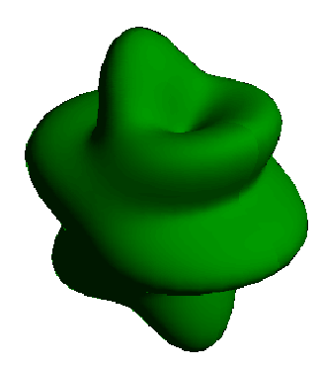
Shading
Motivation 1: Perceive geometry
Motivation2: In order to produce realistic images, we must simulate the appearance of surfaces under various lighting conditions.

Slide 32
Illumination Model Parameters
Lighting effects are described with models that consider the interaction of light sources with object surfaces.
The factors determining the lighting effects are:
The light source parameters:
Positions.
Electromagnetic Spectrum.
Shape.
The surface parameters
Position.
Reflectance properties.
Position of near by surfaces.
The eye (camera) parameters
Position.
Sensor spectrum sensitivities.

Slide 33
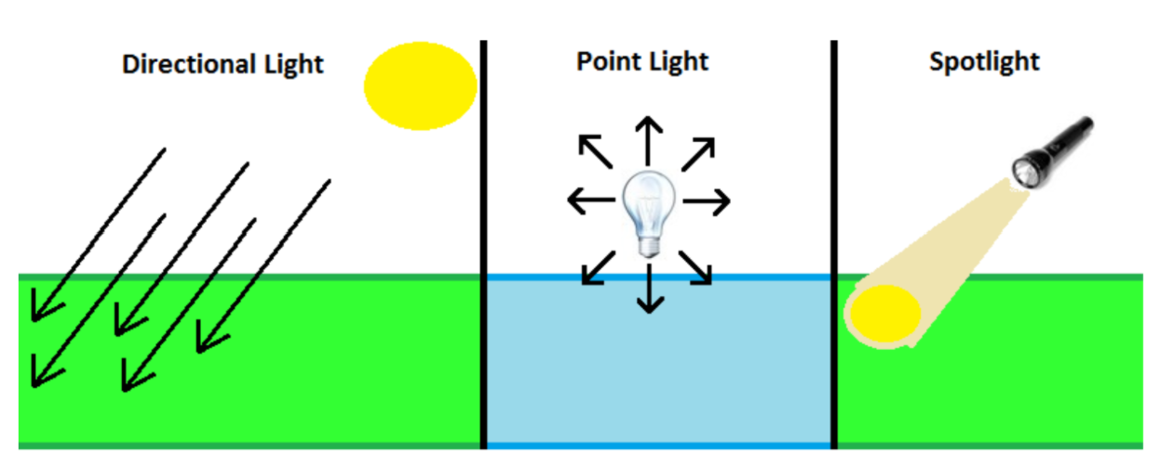
Light Sources

Slide 34
Directional Light
Directional Light
Defined by intensity and a direction.
The intensity is constant at all points.
We assume that the light source lies at infinity.
The direction from all points in the scene to the light-source is in the opposite direction of the light source direction.

Slide 35

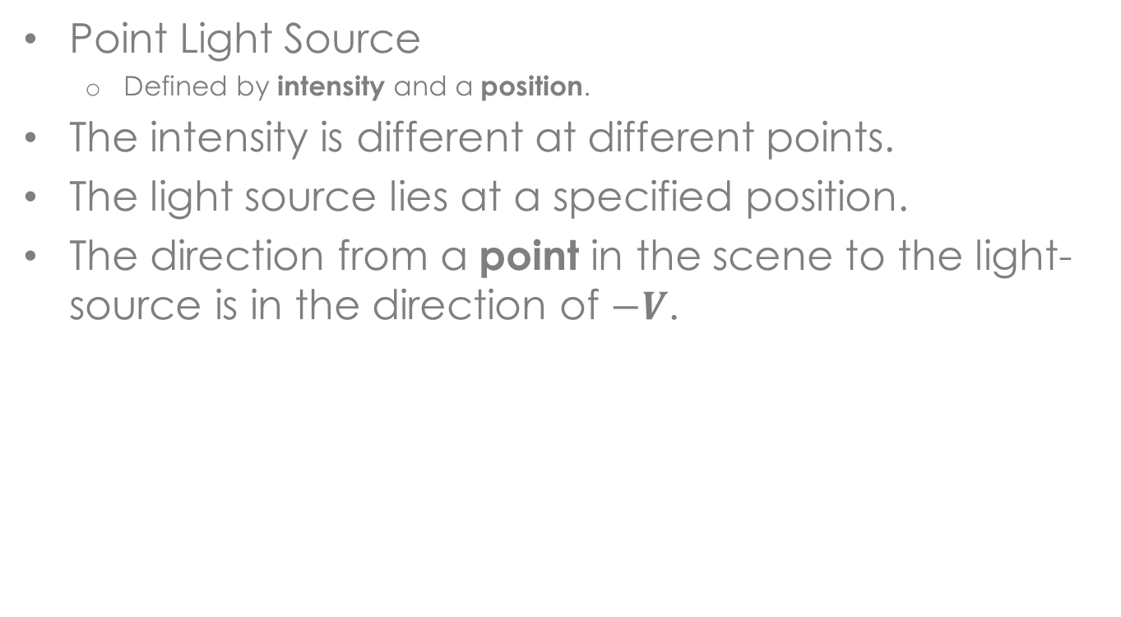



Point Light
Point Light Source
Defined by intensity and a position.
The intensity is different at different points.
The light source lies at a specified position.
The direction from a point in the scene to the light-source is in the direction of $−V$.
$$q$$
$$V=p−q \\ d=\left|p−q\right| \\ I\left(p\right)=\frac{I_{0}}{k_{c}+k_{l}⋅d+k_{q}d^{2}}$$
$$V$$
$$p$$

Slide 36


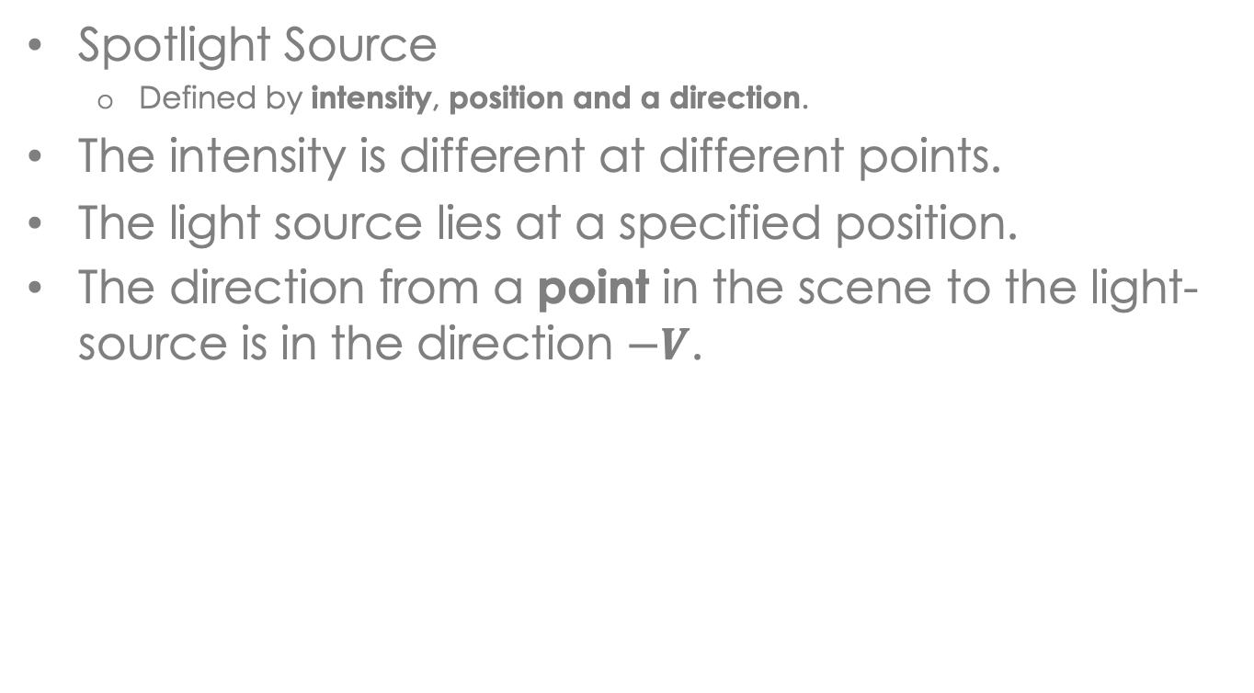




Spotlight
Spotlight Source
Defined by intensity, position and a direction.
The intensity is different at different points.
The light source lies at a specified position.
The direction from a point in the scene to the light-source is in the direction $−V$.
$$q$$
$$\hat{D}$$
$$V=p−q \\ \hat{V}=V/\left|V\right| \\ d=\left|p−q\right| \\ I\left(p\right)=\frac{I_{0}⋅\left(\hat{V}\hat{D}\right)}{k_{c}+k_{l}⋅d+k_{q}d^{2}}$$
$$V$$
$$p$$

Slide 37
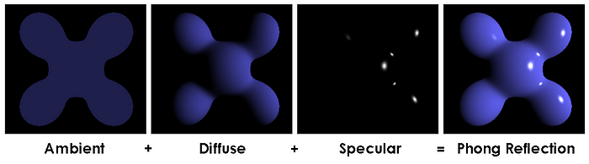
Phong Reflectance Model
An approximation of local illumination of points on a surfaces
It is weighted-sum of three components:
Ambient, Diffuse and Specular reflections

Slide 38
Phong Reflectance Model
Pixel color by calculating:
Ambient term
Specular Reflection
Diffuse reflection
Emitting objects (Optional if object omits light)
Note:
this is the model for one color and it should be duplicated for each channel: I^{R}, I^{G}, I^{B} .
<- Final Color

Slide 39
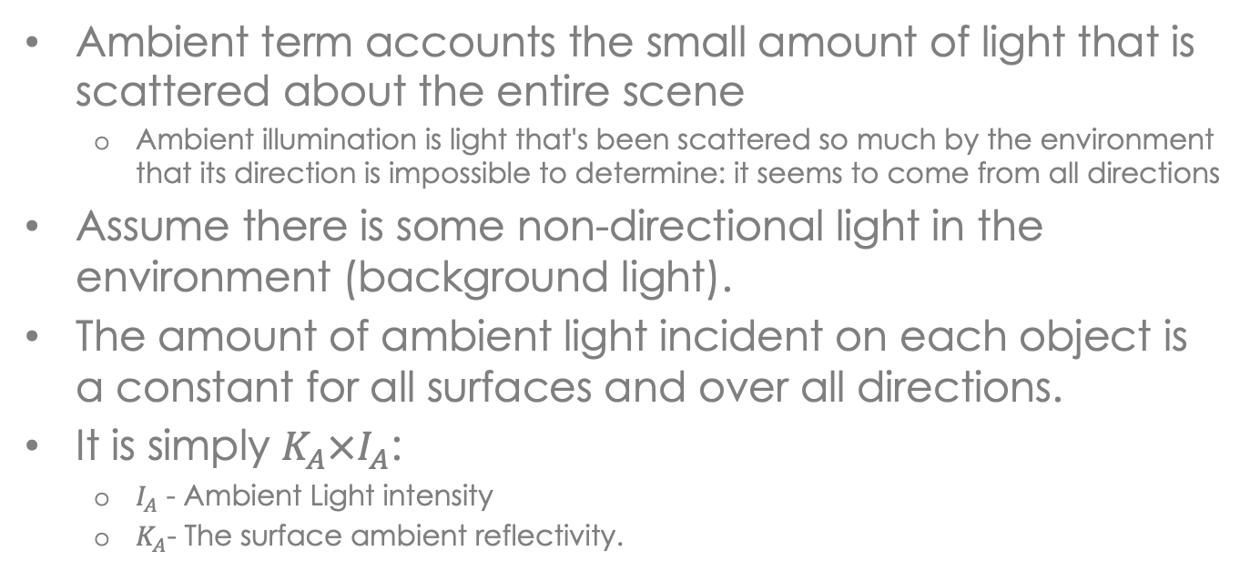
Ambient Term
Ambient term accounts the small amount of light that is scattered about the entire scene
Ambient illumination is light that's been scattered so much by the environment that its direction is impossible to determine: it seems to come from all directions
Assume there is some non-directional light in the environment (background light).
The amount of ambient light incident on each object is a constant for all surfaces and over all directions.
It is simply $K_{A}×I_{A}$:
$I_{A}$ - Ambient Light intensity
$K_{A}$- The surface ambient reflectivity.
I_{amb}=K_{A} I_{A}

Slide 40
Diffuse Reflection
Diffuse (Lambertian) surfaces are rough or grainy (like clay, soil, fabric).
The surface appears equally bright from all viewing directions.
The brightness at each point is proportional to cos(θ):
L
N
θ
40

Slide 41

Diffuse Reflection
Ambient
surface
Diffuse
surface
41

Slide 42
Diffuse Reflection
A light that hits the surface will be reflected in all directions
This means that the intensity is independent of the observers position.
I_{L} – the light intensity at the point.
K_{D} ∈ [0,1] - the surface diffuse reflectivity.
N - the surface normal.
L - the opposite light direction.
N
θ
L
Surface

Slide 43


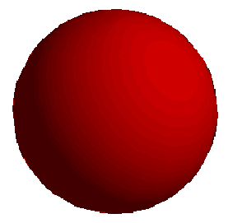



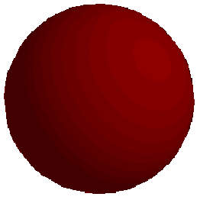

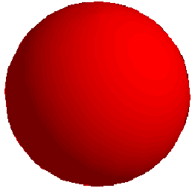
Diffuse Reflection
0
0.3
0.6
K_{d}
0.3
0.5
0.7
K_{a}

Slide 44
Specular Reflection
Shiny and glossy surfaces (like metal, plastic) with highlights.
Reflectance intensity changes with reflected angle.
For an ideal specular surface (mirror) the light is reflected in only one direction - R.
However, most objects are not ideal mirrors (glossy objects) and they reflect in the immediate vicinity of R.
N
N
L
R
L
R
θ
θ
θ
θ
φ
V
Ideal specular surface
non-ideal specular surface
44

Slide 45
Specular Reflection
Light hitting the surface from a single incoming direction will be reflected into a single outgoing direction
K_{s} - the surface specular reflectivity.
n - specular-reflection parameter, determining the deviation from ideal specular surface (for mirror n=∞).
V – direction from point to Viewer
R – Reflection of light-direction about the surface
N
Viewer
R
θ
θ
L
α
V

Slide 46
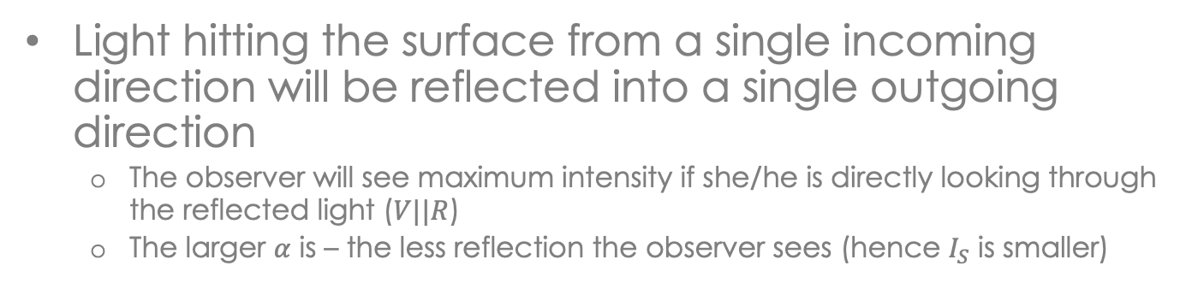
Specular Reflection
Light hitting the surface from a single incoming direction will be reflected into a single outgoing direction
The observer will see maximum intensity if she/he is directly looking through the reflected light ($V||R$)
The larger $α$ is – the less reflection the observer sees (hence $I_{S}$ is smaller)
N
Viewer
R
θ
θ
L
α
V

Slide 47
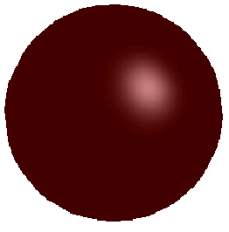
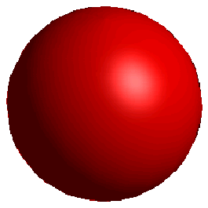
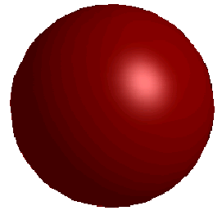
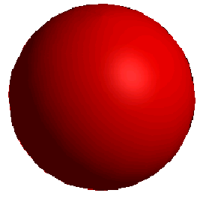
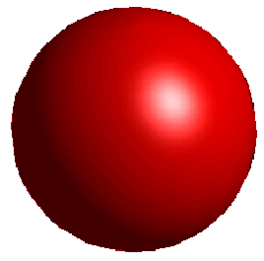

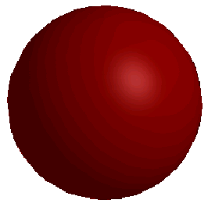
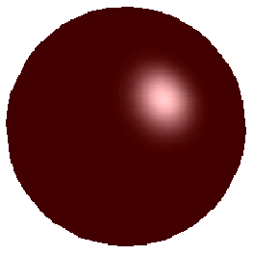
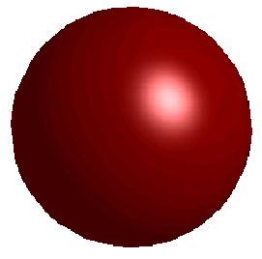
Specular Reflection
0.2
0.5
0.8
K_{s}
0
0.3
0.7
K_{d}

Slide 48
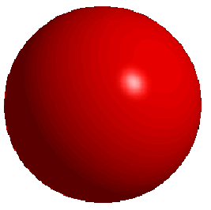
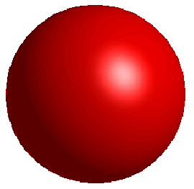
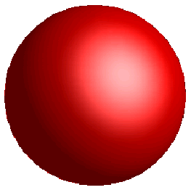
Specular Reflection
n=50
n=10
n=3
48

Slide 49
Surface Illumination Calculation
Single light source:
N
Viewer
R
θ
θ
L
α
V

Slide 50
Surface Illumination Calculation
Multiple light sources:
N
Viewer
L₁
L₂
V

Slide 51
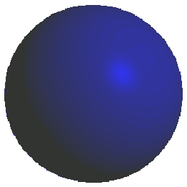
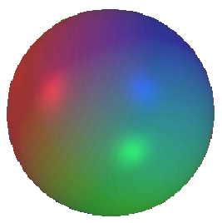
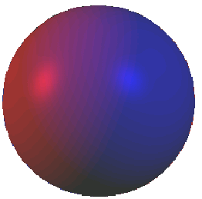
Multiple Light Sources

Slide 52
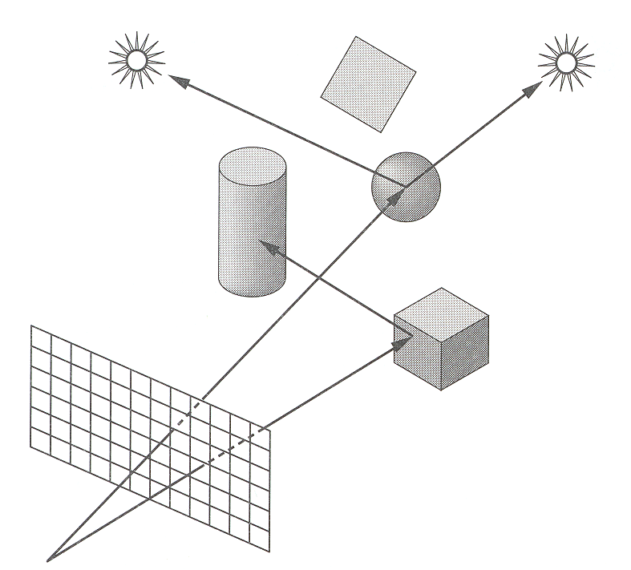

Shadows
Shadow terms tell which light sources are blocked
Cast ray towards each light source $L_{i}$
$S_{i}=0$ if ray is blocked, $S_{i}=1$ otherwise
Shadow
Term

Slide 53
Ray Casting - Shadows
If the ray hits the object
We need to check if light ‘reaches’ this object.
Shadow rays are emitted from the hit point to the light sources.
If the shadow ray hits an object in the way to the light-source, then we know that light doesn’t reach this hit point (This creates shadows)
Otherwise we know that the light reaches this point and we perceive the objects color.
Light can still reach the object from other light sources (need to check all).

Slide 54
Color Model Summary
I_{E} – Material Emission
I_{A} – Global ambient
I_{i} – Light Source i Intensity
K_{A} – Material Ambient
K_{D} – Material Diffuse
K_{S} – Material Specular
K_{R} – Material Reflection
K_{T} – Material Refraction
S_{i} – Light Shadowed?
n – Material Shininess
Normalized vectors:
L – Intersection to light
N – Intersection normal
V – Intersection to Eye
R – Intersection to reflected light
<- Final Color

