Slide 1
Computer Vision Hands-On Project
Skin Detection with OpenCV

Slide 2
Agenda
Image Preprocessing
Skin Detection Approaches
Dempster-Shafer
Gaussian
Baysian
Conclusion

Slide 3
Dempster-Shafer Approach

Slide 4
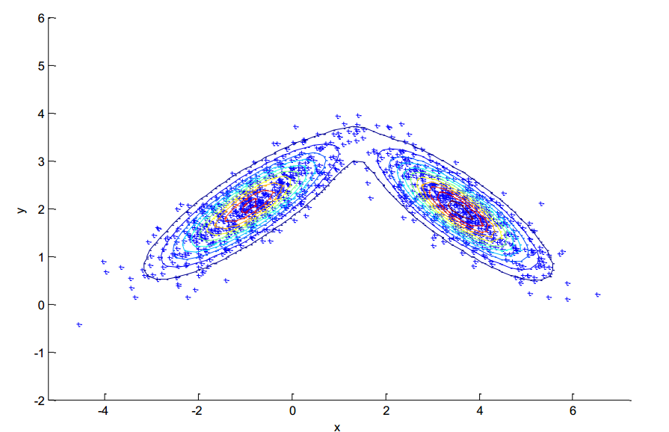
Gaussian Approach
Small amount of training data
Train with built-in Expectation–maximization algorithm
High time complexity
Training exceeds time limit

Slide 5
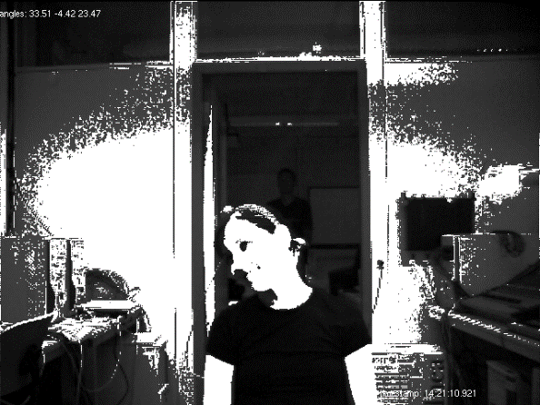
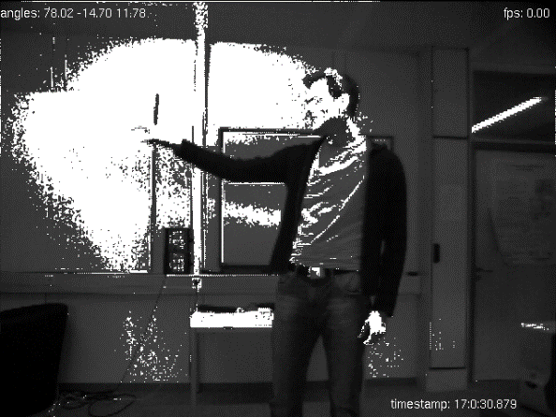
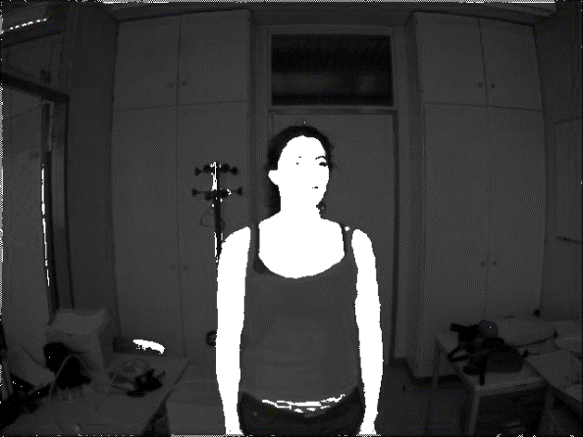
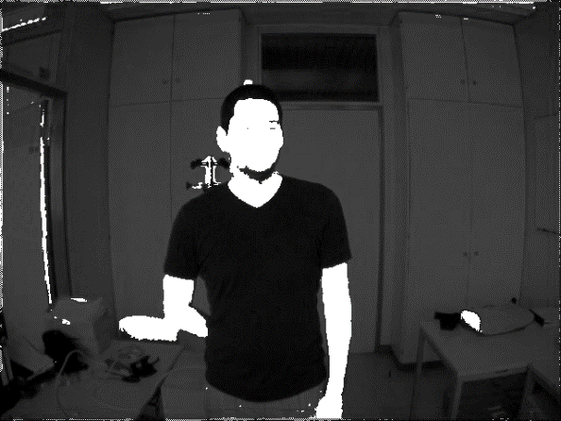
Gaussian Approach
Predefined covariances and means
5 clusters for skin and 5 for non-skin: F1-score: 0.576
One live-trained cluster for skin and
5 predefined clusters for non-skin: F1-score: 0.686

Slide 6
Baysian Approach

Slide 7
Conclusion

