Slide 1
Computer Vision Hands-On Project
Skin Detection with OpenCV

Slide 2
Agenda
Skin Detection Approaches
Dempster-Shafer
Gaussian
K nearest neighbor
Conclusion

Slide 3
Dempster-Shafer Approach

Slide 4
Gaussian Approach
Works well with limited training data
Multiple curves for different lightings

Slide 5
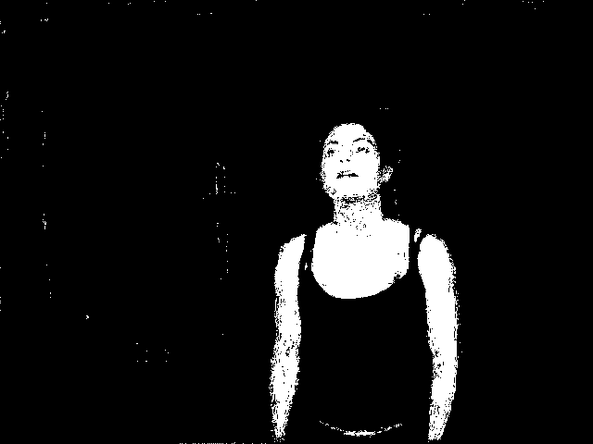
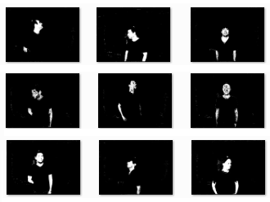

K nearest neighbor
OpenCV class
Training with all the points
Searching for the two nearest neibors
The threashold can not be adjusted -> no ROC

Slide 6
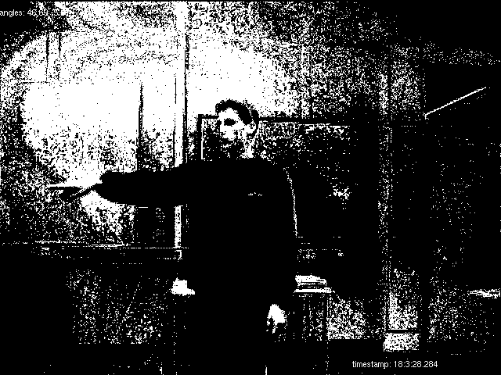
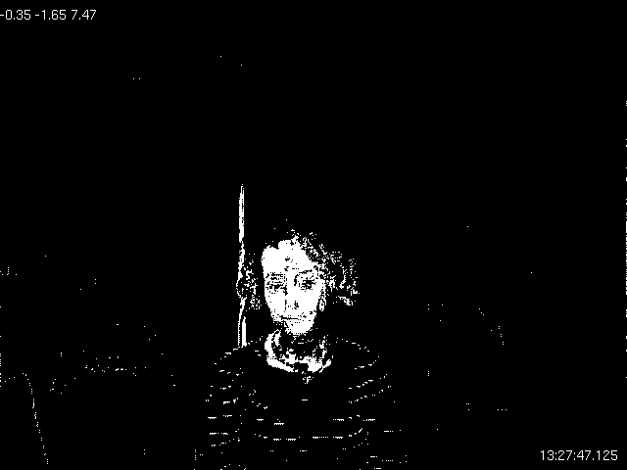
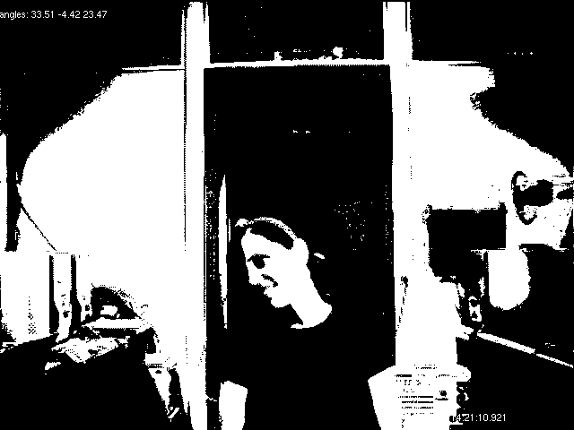
K nearest neighbor
Some pictures are noisy
On others, bad detection

Slide 7
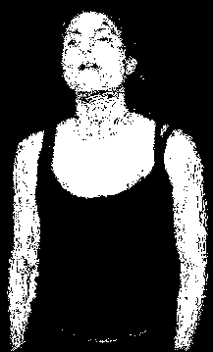
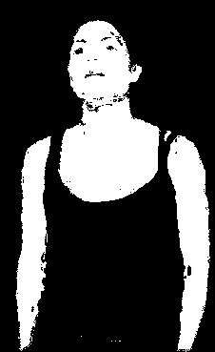

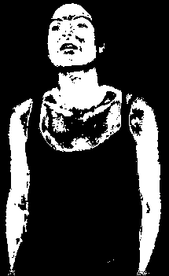
K nearest neighbor
Fast training but the classification can be very long
nb points | all | 1/100 | 1/1000 |  |  | 1/10000
nb neihbours | 2 | 2 | 2 | 6 | 10 | 2 | 6
classification time | 16 h | 10 mn | 1 mn |  |  | 7 sec

Slide 8


K nearest neighbor
Opening

Slide 9
Conclusion

