Slide 1




Recent Progress in Detection and Prediction of Epilepsy Saturday October 15th 2022 (3:30 p.m.) DATE ABOVE Cross-frequency coupling studies of intracranial EEG data of epilepsy patients using time-frequency distributions Daniel Girvitz (1) Daniel Girvitz¹ Supervisor: Dr. Kris Vasudevan¹ Supervisor: Dr. Elena Braverman¹ ¹Department of Mathematics and Statistics, University of Calgary

Slide 2

In memoriam
Dedicated to an inspiring mentor, caring supervisor – and just a great friend,
with whom I am proud to have worked,
and proud to have made proud.
Dr. Kris Vasudevan
March 2nd 1944 – August 22nd 2022

Slide 3
Contents
Motivation; definitions of CFC, PAC
Essentials we need; metric definitions
Methods for Detecting CFC
Methods for Detecting CFC: MVL, MI, GLM
Traditional method vs. time-frequency method
Problems with the TF method
Cohen’s class of TF distributions
Reduced Rihaczek distribution & method
Real Data Examples: MVL method, plus analysis & interpretation
Conclusions
Sources

Slide 4
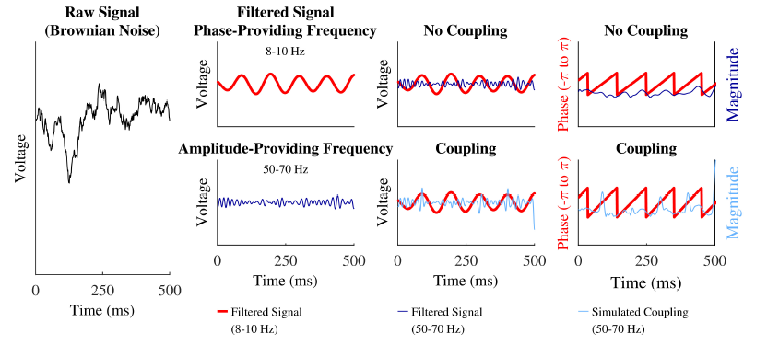
Motivation; definitions of CFC, PAC
Taken from Hülsemann M.J., Naumann E. and Rasch B. — Quantification of Phase-Amplitude Coupling in Neuronal Oscillations: Comparison of Phase-Locking Value, Mean Vector Length, Modulation Index, and Generalized-Linear-Modeling-Cross-Frequency-Coupling. — // Front. Neurosci. — 2019. — Vol. 13 — P. 573.

Slide 5
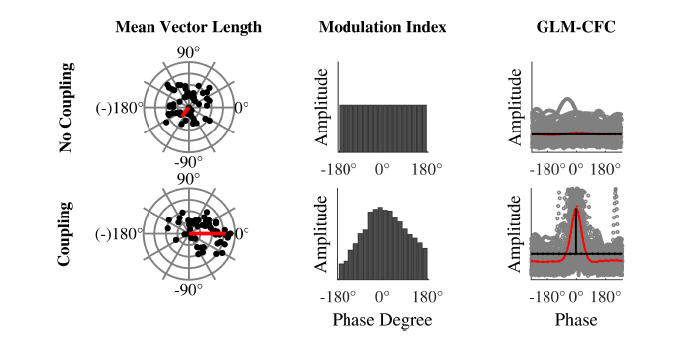
Essentials we need (phase & amplitude estimates); metric definitions i.e. how to quantify PAC?
Taken from Hülsemann M.J., Naumann E. and Rasch B. — Quantification of Phase-Amplitude Coupling in Neuronal Oscillations: Comparison of Phase-Locking Value, Mean Vector Length, Modulation Index, and Generalized-Linear-Modeling-Cross-Frequency-Coupling. — // Front. Neurosci. — 2019. — Vol. 13 — P. 573.

Slide 6
Methods for Detecting CFC
Mean Vector Length (MVL) -- Canolty et al (2006)
Modulation Index (MI) -- Canolty et al (2006), Tort et al (2010)
GLM-CFC -- Penny et al (2008), Voytek et al (2013), Mark & Kramer (2013), Nadalin et al (2019)
Phase-locking Value (PLV) -- Mormann et al (2005), Lachaux et al (1999), Vanhatalo et al (2004)
Correlation Coefficient -- Penny et al (2008)
Envelope-to-signal Correlation -- Bruns and Eckhorn (2004)
Analysis of amplitude spectra – Cohen (2008)
Coherence between amplitude and signal -- Colgin et al (2009)
Coherence between the time course of power and signal -- Osipova et al (2008)
Eigendecomposition of multichannel covariance matrices -- Cohen (2017)

Slide 7
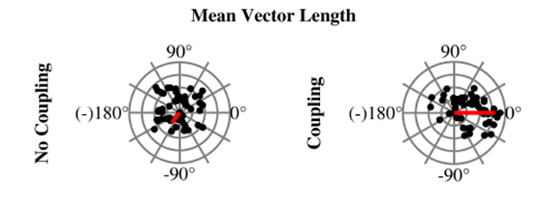

Methods for detecting CFC -- MVL
$$MVL=\frac{\sum_{n=1}^{N}{\left\|{A_{f}}_{A}[n]e^{j{φ_{f}}_{p}\left[n\right]}\right\|}}{N}$$

Slide 8
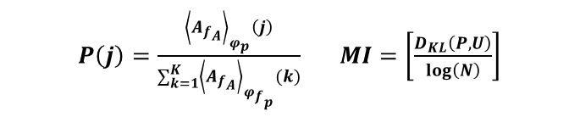
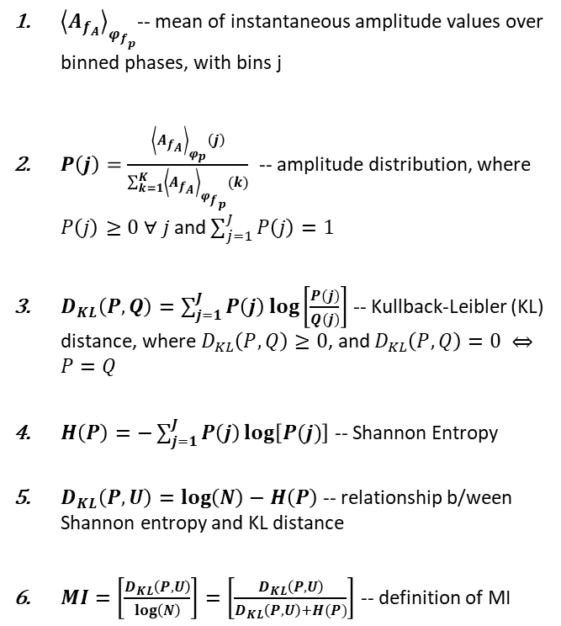
Methods for detecting CFC -- MI
$P\left(j\right)=\frac{{\left\langle A_{f_{A}}\right\rangle }_{φ_{p}}\left(j\right)}{\sum_{k=1}^{K}{{\left\langle A_{f_{A}}\right\rangle }_{{φ_{f}}_{p}}(k)}}$ $MI=\left[\frac{D_{KL}\left(P,U\right)}{\log\left(N\right)}\right]$
${\left\langle A_{f_{A}}\right\rangle }_{{φ_{f}}_{p}}$-- mean of instantaneous amplitude values over binned phases, with bins j
$P\left(j\right)=\frac{{\left\langle A_{f_{A}}\right\rangle }_{φ_{p}}\left(j\right)}{\sum_{k=1}^{K}{{\left\langle A_{f_{A}}\right\rangle }_{{φ_{f}}_{p}}(k)}}$ -- amplitude distribution, where $P\left(j\right)≥0 ∀ j$ and $\sum_{j=1}^{J}{P\left(j\right)=1}$
$D_{KL}\left(P,Q\right)=\sum_{j=1}^{J}{P\left(j\right)\log\left[\frac{P(j)}{Q(j)}\right]}$ -- Kullback-Leibler (KL) distance, where $D_{KL}\left(P,Q\right)≥0$, and $D_{KL}\left(P,Q\right)=0 ⇔P=Q$
$H\left(P\right)=−\sum_{j=1}^{J}{P\left(j\right)\log\left[P(j)\right]}$ -- Shannon Entropy
$D_{KL}\left(P,U\right)=\log\left(N\right)−H\left(P\right)$ -- relationship b/ween Shannon entropy and KL distance
$MI=\left[\frac{D_{KL}\left(P,U\right)}{\log\left(N\right)}\right]=\left[\frac{D_{KL}\left(P,U\right)}{D_{KL}\left(P,U\right)+H(P)}\right]$ -- definition of MI
The KL Distance quantifies the amplitude (over binned phases) distribution’s deviation from the Uniform distribution.

Slide 9
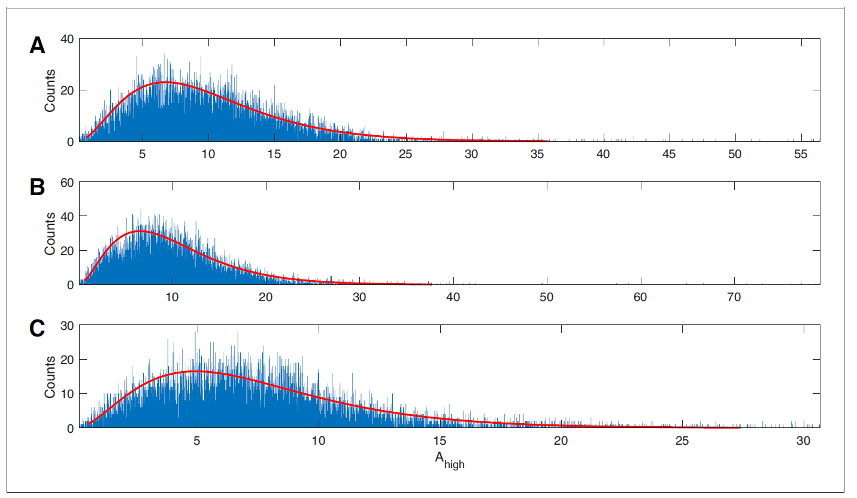
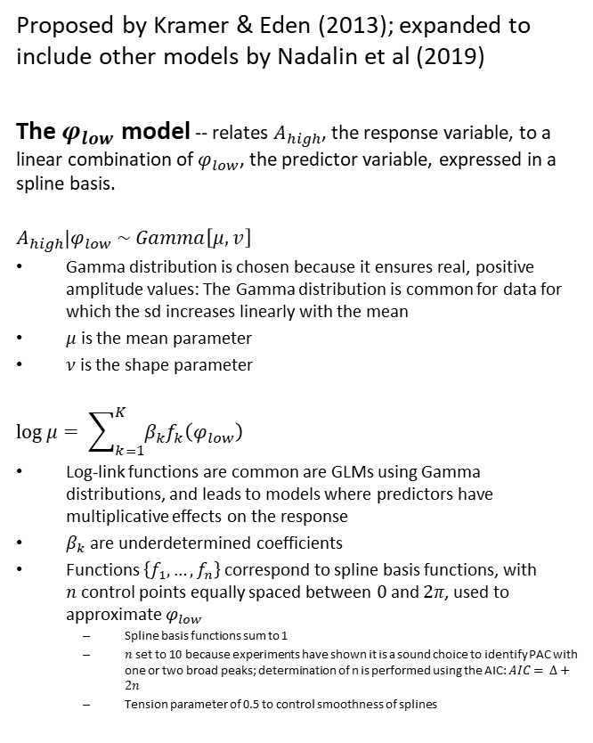
Methods for detecting CFC -- GLM
Proposed by Kramer & Eden (2013); expanded to include other models by Nadalin et al (2019)
The $φ_{low}$ model -- relates $A_{high}$, the response variable, to a linear combination of $φ_{low}$, the predictor variable, expressed in a spline basis.
$$A_{high}|φ_{low} \sim Gamma\left[μ,v\right]$$
Gamma distribution is chosen because it ensures real, positive amplitude values: The Gamma distribution is common for data for which the sd increases linearly with the mean
$μ$ is the mean parameter
$ν$ is the shape parameter
$$\log{μ}= \sum_{k=1}^{K}{β_{k}f_{k}\left(φ_{low}\right)}$$
Log-link functions are common are GLMs using Gamma distributions, and leads to models where predictors have multiplicative effects on the response
$β_{k}$ are underdetermined coefficients
Functions $\left\{f_{1}, …, f_{n}\right\}$ correspond to spline basis functions, with $n$control points equally spaced between $0$and $2π$, used to approximate $φ_{low}$
Spline basis functions sum to 1
$n$ set to 10 because experiments have shown it is a sound choice to identify PAC with one or two broad peaks; determination of n is performed using the AIC: $AIC= Δ+2n$
Tension parameter of 0.5 to control smoothness of splines
Taken from Nadalin et al – A statistical framework to assess cross-frequency coupling while accounting for confounding analysis effects. – // Elife. – 2019 Oct 16. – doi:10.7554/eLife.44287
Taken from Nadalin et al – A statistical framework to assess cross-frequency coupling while accounting for confounding analysis effects. – // Elife. – 2019 Oct 16. – doi:10.7554/eLife.44287
Note: the use of the basis/cardinal spline functions move the model into the larger class of Generalized Additive Models (GAMs)
Notes:
TOP FIGURE
The gamma distribution provides a good fit to example human data.
Three examples of 20 s duration recorded from a single electrode during a human seizure. In each case, the gamma fit (red curve) provides an acceptable fit to the empirical distributions of the high frequency amplitude.
BOTTOM FIGURE
The statistical modeling framework successfully detects different types of cross-frequency coupling.
(A–C) Simulations with no CFC.
(A) When no CFC occurs, the low frequency signal (blue) and high frequency signal (orange) evolve independently.
(B) The surfaces SAlow, Sϕlow, and SAlow,ϕlow suggest no dependence of Ahigh on ϕlow or Alow.
(C) Significant (p<0.05) values of RPAC and RAAC from 1000 simulations. Very few significant values for the statistics R are detected.
(D–G) Simulations with PAC only.
(D) When the phase of the low frequency signal is near 0 radians (red tick marks), the amplitude of the high frequency signal increases.
(E) The surfaces SAlow, Sϕlow, and SAlow,ϕlow suggest dependence of Ahigh on ϕlow.
(F) In 1000 simulations, significant values of RPAC frequently appear, while significant values of RAAC rarely appear.
(G) As the intensity of PAC increases, so do the significant values of RPAC (black), while any significant values of RAAC remain small.

Slide 10
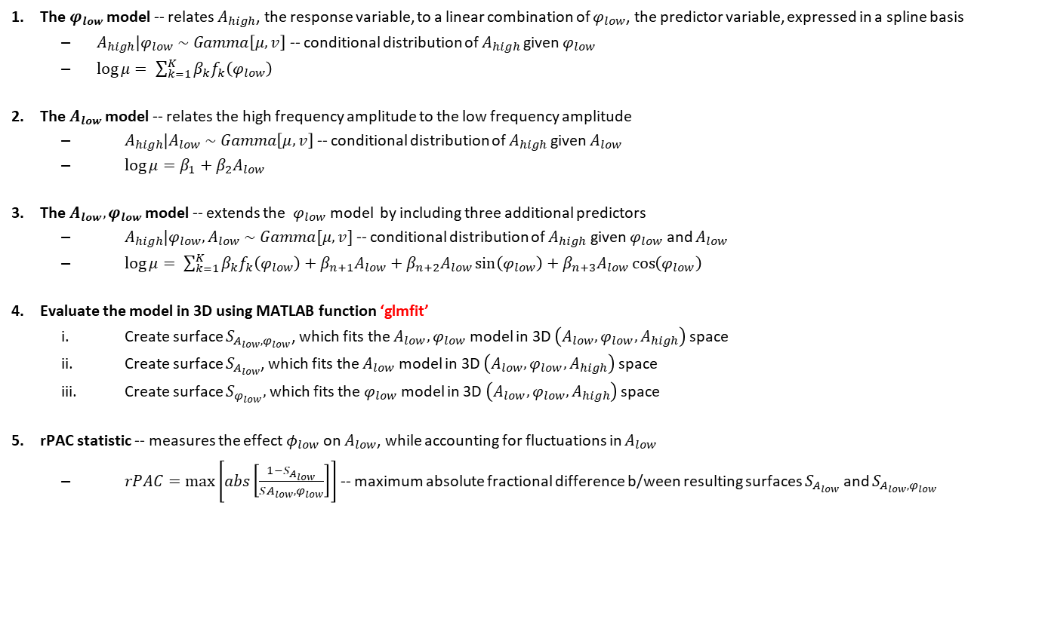
Methods for detecting CFC -- GLM
The $φ_{low}$ model -- relates $A_{high}$, the response variable, to a linear combination of $φ_{low}$, the predictor variable, expressed in a spline basis
$A_{high}|φ_{low} \sim Gamma\left[μ,v\right]$ -- conditional distribution of $A_{high}$given $φ_{low}$
$\log{μ}= \sum_{k=1}^{K}{β_{k}f_{k}\left(φ_{low}\right)}$
The $A_{low}$ model -- relates the high frequency amplitude to the low frequency amplitude
$A_{high}|A_{low} \sim Gamma\left[μ,v\right]$ -- conditional distribution of $A_{high}$given $A_{low}$
$\log{μ}=β_{1}+β_{2}A_{low}$
The $A_{low}, φ_{low}$ model -- extends the $φ_{low}$ model by including three additional predictors
$A_{high}|φ_{low},A_{low} \sim Gamma[μ, v]$ -- conditional distribution of $A_{high}$ given $φ_{low}$ and $A_{low}$
$\log{μ}= \sum_{k=1}^{K}{β_{k}f_{k}\left(φ_{low}\right)}+β_{n+1}A_{low}+β_{n+2}A_{low}\sin\left(φ_{low}\right)+β_{n+3}A_{low}\cos\left(φ_{low}\right)$
Evaluate the model in 3D using MATLAB function ‘glmfit’
Create surface $S_{A_{low},φ_{low}}$, which fits the $A_{low},φ_{low}$ model in 3D $\left(A_{low}, φ_{low},A_{high}\right)$ space
Create surface $S_{A_{low}}$, which fits the $A_{low}$ model in 3D $\left(A_{low}, φ_{low},A_{high}\right)$ space
Create surface $S_{φ_{low}},$ which fits the $φ_{low}$ model in 3D $\left(A_{low}, φ_{low},A_{high}\right)$ space
rPAC statistic -- measures the effect $φ_{low}$ on $A_{low}$, while accounting for fluctuations in $A_{low}$
$rPAC=\max\left[abs\left[\frac{1−S_{A_{low}}}{SA_{low}{,φ}_{low}}\right]\right]$ -- maximum absolute fractional difference b/ween resulting surfaces $S_{A_{low}}$ and $S_{A_{low},φ_{low}}$
Note: ‘glmfit’ uses the Fischer scoring/Iteratively reweighted least squares algorithm

Slide 11
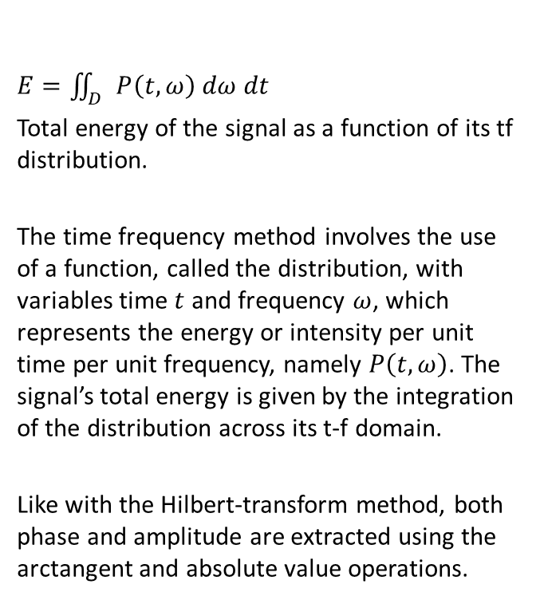
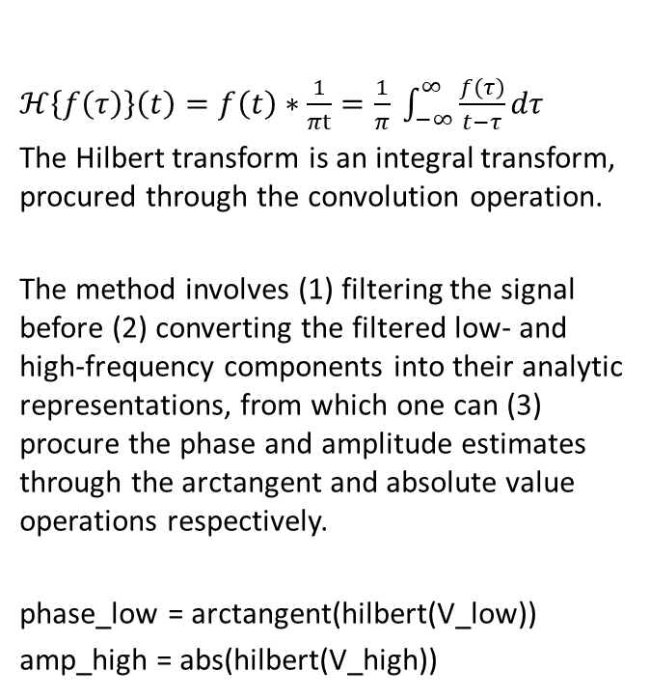
Traditional (Hilbert-transform) method vs. time-frequency method
Hilbert-transform method
Time-frequency method
$ℋ\left\{f\left(τ\right)\right\}\left(t\right)=f\left(t\right)∗\frac{1}{πt}=\frac{1}{π} \int_{−∞}^{∞ }{\frac{f\left(τ\right)}{t−τ}}dτ$
The Hilbert transform is an integral transform, procured through the convolution operation.
The method involves (1) filtering the signal before (2) converting the filtered low- and high-frequency components into their analytic representations, from which one can (3) procure the phase and amplitude estimates through the arctangent and absolute value operations respectively.
phase_low = arctangent(hilbert(V_low))
amp_high = abs(hilbert(V_high))
$E=\iint_{D}{P\left(t, ω\right) dω dt}$
Total energy of the signal as a function of its tf distribution.
The time frequency method involves the use of a function, called the distribution, with variables time $t$ and frequency $ω$, which represents the energy or intensity per unit time per unit frequency, namely $P\left(t,ω\right)$. The signal’s total energy is given by the integration of the distribution across its t-f domain.
Like with the Hilbert-transform method, both phase and amplitude are extracted using the arctangent and absolute value operations.

Slide 12
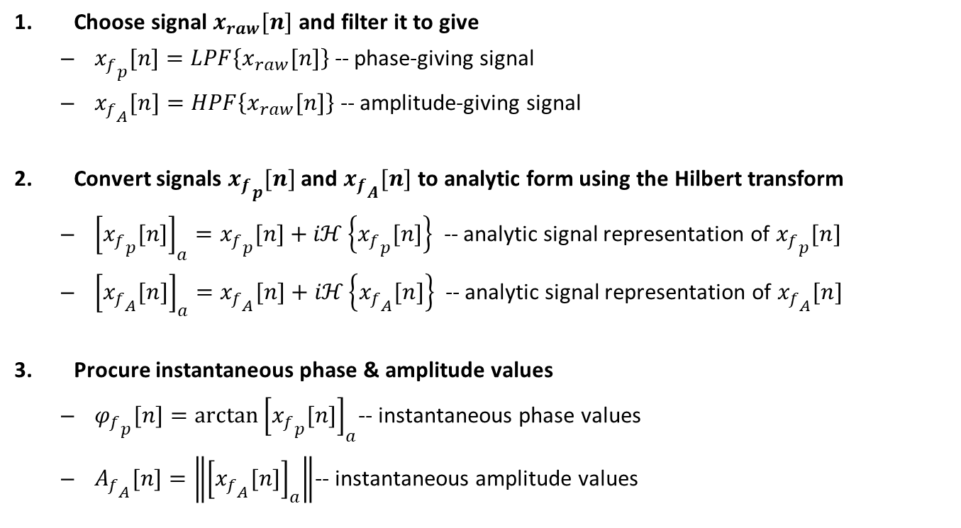
Hilbert-transform method
Choose signal $x_{raw}[n]$ and filter it to give
${x_{f}}_{p}[n]=LPF\left\{x_{raw}[n]\right\}$ -- phase-giving signal
${x_{f}}_{A}[n]=HPF\left\{x_{raw}[n]\right\}$ -- amplitude-giving signal
Convert signals ${x_{f}}_{p}[n]$ and ${x_{f}}_{A}[n]$ to analytic form using the Hilbert transform
${\left[{x_{f}}_{p}[n]\right]}_{a}={x_{f}}_{p}[n]+iℋ\left\{{x_{f}}_{p}[n]\right\}$ -- analytic signal representation of ${x_{f}}_{p}[n]$
${\left[{x_{f}}_{A}[n]\right]}_{a}={x_{f}}_{A}[n]+iℋ\left\{{x_{f}}_{A}[n]\right\}$ -- analytic signal representation of ${x_{f}}_{A}[n]$
Procure instantaneous phase & amplitude values
${φ_{f}}_{p}[n]=\arctan{{\left[{x_{f}}_{p}[n]\right]}_{a}}$-- instantaneous phase values
${A_{f}}_{A}[n]=\left\|{\left[{x_{f}}_{A}[n]\right]}_{a}\right\|$-- instantaneous amplitude values
Note: [n] refers to sample n in an N-sized signal, which MATLAB treats as a vector

Slide 13
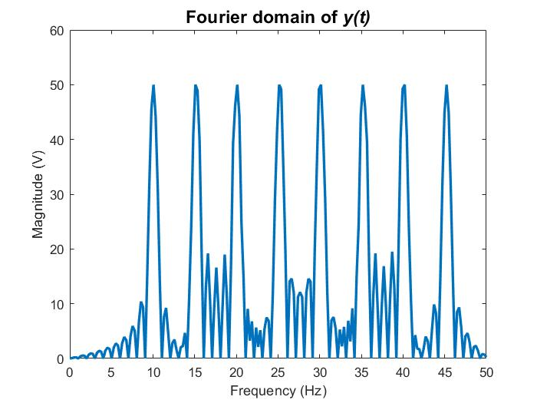
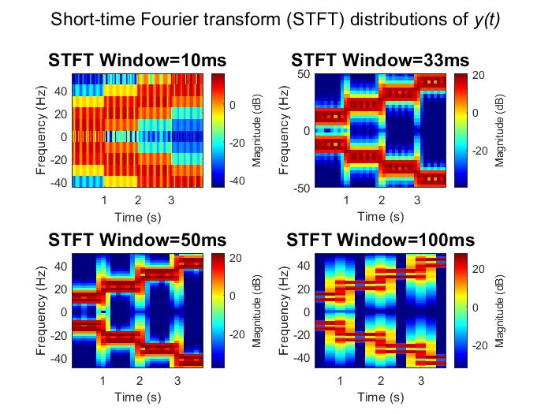
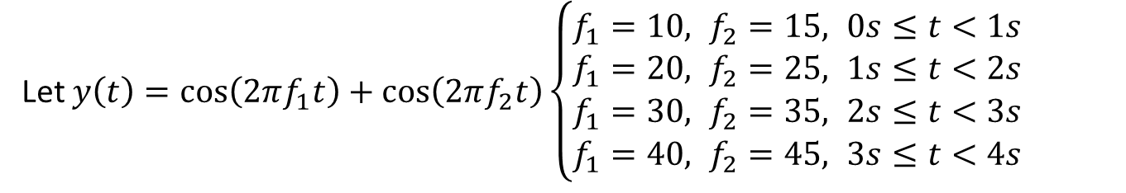
Problems with the TF method
Let $y\left(t\right)=\cos\left(2πf_{1}t\right)+\cos\left(2πf_{2}t\right)\left\{\begin{aligned}f_{1}=10, f_{2}=15, 0s≤t<1s \\ &f_{1}=20, f_{2}=25, 1s≤t<2s \\ f_{1}=30, f_{2}=35, 2s≤t<3s \\ f_{1}=40, f_{2}=45, 3s≤t<4s\end{aligned}\right.$
Traditional Fourier transform methods fail to account for changing frequencies.
Better resolution in the time domain results in worse resolution in the frequency domain and vice-versa -- i.e. the Heisenberg uncertainty principle.
Also, spectral leakage has been introduced.

Slide 14
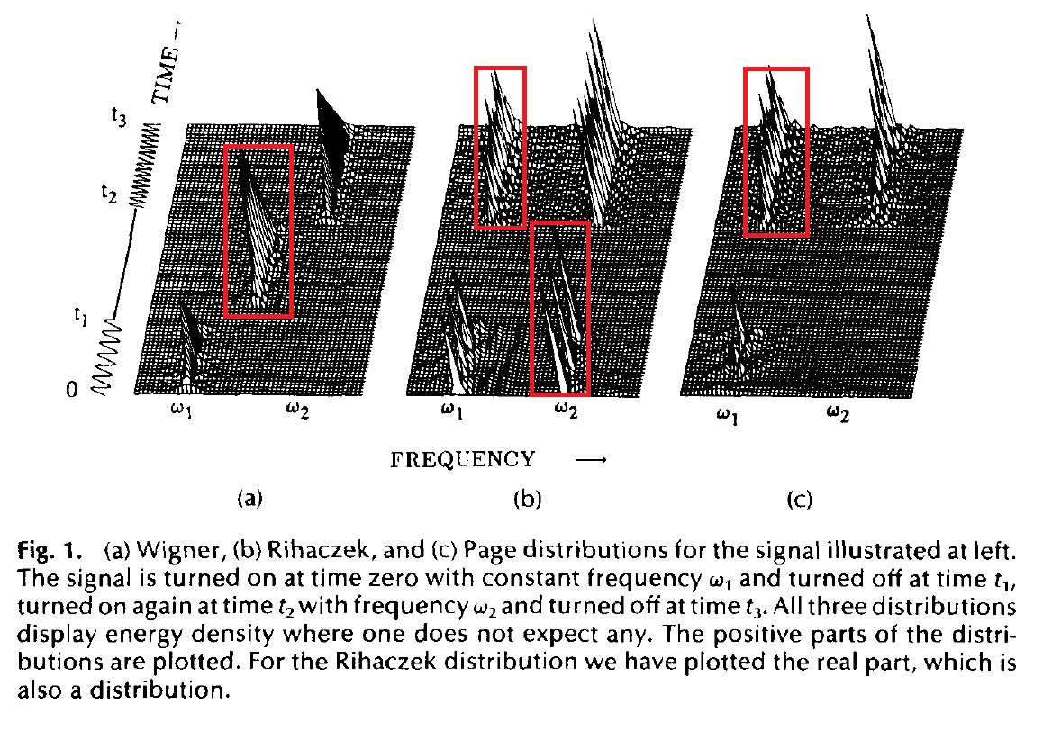

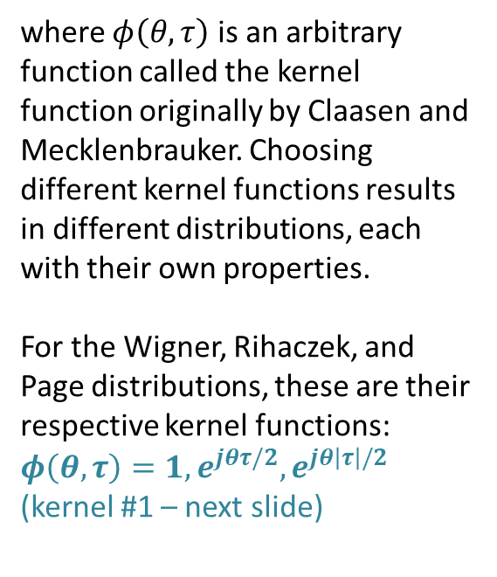
Cohen’s class of TF distributions
Are all generalizations of
$P\left(t,ω\right)=\frac{1}{4π^{2}}\iiint{e^{−jθt−jτω+jθu} φ\left(θ,τ\right){ s}^{∗}\left(u−\frac{1}{2}τ\right)s \left(u+\frac{1}{2}τ\right)}du dτ dθ$
where $φ\left(θ,τ\right)$ is an arbitrary function called the kernel function originally by Claasen and Mecklenbrauker. Choosing different kernel functions results in different distributions, each with their own properties.
For the Wigner, Rihaczek, and Page distributions, these are their respective kernel functions: $φ\left(θ,τ\right)=1, e^{jθτ/2}, e^{jθ\left|τ\right|/2}$
(kernel #1 – next slide)
Taken from Cohen L. — Time-frequency distributions-a review. — // Proceedings of the IEEE. — 1989. — Vol. 77, no. 7. — P. 941–981.

Slide 15
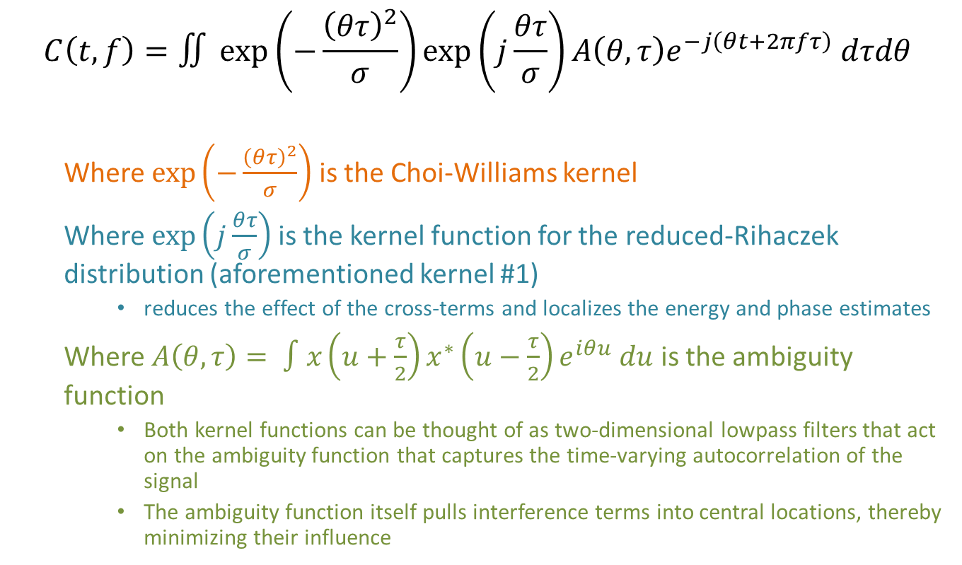
Reduced Interference (RID) - Rihaczek time-frequency distribution
$$C\left(t,f\right)=∬\exp\left(−\frac{{\left(θτ\right)}^{2}}{σ}\right)\exp\left(j\frac{θτ}{σ}\right)A\left(θ,τ\right)e^{−j\left(θt+2πfτ\right)} dτdθ$$
Where $\exp\left(−\frac{{\left(θτ\right)}^{2}}{σ}\right)$ is the Choi-Williams kernel
Where $\exp\left(j\frac{θτ}{σ}\right)$ is the kernel function for the reduced-Rihaczek distribution (aforementioned kernel #1)
reduces the effect of the cross-terms and localizes the energy and phase estimates
Where $A\left(θ,τ\right)= ∫x\left(u+\frac{τ}{2}\right)x^{∗}\left(u−\frac{τ}{2}\right)e^{iθu} du$ is the ambiguity function
Both kernel functions can be thought of as two-dimensional lowpass filters that act on the ambiguity function that captures the time-varying autocorrelation of the signal
The ambiguity function itself pulls interference terms into central locations, thereby minimizing their influence

Slide 16
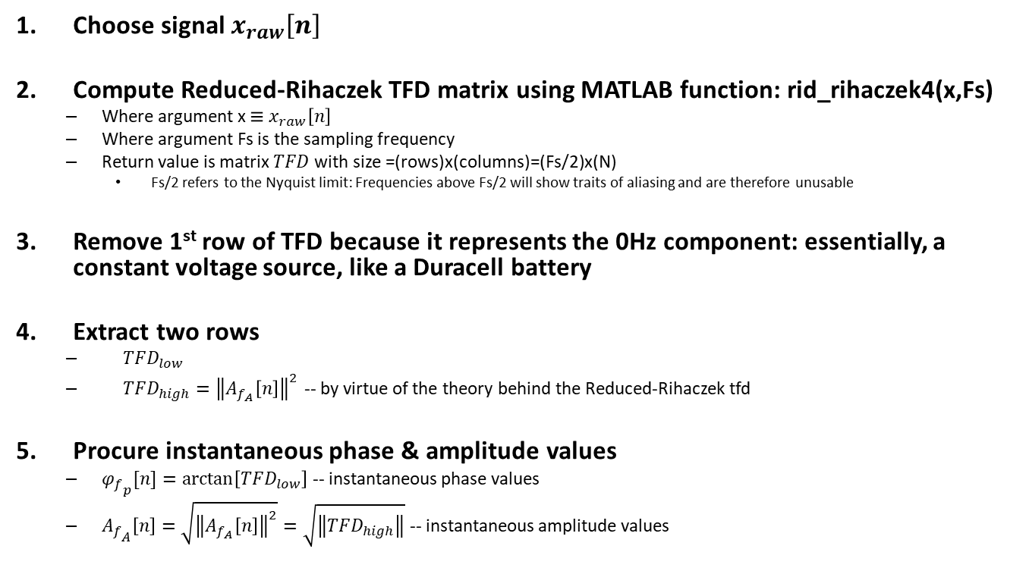
RID-Rihaczek tfd method
Choose signal $x_{raw}\left[n\right]$
Compute Reduced-Rihaczek TFD matrix using MATLAB function: rid_rihaczek4(x,Fs)
Where argument x $≡x_{raw}\left[n\right]$
Where argument Fs is the sampling frequency
Return value is matrix $TFD$ with size =(rows)x(columns)=(Fs/2)x(N)
Fs/2 refers to the Nyquist limit: Frequencies above Fs/2 will show traits of aliasing and are therefore unusable
Remove 1st row of TFD because it represents the 0Hz component: essentially, a constant voltage source, like a Duracell battery
Extract two rows
$TFD_{low}$
$TFD_{high}={\left\|A_{f_{A}}\left[n\right]\right\|}^{2}$ -- by virtue of the theory behind the Reduced-Rihaczek tfd
Procure instantaneous phase & amplitude values
${φ_{f}}_{p}[n]=\arctan\left[TFD_{low}\right]$ -- instantaneous phase values
${A_{f}}_{A}\left[n\right]=\sqrt{{\left\|A_{f_{A}}\left[n\right]\right\|}^{2}}=\sqrt{\left\|TFD_{high}\right\|}$ -- instantaneous amplitude values
Note: [n] refers to sample n in an N-sized signal, which MATLAB treats as a vector

Slide 17
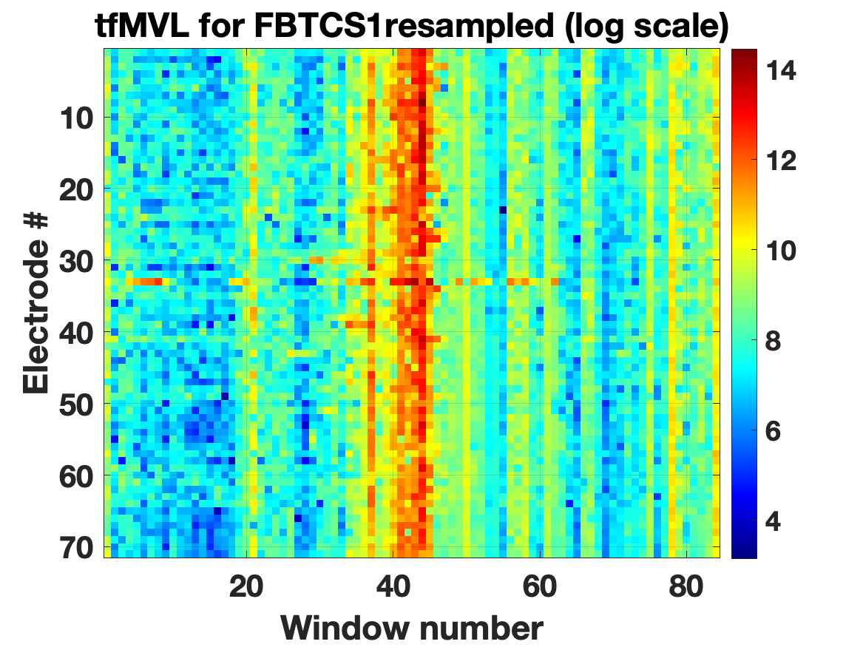
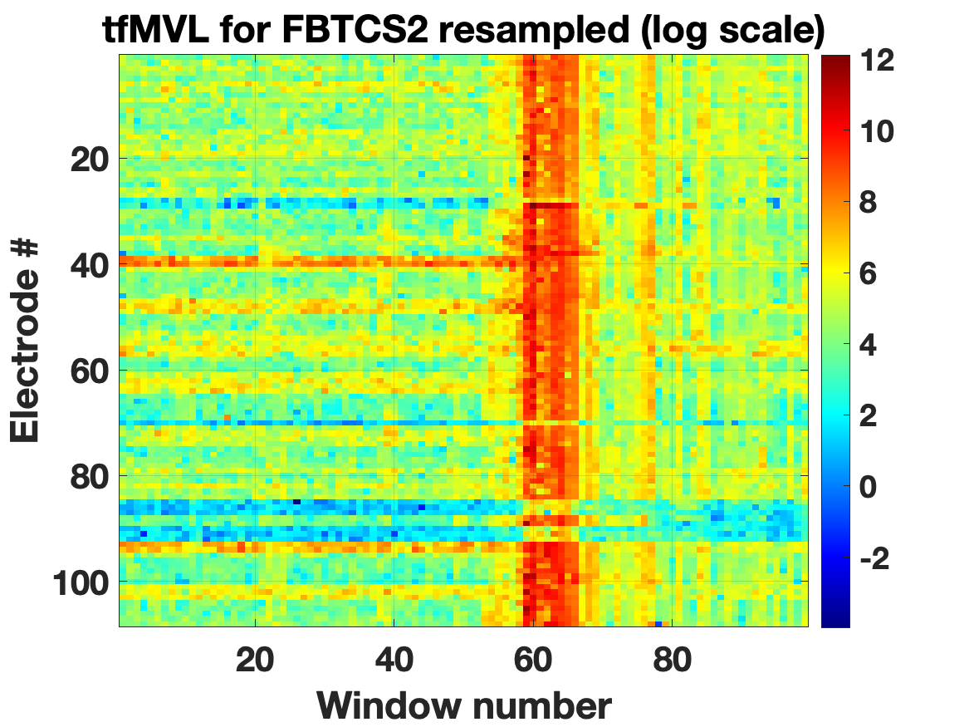
Real Data Examples: MVL method, plus analysis & interpretation
ONSET
OFFSET
ONSET
OFFSET
Each pixel refers to intra-electrode coupling (i=j for a given window).
FBTCS1: there is a clear CFC signature preceding the physical onset marker by 20 seconds
FBTCS2: there are two different window locations preceding the onset where the CFC signature is evident
Note: Having tested both a linear- and log-scale, we found the log-scale allows us to discern finer features in the data

Slide 18
Conclusions
The tfMVL method has clearly uncovered evidence of electrophysiological signatures in two iEEG datasets – more are required to confirm our findings
The tf method is a viable alternative to the Hilbert-transform method
Thank you!

Slide 19
Sources
Aviyente & Mutlu -- A Time-Frequency-Based Approach to Phase and Phase Synchrony Estimation (2011)
Buzsáki, G., Rhythms of the brain, Oxford University Press (2006)
Canolty et al -- High Gamma Power Is Phase-Locked to Theta Oscillations in Human Neocortex (2006)
Hulsemann -- Quantification of PAC in Neuronal Oscillations (Comparison of PLV, MVL, MI, GLM-CFC) (2019)
Kramer & Eden -- Assessment of CFC with confidence using GLMs (2013)
Munia & Aviyente -- Time-Frequency Based Phase-Amplitude Coupling Measure For Neuronal Oscillations (2019)
Nadalin et al -- A statistical framework to assess cross-frequency coupling while accounting for confounding analysis effects (2019)
Tort et at -- Measuring Phase-Amplitude Coupling Between Neuronal Oscillations of Different Frequencies (2010)
Note: Esoteric facts and figures cited at location, while more prominent information is analyzed from several sources, all listed

