Slide 1
A CATHOLIC INTRODUCTION TO AI
Getting Started with
the HSC CIAI Course

Slide 2
A NEW WAY TO LEARN
Using New Technology
to Study New Technology
This course doesn't just teach you about AI — it hands you AI-powered tools to learn it faster.
1
You're studying artificial intelligence.
The subject of this course.
2
Your study mentor is artificial intelligence.
Gemini Notebook, grounded in your own material.
3
Your notebooks run the same building blocks.
Jupyter Notebook cells use the code that trains real models.
Getting Started with the HSC CIAI Course

Slide 3
One New Format for Lectures, Slides, Handouts, and Labs
A Jupyter Notebook is a single file that mixes formatted text with live, runnable Python code — and shows the results right where you can see them.
All course materials — lectures, quizzes, and labs — are accessed through Caravel. However, lecture materials are provided in a Jupyter Notebook. A new tool is required to access a Jupyter Notebook. There are two options:
SOFTWARE INSTALL REQUIRED
NO INSTALL NEEDED
Visual Studio Code
Google Colab
Best experience for completing all course exercises. Requires installing Python, VS Code, and Git once, up front.
Runs entirely in your browser with just a Google account. Ideal if you're new to VS Code or want occasional access.
Getting Started with the HSC CIAI Course
2

Slide 4
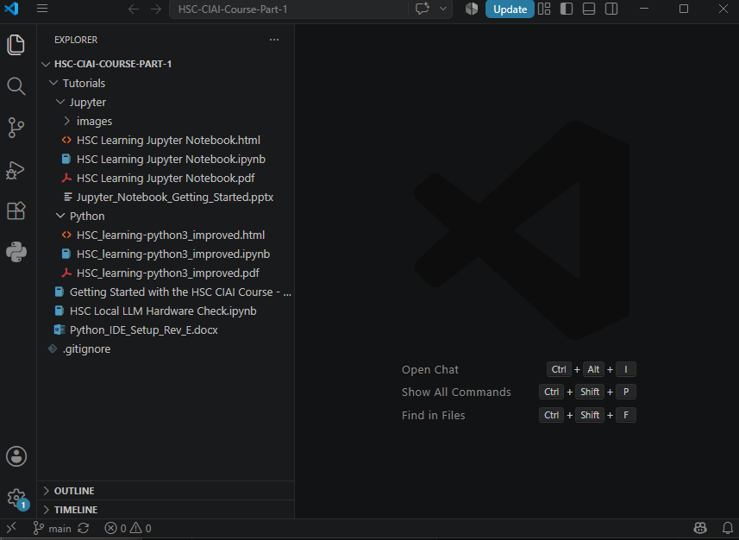
OPTION 1 · VISUAL STUDIO CODE
One-Time Setup
1
Install software
2
Python 3.11.9, VS Code, and Git — plus the Python and Jupyter VS Code extensions.
Clone the repo
3
git clone https://github.com/... — creates your course folder. Do this once.
Open in VS Code
4
File > Open Folder, or run code . from inside the cloned folder.
Select interpreter
Open any notebook, click Select Kernel, and choose your Python interpreter.
Getting Started with the HSC CIAI Course
3

Slide 5
OPTION 1 · VISUAL STUDIO CODE
Weekly Updates, One Command
You never re-download the repository. Open a terminal in the course folder each week and run:
git pull
If Git blocks the pull
This usually means you edited a course notebook directly. Make a copy of your work first, then contact the instructor if you're unsure how to proceed.
Students should generally not modify the original course notebooks — save your work under a new filename instead.
✓
Downloads only the files that changed
✓
No ZIP files to manage
✓
No copying or replacing folders
✓
New lessons simply appear in place
Getting Started with the HSC CIAI Course
4

Slide 6
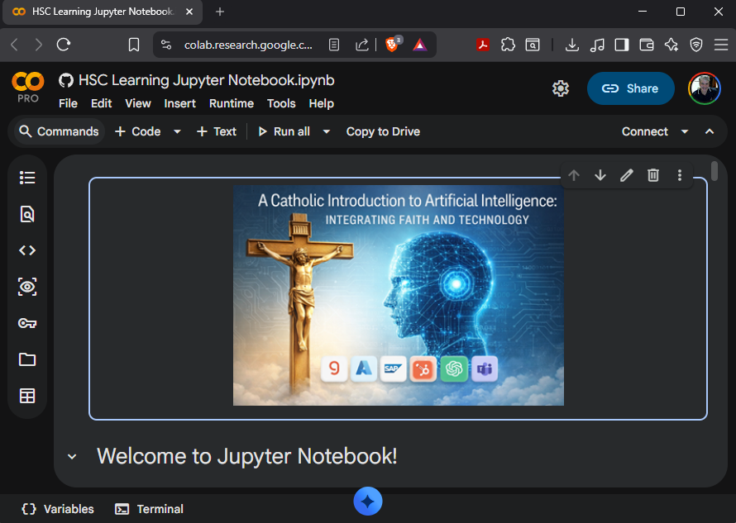
OPTION 2 · GOOGLE COLAB
No One-Time Setup
!
No software to install!
Simply open the notebook directly from Caravel.
A new browser tab will open in Google Colab.
Getting Started with the HSC CIAI Course
3

Slide 7
OPTION 2 · GOOGLE COLAB
Weekly Updates
NO ADDITIONAL STEPS REQUIRED
Open notebook from Caravel; Notebook opens in a new browser tab
✓
Maintain your own folder structure
✓
Create a new subfolder for each new week
✓
Save your notebook in the current week’s subfolder
Getting Started with the HSC CIAI Course
4

Slide 8
Which Option Should I Choose?
Feature | VS Code | Google Colab
Works offline | Yes | No
Full Python environment required (with git) | Yes | No
Weekly updates | git pull | Launches from Caravel as a new tab in a browser
Software installation required | Yes | No
Past experience with using VSC | Yes | Good for occasional use
No past experience with using VSC | No | Yes
Getting Started with the HSC CIAI Course
6

Slide 9
OPTION 2 · GOOGLE COLAB
Running Notebooks in the Browser
1
Open from Caravel
Click "Open in new tab" next to any notebook. You may be asked to sign into Google first.
2
Save your work
Colab notebooks are temporary — use File > Save a copy in Drive, or Download the .ipynb.
3
Get weekly updates
Notebooks load from GitHub, so reopening from Caravel always gives you the latest version.
Never edit the instructor's copy directly — always work from your own saved version.
Getting Started with the HSC CIAI Course
5

Slide 10
Frequently Asked Questions
Do I need a GitHub account?
No. The repository is public — clone or download it without creating an account.
Do I need to download a ZIP every week?
No, if you use Git. Run git pull to get only the changed files; without Git, download the latest ZIP instead.
Can I edit the course notebooks?
Yes, but save your own copy first — it keeps your work comparable to the original and avoids conflicts with new versions.
Getting Started with the HSC CIAI Course
7

Slide 11
GEMINI NOTEBOOK
From Study Habits to a Study Mentor: Gemini Notebook
Formerly Known as NotebookLM
The old habits were things you did TO your notes. The new habit is a conversation your notes have back WITH you.
OLD STUDY HABITS
YOUR NEW STUDY MENTOR
—
Re-read notes and hope it sticks
✓
"Quiz me" — it tests you on your own notes, right now
—
Highlight everything, remember little
✓
Explains any concept back to you, in plain language
—
Make your own flashcards by hand
✓
Flags what you got wrong and what to review next
—
Cram the night before, alone
✓
A mentor grounded in your material, available anytime
—
Find out what you didn't know on the test
Getting Started with the HSC CIAI Course

