Slide 1
Meeting 3 - Linear Regression for Welding Data Analysis
Daniil Gofman
Welding Engineering – Department of Material Science and Engineering
Notes:
RHA
MA2JIC consortium

Slide 2
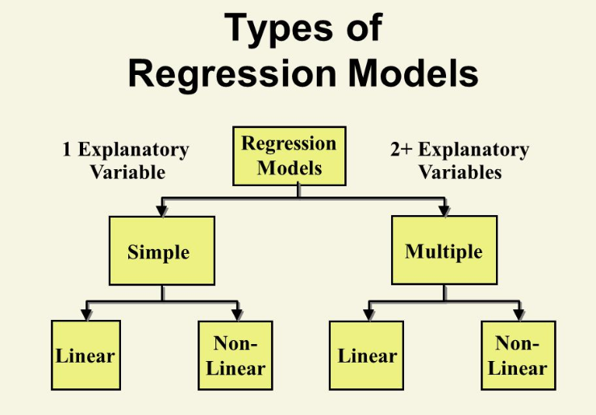
Introduction to Regression Analysis
Regression analysis models the relationship between a dependent variable and independent variables.
Used in welding engineering to predict process outcomes, optimize parameters, and improve weld quality.

Slide 3
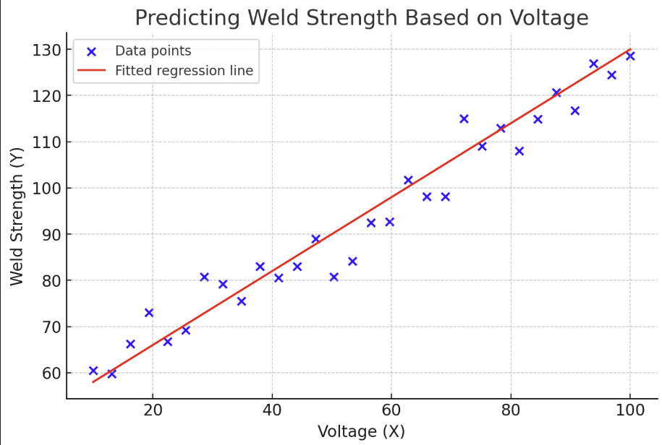
Simple Linear Regression
Equation: Y = β₀ + β₁X + ε
Y = Dependent variable (e.g., weld strength)
X = Independent variable (e.g., voltage)
β₀ = Intercept, β₁ = Slope, ε = Error term
Example: Predicting weld strength based on heat input.

Slide 4
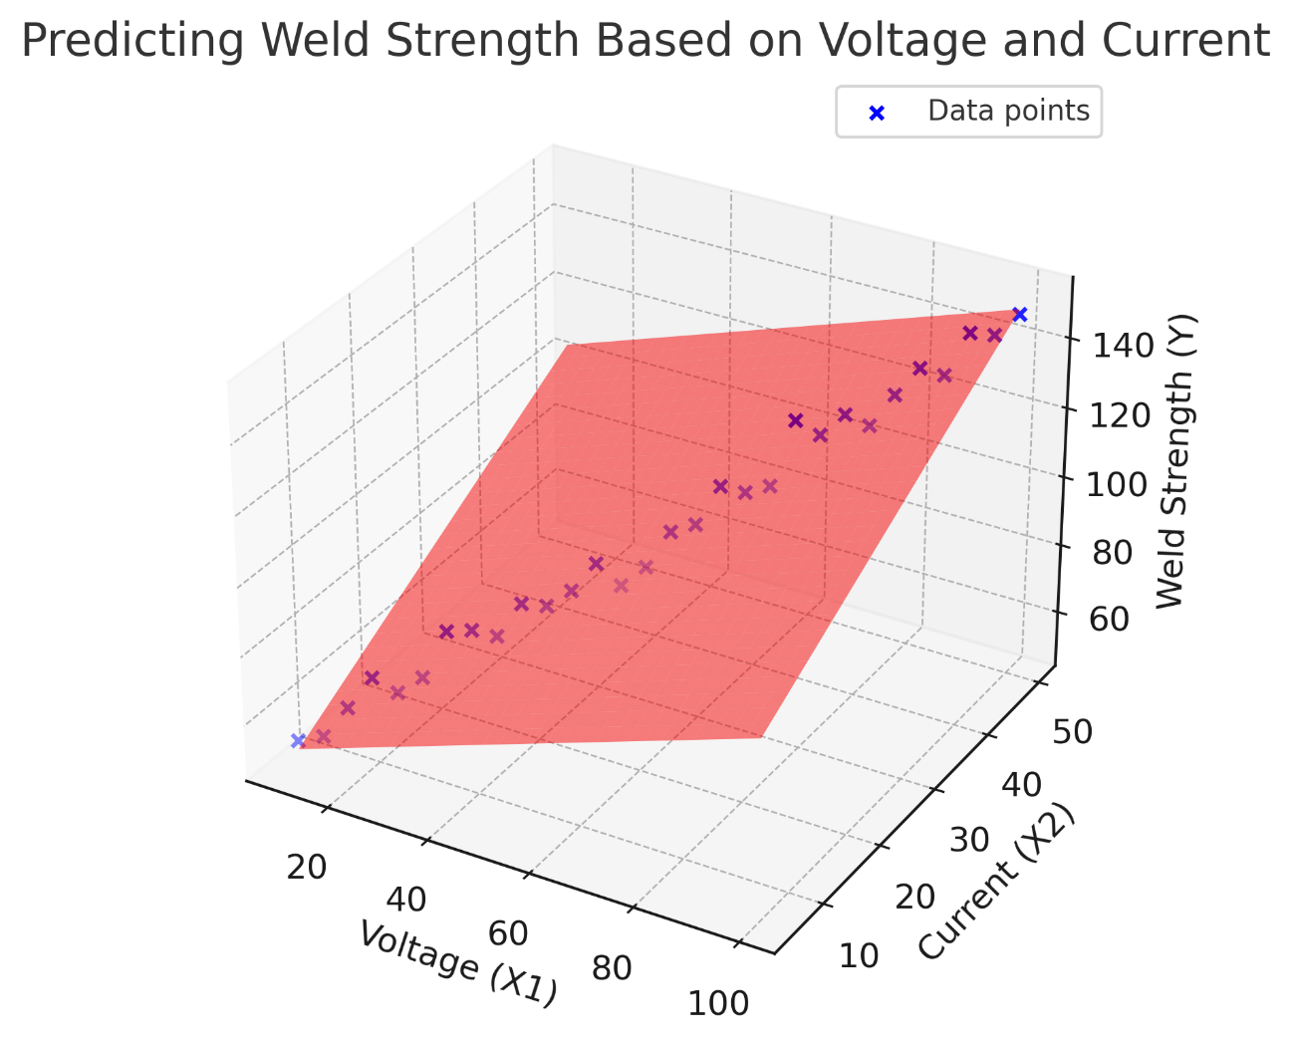
Multiple Linear Regression
Equation: Y = β₀ + β₁X₁ + β₂X₂ + ... + βₙXₙ + ε
Example: Predicting weld strength based on voltage, current, and travel speed.

Slide 5
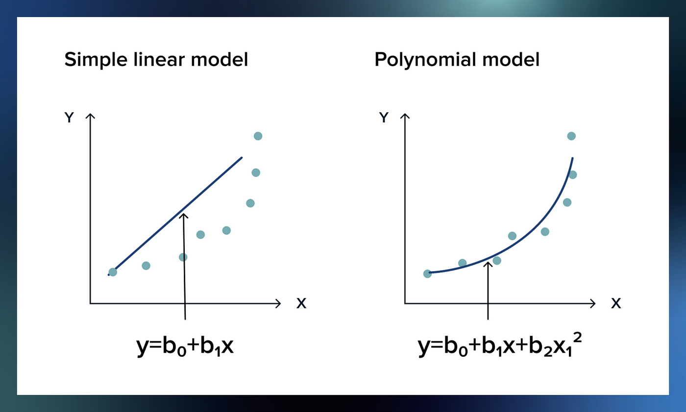
Model Selection
Linear Regression – Assumes a linear relationship between variables. Simple but may underfit complex data.
Polynomial Regression – Extends linear regression by adding polynomial terms (e.g., X2,X3X^2, X^3X2,X3). Useful for capturing nonlinear trends but can lead to overfitting.
Regularization Methods (Lasso & Ridge)
Lasso Regression – Shrinks some coefficients to zero, aiding feature selection.
Ridge Regression – Reduces coefficient magnitudes to prevent overfitting but keeps all variables.

Slide 6
Hyperparameter Optimization
Learning Rate – Controls step size in gradient descent optimization. Too high: overshoots minima; too low: slow convergence.
Regularization Strength (λ) – Higher values increase penalty on large coefficients, improving generalization but risking underfitting.
Polynomial Degree – Higher degrees capture complex patterns but can overfit.

Slide 7
Model Evaluation Metrics
R-squared (R²): Measures how well the model explains variability.
Mean Squared Error (MSE): Average squared difference between actual and predicted values.
Root Mean Squared Error (RMSE): Square root of the MSE.

Slide 8
Application of Linear Regression to Welding Data
Data Collection: Gather welding parameters (e.g., voltage, current, speed).
Data Preprocessing: Clean data, handle missing values, normalize features.
Model Training: Split data into training and test sets.
Evaluation and Prediction: Use metrics to assess performance and predict outcomes.

Slide 9
Example Scenario: Predicting Weld Strength
Objective
Develop a regression model to predict weld strength based on key welding parameters.
Optimize model performance for accurate predictions.
Data Features
Voltage (V) – Affects heat input and weld penetration.
Current (A) – Influences bead shape and material fusion.
Travel Speed (mm/s) – Determines heat distribution and cooling rate.
Model Outcome
The regression model predicts weld strength based on process parameters.
Provides insights to optimize settings for better weld quality.
Ensures high accuracy and minimal prediction error.

Slide 10
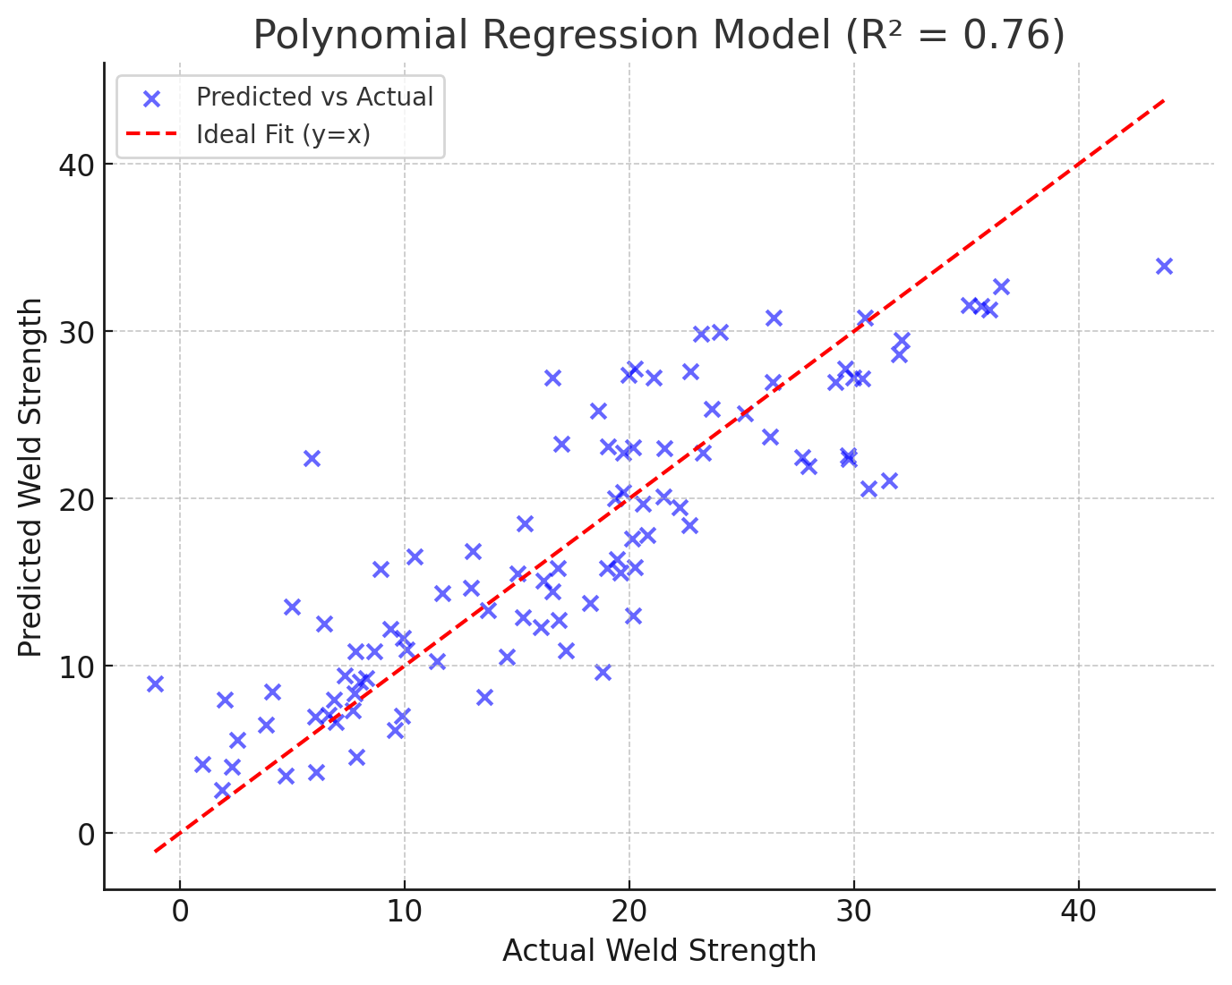
Example Scenario, Cont.
The dataset includes welding parameters and corresponding measured weld strength:
Voltage (V): 10V - 30V
Current (A): 5,000A - 15,000A
Travel Speed (mm/s): 10 - 50 mm/s
Weld Time (ms): 100 - 500 ms
Electrode Force (N): 2,000N - 5,000N

Slide 11
Results
The polynomial regression model (degree = 2) achieved R² = 0.92, indicating a strong predictive capability.
Identified optimal welding conditions: Current = 12,000A, Voltage = 20V, Travel Speed = 30 mm/s, maximizing weld strength while minimizing defects.
The model helped reduce weld failures by 15%, improving overall assembly efficiency.

Slide 12
Questions? Feel free to reach out to me via email: gofman.4@osu.edu

