Slide 1
Meeting 1 - Introduction to Artificial Intelligence
Daniil Gofman
Welding Engineering – Department of Material Science and Engineering
Notes:
RHA
MA2JIC consortium

Slide 2

About course
4 modules:
Introduction to Artificial Intelligence
Python Fundamentals for Welding Engineers
Linear Regression for Welding Data Analysis
Basic AI Algorithms for Welding Engineers
Website:

Slide 3
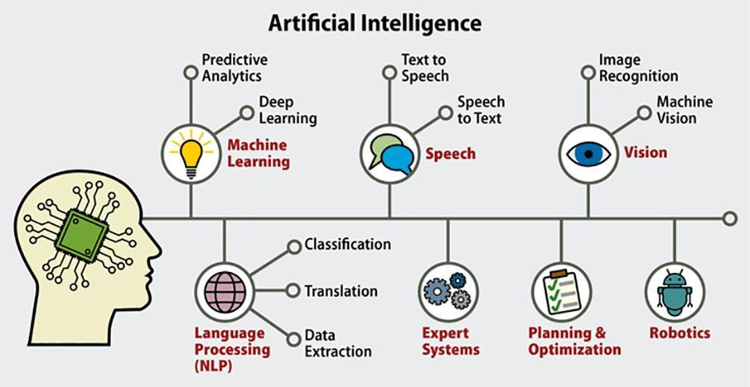
Introduction to Artificial Intelligence
Artificial Intelligence (AI) is a branch of computer science focused on creating systems capable of performing tasks that typically require human intelligence.
Examples: Speech recognition, decision-making, visual perception.

Slide 4
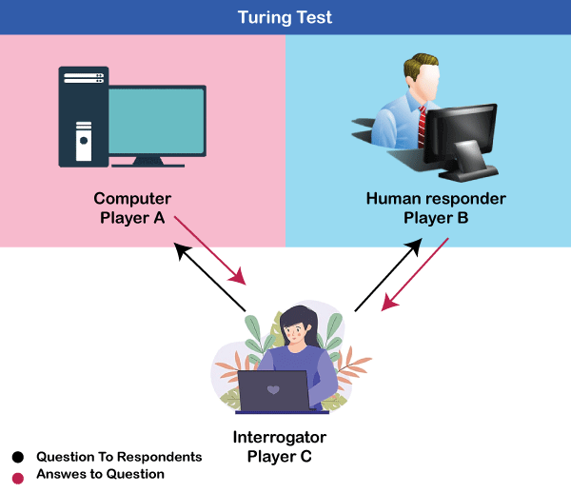
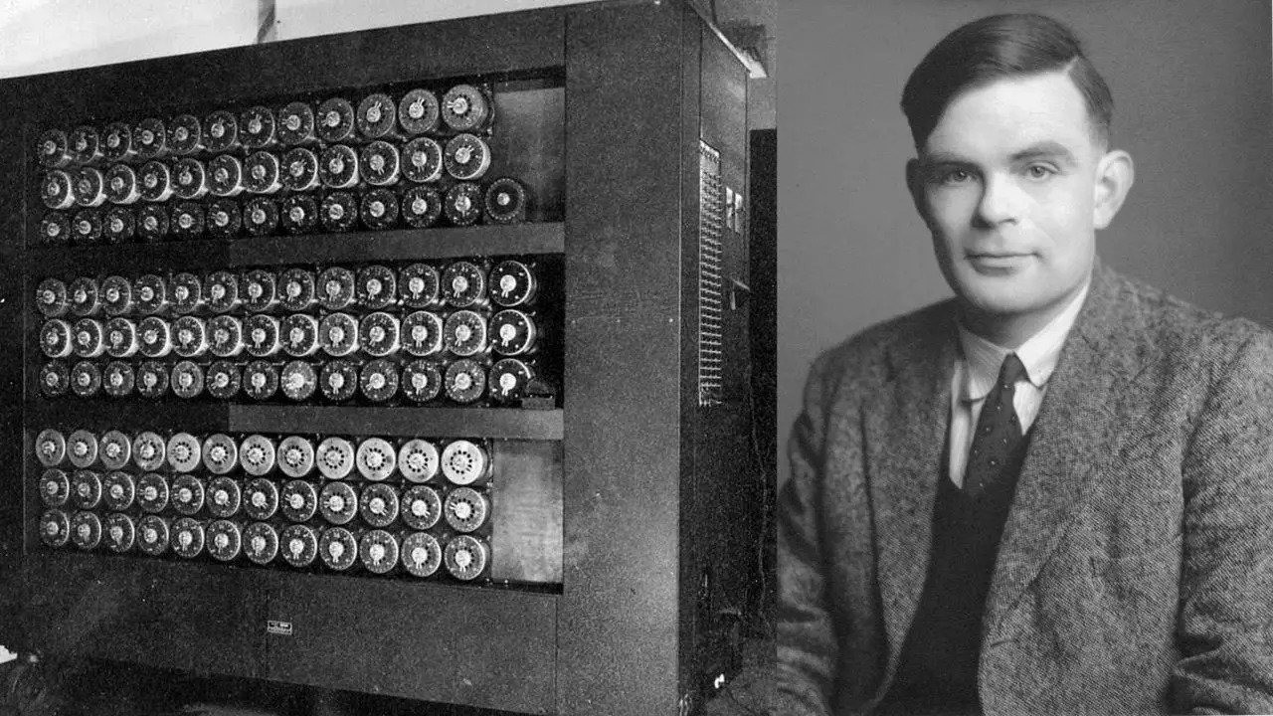
History and Evolution of AI
1950s: Alan Turing proposes the Turing Test.
1956: Dartmouth Conference marks the birth of AI as a field.
1980s: Rise of machine learning and expert systems.
2000s: Deep learning revolutionizes AI.

Slide 5
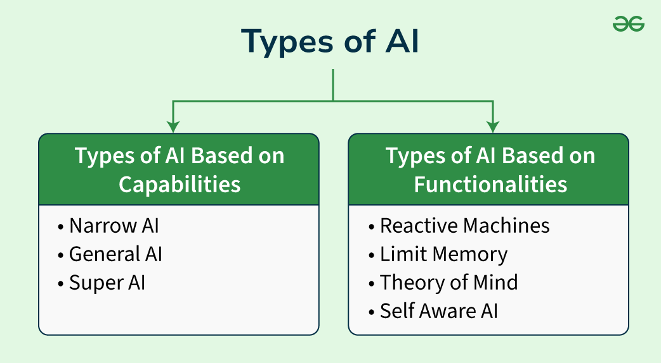
Types of AI
Narrow AI: Specialized in specific tasks (e.g., virtual assistants).
General AI: Hypothetical AI with human-like cognitive abilities.
Super AI: A theoretical AI surpassing human intelligence.

Slide 6
AI Applications in Manufacturing
Predictive maintenance using sensor data.
Quality control with computer vision.
Automation of repetitive tasks via robotics.
Optimizing supply chain and logistics.

Slide 7
Questions? Feel free to reach out to me via email: gofman.4@osu.edu

