Slide 1
Meeting 4 - Basic AI Algorithms for Welding Engineers
Daniil Gofman
Welding Engineering – Department of Material Science and Engineering
Notes:
RHA
MA2JIC consortium

Slide 2
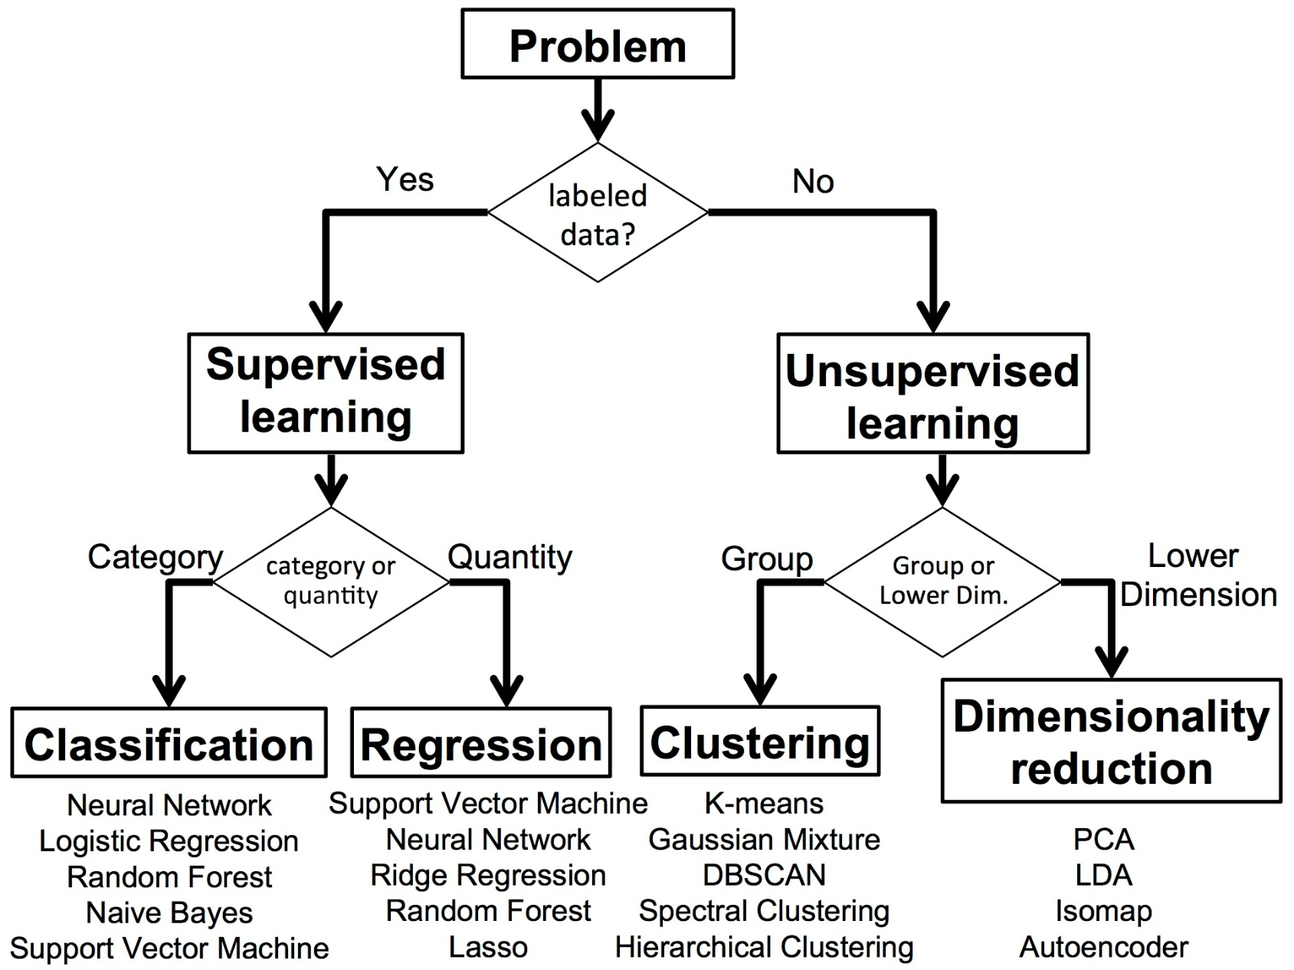
Types of Machine Learning

Slide 3
📊 Supervised Learning

Slide 4
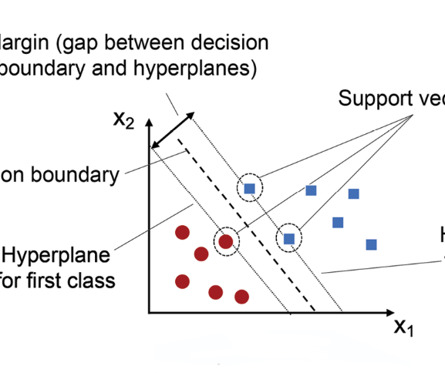
Support Vector Machines (SVM)
Theory: Maximizes the margin between data classes using hyperplanes.
Application:
Classify weld defects (e.g., porosity, cracks) based on features like temperature, voltage, or acoustic signals.
Works well for high-dimensional datasets common in NDT (Non-Destructive Testing).

Slide 5
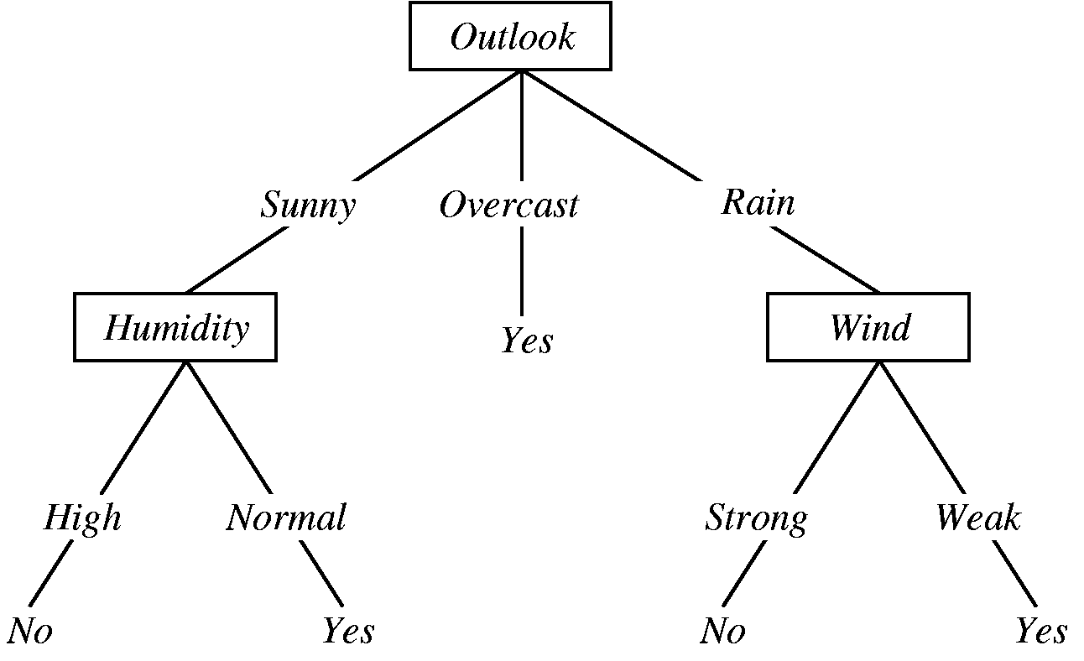
Decision Trees
Theory: Recursive splitting of data based on feature thresholds.
Application:
Predict weld quality based on parameter thresholds.
Easy interpretation makes it useful for real-time decision support.

Slide 6
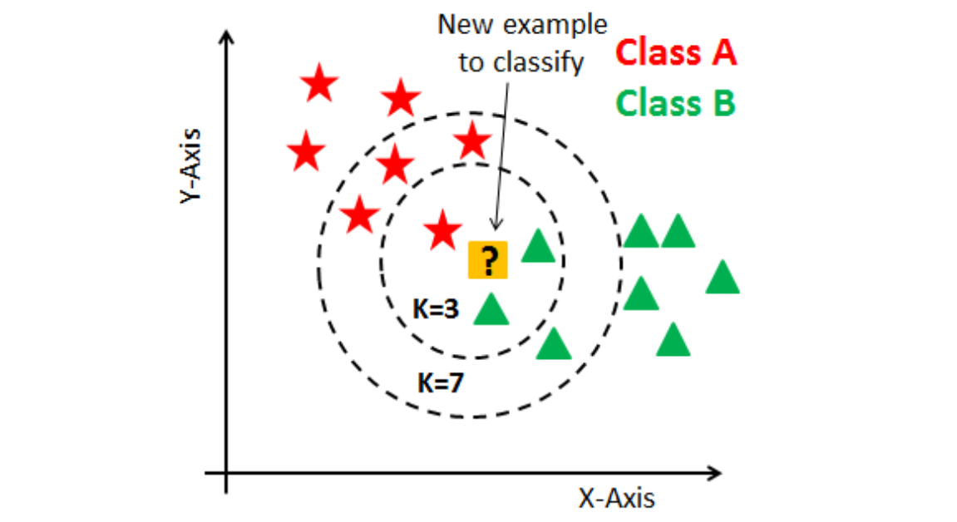
🧠 Unsupervised Learning
K-means Clustering:
Groups similar data points by minimizing intra-cluster variance.
Application: Cluster weld samples based on characteristics like bead geometry, hardness.

Slide 7
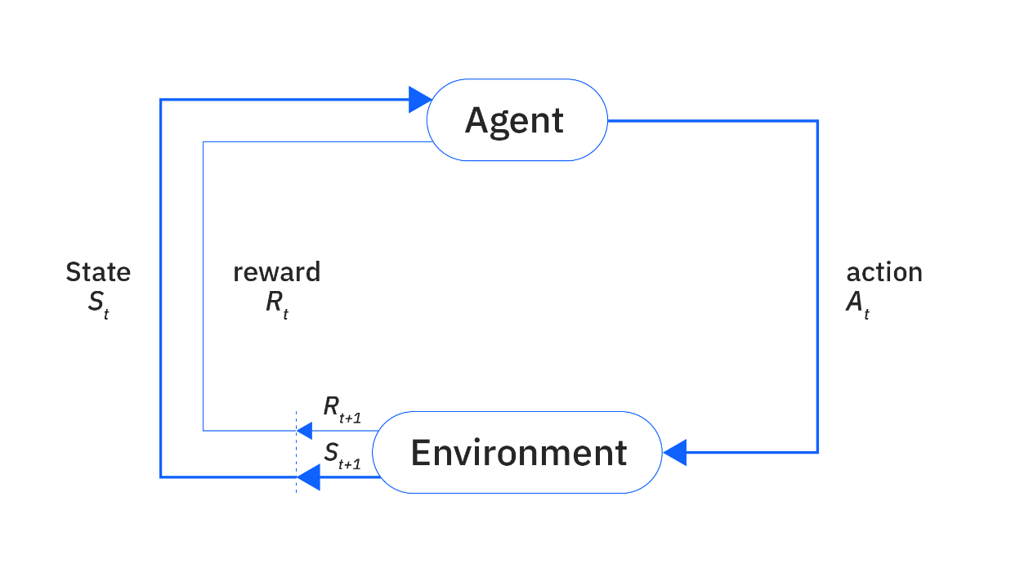
🤖 Reinforcement Learning (RL)
Introduction to RL Concepts:
Agent interacts with environment to maximize reward.
Techniques include Q-learning and policy gradients.
Applications in Welding:
Real-time optimization of welding parameters like current, speed.
Goal: Improve strength, reduce defects, minimize waste.

Slide 8
Questions? Feel free to reach out to me via email: gofman.4@osu.edu

