Slide 1
Meeting 2 - Python Fundamentals
Daniil Gofman
Welding Engineering – Department of Material Science and Engineering
Notes:
RHA
MA2JIC consortium

Slide 2
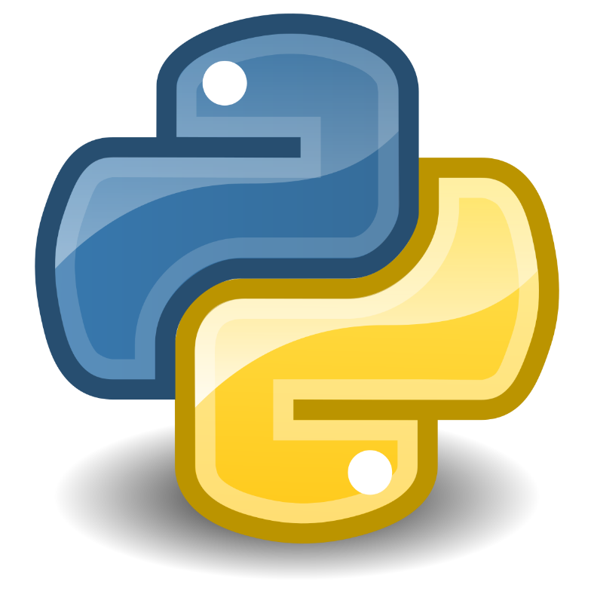
Introduction to Python
Python is a high-level, interpreted programming language known for its simplicity and versatility.
Applications in Welding Engineering:
Data analysis for welding process optimization
Automation of welding simulations
Integration with machine learning for defect detection
More on Python: https://docs.python.org/3/

Slide 3

Introduction to Google Colab
What is Google Colab?
A cloud-based Jupyter notebook environment provided by Google.
Allows writing and executing Python code in the browser.
Free access to GPUs and TPUs for machine learning.
Key Features:
No setup required, runs in the cloud.
Seamless integration with Google Drive.
Supports libraries like TensorFlow, PyTorch, OpenCV, etc.
Collaboration features for real-time code editing and sharing.
Who Uses Google Colab?
Data scientists and AI researchers.
Students and educators for coding and ML courses.
Developers experimenting with Python and deep learning models.
Why Use Google Colab?
Free access to powerful computing resources.
Ideal for learning, prototyping, and small-scale ML experiments.
Simplifies collaboration and sharing of code.
https://colab.research.google.com/drive/1Li9RXsIiyy6AlontfmoKweBCV8dhHbbb?usp=sharing

Slide 4
Data Types and Variables
Python provides several built-in data types:
Integer (int): Whole numbers, e.g., `welding_temp = 1500`
Float (float): Decimal numbers, e.g., `cooling_rate = 12.5`
String (str): Text, e.g., `material = 'Steel'`
Boolean (bool): True/False values, e.g., `is_safe = True`
Variables store data and are dynamically typed.
More on Data Types: https://docs.python.org/3/library/stdtypes.html

Slide 5
Control Flow (if-else, loops)
Control flow statements guide program execution:
if-else: Conditional execution based on conditions
for loop: Iterates over sequences
while loop: Runs until a condition is met
More on Control Flow: https://docs.python.org/3/tutorial/controlflow.html

Slide 6
Functions and Modules
Functions help modularize code and improve reusability.
Example:
def heat_input(voltage, current, speed):
return (voltage * current) / speed
Python modules allow code reuse across projects.
More on Functions: https://docs.python.org/3/tutorial/controlflow.html#defining-functions

Slide 7
Data Structures (Lists, Dictionaries)
Python provides various data structures to store and manipulate data:
Lists: Ordered collection of items, e.g., `materials = ['Steel', 'Aluminum', 'Titanium']`
Dictionaries: Key-value pairs, e.g., `welding_params = {'Voltage': 25, 'Current': 200}`
These structures are essential for managing welding parameters and analysis.
More on Data Structures: https://docs.python.org/3/tutorial/datastructures.html

Slide 8
Working with Data (Pandas)
Pandas is a powerful library for data manipulation and analysis.
Example:
import pandas as pd
df = pd.read_csv('welding_data.csv')
print(df.head())
Useful for handling large datasets in welding research.
More on Pandas: https://pandas.pydata.org/docs/

Slide 9
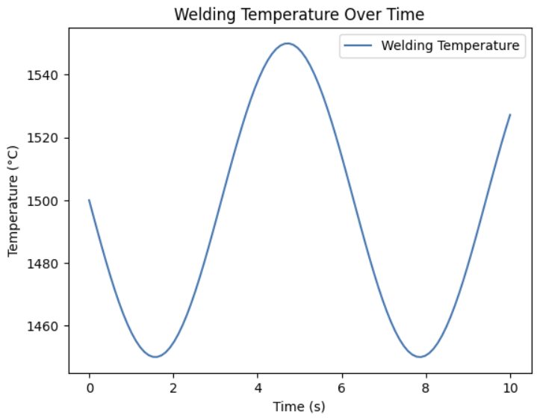
Data Science Libraries
Python offers multiple libraries for scientific computing:
NumPy: Numerical computing with arrays
Matplotlib: Data visualization
Pandas: Data analysis
Example:
import numpy as np
import matplotlib.pyplot as plt
time = np.linspace(0, 10, 100)
temperature = 1500 - 50 * np.sin(time)
plt.plot(time, temperature)
plt.show()
More on NumPy: https://numpy.org/doc/
More on Matplotlib: https://matplotlib.org/stable/contents.html

Slide 10
Questions? Feel free to reach out to me via email: gofman.4@osu.edu

