Slide 1

Logging & Monitoring
of a Kubernetes Cluster and its running applications – implemented on AWS

Slide 2
Structure
1. Used Services
2. Kubernetes
What is K8s?
Terminology
Architectural Overview of a Kubernetes Cluster
3. My Kubernetes Cluster on AWS „myEKS“
Architectural Overview
Components of EKS Cluster (esp. node group)
Workflow
Deployments / Pods
(RBAC)
Monitoring (Kubernetes-Dashboard, Grafana, Prometheus)
Logging with CloudWatch
4. Summary & Outlook

Slide 3


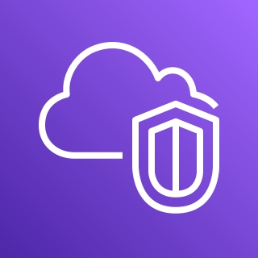
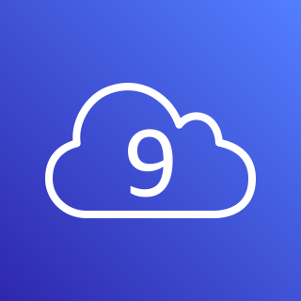
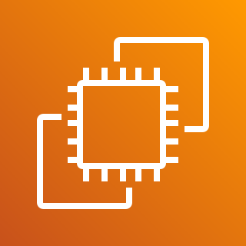
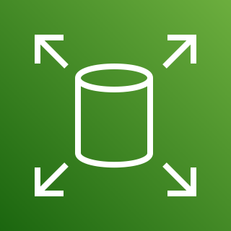
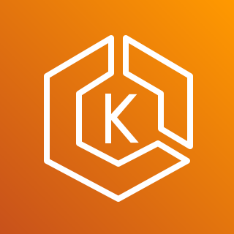

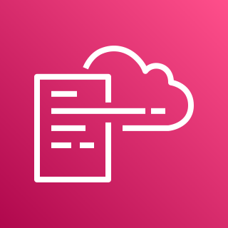
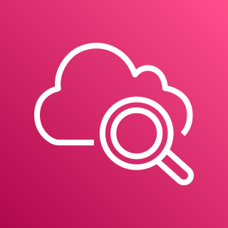
1. Used Services
Amazon Cost Management
AWS Cost Management
IAM (Identity and Access Management)
AWS Cloud9 (EC2 + EBS)
EKS (Elastic Kubernetes Service)
ECR (Elastic Container Registry)
Amazon CloudWatch
AWS Identity and Access Management (IAM)
Amazon Virtual Private Cloud (Amazon VPC)
Amazon EC2
Amazon Elastic Block Store (Amazon EBS)
AWS Cloud9
Amazon EKS
Amazon ECR
AWS CloudFormation
Amazon CloudWatch

Slide 4
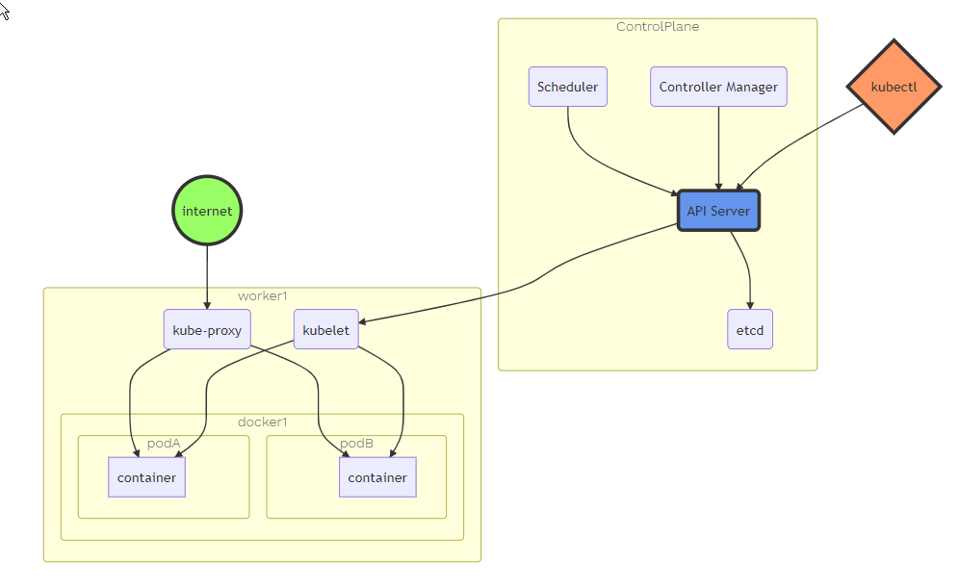
2. Kubernetes (K8s)
OBJECTS Overview:
Pod: a wrapper around one or more containers
DaemonSet: implements a single instance of a pod on a worker node
Deployments: Details how to roll out (or roll back) across version of your application
ReplicaSet: ensures a defined number of pods are always running
Job: ensures a pod properly runs to completions
Service: maps a fixed IP adress to a logical group of pods
Architectural Overview
Control Plane
Data Plane
Image 1: Architectural Overview

Slide 5
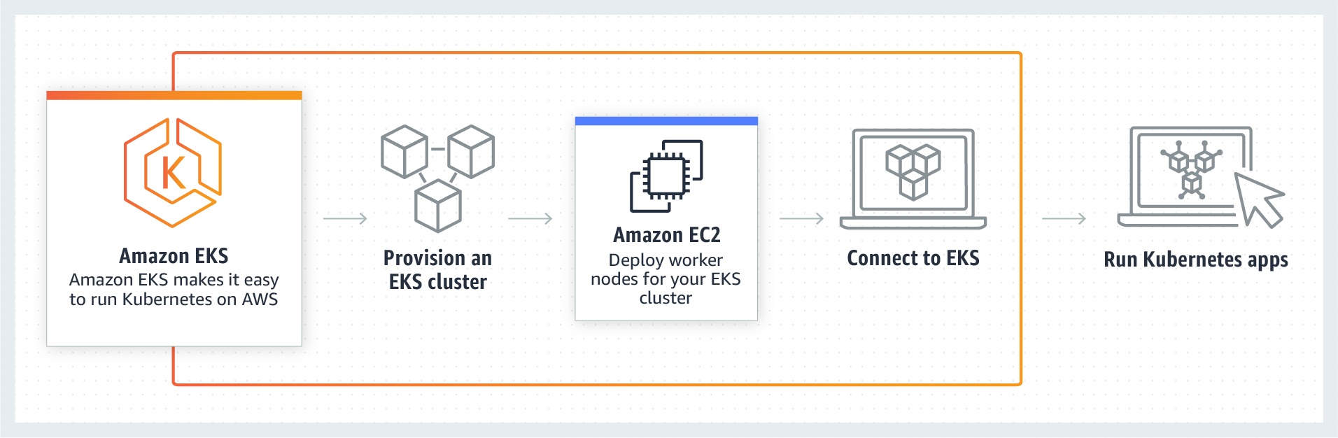
3. My Kubernetes Cluster on AWS „myEKS“
3. My Kubernetes Cluster on AWS „myEKS“
Architectural Overview
Components of EKS Cluster (esp. node group)
Workflow
Deployments / Pods
(RBAC)
Monitoring (Kubernetes-Dashboard, Grafana, Prometheus)
Logging with CloudWatch
Image 2: Amazon EKS

Slide 6




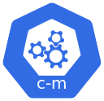





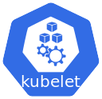
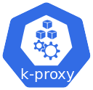


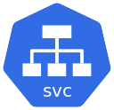

3.1 Architectural Overview
AWS Cloud
User
Region eu-west-1 (Ireland)
VPC
Amazon EKS control plane
IAM
kubectl
Role
kubectl
Amazon EKS data plane
Internet
AWS Cloud9
AWS CloudFormation
Image
Amazon CloudWatch
Amazon ECR

Slide 7

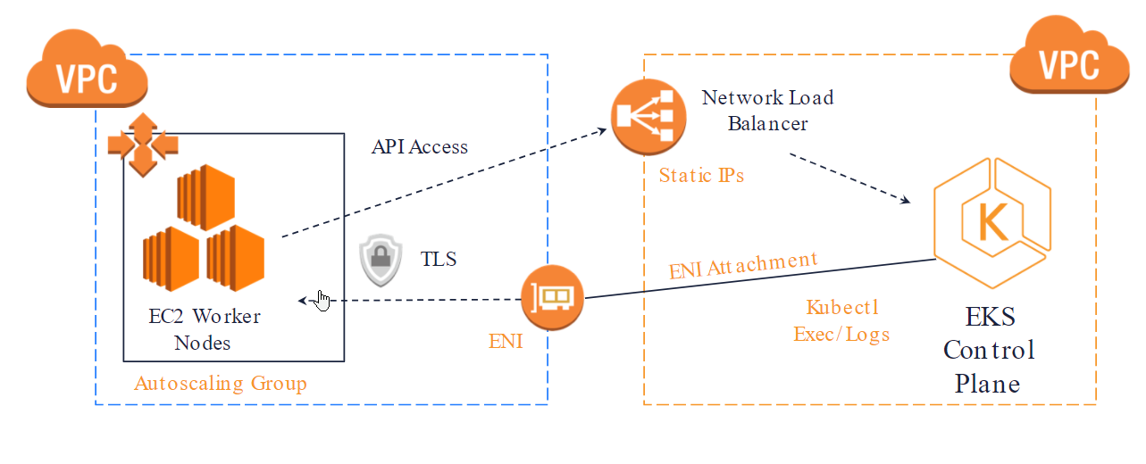





3.2 My Kubernetes Cluster on AWS „myEKS“
Why no control plane? managed by aws eks
only managed worker nodegroup deployed (ec2 instances)
Configuring auto-scaling
Assigning pods to nodes with labels
kubectl
AWS Cloud
Availability Zone 1
Availability Zone 2
Availability Zone 3
VPC 192.168.0.0/19
Public subnet
Public subnet
Public subnet
NAT gateway
NAT gateway
NAT gateway
Bastion Host
Auto Scaling group
Bastion Host
Bastion Host
192.168.0.0
192.168.32.0
192.168.168.0
Private subnet
Private subnet
Private subnet
kubernetes nodes
kubernetes nodes
kubernetes nodes
Image 3: EKS Control and Data Plane
Auto Scaling group
192.168.64.0
Amazon EKS
192.168.96.0
192.168.128.0

Slide 8
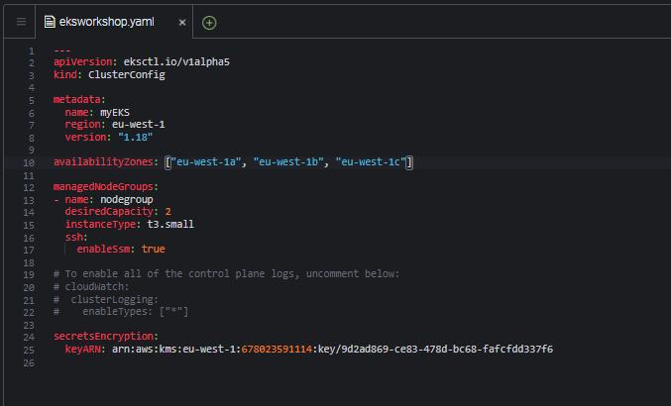

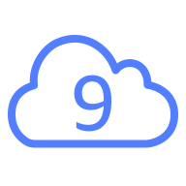
3.3 Workflow
Creation-Workflow
IAM Roles
Amazon Elastic Kubernetes Service
creating a k8s cluster with eksctl (yaml file)
AWS STS
IAM
AWS Cloud9
Role
Amazon EC2
Amazon EKS
Cloud9
Identiy and Access Management:
configuring a role
cofigure a workspace to manage EKS
Create EKS Cluster
provision
Launch
….
Setup LB
worker
nodes
Workloads
(Pods)

Slide 9
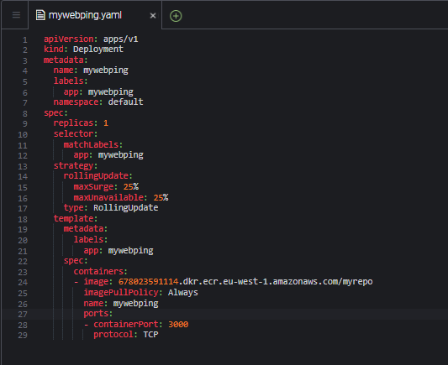
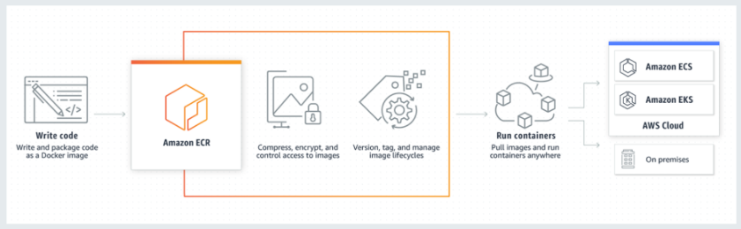
3.4 Deployments / Pods (+ ECR)
Amazon ECR
Image
ECR = Elastic Container Registry
easy to store, manage, share, and deploy container images
highly available and high performance architecture
privately <----> publicly (management possible by IAM)
works with ECS, EKS and AWS Lambda
further: with Fargate one-click deployments
$kubectl apply –f mywebping.yaml
-> deployed
annotation:
assigning deployments / pods to a certain node possible by specificating this in deployment yaml file
Image 4: Amazon ECR

Slide 10
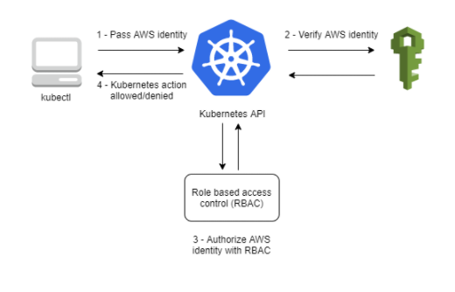
3.5 RBAC Permission for EKS Cluster
I have a k8s joke, however i am not authorized
Security Topic
Role-based access control (RBAC): method of regulating access to compute/network ressources
EKS uses IAM to provide authentication to EKS Cluster, but still relies on native Kubernetes RBAC
Rbac is managed kubernetes api server, api server know all ressources out there in k8s environment,
= set of permissions
Two different types:
Role: dedicated to a specific namespaces
ClusterRole: clusterwide
Image 5: Cluster Authentication

Slide 11

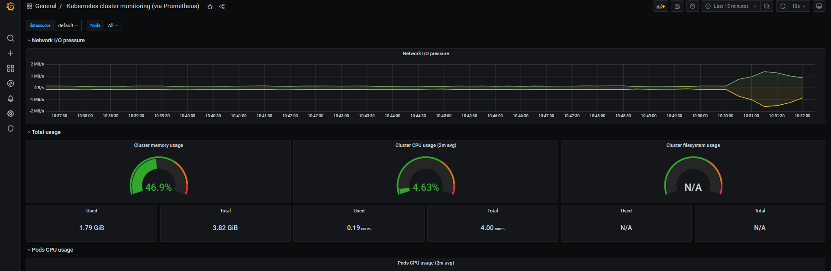
3.6 Monitoring (K8s, Grafana, Prometheus)
Definition: Monitoring = „surveillance process on measurable events and outputs of a system“
Helm: package manager and appl. Management tool for K8s -> packages ressources into a Chart
Kubernetes-Dashboard:
start proxy
listen on port 8080
access dashboard with aws cluster token
Prometheus:
open-source sytems monitoring and alerting toolkit
monitoring service for metrics
is running in a dedicated namespace as several pods
Grafana:
open source visualization and analytics SW
query, visualize, alert on and explore metrics
-> beautiful graphs and visualization
all three monitoring services are running as pods on „myEKS“ cluster
Screenshot1: Grafana

Slide 12

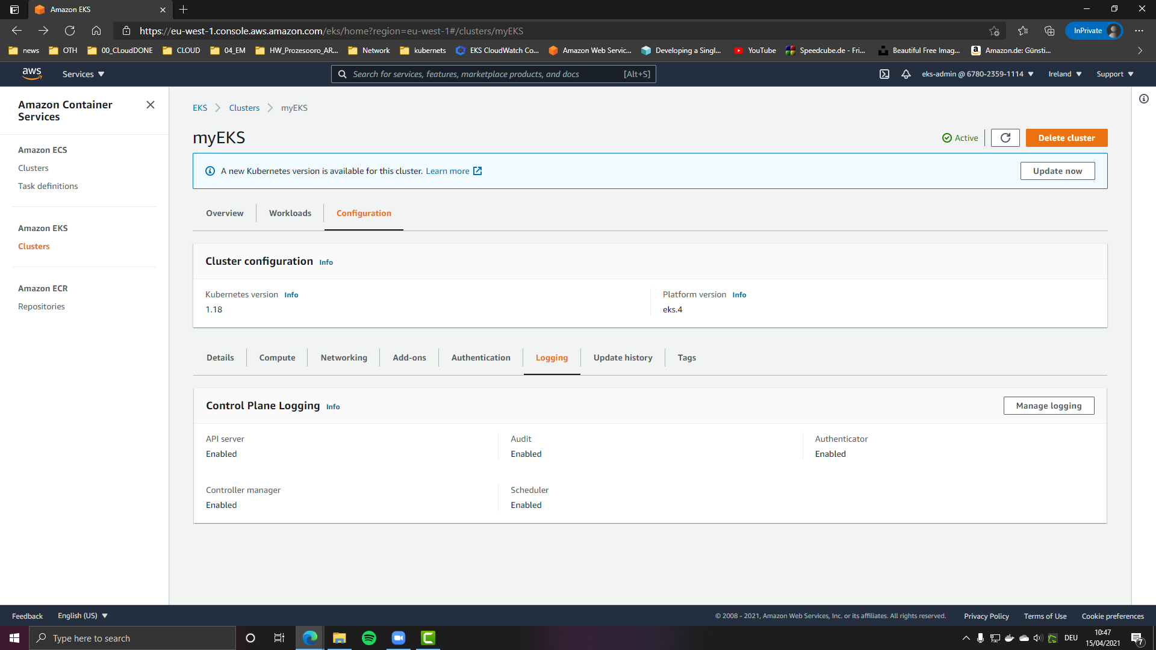
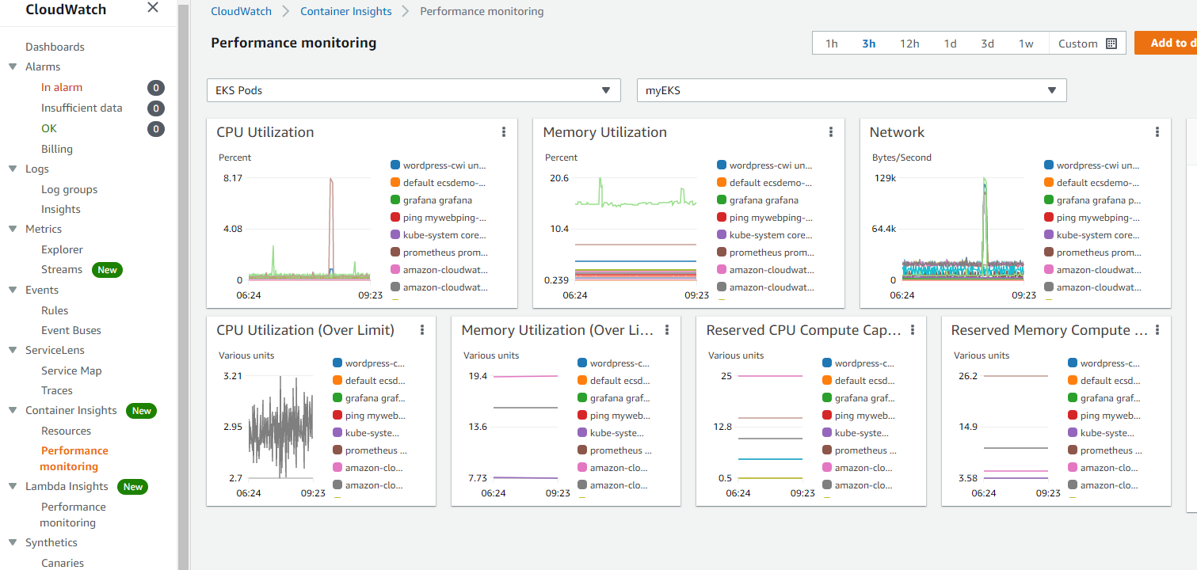
3.7 Logging with CloudWatch
Amazon CloudWatch
Definition: Logging = automatic creation of a protocol (=log) of software processes
Logging of „myEKS“ Cluster
2. CloudWatch Container Insights
API Server
Audit
Authenticator
Controller Manager
Scheduler
required: Security Account, ClusterRole, RoleBinding
CloudWatch-Agent: responsible for sending metrics to CloudWatch
Fluentd: responsible for sending logs to CloudWatch
Terms:
Logs: only „log“ events stream
Metrics: get a view of the state of applications
Logs
Screenshot2: Logging EKS Cluster
Screenshot3: Logging Container Insights

Slide 13
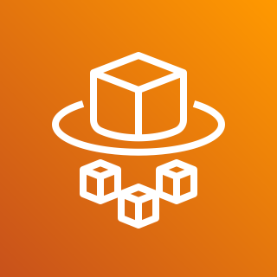
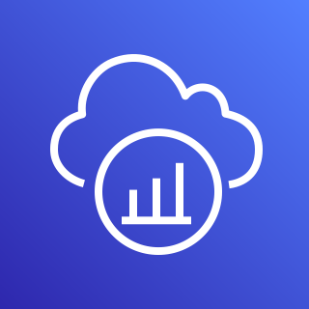
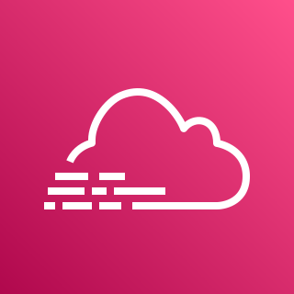
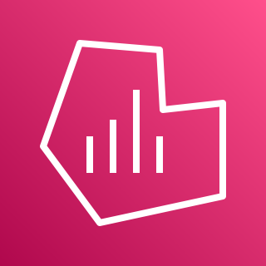

4. Summary & Outlook
Summary:
Big challenge to deal with all different AWS Services, especially IAM at first
Kubernetes was a very complex topic, which I needed many hours to get an idea how it works (and Docker Containers)
Lots of documentation available, but only one is easy to understand for newcomers: https://www.eksworkshop.com
All in all very challenging but worth spending time
Outlook:
instead of Prometheus and Grafana running as pods on the cluster -> using AMP and AMG
using Fargate (serverless, as replacement for managed node worker groups)
AWS CloudTrail, AWS X-Ray
AWS Fargate
AWS X-Ray
AWS CloudTrail
Amazon Managed Service for Grafana
Amazon Managed Service for Prometheus

Slide 14
Sources
Logos
https://aws.amazon.com/architecture/icons/
https_//github.com/kubernetes/community/tree/master/icons
https://helm.sh/
AWS
https://www.eksworkshop.com
https://docs.aws.amazon.com/eks/latest/userguide/getting-started.html
Kubernetes
https://kubernetes.io/docs/tasks/access-application-cluster/web-ui-dashboard/
https://kubernetes.io/docs/reference/access-authn-authz/rbac/
Others
https://www.igi-global.com/dictionary/system-monitoring/29068
Images
Image 1: https://www.eksworkshop.com/010_introduction/architecture/architecture_control_and_data_overview/
Image 2: https://aws.amazon.com/de/eks/?whats-new-cards.sort-by=item.additionalFields.postDateTime&whats-new-cards.sort-order=desc&eks-blogs.sort-by=item.additionalFields.createdDate&eks-blogs.sort-order=desc
Image 3: https://www.eksworkshop.com/010_introduction/eks/eks_high_architecture
Image 4: https://aws.amazon.com/de/ecr/
Image 5: https://docs.aws.amazon.com/eks/latest/userguide/managing-auth.html
Screenshots: refers to my implemented EKS Cluster
Books
Learn Docker in a Month of Lunches – Elton Stoneman, publisher: Manning
Learn Kubernetes in a Month of Lunches – Elton Stoneman, publisher: Manning

