Slide 1




Ecological Data Analysis in R
5.1 More Messy Data
Luis Malpica Cruz
lmalpica@uabc.edu.mx - @luismalpicaC

Slide 2
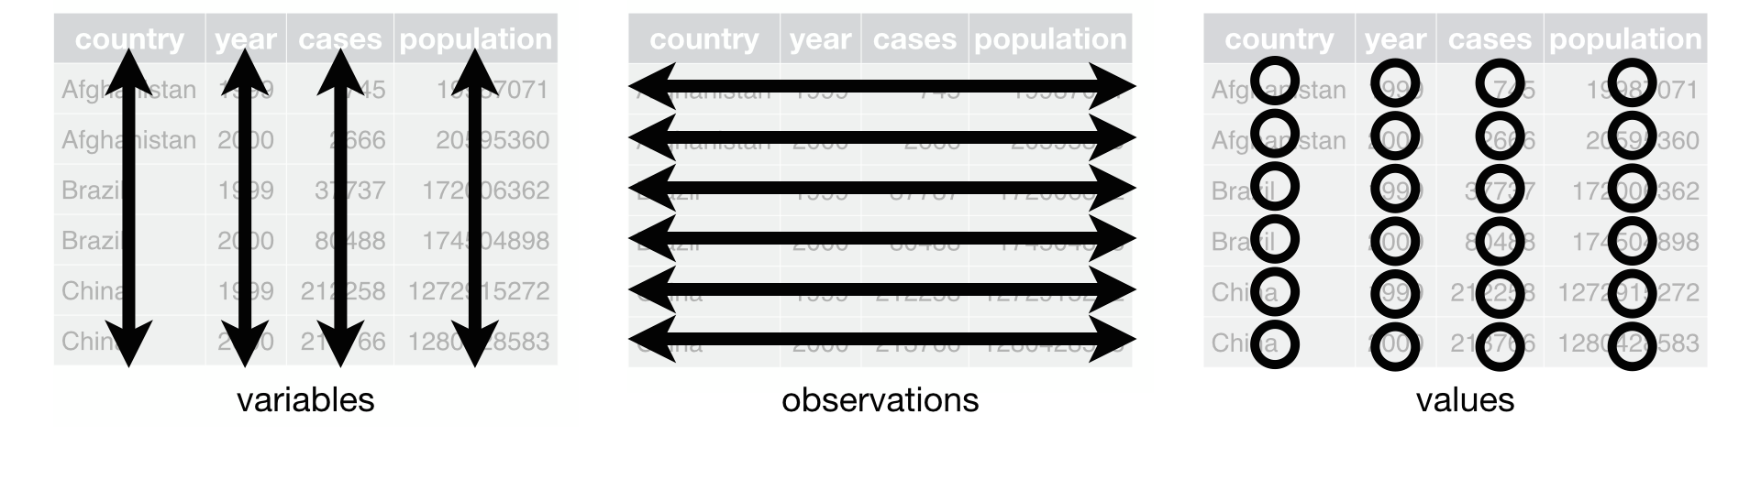
Recall: Tidy Data
One column = one variable
One row = one observation
One cell = one value
One column = one data type
Grolemund and Wickham, 2017

Slide 3

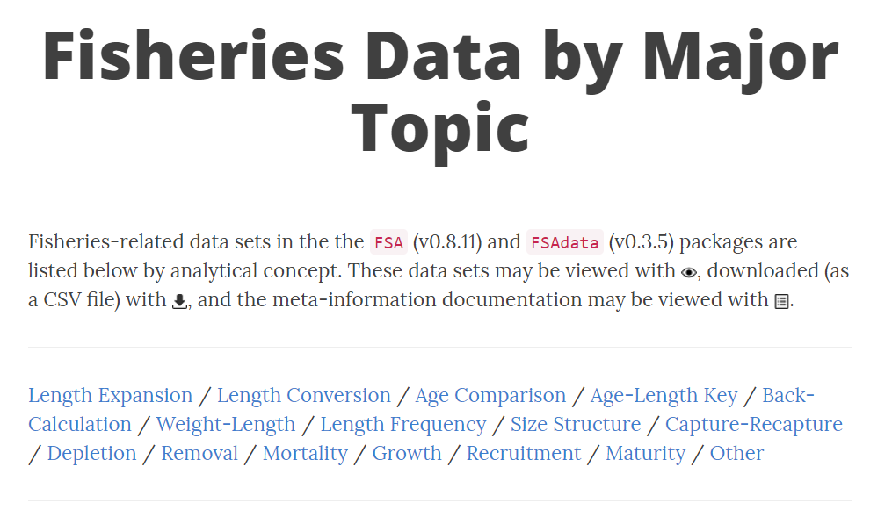
http://derekogle.com/fishR/data/byTopic

Slide 4
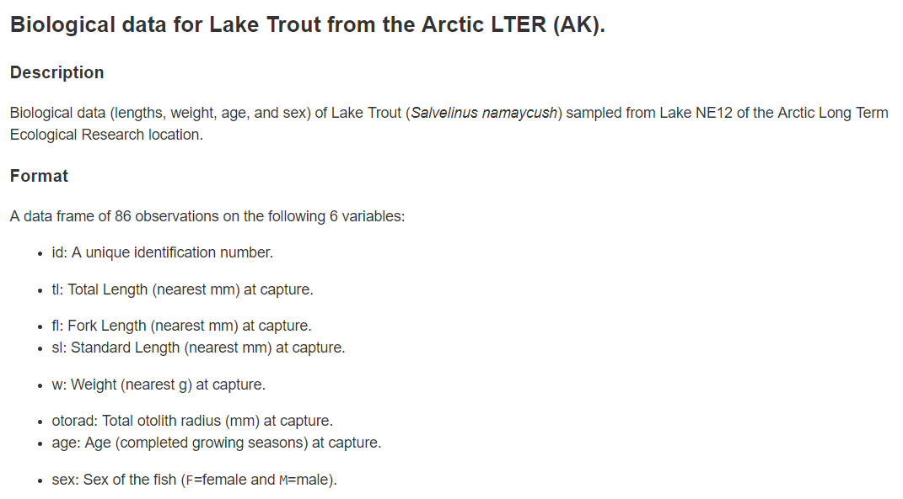
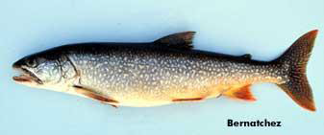
http://derekogle.com/fishR/data/data-html/LakeTroutALTER.html
http://www.arctic.uoguelph.ca/cpl/organisms/fish/fresh/salmon/laketrout.htm

Slide 5
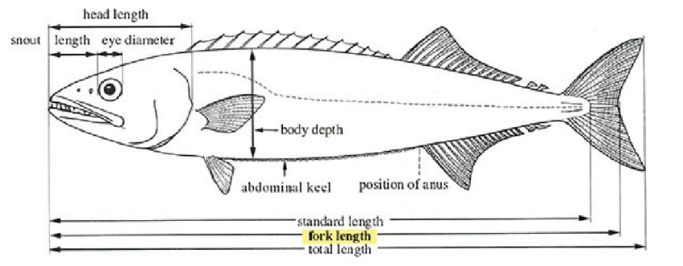
https://www.researchgate.net/publication/335179001_Overview_of_Machine_Vision_on_Digital_Imaging_Approach_for_Automatic_Tuna_Length_Measurement

Slide 6
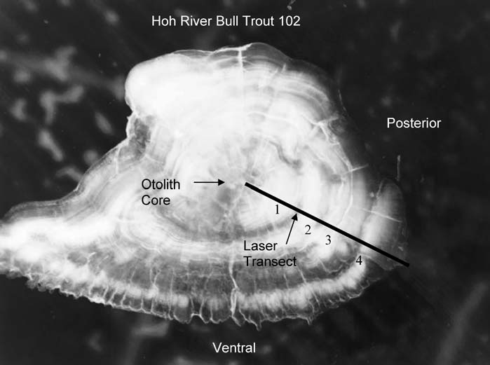
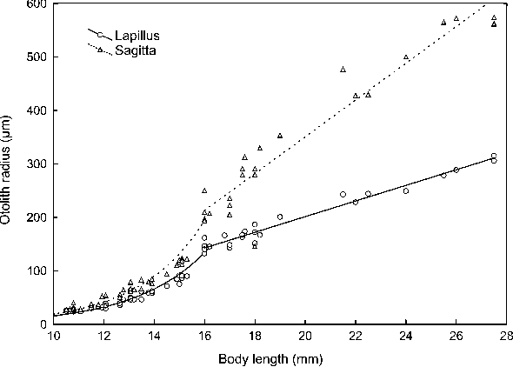
Brenkman, S.J., Corbett, S.C. and Volk, E.C. (2007), Use of Otolith Chemistry and Radiotelemetry to Determine Age‐Specific Migratory Patterns of Anadromous Bull Trout in the Hoh River, Washington. Transactions of the American Fisheries Society, 136: 1-11. doi:10.1577/T05-285.1
Song, Zhaobin et al. “Validation of daily otolith increments in larval and juvenile Chinese sucker, Myxocyprinus asiaticus.” Environmental Biology of Fishes 82 (2007): 165-171.

Slide 7
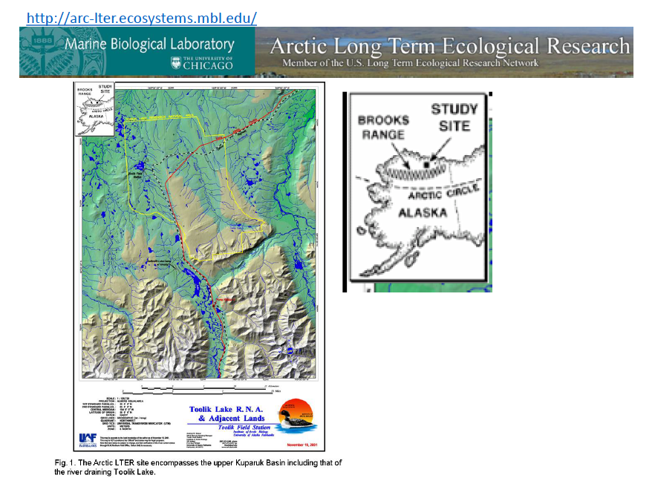

Slide 8
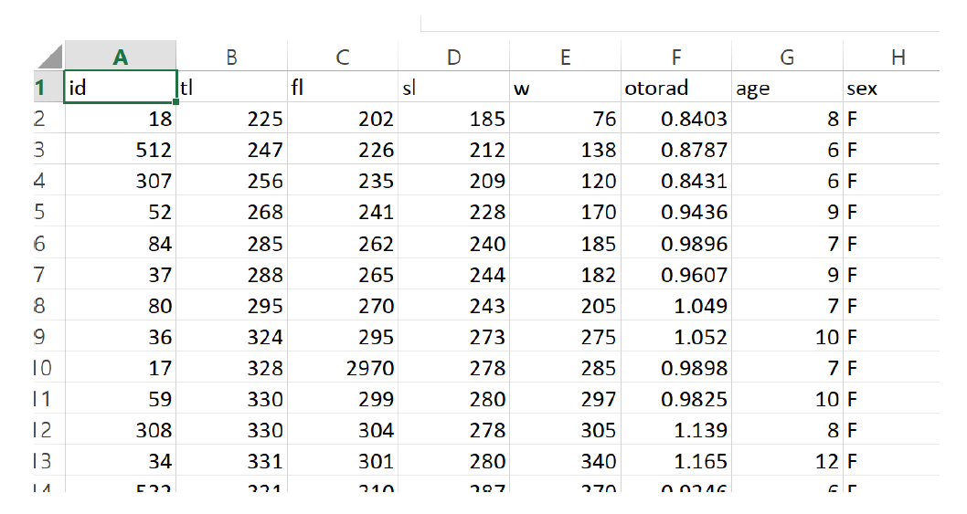

Slide 9
When loading data, take four steps:
Did it load correctly?
Are data types what they should be?
Numbers: Are there impossible values?
Factors: Are factor levels correct?

Slide 10

The following dataset is deliberately broken. Our job is to clean it up in R...

