Slide 1

Quantifying the value of
peer review for scientific publishing
Huaien Gu (30137628)
Data Science MSc Program, University of Calgary .
Work Term: May 2nd to Aug 10th
Instructor: Associate Professor Dr. Quan Long
Department of Biochemistry and Molecular Biology, University of Calgary

Slide 2




Topic introduction
Peer review
Publishing papers in high-level journals is
essential for researchers in research institutions
and corporate employees.
Original paper
Published paper
Number of Pages is suitable or not
Images are better or not
However, from the original paper
to the publication of the paper,
the article must be reviewed.
What factors need to be evaluated?
Peer
Review
Are these changes useful for publication?
And can we use these factors to predict a paper’s publication status?
The sentiment of author should be changed
Number of Words needs modify

Slide 3
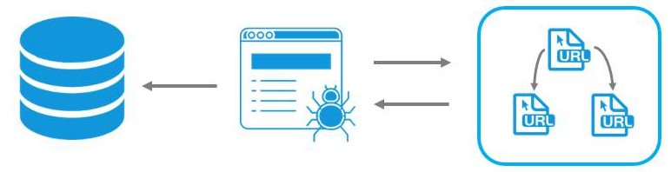

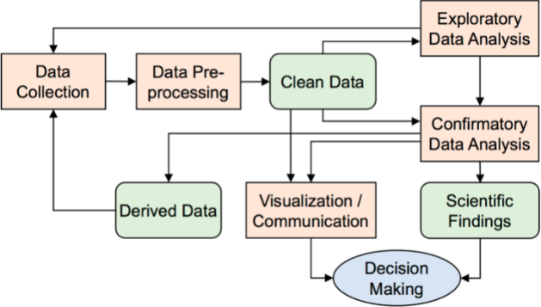
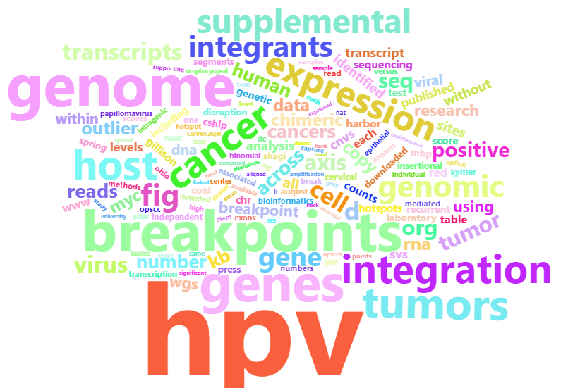
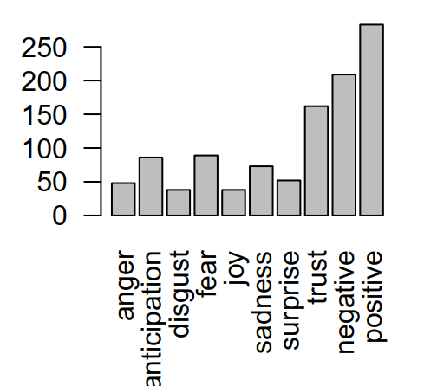
Methodology & Solution
It is a typical data analysis topic.
Data collection -> data processing -> data visualization -> data model building
Data Modeling
Data collection
1
4
Correlation analysis
KNN model building
R, Python
Data web scraping
Data processing
Data processing
2
3
Sentiment analysis
Pdf file analysis
Word cloud analysis

Slide 4
200
original papers
Conclusion
Through this project, scraped 200 papers from https://www.biorxiv.org/ , among them there are 71 papers were published, from library of Ucalgary downloaded 59 papers with PDF format.
71
Published papers
We found, the four factors changed after peer review have no strong contribution to papers’ publication,
in details
59
Download pdf
Correlation Factors
Prediction Model
Author sentiment
Only “Number of Pages” as a factor effect the publishing status, and
it is negative direction
Such as, images number, words number have no relationship
The prediction model is built based on KNN Classification Model.
But the accuracy is only 63.16%
Comparing authors’ sentiment, there are no significant regulation.
Such as, based on NRC dictionary( National Research Council Canada) , the main emotion are “positive” among 10 typical feelings
Angery, anticipation,disgust,fear,joy,sadness,
surprise,trust,negative, positive

Slide 5

Thank You

