Slide 1
Non-parametric model
Motivation
Linear regression models suffered due to few predictors
Only have time and daily weather
Would require many more predictors to build viable model
Non-parametric model
Instead use local polynomial fitting
Approximate each value based on a particular neighborhood
Determines arbitrarily many predictors based on neighborhood size

Slide 2
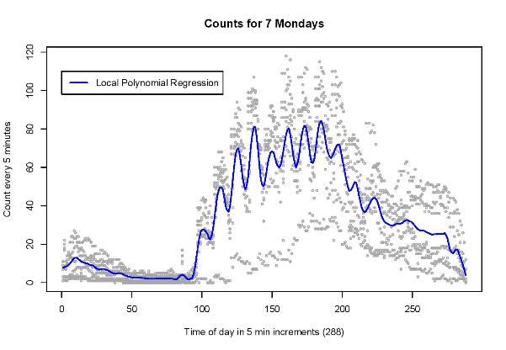
Non-parametric Results
The above plot is of the occupancy counts for 7 Mondays starting in January. The Loess algorithm was used to build a non-parametric model. The neighborhood was set to 4%, meaning that 4% of the data near a point were used.

