Slide 1

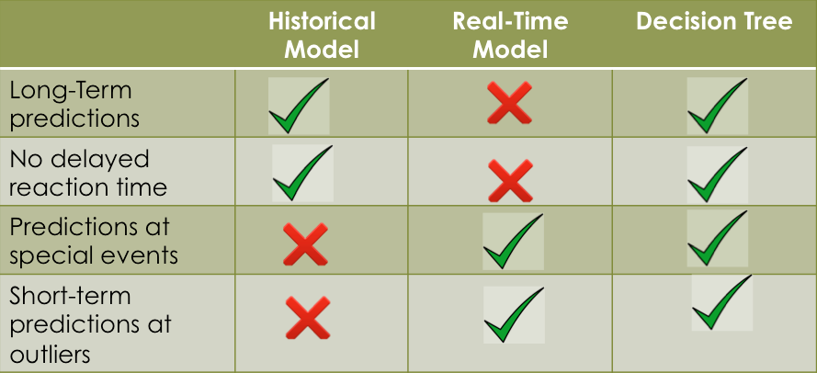
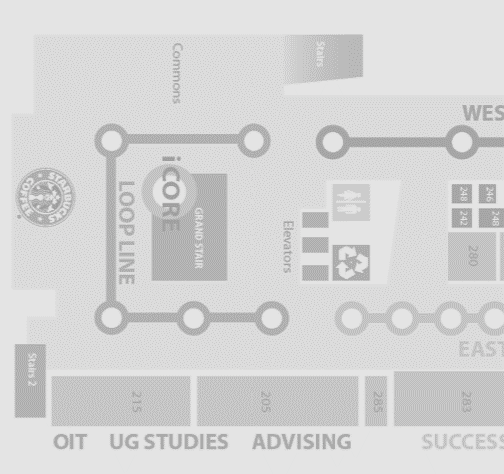
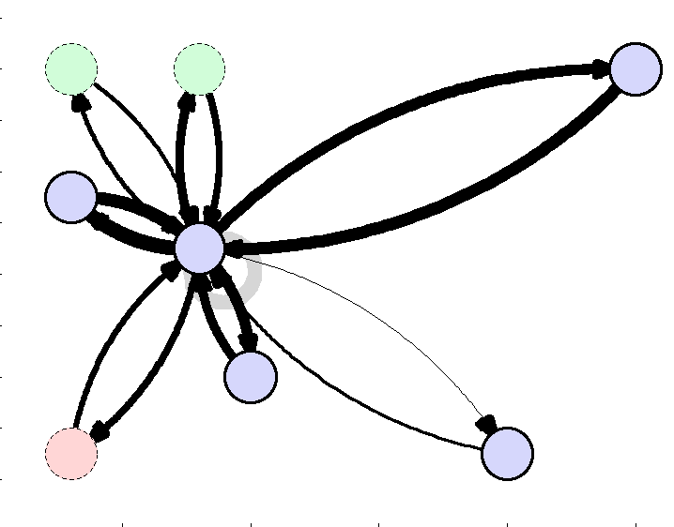
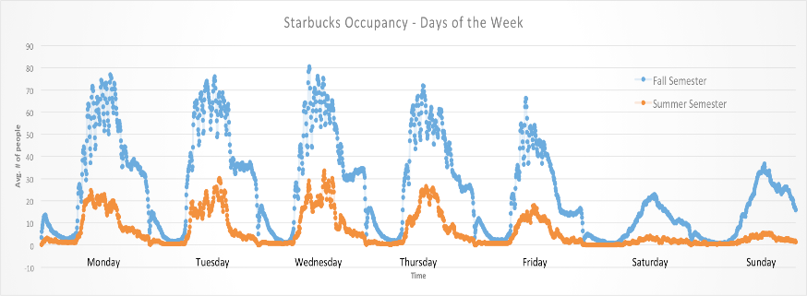
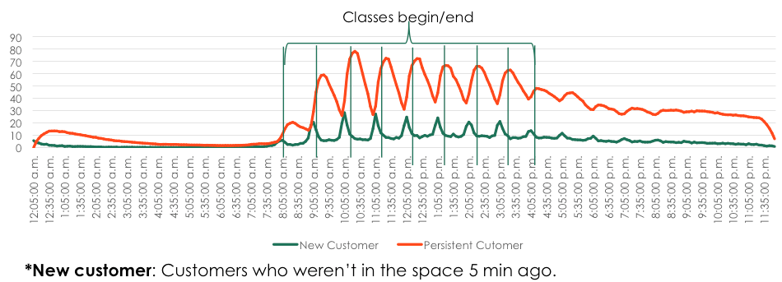



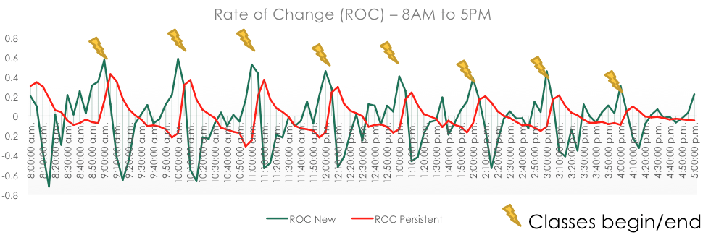
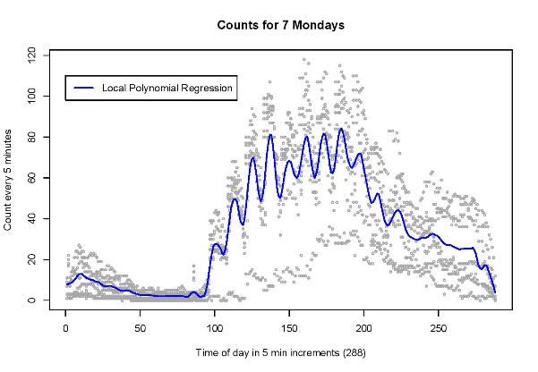

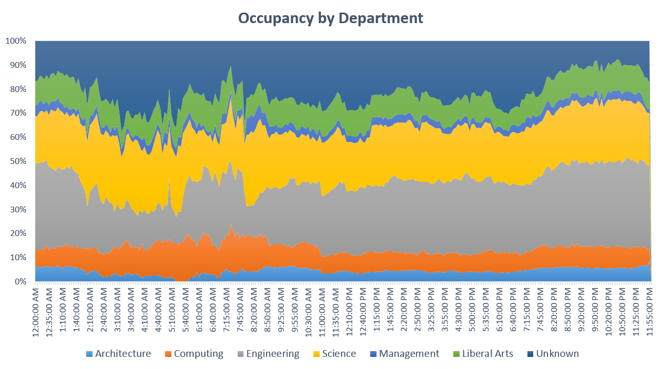

Analysis of Campus WiFi Network
Daniel García Ulloa¹, Daniel Sedra², Richard Zheng³
¹ Emory University, ² Cornell, ³ Georgia Tech
Motivation
Challenges
Prediction Model
Future Work
Buildings and campuses with WiFi Access Points, as well as devices with access to WiFi has become ubiquitous. The log data can be used to analyze trend of space usage and migration patterns. This can be used for:
Efficient space planning
HVAC control
Waiting time estimation
Resource allocation
Event planning
Sustainable energy consumption
No logout data stored
Inconsistent connections
Differing device connection
Multiple devices – one user
Users with no connection to Wifi
Analysis of Migration Patterns
AP in 3rd floor
Analysis
AP in 2nd floor
AP in 1st floor
Establish inferred to actual people relation
Non Parametric Model
Data Processing
Linear model required too many predictors.
Loess algorithm (local polynomial fitting)
Neighborhood set to 4% (i.e. 4% of the data near a point were used)
WiFi Access Points
WiFi enabled
devilces
Acknowledgements
GT
users DB
WiFi
DB
DSSG
Dr. Ellen Zegura, Dr. Russ Clark, Matt Sanders
NSF
Anonymization
Funding Source:
First Person
Second Contributor
Exploratory Analysis
Inference
Predictions

